Slide 1
Altitude Deviations
STEADES In-depth analysis
Giancarlo Buono
Regional Director, Safety and Flight Operations, Europe

Slide 2
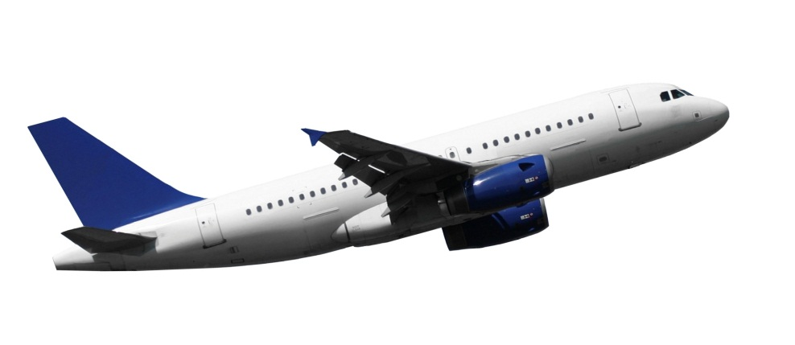
Agenda
High Level Analysis Outcomes
In-depth Analysis
  Altitude Deviation Context
  Altitude Deviation Contributing Factors
  Altitude Deviation Recognition and Response
  Altitude Deviation Outcome
Conclusion

Slide 3
High level analysis: Summary
Event Backgrounds
The majority of altitude deviations occurred during the descent (41%) and approach (19%) phases
The top three contributing factors for all altitude deviation events were identified as
  Flight Management
  Air Traffic Management and
  Weather
Event Effects
Majority of altitude deviation events were successfully managed and did not have further effect on the flight
13% of reports coded with immediate effects, of these:
  68% Flight Path Deviation – Lateral
  7% Avoidance Maneuver

Slide 4
In-depth Analysis: Overview
Data set:
  Random data sample comprising 369 ASRs
  Q1 2013 to Q4 2013 incl.
Objective:
Analyze ASRs from STEADES database for Altitude Deviation related items in the predefined areas:
  Context
  Contributing Factors
  Recognition and Response
  Outcome
The random data sample was built on the assumption that throughout all operators reporting to STEADES an “altitude deviation” is understood as the same type of event

Slide 5
In-depth analysis: Limitations
Methodology:
In-depth analysis includes reading and categorizing each ASR
Quality, content and information of ASRs vary depending on information submitted by the flight crew
Information typically included in ASRs
  Altitude, pilot duties, outcome
  Managing Limitations:
Due to the limitations some sections of the analysis are based on relatively small proportions of ASRs
Type of normalization of the random data sample limits regional analysis

Slide 6
Context
Altitude Deviation

Slide 7
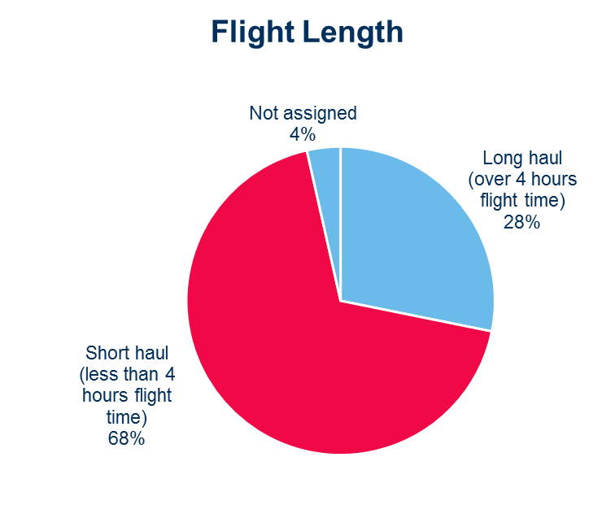
Context: Flight Length
96% (356 rpts)
of overall dataset contained information about flight duration
68% Short haul
28% Long haul

Slide 8
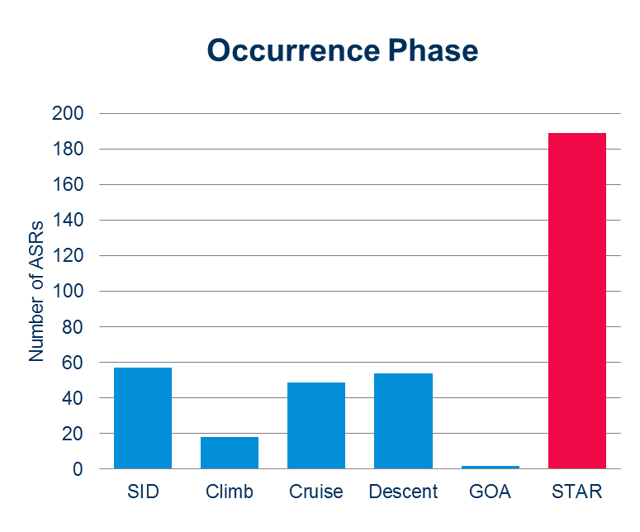
Context: Occurrence Phase
100% (369 rpts)
of overall dataset contained information about occurrence phase
51% during STAR
15% during SID

Slide 9
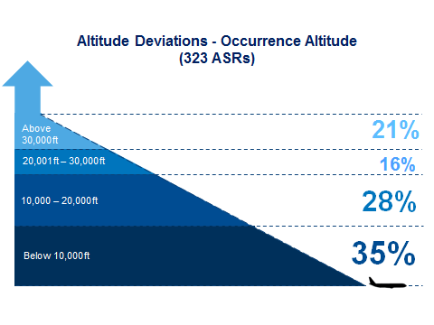
Context: Occurrence Altitude
88% (323 rpts)
of overall dataset contained information about occurrence altitude

Slide 10
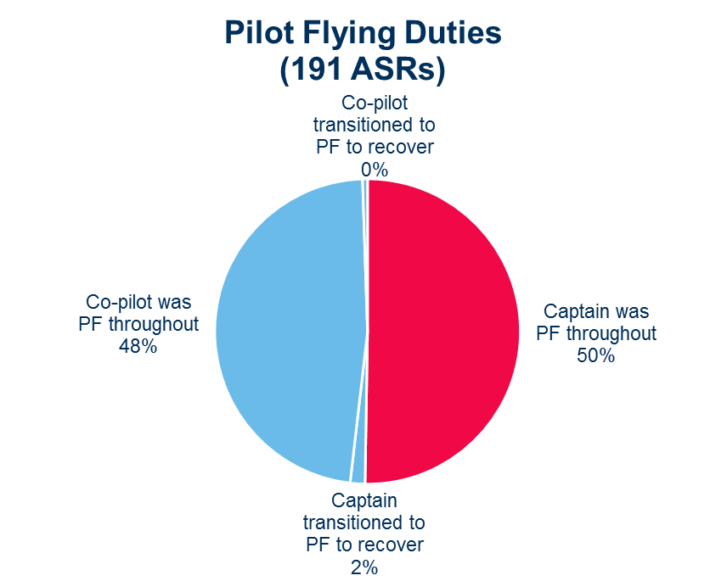
Context: Pilot Duties
52% (191 rpts)
of overall dataset contained information about pilot duties
50% Captain
50% Co-pilot

Slide 11
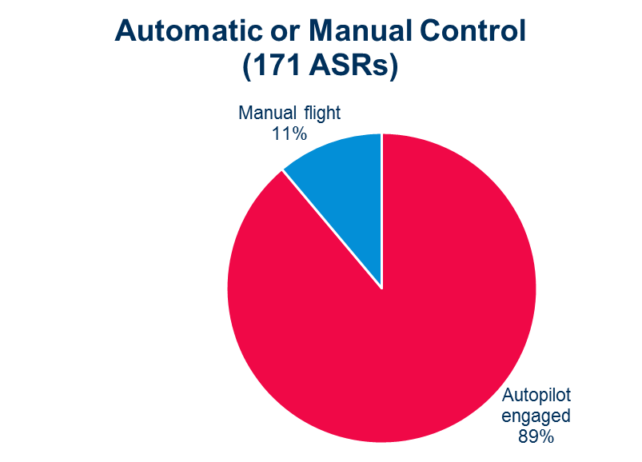
Context: Automation
46% (171 rpts)
of overall dataset contained information about automation
89% Autopilot 11% Manual

Slide 12
Context: ATC Aspects
A vast majority of STEADES ASRs are reported by the flight crew. Therefore, the narratives offer only flight crew perspective on altitude deviations regarding the context. Further information of ATC related aspects will be covered under the Contributing Factors and Recognition and Recovery parts of the analysis.

Slide 13
Contributing Factors
Altitude Deviation

Slide 14
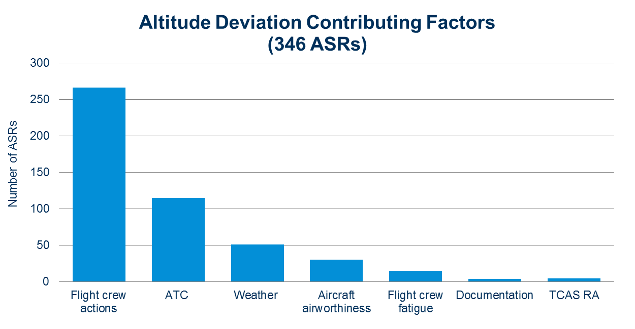
Contributing Factors:
94% (376 rpts)
of overall dataset contained information about contributing factors

Slide 15
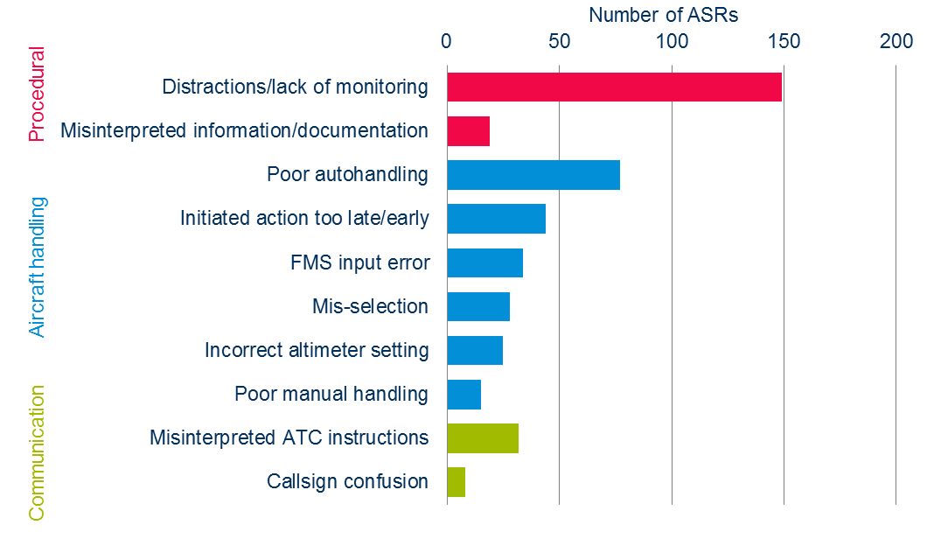
Contributing Factors: Flight Crew Actions
72% (266 rpts)
of overall dataset contained information about flight crew actions

Slide 16
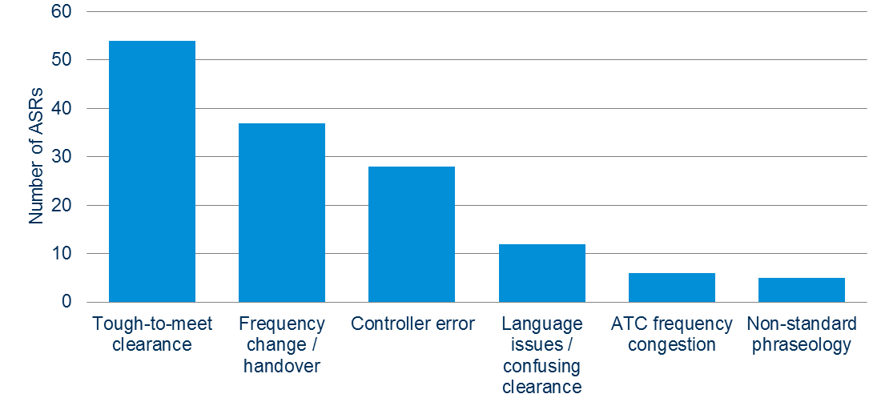
Contributing Factors: ATC
31% (115 rpts)
of overall dataset contained information about ATC factors

Slide 17
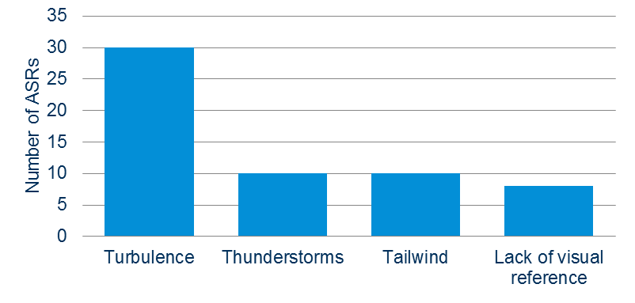
Contributing Factors: Wx
14% (51 rpts)
of overall dataset contained information about weather

Slide 18
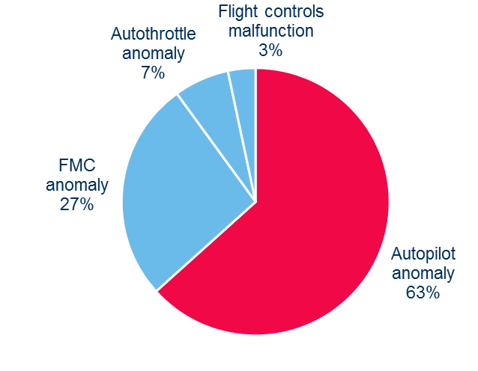
Contributing Factors: Airworthiness
8% (30 rpts)
of overall dataset contained information about technical issues

Slide 19
Recognition and Response
Altitude Deviation

Slide 20
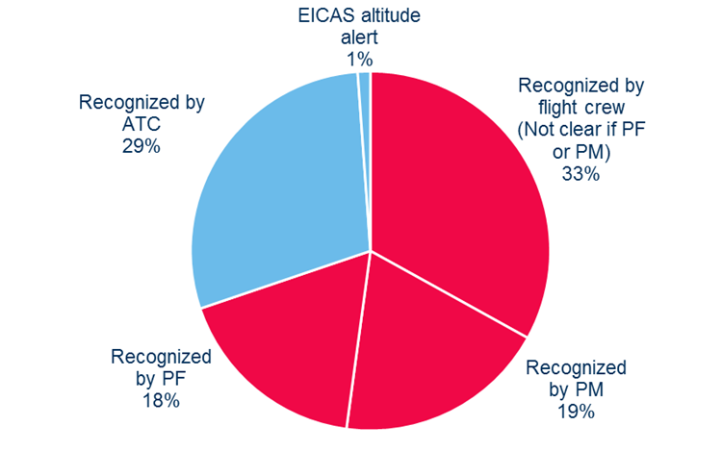
Recognition and Response: Recognition
70% Flight Crew
29% ATC
95% (351 rpts)
of overall dataset contained information about recognition

Slide 21
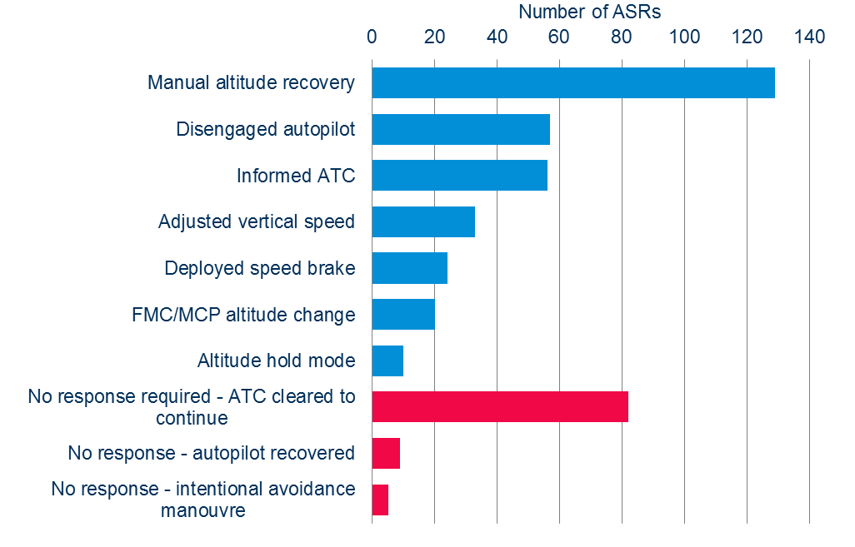
Recognition and Response: Response
69% (256 rpts)
of overall dataset contained information about response

Slide 22
Outcomes
Altitude Deviation

Slide 23
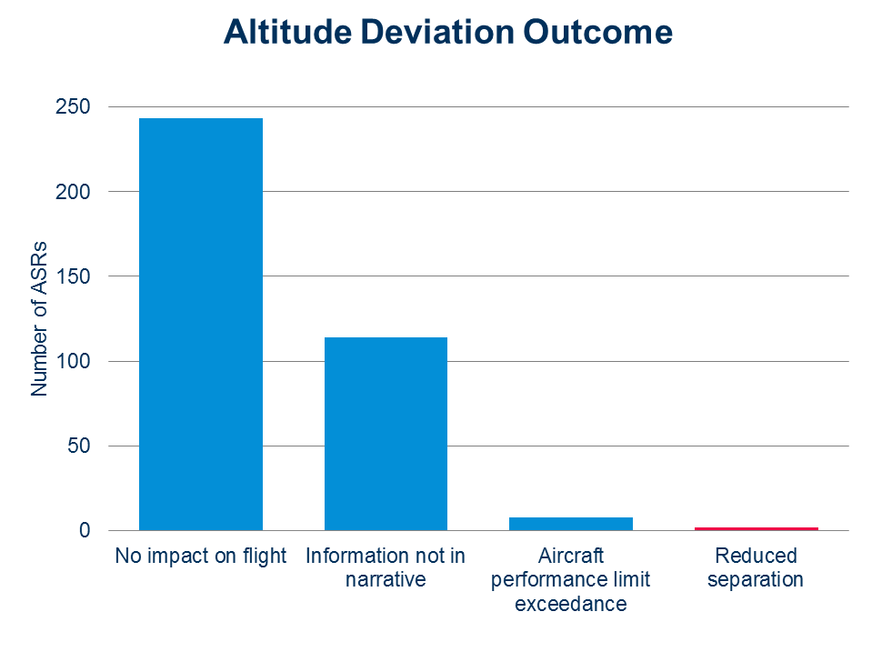
Outcomes:
69% (253 rpts)
of overall dataset contained information about outcome
67% No Impact

Slide 24
Conclusion: Context
  Majority (89%) with autopilot engaged
  Majority during standard departures or arrivals
  Majority above FL100
  Equally split between captain and first officer

Slide 25
Conclusion: Contributing Factors
  Prime Contributing Factors:
  Flight crew distractions
  Deficiencies in automation management
  Unclear instructions from ATC
  Turbulence

Slide 26
Conclusion: Recognition and Response
  Flight crews recognized most altitude deviations
  Crews corrected promptly and correctly in most cases
  ATC was able to issue a new clearance in many cases

Slide 27
Conclusion: Outcomes
  Most reported no impact on the flight
  0.5% of reports indicated reduced separation as a result of the altitude deviation

Slide 28

For information on this or any other STEADES analysis products, please e-mail us at:
STEADES@iata.org

