Slide 1
Will we ever automate the tasks of the ATCO?
Job Brüggen
Safety Manager
LVNL
Ir. Job Brüggen

Slide 2
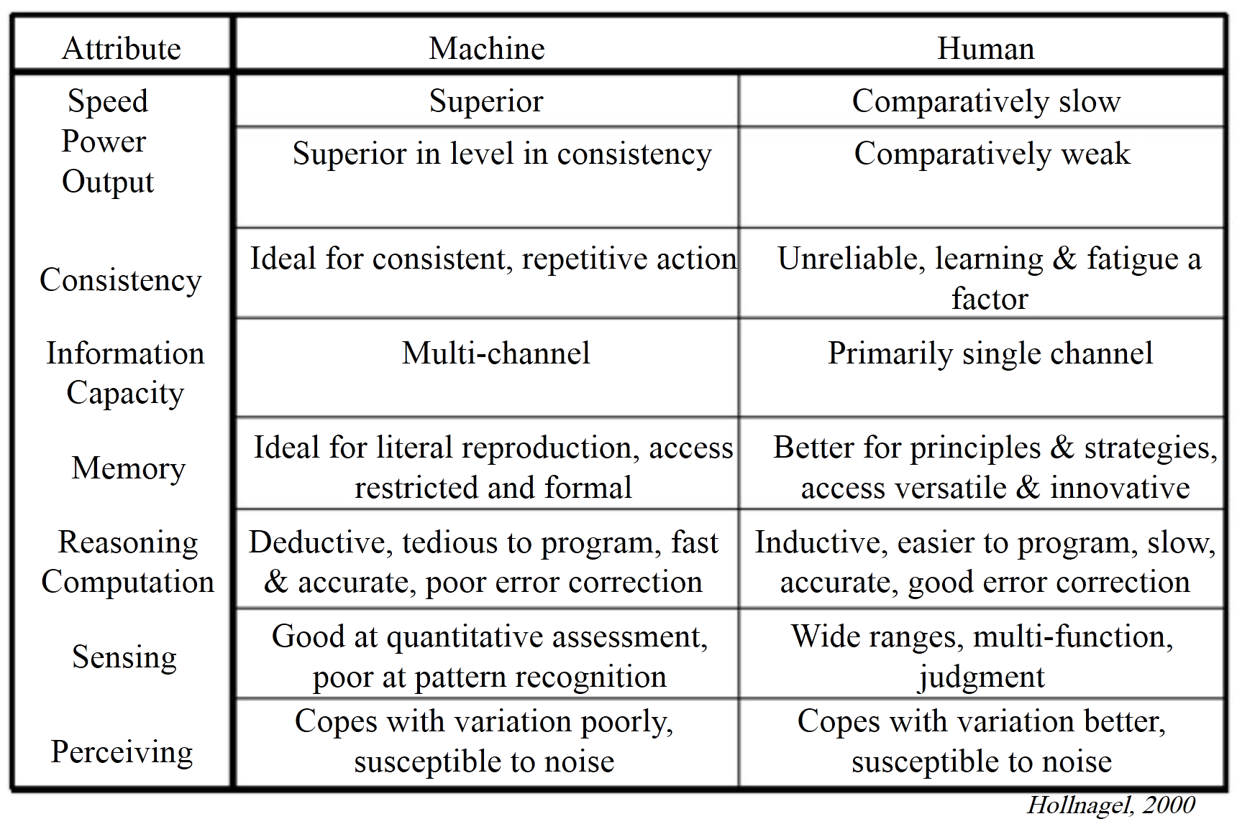
Why automation makes sense
Notes:
also known as a ‘Fitts’ list (1950s) basically describing where humans or machines excel in function allocation.

Slide 3
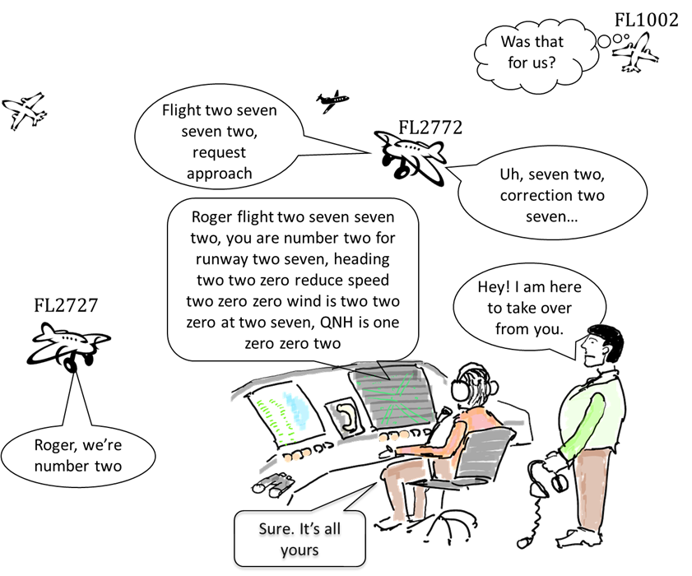

Slide 4
Levels of automation
low
data processing, transformation or other treatment.
  Flight plans, radar tracks, label assignment, presentation screens, input methods, weather updates, information status pages.
medium
algorithms that assist the controller in mental process.
  Predictions, arrival management tools, conflict alerts, flow management tools: also known as decision support tools.
high
automation executes instructions like a controller would.
without interference from controller

Slide 5
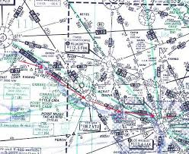
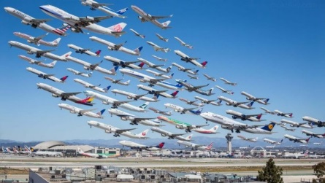




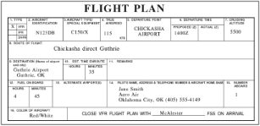



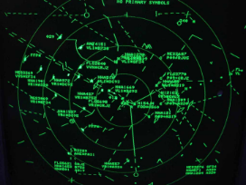

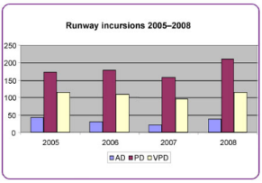

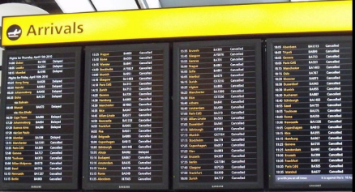
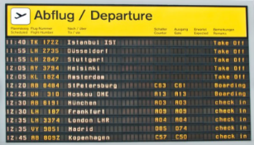
ATC = totally human centered

Slide 6
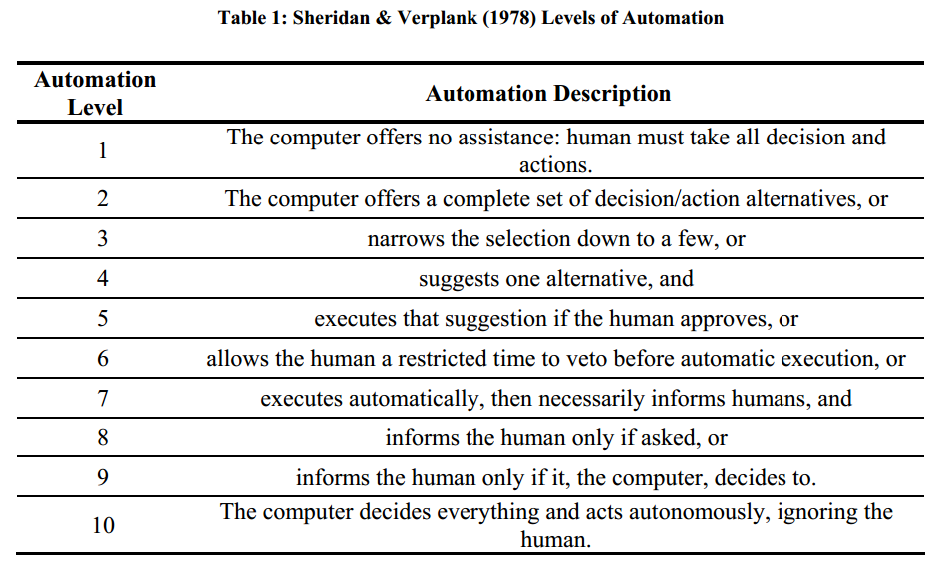
Levels of automation

Slide 7
Is ATC a task that can be automated?
Standard phraseology
Limited set of instructions (heading, altitude, speed, etc.)
Standard routes defined
Airspace structure is known
Weather can be precisely modelled.
Flights are known in advance.
Surveillance / navigation / datalink tools are available

Slide 8
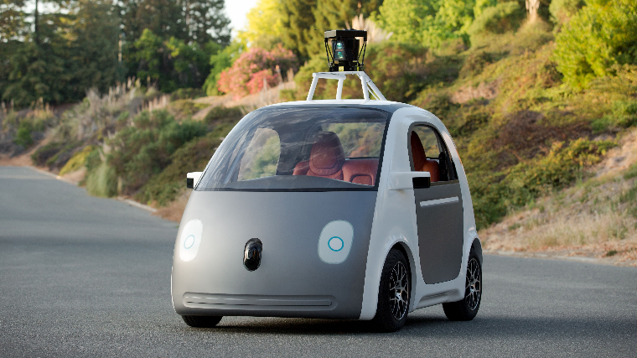
Issues with automation are plenty
Overreliance
Reliability and Liability
Virtual Reality
Mixed-Initiative conflicts
Monitoring for and detection of unexpected low-frequency events,
Expectancy-driven perceptual processing,
Extrapolation of complex four-dimensional trajectories, and
Use of working memory to either carry out complex cognitive problem solving or to temporarily retain information.
User Alienation
  Threatened unemployment
  Erratic Mental workload Dissatisfaction with work
  Centralization of management control and loss of worker control
  Desocialization
  Deskilling
  Intimidation of greater power
  Technological Illiteracy
  Mystification and misplaced trust
  Sense of not contributing
  Abandonment of responsibility
  Blissful enslavement
FLIGHT DECK AUTOMATION ISSUES website lists 94 issues:
  automation behavior may be unexpected and unexplained
  automation information in manuals may be inadequate
  automation may adversely affect pilot workload
  complex automation may have overly simplistic interface
  crew coordination problems may occur
  database may be erroneous or incomplete
  failure recovery may be difficult
  manual operation may be difficult after transition from automated control
  pilots may be overconfident in automation
  pilots may be reluctant to assume control
  protections may be lost though pilots continue to rely on them
  situation awareness may be reduced

Slide 9
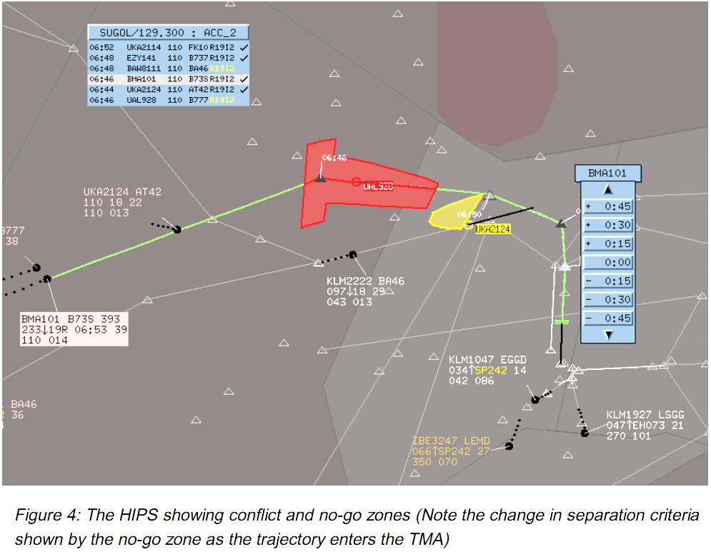
Example: PHARE Demonstrations 1- 3

Slide 10
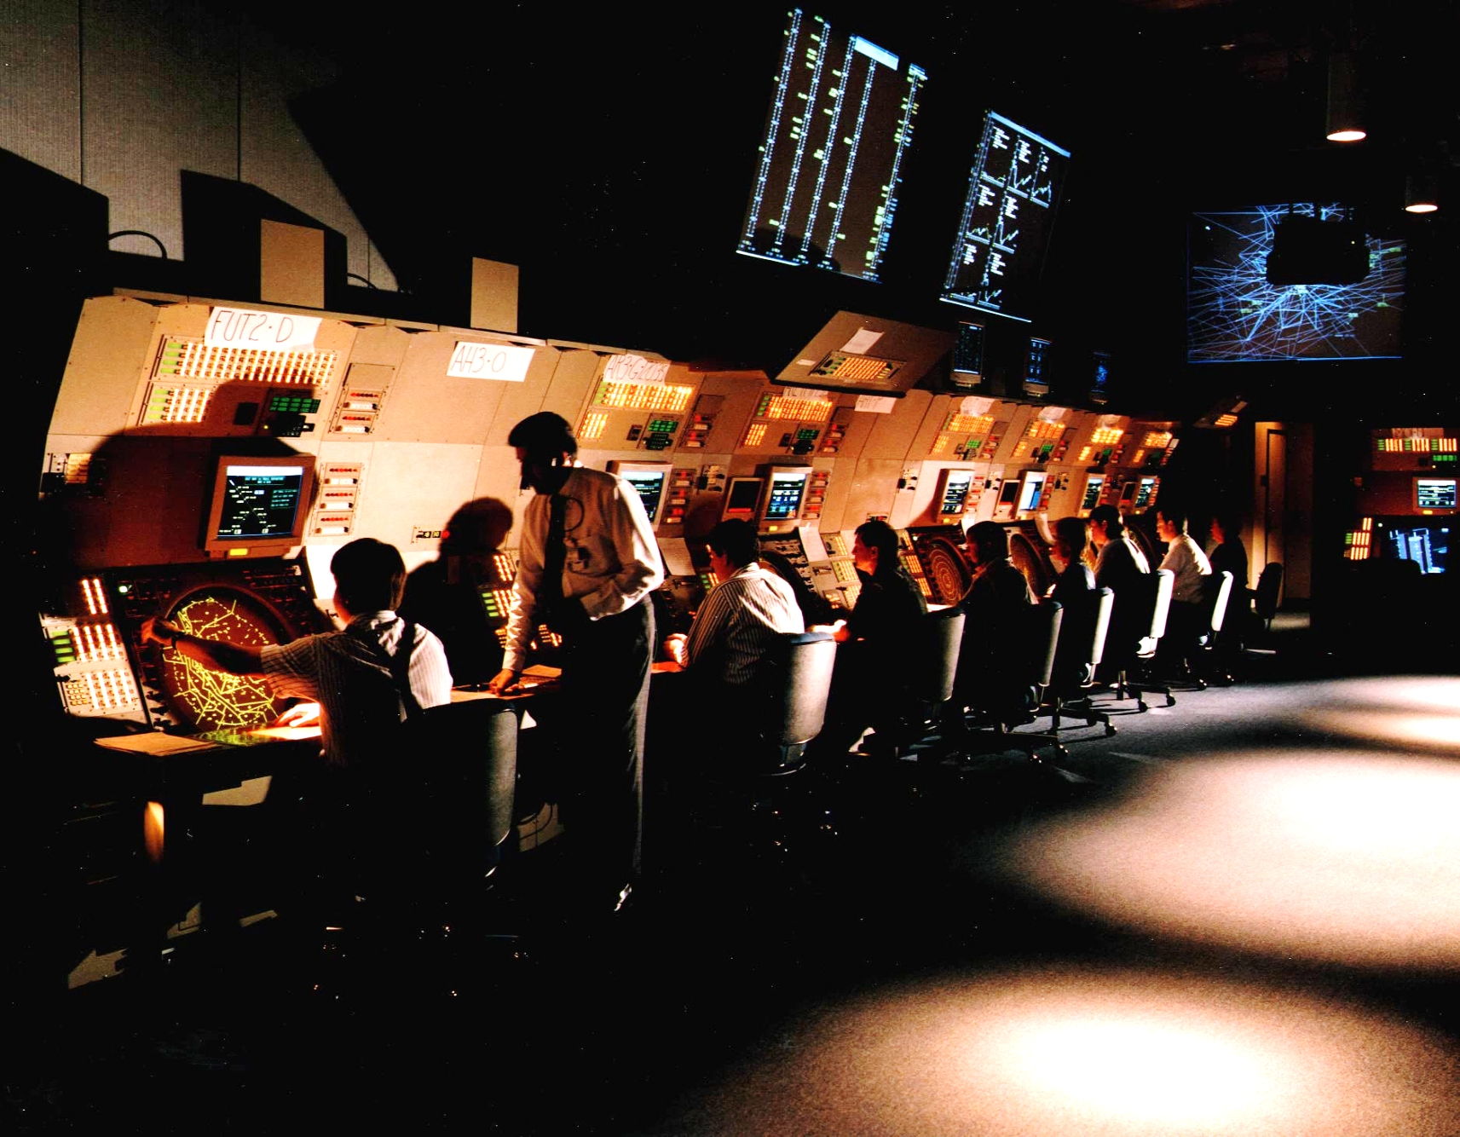
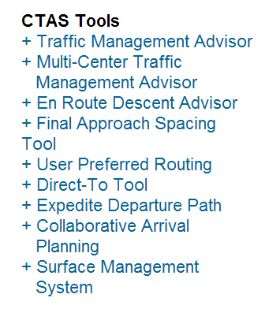
Example: Center Tracon Automation System (CTAS)

Slide 11
Other examples
ERATO (En Route Air Traffic Organiser)
COMPAS (Computer Oriented Metering, Planning and Advisory System)
FAST (Final Approach Spacing Tool)
ARC2000
URET (User Request Evaluation Tool)
AMAN (Arrival Manager)
CTAS (Center Tracon Automation System)
… and many more!

Slide 12
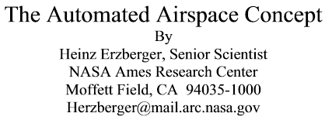
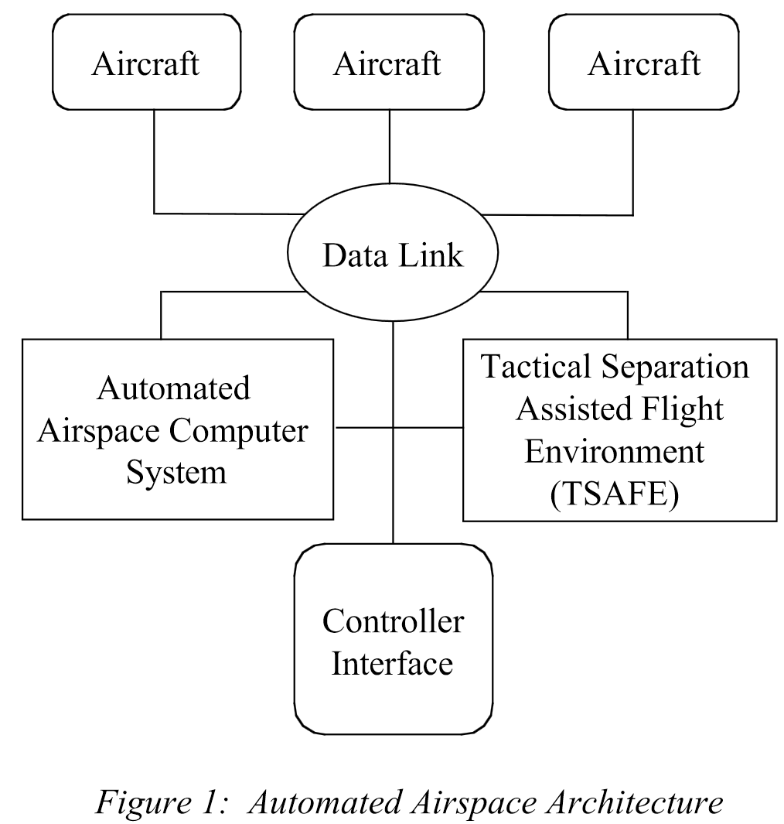
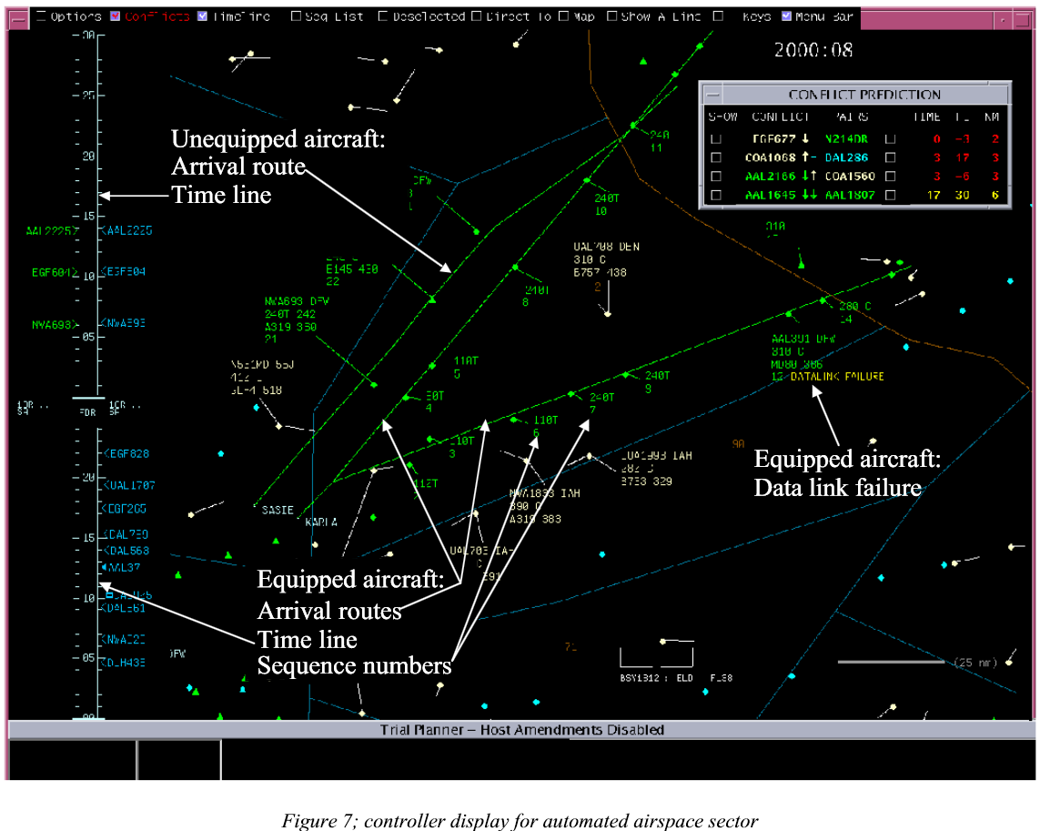
The automated Airspace Concept (2001)

Slide 13
Quotes
“Moreover, human controllers excel at adapting their control strategies to completely new situations, a capability that is beyond existing software design.”
“By reusing software components and infrastructure technologies developed in support of other programs, an experimental version of the concept could be built and evaluated within a relatively short time.”
Paper from 2001 (!)

Slide 14
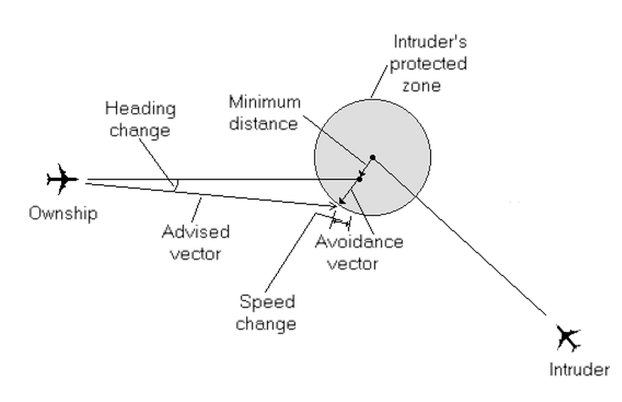
Adding many conflict resolvers

Slide 15
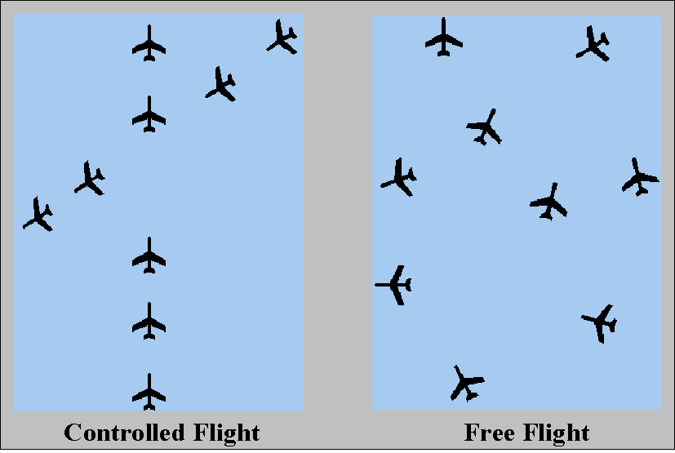
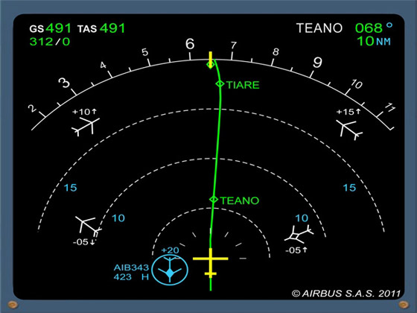
Free Flight

Slide 16
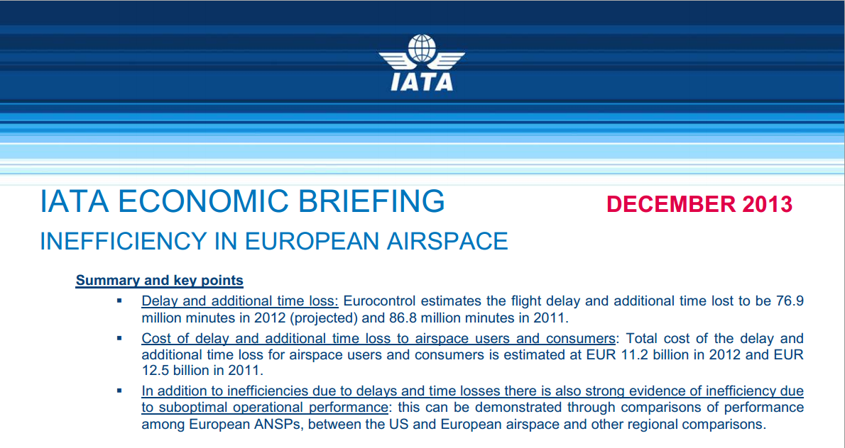
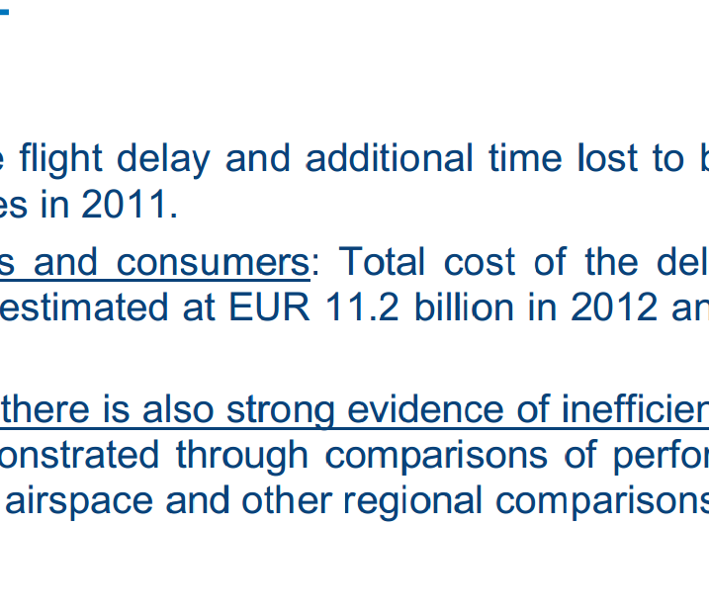
Is there a business case?

Slide 17
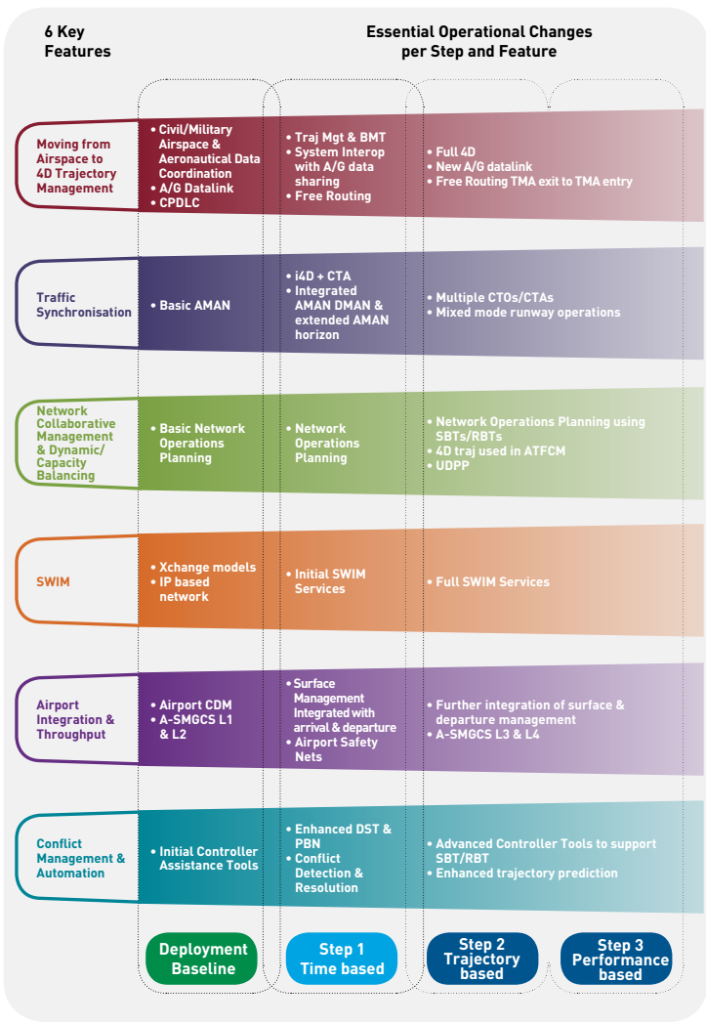

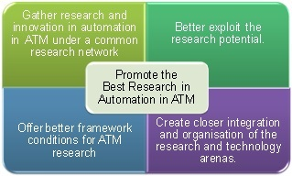
European Research
Higher Automation Levels in ATC (HALA!)

Slide 18
Barriers to innovation
ANSPs are utterly conservative,
(mostly) Monopoly / State enterprises,
With huge legacy systems,
That are required to be standardised World – wide,
With a big liability issue:
  Controllers have responsibility → so controllers must be in command
  Human-Centred Automation (legally) keeps the main bottleneck in the loop (for upper airspace)
The value of the human element input is too good to miss
Maybe the current system works well enough?

Slide 19
Final Observations
ATC is about trying to solve a complex dynamic puzzle by a number of human operators with antiquated tools.
There is no reason to believe that automating the ATC task would not be possible.
However there are reasons NOT to automate
An alternative would be to move the puzzle to other problem solvers (e.g. pilots / self separation systems)
Automation is inevitable…

