Slide 1
Operational Contingency and Resiliency Steve McMahon Manager | Safety Performance and Analysis Group

Slide 2
ZAU SVC NOTAM
CHICAGO ARTCC OUT OF SERVICE TRANSITING OPERATIONS NOT AUTHORIZED OVERFLIGHTS CAN EXPECT REROUTES

Slide 3
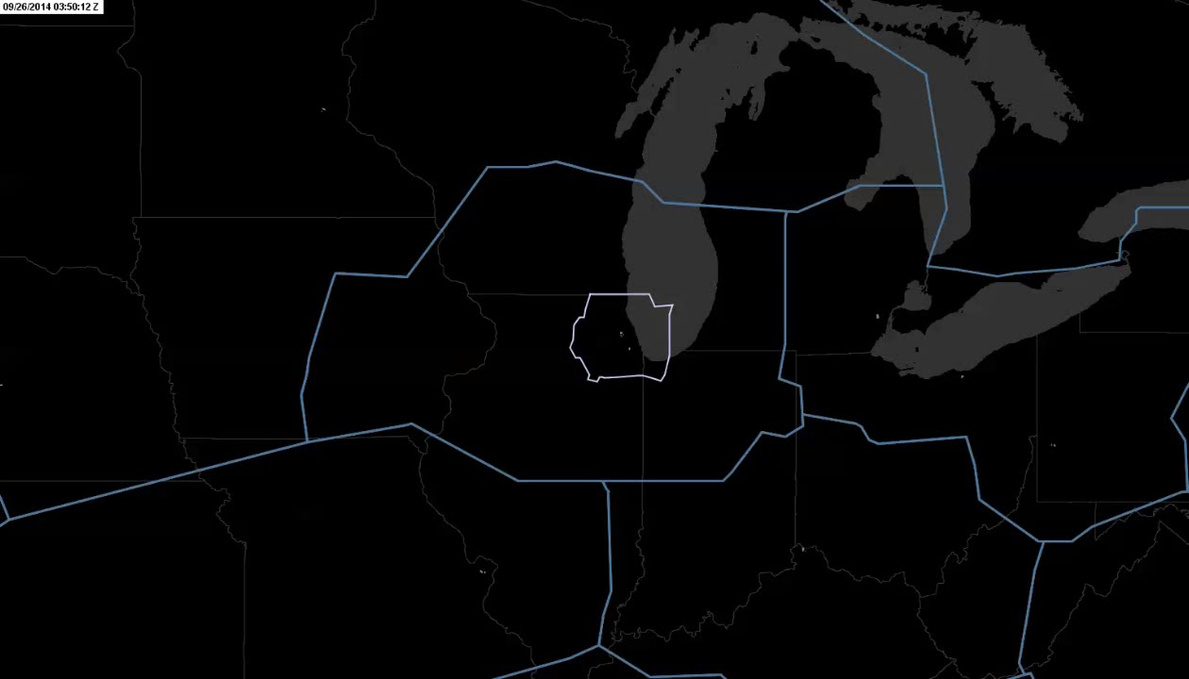

Slide 4
Event Management

Slide 5
ATC Alert
Non-routine maintenance or equipment outages that eliminate redundancies to critical systems and services.
ATC Limited
An ATC facility suffers the loss of one or more operational segments but the facility can still provide published ATC services at a reduced level.
ATC Zero
An ATC facility is unable to safely provide air traffic services.
Operational Contingency Levels

Slide 6
September 26, 2014
Chicago Air Route Traffic Control Center (ZAU) declared ATC Zero at 1042Z (0542 Local) due to simultaneous:
Loss of surveillance, communication and flight data
Fire alarms

Slide 7
September 26, 2014
Safety Risk Management principles were applied in real time to meet target levels of safety
The initial reaction and gradual increase in resuming ops was done in a structured and measured way

Slide 8
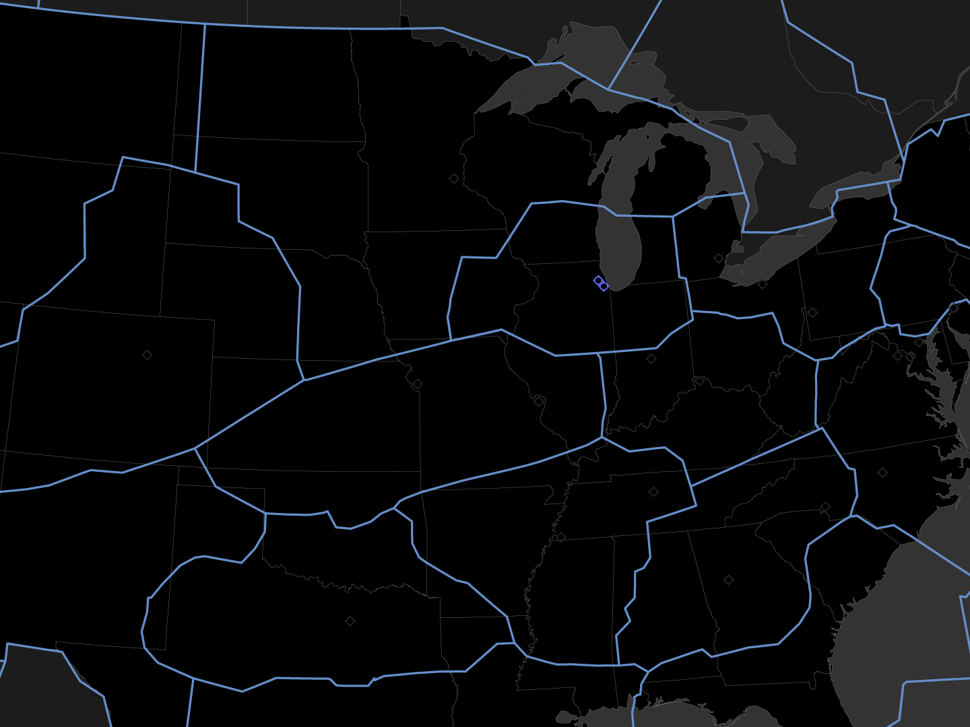

Slide 10
October 13, 2014
ZAU resumed provision of ATC services

Slide 11
October 13, 2014
Over 16 days, 18 hours and 38 minutes, FAA technical teams restored, installed and tested:
More than 20 racks of equipment
835 telecommunications circuits
More than 10 miles of cable

Slide 12
After-Event Safety Analysis

Slide 13
Preliminary After-Event Safety Analysis
Cumulative risk identified following the event through Risk Analysis Event (RAE) data:
ATC working unfamiliar airspace and/or equipment
ATC staffing required to accommodate the shift in air traffic volume
Loss of Flight Data Input-Output

Slide 14
Preliminary After-Event Safety Analysis
RAE rate increased by 51% during the ZAU Outage
From 1 RAE per 113,766 operations,
to 1 RAE per 56,096 operations

Slide 15
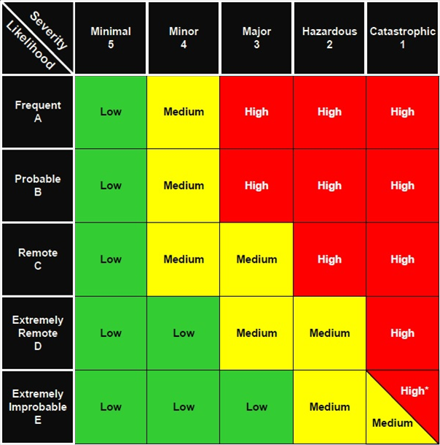
Preliminary Quantitative RAE Risk
2C: 1 High RAE
3C: 6 Medium RAEs
4C: 5 Low RAEs

Slide 16
Preliminary Qualitative Effects
2A: Large Reduction in Safety Margin and ATC Services
3A: Large Increase in Workload

Slide 17
Preliminary After-Event Safety Analysis
Safety Recommendations include:
Update contingency planning and simulations
Identify and mitigate single points of failure
Airspace environment 10,000 ft. vs 15,000 ft.
Audit operational contingency plans to determine level of compliance

Slide 18
Lessons Learned

Slide 19
Lessons Learned
A non-standard operation in terms of people, process and procedures is difficult to sustain for any significant period of time

Slide 20
Lessons Learned
Temporary Operational Contingency Office formed to improve contingency planning
Recommend surveillance, communication and flight data modifications
Leverage En Route Automation Modernization (ERAM) and En Route Communications Gateway (ECG) capabilities

Slide 21
Operational Contingency and Resiliency Steve McMahon Manager | Safety Performance and Analysis Group

