Slide 1
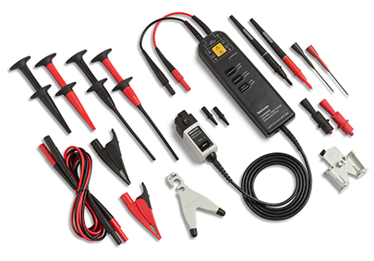
Modelling and Probing ATM automation
Paula Santos David Slater
paula.santos@nav.pt

Slide 2

Question
Current ATM systems leave the decision making to the human element, but there is a tendency to keep adding a little more help from automation, reducing the workload and, on the other hand, adding capacity.
Is automation of the Air Traffic Controllers’ tasks also increasing the safety of the ATM system?
Is there a way to analyze whether a new system feature, or functionality, will really increase the ATM system’s safety?

Slide 3

Agenda
Background
Why? What? How?
The model - MARIA
Overview
Main characteristics
APW addition
Using BBN
Future work
Conclusions

Slide 4

Background – Why?
To better understand a system or phenomena a model, i.e. a simplified version of reality, is a useful tool. Safety being a system property, not a property of the components that comprise it, requires a global picture to analyze it.

Slide 5

Background - Why?
To get global view of the functional system, to know it.
To assess changes, we need to know the system before the change – have a reference.
To allow description of
the architecture

Slide 6
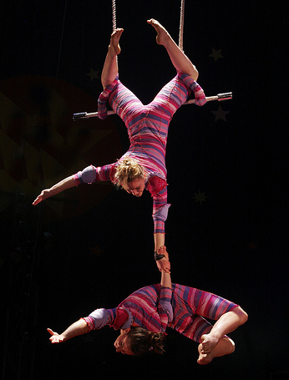
Background - Why?
To show the dependencies between processes
Be the starting point to understand the connection between high level processes and their global impact on safety
The ATM system is defined as all that is required to expedite and maintain a safe and orderly flow of traffic during all flight phases and comprising the interaction between people, procedures and equipment.

Slide 7
Background - What?
The aim of ATM is to prevent accidents.
Five ICAO defined accidents, namely: mid-air collision, wake turbulence, runway collision, taxing collision and CFIT.
Scope:

Slide 8
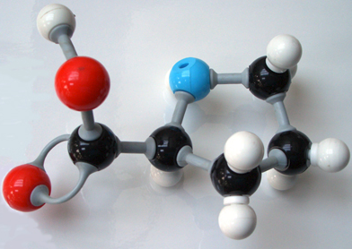
Background - What?
What do we do everyday to prevent accidents?
That is what we have modelled.
What is modelling? Simplifying reality.
What do we have?
A knowledge database.

Slide 9

Background - How?
In business modelling we describe what is done to have success.
Proactive approach: Success, what is done to…
(Safety II)
Notes:
Safety II

Slide 10

Background - How?
Usually in ATM safety analysis we look backwards after an incident. Something went wrong, why?
Reactive approach: Incident, backwards
(Safety I)
Notes:
Safety I

Slide 11

Background - How?
Build the model (knowledge database) using the proactive approach.
It will never be finished…
Improve it, refine it also with the feedback from the analysis of incidents – reactive approach.
Both approaches complement each other.
Notes:
Safety II

Slide 12

Overview
What do we do?
Airspace management
Flow and capacity management
Provide meteorological information
Provide aeronautical information
Manage traffic
Respond to anomalies
Alert
Manage operational room
Technical support
Maintain infrastructure

Slide 13
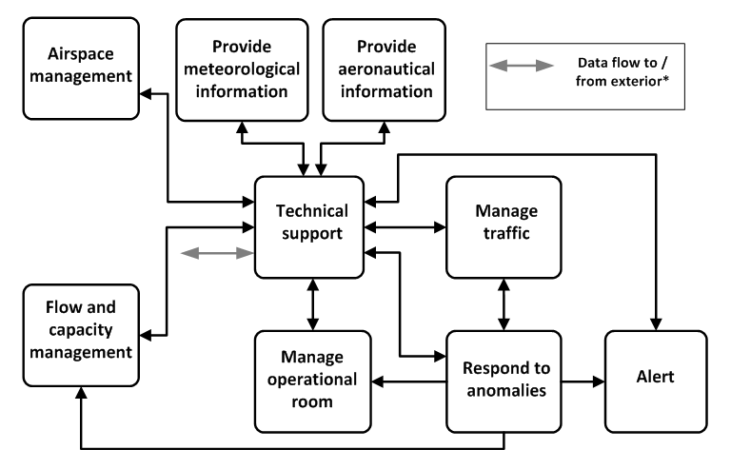
Overview
Top level

Slide 14
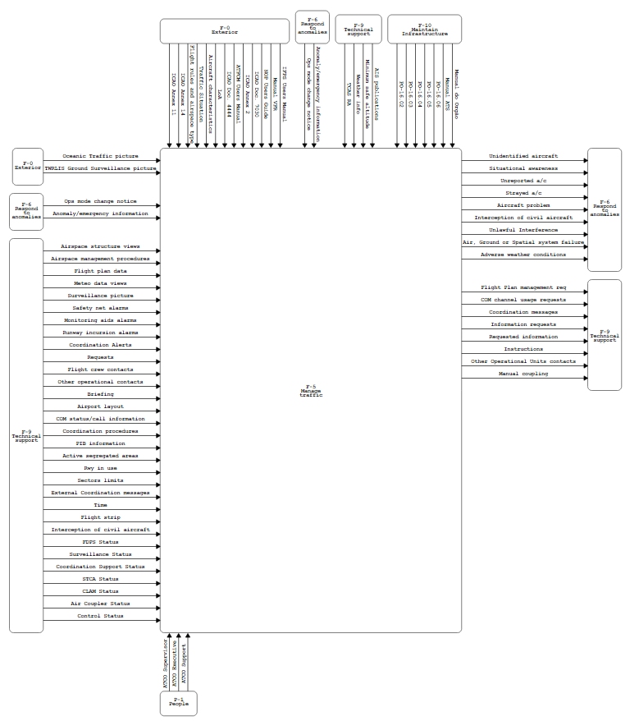
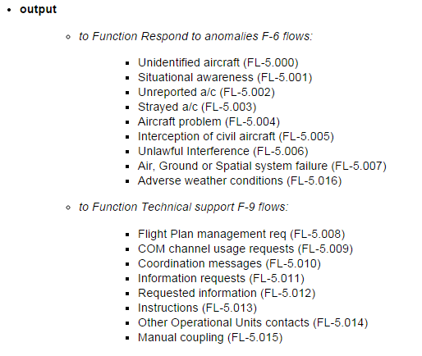
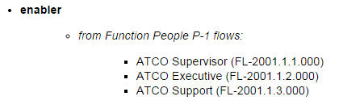
Overview
Manage traffic
(SADT)

Slide 15
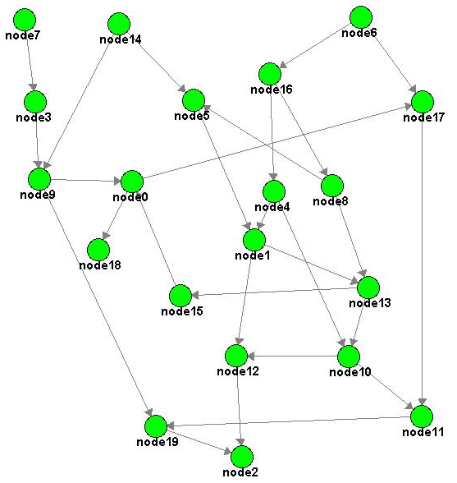
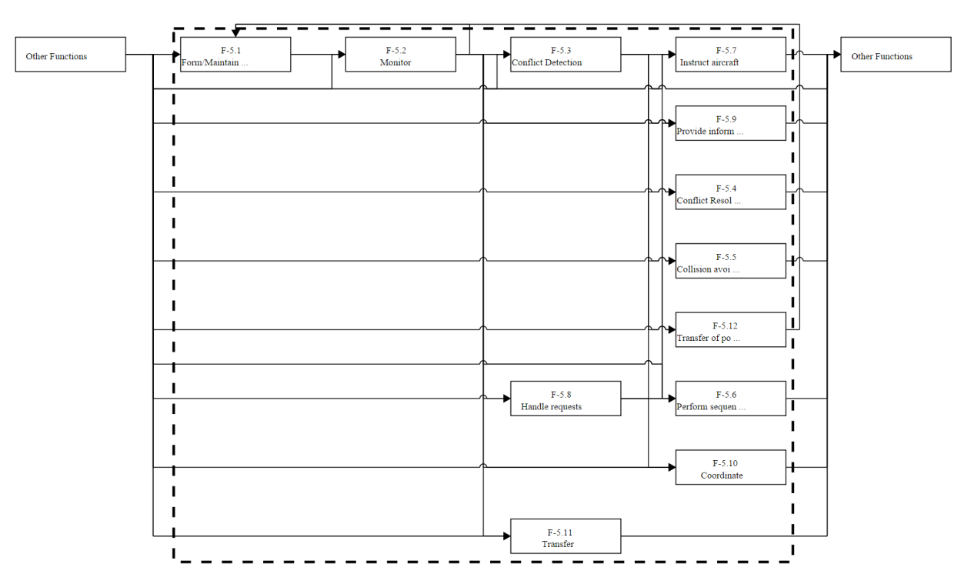
Overview
The model is coded as a graph:
Functions are nodes
Data flows are arcs

Slide 16

Main characteristics
The complexity of the model required the development of a framework to build it and validate it.
Yes, it is a simplification but it is anyway very complex…
It is a knowledge repository.
Knowledge needs to be captured and coded.

Slide 17
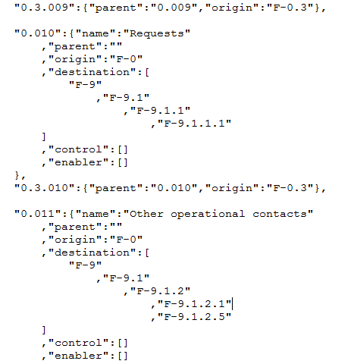
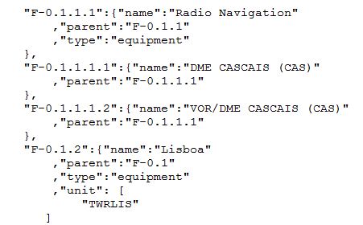

Main characteristics
What concretely is the model?
A bunch of text files with data: flows, nodes (YAML)
A set of scripts (programs) to read the data

Slide 18

Main characteristics
Functions are constituted by sub-functions
Decomposition of function is up to the level where enablers are clearly identified
One can dig deeper and deeper in the model and view details of each function
Entity | Nr. | Remarks
Flows | 1672 | Covering all levels
Low level | 763 | Excluding aggregation flows
Nodes | 526 | Covering all levels
Low level | 399 | Excluding aggregation nodes
People | 23 | Roles of human actors
Technical | 89 | Technical function (under F-9)
Equipment | 232 | List of existing equipment
External | 8 | Functions performed by others
Human | 42 | Human functions
Procedure | 5 | Functions producing rules

Slide 19
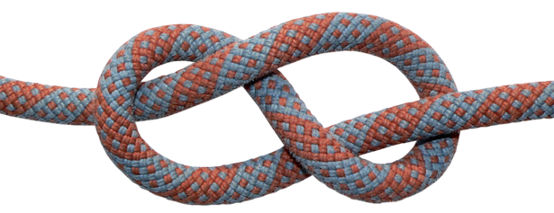
Main characteristics
To allow readability, only shows links to top level functions or to the function’s own top level
No “printable drawing” of the complete model (but the model is coded / accessible)
All flows start and end at an existing node
The framework verifies the model – no loose ends

Slide 20
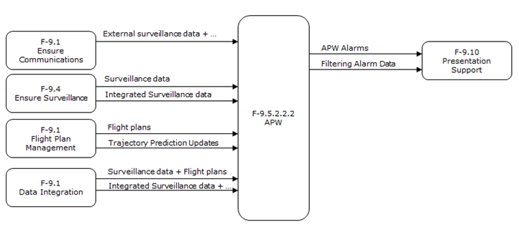
APW addition
APW is
A ground-based safety net intended to assist the controller in preventing the entrance of aircraft in restricted areas generating, in a timely manner, an alert of a potential or actual area infringement.

Slide 21


APW addition
Potential impact
Outputs:
APW Alarms
Filtering Alarm Data
From a technical function to a human function
F-5
Manage Traffic

Slide 22
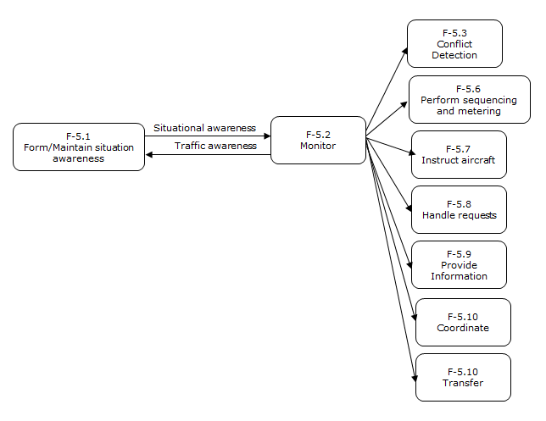
APW addition
Manage traffic

Slide 23
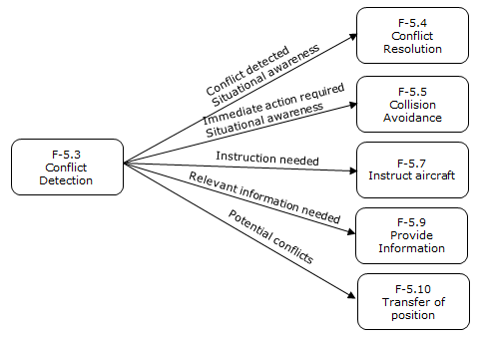
APW addition
Conflict detection

Slide 24

APW addition
New information
Nuisance alarms
Loss of ATCO skills
Better detection
What can help this analysis? BBN?

Slide 25
Swings and Roundabouts?
Has adding these extra “Layers of Protection” actually increased the safety of the system?
Or can it add complications and other scenarios
(Pilot door lock overrides?)
How do we balance pro’s and cons objectively?
As we have the network of functions already mapped (MARIA),
we can utilise it as a Bayesian Belief Net (BBN) for a quantitative “dependency analysis”

Slide 26
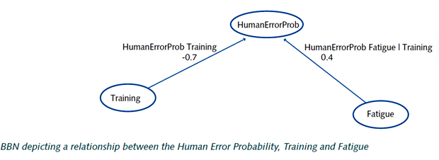
What’s a BBN?
A Bayesian Belief Net is a special kind of directed acyclic graph.(The example below is from Delft University’s Causal Model for Air Transport Safety - Final report - 2 March 2009)
In a BBN nodes represent variables and arcs represent probabilistic or functional influence.

Slide 27
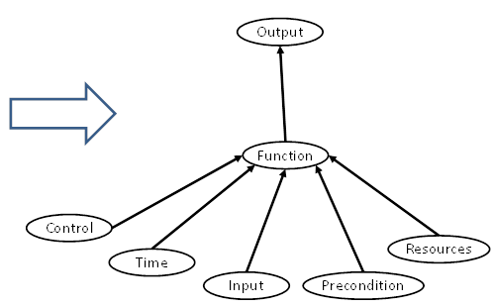
Using BBN’s
Since MARIA comprehensively maps the functional influences
It is possible to utilise MARIA as a comprehensively detailed BBN.

Slide 28
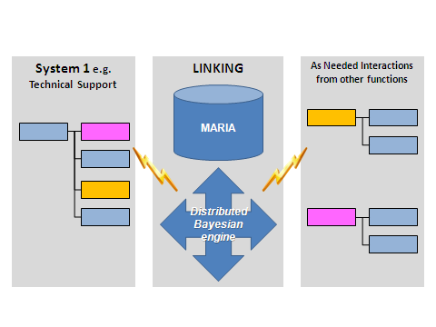
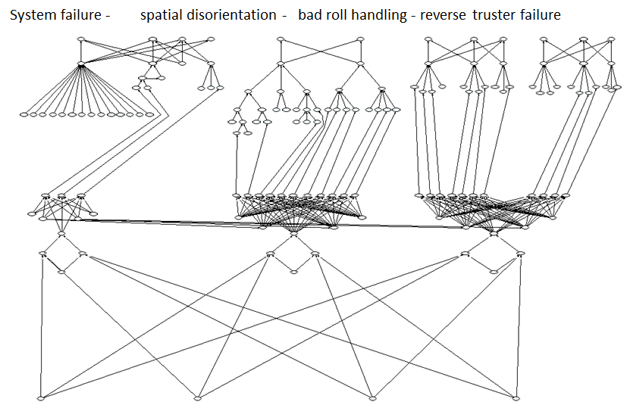
Using BBN
But MARIA also comprehensively allows us to link these functional influences, systematically, wherever the inputs and outputs interact.
So it is now possible to calculate the node probabilities of success throughout the Net.
A BBN from the CATS Report

Slide 29
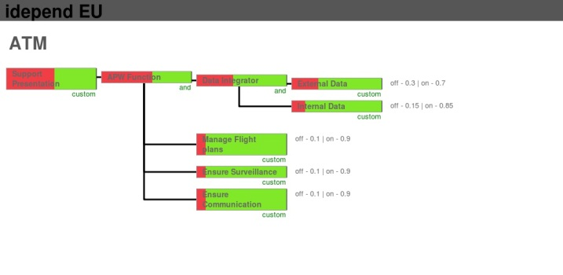
Using BBN’s
These estimated probabilities of success can be displayed visually for each node as red green bars, or traffic lights- as above.
If we can update the status of these “leaf nodes”, this display will monitor the expected performance of the system as a whole as a result of any planned or “what if” changes we may make.

Slide 30

Future work
Integrate MARIA with BBN engine
Graphical framework to change the model
Real time status inputs – visual display
Sliced BBN for recording events
Collect transfer functions (business knowledge)
Verify linkage adherence to reality
Collect data – monitoring
Simulation?
Integrate MARIA in safety assessment
Process to integrate and assess change
Risk evaluation - acceptability

Slide 31
Conclusions
MARIA
Overview of all the functions needed for a successful ATM operation.
Details the way in which these functions interact and the critical interdependencies that emerge.
Coded in a way that is easily read by other applications
BBN can
Model interdependencies
Assess probable performance
Assess changes – probing performance (what if)

Slide 32


