Slide 1
Safety and Automation “For a better use of safety data”
Safety and Automation Forum
Brussels, EUROCONTROL, 2 - 3 June 2015
Notes:
The contribution of automation to safety during the past decades is huge. No doubt about this. This has been widely recognized.
Nevertheless, from the Cali CFIT accident in 1995 to the mid-air collision in Uberligen in 2002 and others later, examples are numerous where automation have been involved as factors in high profile accident scenarios. Contribution of automation to accident is also a reality which must be better understood.
We know from past accident that feedback about non consequence events (automation mismanagement, failure or anomaly) during daily flight provide opportunities for improvements. But this can only be done if the events are made visible and analyzed in a relevant manner.
Basic safety assumptions could be challenged more easily. We have today enough events and monitoring tools to “test” these assumptions, in a non-destructive way unlike accident.
There is not always a need of massive data to initiate actions.
A single event revealing a high risk operational error in a single airline could trigger large and costless “inspections” worldwide through FDM or other monitoring programs.
Optimizing safety benefits from automations while minimizing their drawbacks is our objective.
We have a good example with what maintenance, manufacturer and authorities do when they have discovered a single critical system malfunctions or structural failure. They do not wait for multiple events and trends before inspecting a whole fleet of aircraft.
Today in the operational field, policies, procedures, practices and training are becoming more standardized. Most of LOC related safety concerns detected and addressed in an airline are potentially an issue in other airlines. In other words operational failures around the world are becoming more « predictable ». Taking a better advantage of it is less expensive than the costs induced by catastrophic accidents.

Slide 2
Why automation safety data are poorly used?
Pilot report
« During take-off, the FD bars went off as did the speed bug. After lift-off, the FD bars returned to the EFIS, but gave a turn to the wrong side (towards the mountains) and the thrust started to idle. I just couldn’t understand ... but the weather was fine ! »
Automation failure ?
Automation mismanagement ?
Wrong FMS departure data entry ?
Navigation data base error ?
Notes:
Why safety data related to automation are poorly used?
Safety issues related to automation are often subtle, difficult to observe and to understand in real time, and, as a consequence, difficult to report accurately.
Many events have no visible effect, like this one
(…)

Slide 3
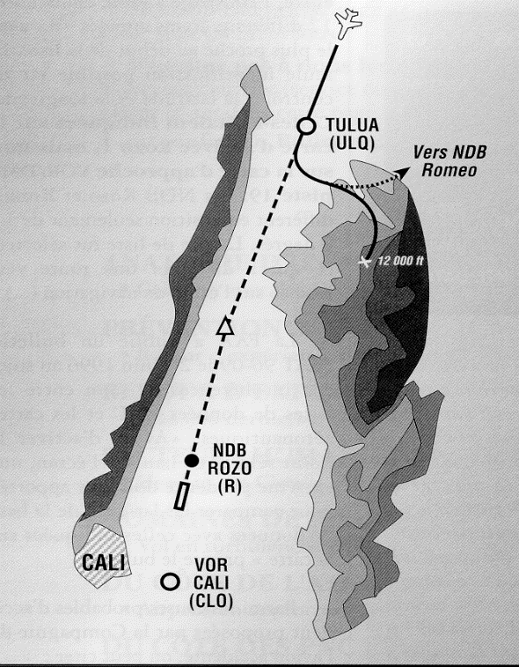
Why automation safety data are poorly used?
Cali CFIT accident (1995)
High crew workload
Cleared dir to « Rozo »
Rozo NDB is “R” on the chart
Crew enter “R” into the FMS.
Plane turned left
Late detection and correction
GPWS “Pull up” (spoilers extended)
Impact into a 12000 ft summit
FMS software modified afterward
How many similar events before this accident ?
Cali direct approach
To
NDB « R »
Bogota
NDB Rozo
« R » on the chart
« Rozo » in the FMS
Notes:
You may remember the Cali CFIT accident.
(…)
Data base and FMS software have been improved
But
How many similar events before this one ?

Slide 4
Why automation safety data are poorly used?
Automation issues difficult to observe and report accurately
Unclear relationship between automation and accident risk
Automation data (ASR, FDM) collected on a random basis
Accident “precursors” hidden among thousands of events
Safety assumptions supporting certification unchallenged
Latent weaknesses unrecognized
Notes:
Safety data from crew report or Flight Data Monitoring (FDM) sources are generally collected on a random basis.
They are embedded among thousands of other safety events from various nature.
Common patterns related to specific automation safety issue remain hidden until serious incidents justify a dedicated study.
Data collection dedicated to automations need to be more systematic and structured to support better risk management processes.
We will present some suggestions on this regard.

Slide 5
For a better use of automation safety data
The objectives are
to optimize automation safety benefits
to identify and minimize the most significant drawbacks
The questions are
What systems should be monitored ?
What data should be collected and analyzed ?
Automations are reviewed for the following risk perspective: Runway Excursion (RE), Mid Air Collision (MAC), CFIT
Notes:
> Because automation related events are difficult to observe and to report accurately, Flight Data Monitoring programs has to play a role as a primary source of data or as a complement to crew reports.
> Looking at automation issues through data mining on a random basis, in isolation from the risk we want to manage, is a theoretical exercise. We suggest to refer to a limited number of generic accidents to orient data mining to better identify the weaknesses we are looking for.
As a start, we will use here a selection of generic accident families among those systematically reviewed in the IATA yearly safety report. They are based on the CAST/ICAO taxonomy: Runway excursion (RE), Mid Air Collision (MAC), Controlled Flight Into Terrain (CFIT). These are among the main to fatalities and hull losses accidents.
Referring to each of these generic risks, we may review the role of automation systems that have a significant influence on these risks.
Are we getting the best value from them?
How could we gain more safety benefits?
What do we know about automation drawbacks or mismanagement?
Warning, alert and advisory systems will be considered as automations for the purpose of this presentation.
This works could be extended further and with the same method, to other risk domains such as Loss of Control in Flight (LOC-I), Runway Collision (RI), Abnormal Runway Contact (ARC), Runway Undershoot etc.

Slide 6
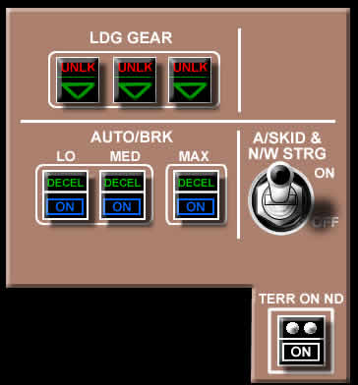
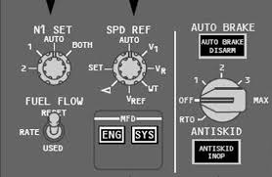
Automation and Runway Excursion (RE) risk
Auto brake at take-off
(Are we getting the best from it?)
Value of RTO mode
Time to maximum braking reduced.
Braking pressure better managed (manual braking less efficient).
What could happen?
RTO mode not set
Reverting to manual braking at high speed in case of RTO
What should be monitored and how?
TO without RTO mode and RTO overridden at high speed
FDM for daily flight or FDM + Pilot report (if high speed RTO)
Notes:
Runway excursion (overrun and veer off) is the most frequent type of hull loss accidents. Some could be catastrophic. Most are related to energy management, pilot decision, braking perfmce and and lateral control. Several automations are related to RE.
> Auto brake mode for take-off is one example
It is a highly efficient device for high speed aborted take-off. It reduces significantly the time to obtain the maximum braking capacity. Omitting to select the Autobrake system in RTO mode before take-off, or overriding it too early at high speed to brake “manually” will degrade the stopping performance.
The first cases could be easily and systematically monitored and collected through FDM. The second one should be carefully analysed whenever a high speed aborted take-off is detected.
In a similar manner, collecting data from FDM about the use of auto-brake for landing on specific runways or circumstances when the runway excursion risk is higher could give indication to see if pilots (and the airlines) are taking the best advantage of their auto-brake systems. Preselected deceleration and disconnection speed are significant data to be collected with FDM is a key tool to get this picture.

Slide 7
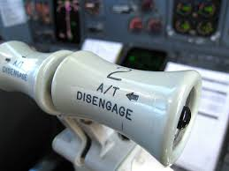
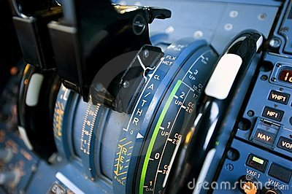
Automation and Runway Excursion (RE) risk
Auto Throttle (ATH) or Auto Thrust (ATHR) at TO
Are we keeping ATH/ATHR
mismanagement under control ?
What could happen at take off?
TOGA too early > uncontrollable thrust asymmetry and rwy veer off
ATH not armed > crew distractions > critical errors
ATHR lever wrong detent > inappropriate thrust and AP/FD mode
What should be monitored and how?
Various ATH/ATHR mismanagements through FDM program
Quantitative data (FDM) complemented with qualitative data (ASR)
Notes:
> Auto Throttle or Auto Thrust at take off
Auto throttle or Auto thrust mismanagement may contribute to runway excursions. Because each engine FADEC are managing the “spool up” phase automatically and independently, activating the take-off mode too early, before minimum N1/EPR stabilization has been reached, could contribute to an uncontrollable asymmetrical thrust and lead to an immediate runway veer off before pilot could react.
Another common safety issue is the omission to arm the auto throttle or to place the levers in the wrong ATHR detent.
Both errors could happen without consequence and remain unknown until something more serious happen. With relevant FDM algorithm it is possible to detect and address early enough these precursors.
Relevant data could be collected also from FDM about the use of Auto Throttle or Auto Thrust during landing.
It may help to detect early enough elements of catastrophic scenarios such as the runway overrun in Sao Paulo in 2007 or the runway undershoot accident in San Francisco in 2013.
Many articles and pilot briefings have been dedicated to best practices regarding this automation. Surprisingly, few publications have been based on real recorded data from daily operations.

Slide 8
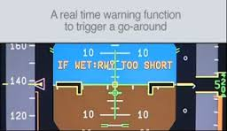
Automation and Runway Excursion (RE) risk
ROPS (Runway Overrun Prevention System)
Are we getting the best from it?
Value of ROPS
Explicit warning. Key decision aid.
ROPS value depends on pilots reaction and decision.
What could happen ?
Absence of reaction or wrong pilots reaction
Nuisance warnings or absence of warning
What should be monitored and how?
ROPS activations + pilot reactions
FDM for monitoring daily flight or FDM + Pilot report in case of actual ROPS activation
Notes:
> ROPS (Runway Overrun Prevention System)
It displays an explicit warning to the pilots whenever the stopping distance margin are becoming less than minimum at landing.
It offers a key decision aid either to go around or, when on the ground, to apply maximum brakes and reverse thrust.
How often this system activates? Are the pilot reactions appropriate? Do we observe spurious warnings?
It is critical to get data from real cases and see how ROPS + Pilot reaction match our expectations and take corrective actions is needed.
A similar work could be done regarding
- GPWS or “Smart landing” call out related stabilization
Part of these GPWS call outs are optional. Airlines are paying for these specific equipment and should be interested in assessing the “return on investment”. As an absence of accident does not mean no risk, it is necessary to check further and to look at pilot reactions to actual call outs through FDM program. No need of individual monitoring, a global assessment is enough.
- FMS take off data entry: The source of error does not come from the FMS itself but may occur when the weight parameters are entered into the take-off computation device. Typing 2(00)t instead of 3(00)t or a ZFW in place of the actual TOW are among the most dangerous errors. How often such wrong data are entered? Studies based only on pilot reports do not give the real picture as these errors may remain undetected.

Slide 9
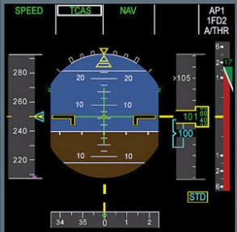
Automation and Mid Air Collision (MAC) risk
TCAS (Airborne Collision Avoidance System)
Are we getting the best from it?
Value of TCAS
Dependant on TCAS + Pilots reactions
What could happen ?
Absence of reaction or wrong pilots reaction
Nuisance warnings or absence of warning
What should be monitored and how?
Any ACAS activation and pilot reactions
FDM for daily flight or FDM + Pilot report if TCAS activation
Combined analysis of FDM events + pilot report + ATC report
Notes:
Automation and Mid Air Collision (MAC) risk
This risk is shared between ATC and pilots, and should be addressed from this perspective. Automations have been implemented on both side to prevent it. How far their global performance (human + automation) match our expectation? Have the risks been reduced the way we want? Nobody could offer to wait for an accident to “see how it works”.
- ACAS (Airborne Collision Avoidance System)
The safety benefit results from the combined effect of the systems itself (relevant and timely alert) and the cockpit crew reactions. Airlines that are systematically collecting data to monitor crew responses to ACAS event are not numerous. Without this feed-back it is impossible to assess and manage the global value of ACAS

Slide 10
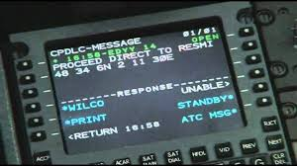
Automation and Mid Air Collision (MAC) risk
CPDLC (Controller/Pilot Data
Link Communication)
Are we keeping CPDLC
mismanagement under control ?
What could happen?
See “Skybrary” list of errors
http://www.skybrary.aero/index.php/CPDLC_General_Safety_Considerations
What should be monitored and how?
Joint ATC/Airlines CPDLC miscommunication data analysis
Notes:
> CPDLC
Reliable & “fail safe” Pilot/ATC com. are key for MAC prev.
By resolving ambiguities and getting rid of multiple sources of error CPDLC were expected to reduce the mid-air collision risk. After its implementation, both air traffic controllers and pilots realised that new type of errors have emerged.
Skybrary has published an interesting review of it.
Unlike data from FDR which can be automatically processed to detect anomalies, CPDLC data (when recorded) cannot be analysed the same way.
Classic reporting programs must be better used to understand error scenarios.
One way is to merge pilots and ATC report data base in order to capture complementary perspective about the same event.
Such initiatives are already in place and should be developed further.

Slide 11
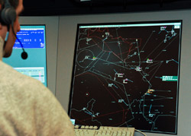
Automation and Mid Air Collision (MAC) risk
“S Mode” (Enhanced Surveillance & ADS B System)
Are we getting the best from it?
Value of S Mode + ADS B
Possible real time detection of ATC/Cockpit
communication errors such as wrong altitude
selected on board. Crosscheck similar to the PF/PM cross check.
What should be monitored and how?
ATC reports of miscommunications detected through ADSB (similar to potential Gross Navigation Errors monitored and collected in oceanic airspaces).
Notes:
> Mode S Enhanced Surveillance & ADS-B
Altitude, heading and a few other parameters can be cross-checked on the ground by air traffic controllers the same way Pilot Flying and Pilot Monitoring are cross checking each other critical actions.
This opportunity is already used in a few countries in Europe. Data should be collected regarding these air/ground cross-checks and its implementation encouraged.

Slide 12
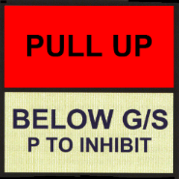
Automation and CFIT risk
EGPWS (Enhanced GPWS)
Are we getting the best from it?
Value of EGPWS
Depends on pilot reactions
What could happen ?
Absence of reaction or wrong pilots reaction
Nuisance warnings or absence of warning
What should be monitored ?
Any EGPWS “Pull up” + Pilots reactions
Use of “TERR” mode in mountainous environment (terrain awareness)
TERR ON ND
Notes:
CFIT accidents are a consequence of pilot loss of terrain separation awareness. Such accidents happen in IMC or at night when no visual and intuitive visual cues to avoid obstacles are available.
The rate of CFIT has been reduced in such a way that it is no longer the first “killer” of aviation it was before.
But no, or very few CFIT accidents doesn’t mean “no risk”.
Automations that have contributed to this accident rate reduction should be monitored and related data collected to assess continuously the way they protect us.
- EGPWS (Enhanced GPWS) and MSAW (Minimum Safety Altitude) warning for ATC
- Use of Auto Pilot basic approach modes during Non-Precision Approaches
- Use of Auto Pilot during GNSS approaches

Slide 13
For a better use of automation safety data
Data collection need to be more structured and more systematic
FDM data should be used as a primary source whenever possible
Data recorders/FDM tools should be adapted to automation issues
ASR or ATC reports analysis should be combined with FDM analysis
Data mining should refer to generic accidents + specific automation
A systematic review of automation to be monitored as a priority should be initiated in correlation with generic accidents
Further work : Loss of Control (LOC), Abnormal Rwy Contact (ARC)…

Slide 14
Automation & Manual Handling
FD/ATHR mismanagement
5 reported events (ASR)
1 investigated incident
How many other events in airlines FDM or ASR data base?
How far these lessons have been disseminated within the industry?

Slide 15
“For a better use of automation safety data”
Questions ?

