Slide 1

2015 Safety and Automation Safety Forum Captain Tim Cheal
2-3 June 2015
Notes:
The Proficiency Check – Time for Change
The introduction of 3rd and 4th generation aircraft has seen dramatic changes in aviation, and particularly how these aircraft are operated. But, the proficiency check required under Appendix 9 of EASA has changed little. ATQP has done much to help airlines move towards an “evidence based training” environment, but is this enough?
It’s time the regulator took a good hard look at how current practices enhance training, and particularly the examination criteria – the Proficiency check. What does it do to address many of our areas of interest e.g. crew cooperation (arguably it is counterproductive in this respect), use of automation and the role of pilot monitoring. How many single engine go-arounds have ever been flown for real, and what is the benefit of this manoeuvre. Are we encouraging pilots to disconnect the automatics when their use should be encouraged? Pilots may need manual flying practice, but it is time to reconsider how we do this.

Slide 2
Time for Change?
2-3 June 2015
Notes:
So who am I addressing this to.
The Regulators, no doubt
Operators who believe LPCs are keeping them sfae??

Slide 3
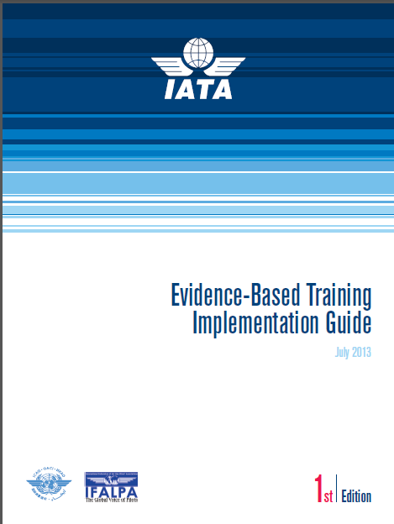
Time for Change?

Slide 4
Time for Change?
What is EBT
It is impossible to foresee all plausible accident scenarios, especially in today’s aviation system where the system’s complexity and high reliability mean that the next accident may be something completely unexpected. EBT addresses this by moving from pure scenario-based training, to prioritizing the development and assessment of defined competencies, leading to better training outcomes. Mastering a finite number of defined competencies will allow a pilot to manage previously unseen potentially dangerous situations in flight.

Slide 5
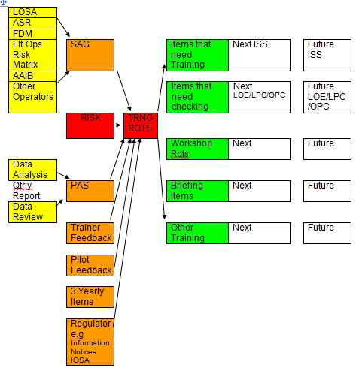
Evidence Based Training

Slide 6
Time for Change?
EBT competencies
Aircraft Flight Path Management, manual control
Knowledge (from Airbus EBT)
Aircraft Flight Path Management, automation
Workload Management
Application of Procedures
Communication
Leadership and Teamwork
Situation Awareness
Problem Solving and Decision Making
Notes:
The EBT competencies have been carefully thought through, as were the previous competencies (very similar).
So how can we ensure we are training out pilots in these matters??

Slide 7
Time for Change?
The LPC?
Mandatory Items
Pre-Flight Activities/Check List
Adherence to DEP/ARR procedures
EFATO
SE ILS to DA
G/A from MDA/DH, SE
SE Landing
RTO
Non-Precision Approach to MDA
Normal and abnormal operations of following systems: 3 items
Abnormal and emergency procedures: 3 items
Notes:
Appendix 9:
9. At the discretion of the examiner, any manoeuvre or procedure of the test may be repeated once by the applicant.
The examiner may stop the test at any stage if it is considered that the applicant’s demonstration of flying skill
requires a complete re-test.
14. The applicant shall operate as PF during all sections of the skill test, except for abnormal and emergency procedures,
which may be conducted as PF or PNF in accordance with MCC. The applicant for the initial issue of a multi-pilot
aircraft type rating or ATPL shall also demonstrate the ability to act as PNF. The applicant may choose either the left
hand or the right hand seat for the skill test if all items can be executed from the selected seat.
15. The following matters shall be specifically checked by the examiner for applicants for the ATPL or a type rating for
multi-pilot aircraft or for multi-pilot operations in a single-pilot aeroplane extending to the duties of a PIC,
irrespective of whether the applicant acts as PF or PNF:
(a) management of crew cooperation;
(b) maintaining a general survey of the aircraft operation by appropriate supervision; and
(c) setting priorities and making decisions in accordance with safety aspects and relevant rules and regulations
appropriate to the operational situation, including emergencies.
FLIGHT TEST TOLERANCE
3. The applicant shall demonstrate the ability to:
(a) operate the aeroplane within its limitations;
(b) complete all manoeuvres with smoothness and accuracy;
(c) exercise good judgement and airmanship;
(d) apply aeronautical knowledge;
(e) maintain control of the aeroplane at all times in such a manner that the successful outcome of a procedure or
manoeuvre is always assured;
(f) understand and apply crew coordination and incapacitation procedures, if applicable; and
(g) communicate effectively with the other crew members, if applicable.

Slide 8
Time for Change?
The LPC?
Mandatory Items
Normal and abnormal operations of following systems: 3 items
Abnormal and emergency procedures: 3 items
AMC1 ORO.FC.230 Recurrent training and checking (a) (4) i (A)
The aircraft/FSTD training programme should be established in a way that all major failures of aircraft systems and associated procedures will have been covered in the preceding 3 year period.

Slide 9
Time for Change?
The LPC?
Mandatory Items
Pre-Flight Activities/Check List
Adherence to DEP/ARR procedures
RTO
Non-Precision to MDA
.
Notes:
Value
Aircraft took off with stab trim switches off….

Slide 10
Time for Change?
The LPC?
Mandatory Items
EFATO
SE ILS to DA
G/A from MDA/DH, SE
SE Landing
Single Engine

Slide 11
Time for Change?
LPC
What is the benefit of SE GA?
Are we encouraging pilots to disconnect the automatics when their use should be encouraged?
Pilots may/do need manual flying practice, but it is time to reconsider how we do this.

Slide 12
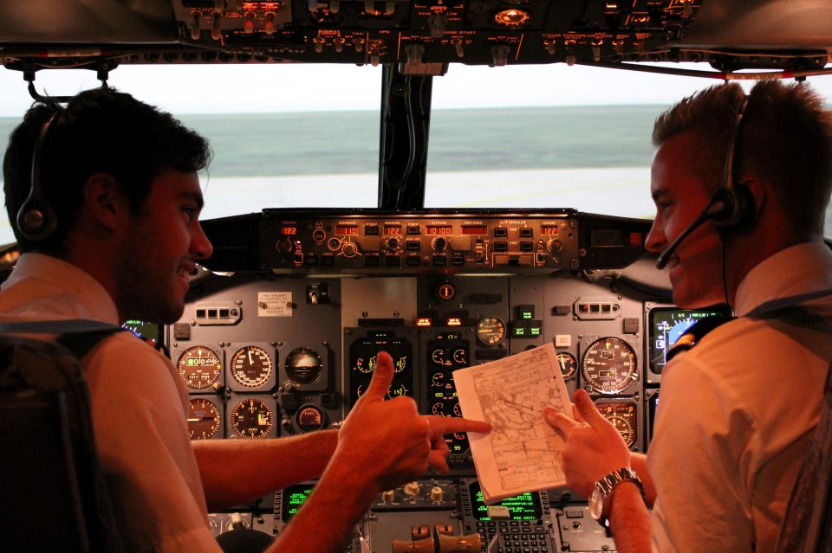
Time for Change?
LPC
How does it address
Crew cooperation (arguably it is counterproductive in this respect)?
Use of automation and the role of pilot monitoring.

Slide 13
Time for Change?
Some Scores on the Doors!
Analytical Data 1 = Fail 5 = Very Good | Feb 13 - Feb 14 | Feb 09-Feb 10
Non precision approach to MDA | 4.3 | 4
EFATO | 4.2 | 3.9
Landing with critical engine inoperative | 4.2 | 4
Go around from DA/MDA, SE | 4.2 | 4

Slide 14
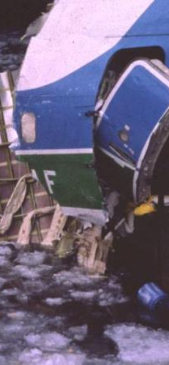
Time for Change?
How does the LPC prevent (for example)
Eastern 401 (1972)
Air Florida 90 (1982)
Colgan 3407 (2009)
Air France 447 (2009)
Qantas 32 (SIN 2010)
Asiana 991 (SFX 2011)
2 engine Go Arounds (a known area of concern)

Slide 15
Time for Change?
One Solution:
Emirates: Manoeuvre Validation Exercises

Slide 16
Time for Change?
Is it time to review what we do as an industry, and use our valuable training time to better effect?

Slide 17
Thank You

