Slide 1
Aviation Safety International
Structural Redesign of Pilot Training
for Automated Aircraft
2015 Safety and Automation Safety Forum
By Karlene Petitt
Typed: A330, B747-400, B747-200, B767 , B757, B737, B727
an
Embry-Riddle Aeronautical University

Slide 2
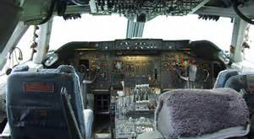
My Office 1995
Notes:
This was a time when pilots diagrammed the electrical systems…

Slide 3
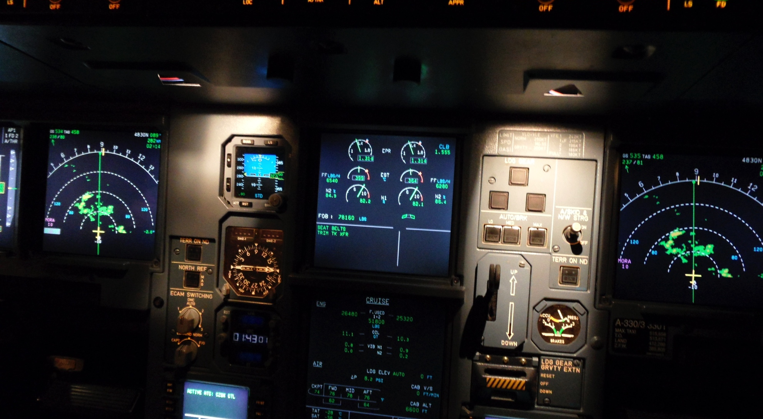
My Office 2015
Notes:
Today we take electronic multiple choice test.

Slide 4

Results of this Automation Shift
Notes:
Automation was designed to reduce workload, and improve safety. However, numerous catastrophic accidents such as AF447, Colgan Air 3407, Asiana 214 and UPS 1354 have proven otherwise.

Slide 5
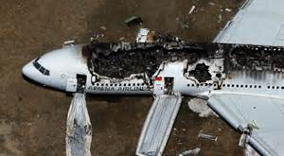
Pilot Error?
70-90% accidents
Due to Pilot Error
Notes:
According Airbus, 70-90% accidents are due to pilot error. The results of errors are obvious. The question is why the errors when the technology is there to support the pilot? How can pilots fly a highly automated aircraft into a mountain or land at the wrong runway? How can pilots not realize the autothrust is disengaged, and watch their plane crash short of the intended runway, in visual conditions. Worse yet, what would make a pilot think it’s okay to pull the stick full aft at altitude?

Slide 6
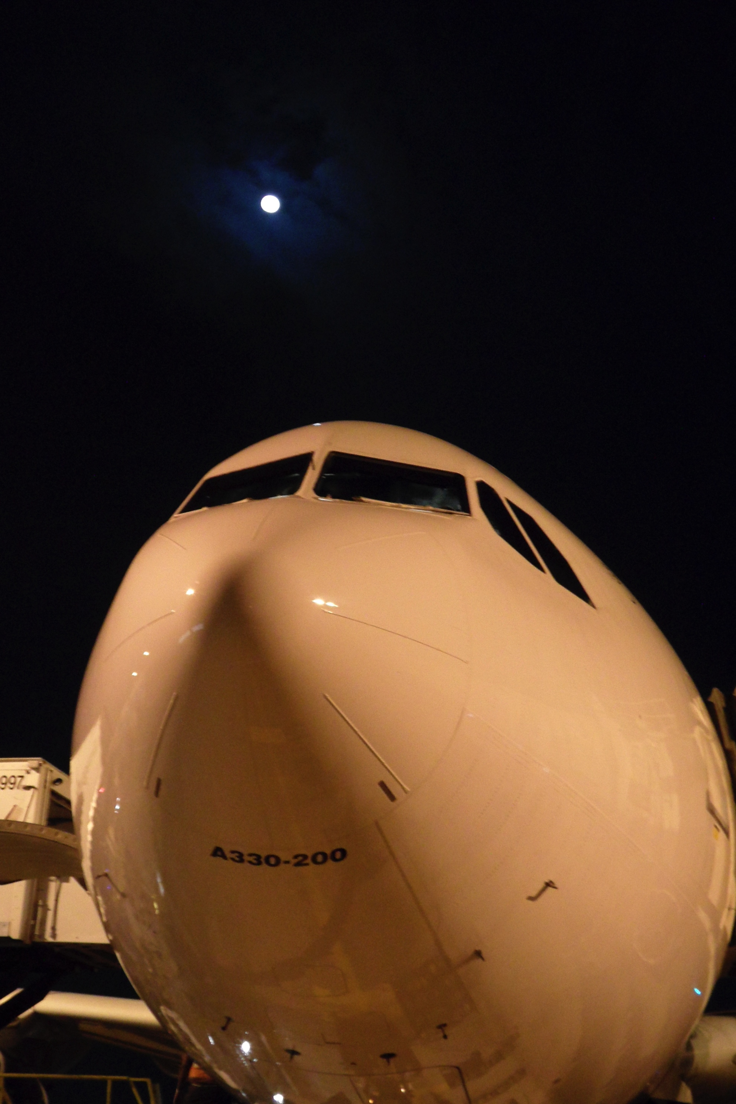
A330 Experts Report
Poor Aircraft Management
Lack of Understanding
Pilots Rarely Fly without Automation
(and never without a flight director)
Notes:
Interviews with A330 Line Check Airman and FAA designees identified poor aircraft management, lack of understanding and the fact that pilots never fly without the automation to be a problem with decreased performance. These statements are real life non-accident observations from training professionals.

Slide 7
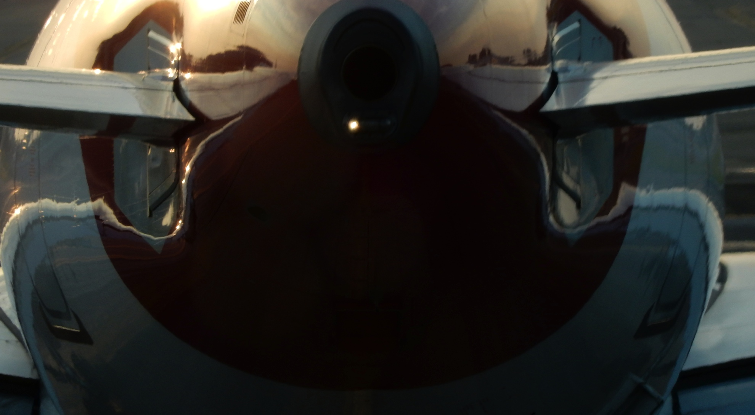
FAA Research
46 accidents & major incidents
734 US ASRS
9155 global LOSAs
Numerous interviews
Understanding
Overuse of Automation
Pilot Training
Notes:
In agreement with those observations, FAA sponsored research identified three attributing factors of lack of understanding, overuse of automation and pilot training. Interesting enough, understanding and manual flight skill loss belong to pilot training. Thus, we actually have one problem… pilot training.
The question is what can be done?

Slide 8

Adapt to Changing Times
From Skill to Cognition
Notes:
Pilots once flew aircraft with skill. We practiced and demonstrated that skill in level D simulators. Machines that mirrored the aircraft. We trimmed control forces and hand flew approaches to minimums. But today we fly with cognition. Our aircraft trim themselves. The complexity of aircraft is increasing and while training footprints are reducing due to cost. Unfortunately plots do not understand their aircraft as they once did, and they need more training. But training is expensive.

Slide 9
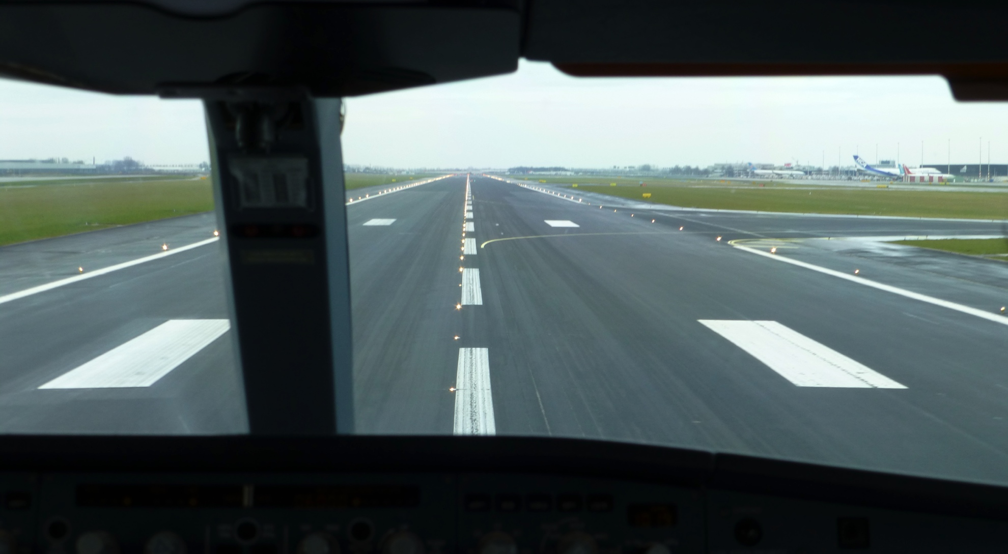
The Solution
Redesign Pilot Training
Notes:
Training does not have to be as expensive as we think. Pilots do not need more practice in a Level-D simulator. Pilots need different training for better understanding. There are cost-effective solutions available today. We just need to utilize them.

Slide 10

Better Use of Technology
Training should include computer
Expand Computer Based Training
Notes:
Today, many airlines are paying pilots to learn aircraft systems at home. A more cost effective to training. However, we must expand upon that technology and create programs that enable pilots to perform all phases of flight, from flightdeck set up to engine shutdown, while incorporating systems. We must allow pilots to perform navigation functions. Allow the pilot to perform emergency procedures by reading the EICAS on their computer screens and actioning the steps by touching the item with a click of a mouse. Pilots would have a far greater understanding and bring that to the training center.

Slide 11
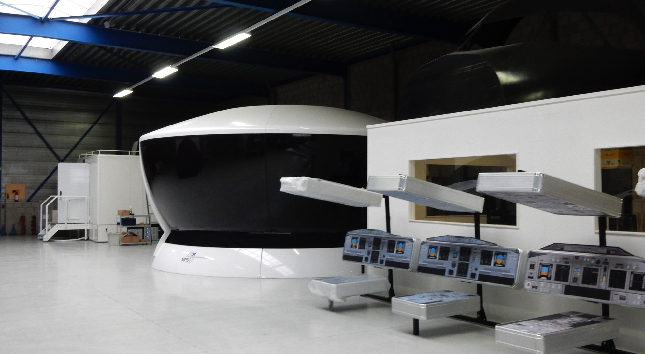
The Right Tool for Training
Level 6 Fixed Base Simulator
Better Training
Notes:
After learning systems and operational procedures these pilots should move to a Level 6 fixed base simulator. A 3 million dollar solution to better training than a 30 million level D FFS. An FAA experiment has proven non-motion is more effective in training and transition to an aircraft than motion. There is no reason to train any procedures in a Level D FFS with automation connected. This is a waste of resources. Motion simulators are expensive and have high operational costs, and are less effective in training.

Slide 12
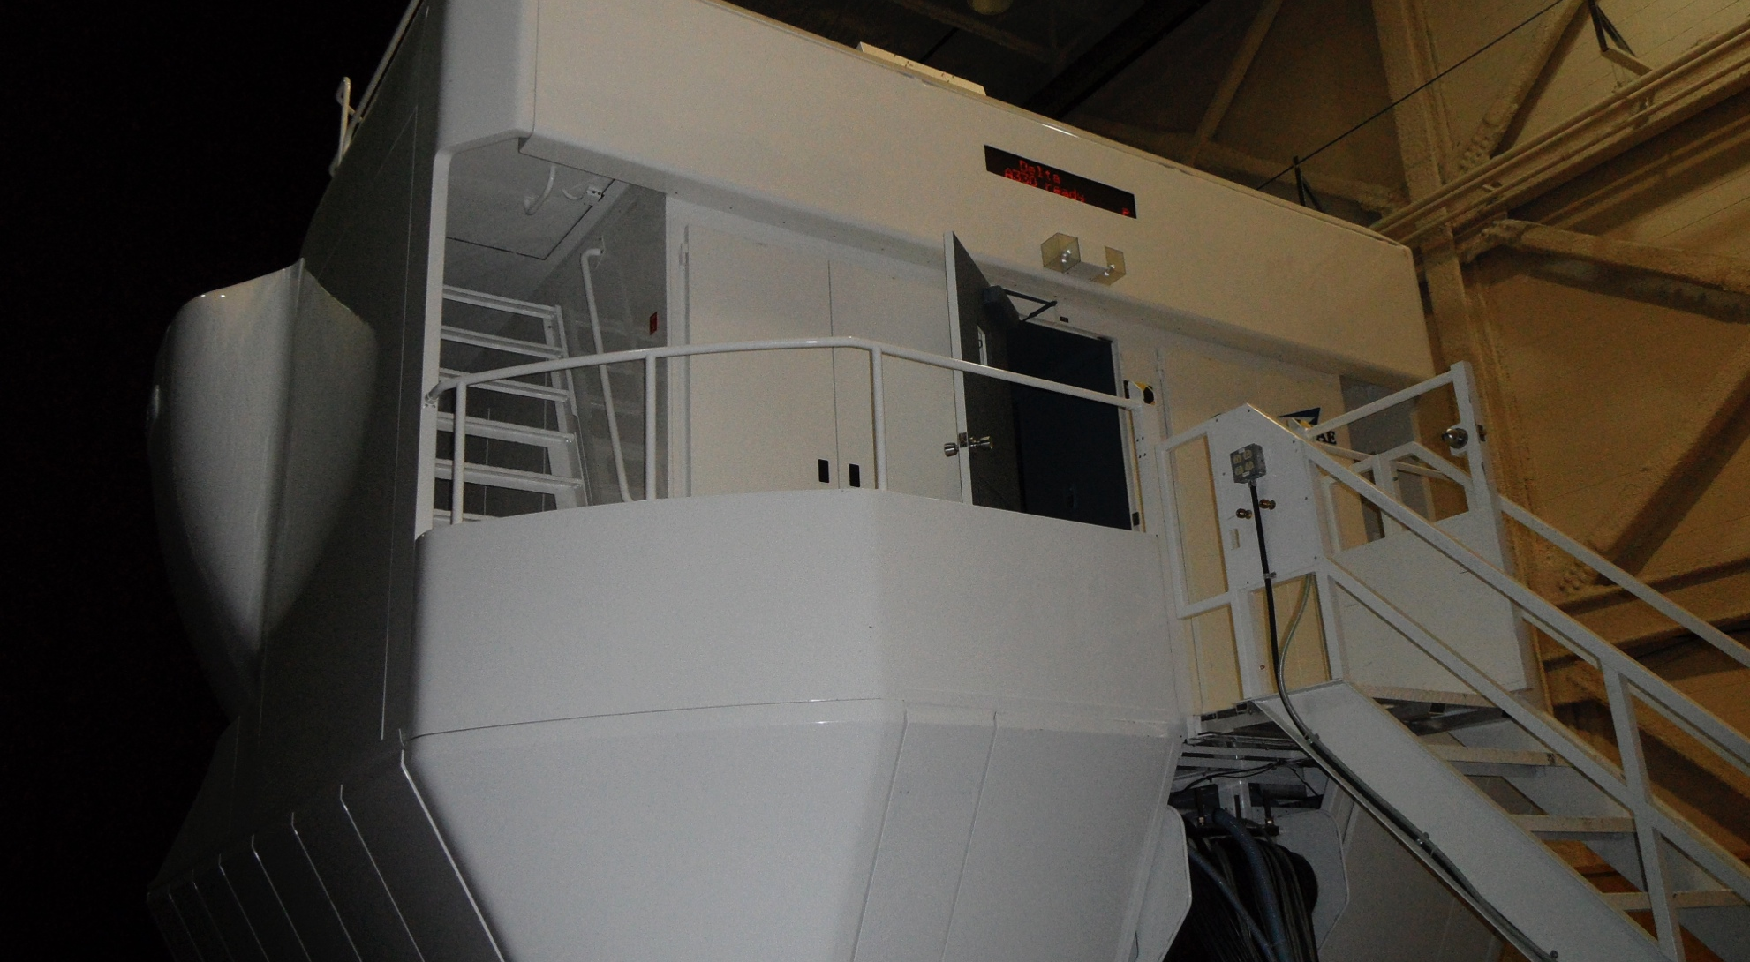
The Right Tool for Skill Retention
Level D FFS For Manual
Flight Skills
Notes:
Should we be encouraging pilots to “practice” with passengers on board? This practice belongs in the device designed for that challenge. Taking a pilot out of the loop during high workload events removes a level so safety. This practice should be in a level D FFS, that mirrors the aircraft. This is where hand flying skills should be retained. By moving normal operational training to a level 6 FBS, the Level D will become available for manual flight skills.

Slide 13

Goal Of Flight Training
Understanding the Aircraft
Cost Effective Solution
to Safety
Notes:
Understanding the aircraft is the solution to solving the automation challenge, and improving performance. We have to tools available to assist with better understanding… let’s use them!

Slide 14
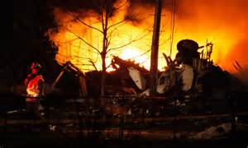
TIME TO CHANGE
Before the Next Event Occurs
Notes:
With NextGen around the corner, pilots workload will increase. If we don’t do something to improve a pilot’s understanding of the aircraft we will see more accidents in the future.

Slide 15

Understanding In Three Steps
Better use of CBT
Level 6 FBS for Training
Level D FFS for Manual Flight
Notes:
The solution is through understanding via pilot training in three simple cost-effective phases.

Slide 16
Advanced Technology
Overcoming the challenge
Through Pilot Training
Questions?

