Slide 1
Measuring Safety Performance Guidelines for Service Providers

Slide 2
Outline
The Document
Safety Performance
Components of Safety Performance
Why Measuring Safety Performance?
How to Measure…
Safety Performance Indicators (SPIs)
The Measurement Cycle
Developing SPIs
Process approach
Indicator Examples

Slide 3
The Document
Initial release: 23 July 2013
Available on: www.skybrary.aero/ (insert path)
Objective:
To provide guidelines for the definition & implementation of a set of SPIs as part of your SMS
Benefit:
Effective safety performance measurement will be an integral part of your SMS: it will support the identification of weaknesses and of opportunities for improvement not only related to safety, but also to efficiency and capacity.

Slide 4

Safety Performance & Operational Definitions
‘A service provider’s safety achievement as defined by its safety performance targets and safety performance indicators’ ICAO Annex 19
Safety: how well risk is managed (state of being)
Safety performance: capability to manage risk
Measurement of safety management: capability in terms of SM processes (what)
Process measurement (How – measurement strategy)
Process: Leading/Lagging indicators
Outcome: Ultimate benefits, results (Lagging indicators)

Slide 5
‘Components’ of Safety Performance
Operational
(core processes)
Risk 1
Risk 2
Risk 3
focus on the main risks in operations that need to be addressed (the things that may cause ‘your next accident’)
Safety Culture
SAFETY OUTCOMES
Impact of external factors
competition
new technologies
changes in regulations
etc...
Systemic
support processes
reporting system
qualification & training
compliance management
etc...
measures also need to address how external factors may influence enabling elements, risk controls and barriers or how these controls and barriers influence each other
focus on system features intended to ensure safe outcomes (organizational enablers of safety outcomes)

Slide 6
Why Measuring Safety Performance?
You can’t manage what you can’t measure (Drucker).
What gets measured gets managed.
but…
If you measure the wrong things, you’ll manage the wrong things.
Careful measurement is essential in safety decision making!

Slide 7
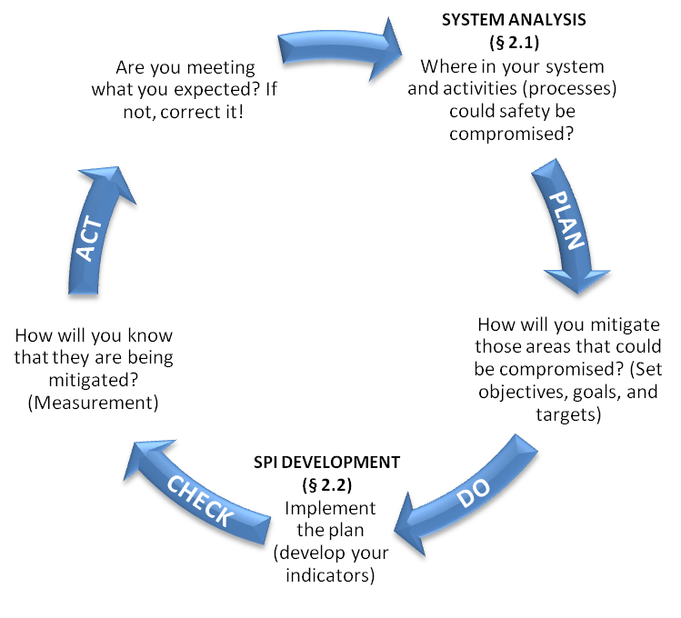
Why Measuring Safety Performance? The Measurement Cycle

Slide 8
How to Measure…
Select safety performance indicators that consider the type of feedback needed to ensure your company’s capabilities for safety management can be properly evaluated and improved (feedback is an essential element of safety management).
Measure performance:
at all levels of your organization
by adopting a set of indicators involving key aspects of your system and operations and measuring those key aspects in different ways to gain a more accurate picture.

Slide 9
Safety Performance Indicators
‘A data-based safety parameter used for monitoring & assessing performance’
Lagging indicators: measures of safety occurrences
Leading indicators: should measure
things that have the potential to become or contribute to a negative outcome, and
(positive) things that contribute to safety
Safety performance measurement should ideally consider a combination of leading and lagging indicators.

Slide 10
Developing SPIs – a process approach
Prerequisite
Perform a system analysis (make use of existing material, e.g. process maps and procedures) :
generate an accurate & reliable description of your organizational structures, policies, procedures, processes, staff, equipment and facilities
analyse the interactions between system components and the impact of external factors
The resulting system description and the related model of how your activities lead to the expected outcomes will inform you on what to measure & monitor to drive safety performance
Use a step-by-step process for developing your own set of SPIs.
Ensure your set of SPIs is regularly reviewed and make changes as necessary.

Slide 11
Process to develop/review SPIs
SYSTEM ANALYSIS
SYSTEM DESCRIPTION
1- designate responsibilities
7- evaluate SPIs and make changes as appropriate
2- review safety policy & objectives - identify key issues and main focus
6- analyse results and act on findings from SPI monitoring
3- determine data needs
5- collect data and report results
4- define indicator specifications
Notes:
The analysis and assessment of how your company ‘functions’ to deliver its activities should form the basis for defining your safety policy, the related safety objectives and the corresponding safety performance indicators and targets.

Slide 12
Indicator examples
Indicators for systemic issues:
Example of an indicator in the area of compliance:
measurement focuses on internal audits – compliance monitoring
metric: ‘number of repeat findings within audit planning cycle’
Indicators for operational issues:
Example of an indicator in the area of air operations:
high consequence negative outcome: traffic collision
metric: ‘number of TCAS resolution advisories per 1000 FH’.
Indicators to monitor external factors:
Example of an indicator in the area of regulations:
measurement focuses on new regulations
metrics ‘number of new regulatory requirements that will affect your organization within the next 12 months’.
Notes:
evolution towards performance-based regulations
number of objective based rules for which you have defined your own means of compliance

Slide 13
Your feedback on the guidelines is welcome! You may send your comments to: safety.management@easa.europa.eu

