Slide 1
Runway Safety Nets
James Fee
Manager | Runway Safety Group

Slide 2
DTW Detroit Metro Airport
Significant Occurrence Alert
27 January 2016
MOR Alert for DTW
Type: Suspected loss involving A/C and Vehicle

Slide 3
Event REVIEW

Slide 4
C
An incident characterized by ample time and/or distance to avoid a collision.
B
An incident in which separation decreased and there is a significant potential for collision, which may result in a time critical corrective/evasive response to avoid a collision.
A
A serious incident in which a collision was narrowly avoided.
Runway Incursion Categories

Slide 5
C
An incident characterized by ample time and/or distance to avoid a collision.
B
An incident in which separation decreased and there is a significant potential for collision, which may result in a time critical corrective/evasive response to avoid a collision.
A
A serious incident in which a collision was narrowly avoided.
Runway Incursion Categories

Slide 6
After-Event Safety Analysis

Slide 7
After-Event Safety Analysis
Contributing factors identified following the event by NTSB work group:
  Runway Status Lights (RWSL) could have prevented the surface event from occurring if they were in an operational status.
  The controller working the Local Northeast position did not engage in either, active scanning of the airport environment, or active listening.
  Combining non-dependent tower positions, during the same time period, was a contributing factor. The lack of additional staffing, or “extra set of eyes” in the tower cab also contributed to the lack of awareness that an event was occurring.

Slide 8
After-Event Safety Analysis
Positive system performance
  The Airport Surface Detection Equipment, Model X (ASDE-X) functioned properly and helped the LNE controller resolve the conflict.

Slide 9
After-Event Safety Analysis
Safety Recommendations
  The facility put mitigations in place after the event including; no combining of tower positions, or use of aircraft LUAW when vehicles are conducting a runway inspection, and ensuring airport vehicles have an ASDE-X data tag.

Slide 10
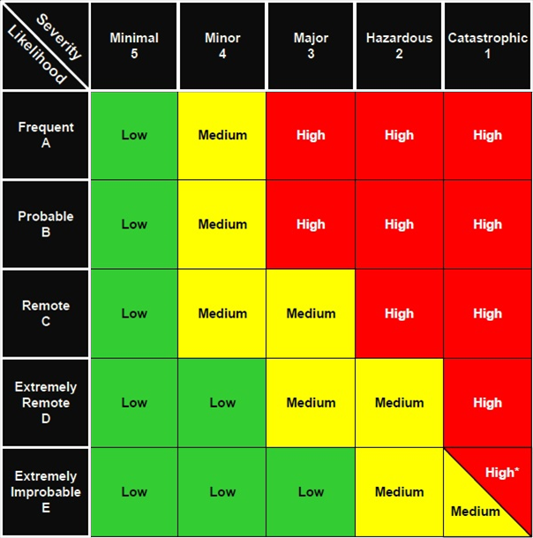
Qualitative RAE Risk
Cumulative risk identified following the event through Risk Analysis Event (RAE) data:
  Relief briefing
  ATC staffing required to accommodate the shift in air traffic volume

Slide 11
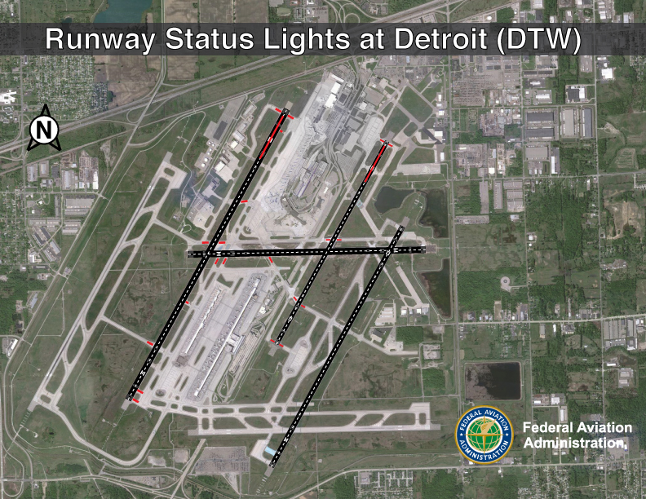
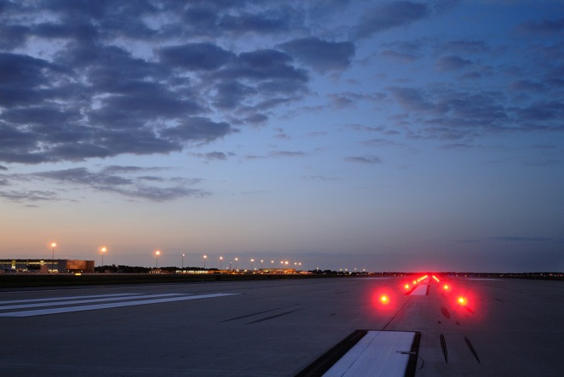
Runway Status Lights at Detroit Metro Airport
Runway Status Lights (RWSL) provide direct indication to pilots and vehicle operators that it is unsafe to enter a runway or begin a takeoff.
The lights turn red when other traffic makes it dangerous to enter, cross, or begin takeoff.
On taxiways, Runway Entrance Lights (RELs) show that a runway is not safe to enter or cross.
On runways, Takeoff Hold Lights (THLs) show pilots in position for takeoff that the runway is not safe for departure.

Slide 12
FLL Fort Lauderdale Airport
Significant Occurrence Alert
29 January 2016
MOR Alert for FLL
Type: Ground surveillance alert (i.e. ASDE, AMASS) between an A/C and Vehicle

Slide 13
Lessons Learned

Slide 14
Lessons Learned
The DTW and FLL events share the most common contributing factor in Runway Safety
  Lack of communication
In the simplest terms it is a failure to ensure the “mental pictures” match.
  The foundation of aviation conversations assume that individuals understood each other 100%, but only 33% of the average conversation is totally understood.

Slide 15
Runway Safety Nets
James Fee
Manager | Runway Safety Group

