Slide 1
GARDS
A Go-Around Detection System implemented at Schiphol Airport
Mariska Roerdink
Project manager GARDS & Senior Performance Expert
Air Traffic Control the Netherlands / Luchtverkeersleiding Nederland
Air Traffic Control
the Netherlands

Slide 2
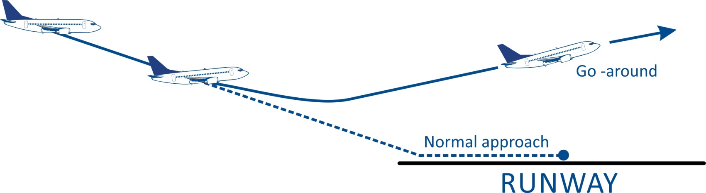
In case of a go-around…
What happens between
air traffic controller
and flight crew?

Slide 3

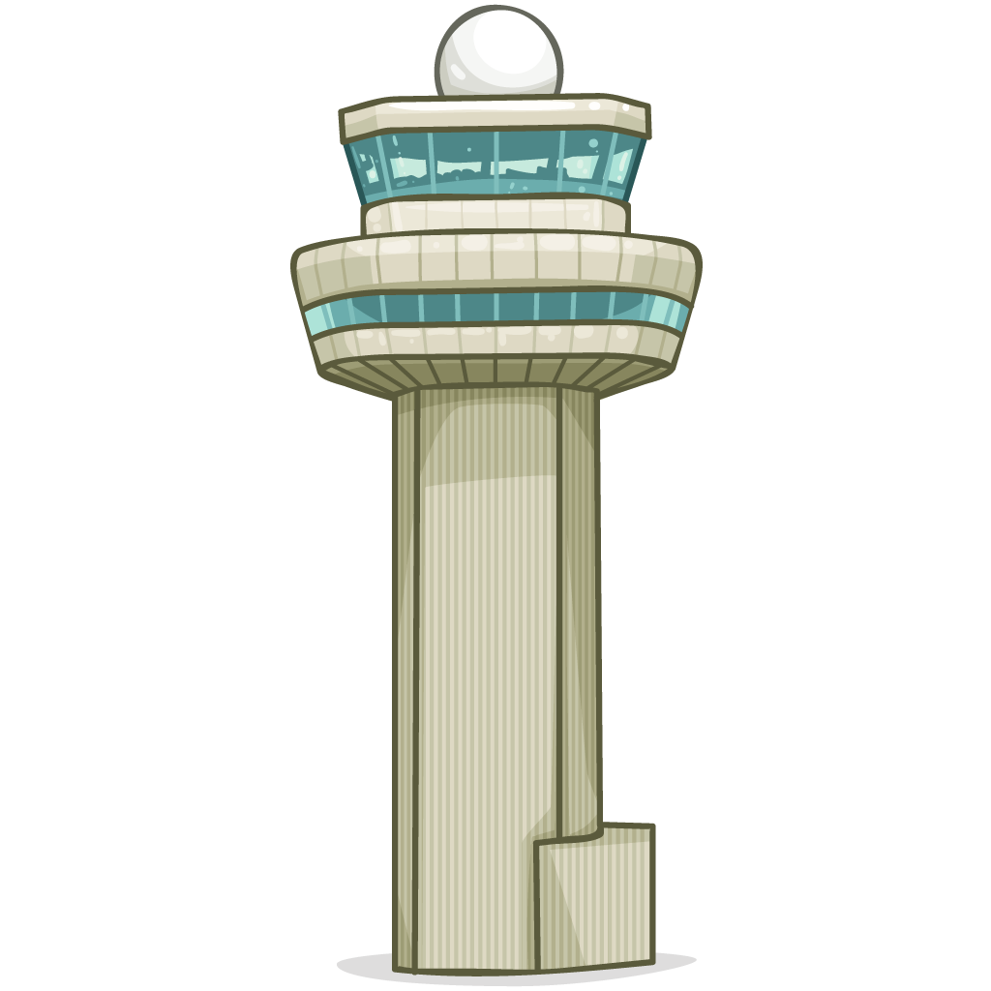



Procedure vs. practice
ATCo instructs go-around
Flight crew initiates go-around and informs ATC
Flight crew initiates go-around, does not (immediately) inform ATC, ATC detects go-around
Flight crew initiates go-around, does not (immediately) inform ATC, ATC does not detect go-around

Slide 4
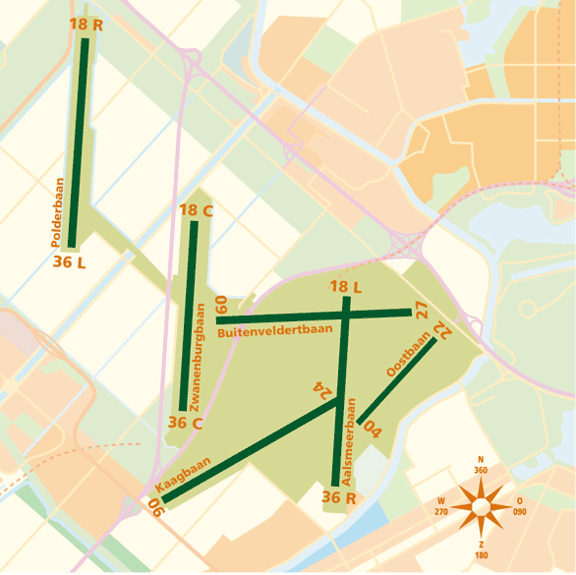
Schiphol Airport runway layout
Dependent runway use

Slide 5
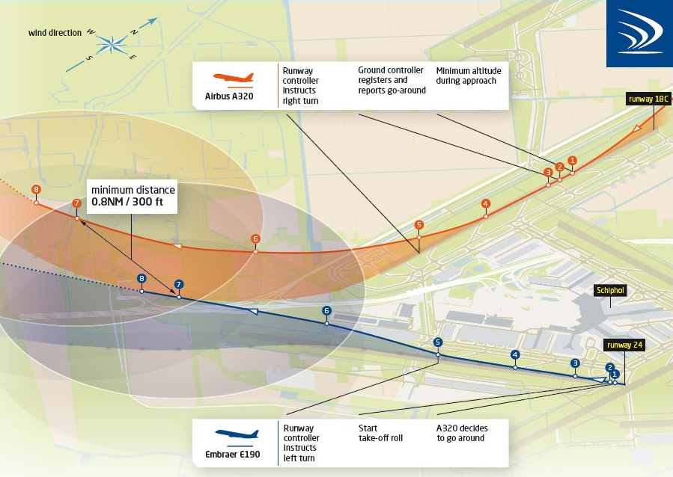
A possible incident

Slide 6
Continuous safety improvement
Procedure
Machine
Human
Increase detection probability
Restrict use of dependent runways
Training
Safety awareness
Timing procedures
GARDS: Go-ARound Detection System

Slide 7


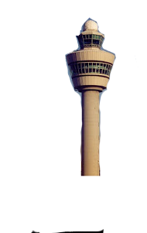

GARDS: automatic go-around detection
visual detection
pilot report
Surveillance
Runway
Landing
Aircraft?
YES
Non-nominal landing parameters?
YES
ALERT
Altitude / position
High speed

Slide 8
GARDS operational concept
Conditions
Traffic
Alerting
System use
All runways & combinations
All visibility conditions
IFR approaches only
Visual
Auditory
Safety net
No GARDS inputs required
Cannot be switched off by ATCo
No change in working method

Slide 9
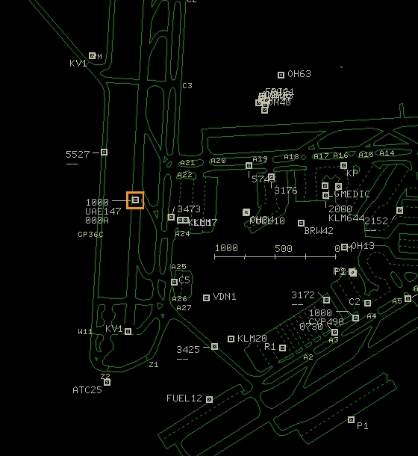

Human Machine Interface
Visual alert
Presented on ground situation and air surveillance display.
Auditory alert
Generated at working position of the involved runway controller

Slide 10
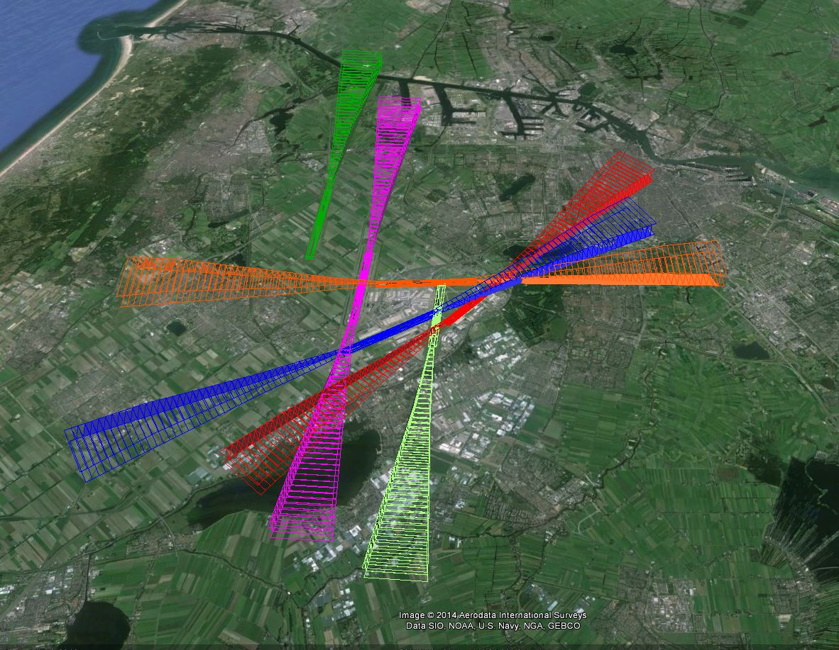
Technical approach

Slide 11

System tuning: find the balance
False alerts
Timing of alerting

Slide 12

Performance validation
Analysis based on:
More than five years of radar data
More than 1 million arrivals
More than 2000 go-arounds
Timing of alerting
7 (late GA) –
15 seconds (early GA)
False alerts
0,01 %
Go live!

Slide 13
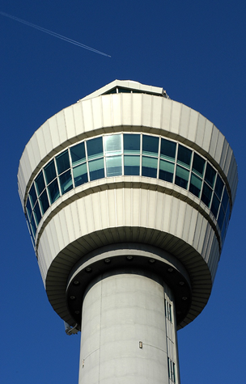
Implementation
Live at Schiphol control towers since May 2015
Operational evaluation in 2015
Minor update in November 2015

Slide 14

Facts & figures
After go-live:
More than 215.000 arrivals
All go-arounds detected
10 false alerts
  Some solved by november 2015 update

Slide 15
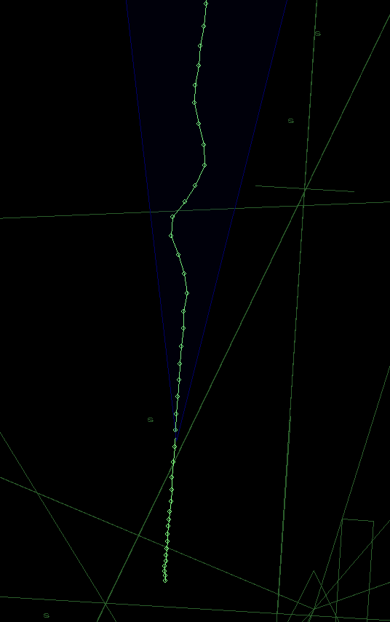
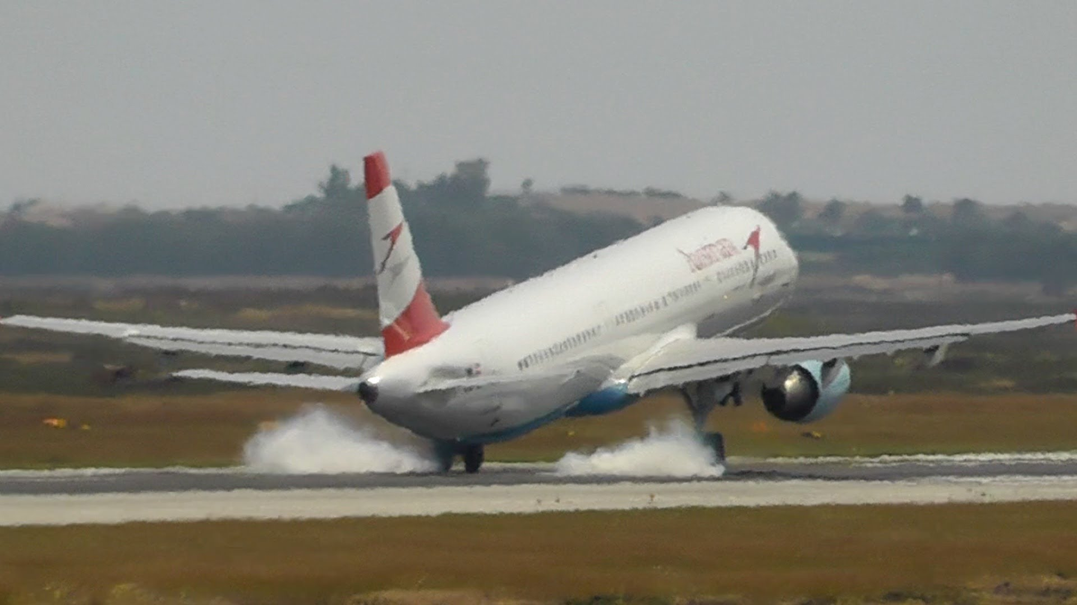
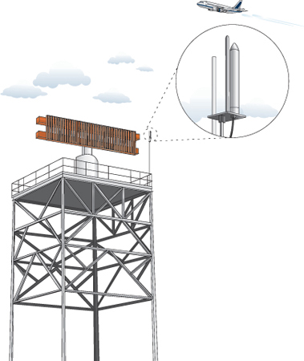
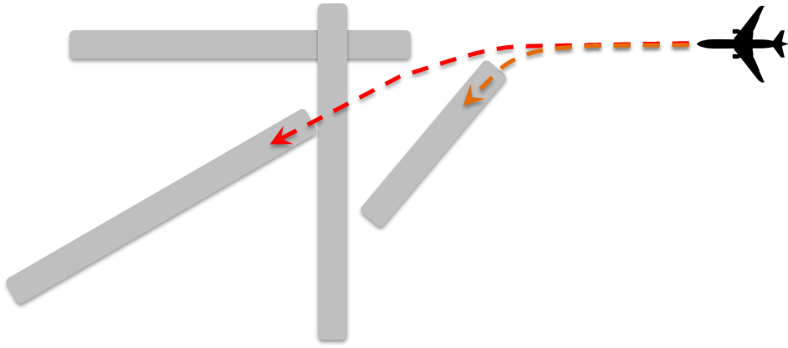
False alerts explained
Glidepath deviation
Temporary loss of multilateration coverage
High speed after landing
Circling approaches –
no false alert!

Slide 16
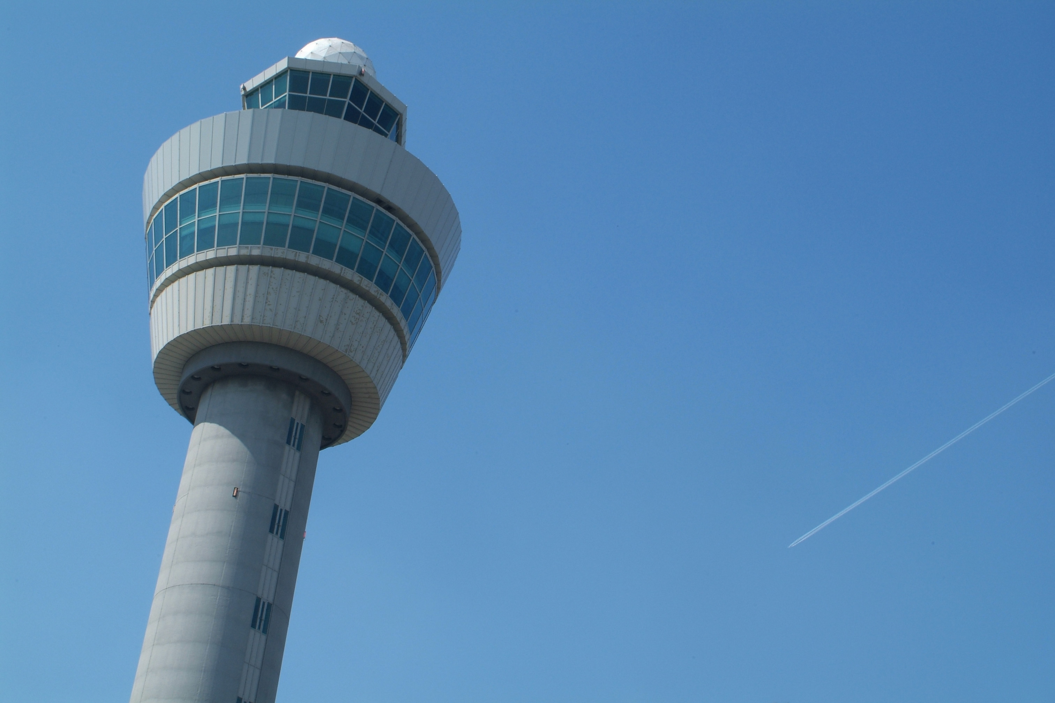
Lessons learned –
Development
Continuous involvement of controller community
Safety net part of complete package of measures
Safety net complementary to existing practice
Intuitive system
  Consistent use over runways and conditions
  Easy to explain system design

Slide 17
Lessons learned –
In practice
Positive acceptance of GARDS
Off-line tuning ensures successful go-live
Evaluation in practice for minor updates
Ground safety net introduces air-ground awareness

Slide 18

More information?
This project was sponsored by the Knowledge & Development Centre Mainport Schiphol
Mariska Roerdink
Project manager GARDS
Air Traffic Control the Netherlands / Luchtverkeersleiding Nederland
 m.roerdink@lvnl.nl
 +31 20 406 2947

