Slide 1
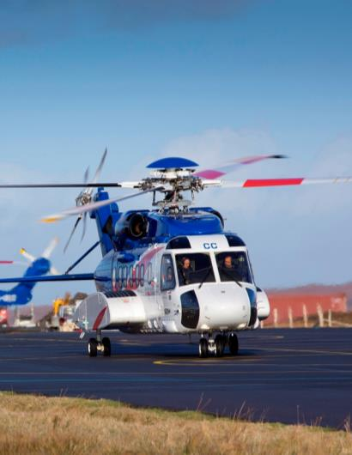
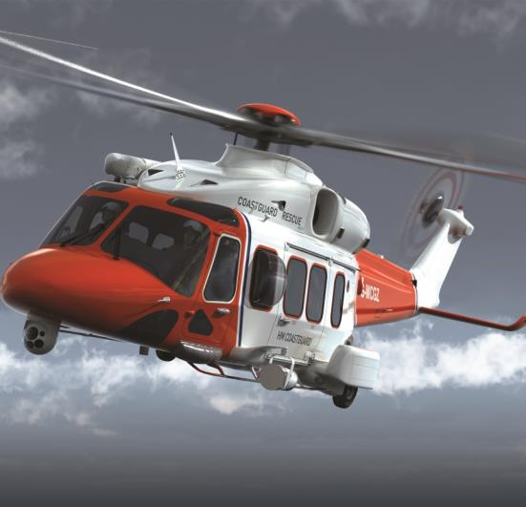
Landing and Takeoff Area Incursions and Excursions:
A Rotorcraft Perspective

Slide 2
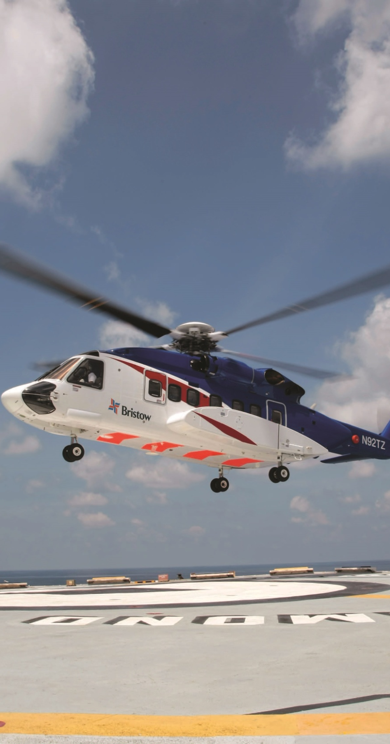
Landing and Takeoff Area Incursions and Excursions: A Rotorcraft Perspective
Presented to: European Organization for the Safety of Air Navigation (EUROCONTROL)
By: Joseph Obioma and Ana Belak
Date: June 2016

Slide 3
Landing and Takeoff Area Incursions and Excursions: A Rotorcraft Perspective
Why do we care?
Incursions and excursions in general.
Past events and statistics.
As related to helidecks and helipads/heliports.

Slide 4
Landing and Takeoff Area Incursions and Excursions: A Rotorcraft Perspective
Why do we care? (continued)
Incursions and Excursions

Slide 5
Landing and Takeoff Area Incursions and Excursions: A Rotorcraft Perspective
Why do we care? (continued)
Past events and statistics
ICAO data 2006-2010
Scheduled commercial traffic (over 2250Kg)

Slide 6
Landing and Takeoff Area Incursions and Excursions: A Rotorcraft Perspective
Why do we care? (continued)
Past events and statistics
Location: Oil & Gas helicopter base, Gulf of Guinea
Duration: 2 year period (January 2014 – December 2015)
~ 34,000 takeoffs and landings
~ 680 general safety reports
~ 20 runway related safety reports

Slide 7
Landing and Takeoff Area Incursions and Excursions: A Rotorcraft Perspective
Why do we care? (continued)
Past events and statistics

Slide 8
Landing and Takeoff Area Incursions and Excursions: A Rotorcraft Perspective
Why do we care? (continued)
Past events and statistics

Slide 9
Landing and Takeoff Area Incursions and Excursions: A Rotorcraft Perspective
Why do we care? (continued)
Past events and statistics

Slide 10
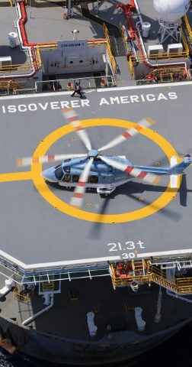
Landing and Takeoff Area Incursions and Excursions: A Rotorcraft Perspective
Why do we care? (continued)
As related to helidecks/heliports

Slide 11
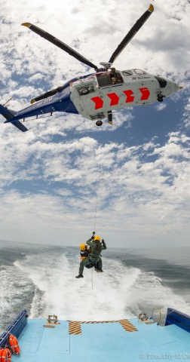
Safety Nets
Safety nets in general.
Technology / Operational procedures / Human Component
Limits

Slide 12
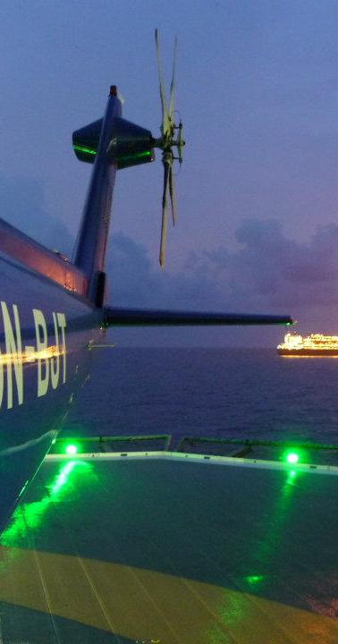
Landing and Takeoff Area Incursions and Excursions: A Rotorcraft Perspective
Helideck Status Lighting System (HSLS)
FAA runway status lights
UK CAA CAP 437

Slide 13
Landing and Takeoff Area Incursions and Excursions: A Rotorcraft Perspective
How HSLS works
Combines FAA and UK CAA concepts.
HSLS Green: No hazardous conditions and cleared to land on deck.
HSLS Red: Hazardous conditions AND/OR aircraft not cleared to land.

Slide 14
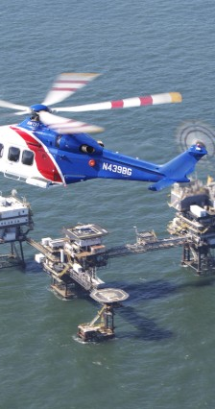
Landing and Takeoff Area Incursions and Excursions: A Rotorcraft Perspective
Stabilized Approach Protection System for Helidecks (SAPS)
Airbus (ROPS)
GNSS (GPS) / ADS-B
Radar altimeter

Slide 15
Landing and Takeoff Area Incursions and Excursions: A Rotorcraft Perspective
How SAPS works
Typical fixed wing solutions: Rr(t) < Ra(t)
SAPS for rotor wing: Applying Lagrangian mechanics we seek
Lr < Lp
Where:
Rr(t), Ra(t) are the required and available runway lengths at time t
Lr, Lp are the required and preferred Lagrangian of the rotorcraft system

Slide 16
Landing and Takeoff Area Incursions and Excursions: A Rotorcraft Perspective
How SAPS works (continued)
SAPS cockpit interface green: Rotorcraft system approach parameters within limit. Crew can continue approach.
SAPS cockpit interface yellow (with audio): Rotorcraft system approach parameters outside limit. Crew consider adjusting approach parameters or discontinuing approach to avoid helideck overshoot or late go around.

Slide 17
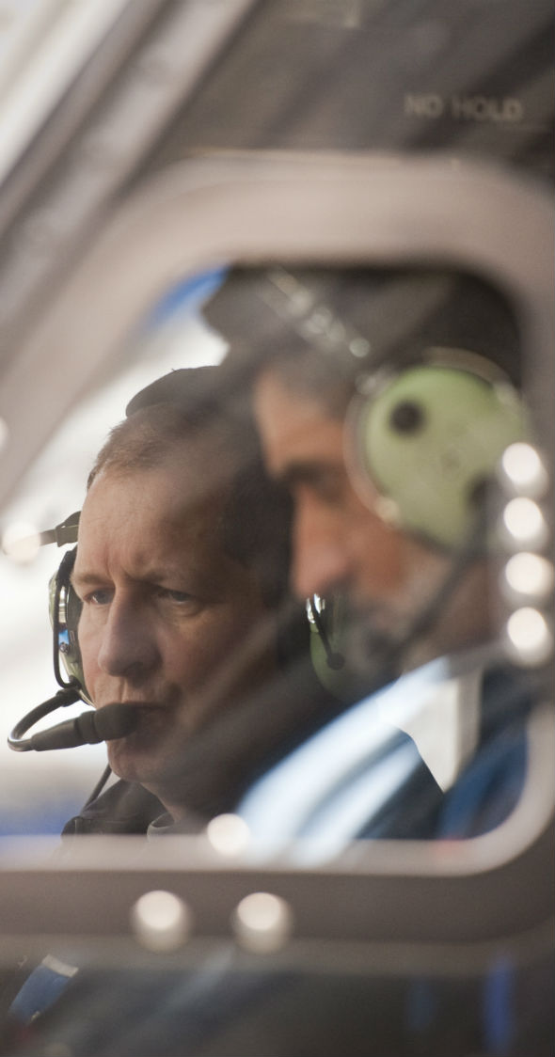
Case Studies
Case study 1: IMC Incursion (Wrong Deck Landing)
Case study 2: VMC Incursion (Wrong Deck Landing)
Case study 3: IMC Excursion (Helideck overshoot due unstable approach)
Case study 4: VMC Excursion (Helideck overshoot due unstable approach)

Slide 18
Landing and Takeoff Area Incursions and Excursions: A Rotorcraft Perspective
Representative case studies
Case 1: Wrong helideck name seen late after an instrument approach procedure.

Slide 19
Landing and Takeoff Area Incursions and Excursions: A Rotorcraft Perspective
Representative case studies (continued)
Case 2: Multiple similar helidecks with similar names.

Slide 20
Landing and Takeoff Area Incursions and Excursions: A Rotorcraft Perspective
Representative case studies (continued)
Case 3: Unstable approach after transition to visual maneuver.

Slide 21
Landing and Takeoff Area Incursions and Excursions: A Rotorcraft Perspective
Representative case studies (continued)
Case 4: Unstable approach in high winds.

Slide 22

Summary
I&E are real risks to rotorcraft operations
Safety nets are required and used
Constant re-evaluation needed
HSLS and SAPS will contribute to increased helideck/heliport safety

Slide 23
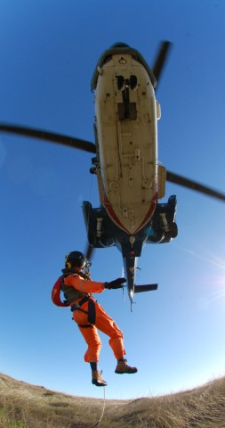
Future Work
Human Factors study on HSLS and SAPS
Rotorcraft / Helideck Risk Prediction modeling

Slide 24
Landing and Takeoff Area Incursions and Excursions: A Rotorcraft Perspective
Acknowledgement
Captain Alexander Oshomah (Aircraft Type Rating Instructor & Examiner, Bristow)
Charles Osheku, PhD (Director, Centre for Space Transport and Propulsion)
Captain Matthew Ijachi (Aviation Superintendent, ExxonMobil)
European Organization for the Safety of Air Navigation (EUROCONTROL)

Slide 25
Landing and Takeoff Area Incursions and Excursions: A Rotorcraft Perspective
Questions and bright ideas?

Slide 26
Landing and Takeoff Area Incursions and Excursions: A Rotorcraft Perspective
Thank you for your time!

