Slide 1
Airport Condition Reporting and the Runway Condition Assessment Matrix (RCAM)
Airport Operators and Stakeholders
HQ FAA/Office of Airports
August/September 2016
Notes:
Thank you for joining us for this Webinar on the airport condition reporting process and the RCAM. We are going to talk about some of the changes associated with assessing and reporting airport conditions and how we collaborated with industry over the last several years to develop a standardized means by which we assess surface contaminants that will be used throughout the National Airspace System.
This information and background on the changes we are expecting this fall should help answer your questions and concerns about the impact of the transition.
We believe you will find it’s not going to be that significant of a change, either operationally or functionally.
It’s more of a conceptual change.
We will also talk about some of the tools and resources we will provide to assist you with this change.
We believe all this will address some of misperceptions associated with this change.

Slide 2
Agenda
Background on TALPA & the ARC
Runway Condition Assessment Matrix (RCAM)
NOTAM System functionality
RCAM and Aircraft Operator relationship
Guidance and Resources available
Advisory Changes
Notes:
We’re going to talk a little bit about the background of TALPA. We know over the last few years you’ve heard some thing called TALPA is coming, and about the new tool called the RCAM.
We will talk about the Advisory Circulars changes and hit upon the major points in this revision.
And we’ll get into the RCAM and provide some more functional details and run through a couple of scenarios about building a NOTAM using the RCAM so you’ll know how both the RCAM and the NOTAM system will interact.
And we will wrap up with guidance and resources information for you to refer to.

Slide 3

Southwest Airlines Accident at Midway
Source: NTSB
Notes:
The catalyst for this change was the overrun of a Southwest Airlines Boeing-737, in December of 2005. Following the incident, the FAA reviewed their internal policies and also took a look at the industry as a whole to see what areas could be improved upon and how we could better manage the challenges that winter operations pose for aircraft and for airport operators.

Slide 4
Aviation Rulemaking Committee (ARC)
Airplane Operators
Part 121
ABX Air
Alaska
American Eagle
American
Continental
Delta
Express Jet
Federal Express
Northwest
Pinnacle
Southwest
United
UPS
 US Airways
Regulatory Authorities
FAA (Airports, Flight Standards, Certification, NOTAMS, Rulemaking, Legal)
Transport Canada
Brazilian Certification Authority
EASA (Limited Participation)
Airplane Operators
Part 91-K/125/135
Alpha Flying, Inc
Bombardier Flexjet
Chantilly Air
Flight Works
Jet Solutions
Conoco Phillips Alaska
Net Jets
Pogo Jet, Inc
Other Organizations
Air Transport Association
Airline Pilots Association
Airports Council International
Allied Pilots Association
National Air Carrier Association
National Business Aviation Association
National Transportation Safety Board
Neubert Aero Corporation
Regional Airline Association
Southwest Airlines Pilot Association
Allied Pilots Association
Airplane Manufacturers
Airbus
Boeing
Bombardier
Cessna
Eclipse
Embraer
Gulfstream
Hawker
Airports
Cherry Capital
Chicago Airport System
Chicago O’Hare
Grand Rapids Regional
Minneapolis/St. Paul Airport System
Notes:
That was the focus and the task for The Takeoff and Landing Performance Assessment (TALPA) Aviation Rulemaking Committee (ARC) that was formed to address the issues.
The TALPA ARC initiative was extremely well represented by industry.
It was unprecedented in the sense that we had consistent participation by all the major players, and the industry that you see represented here for a period of about 2 years.
Every major aircraft manufacturer was represented, the majority of airplane operators were represented, as well as, regulatory authorities, both domestic and international, and airports as well.
So a good segment of industry representation was there and contributed to finding a way to best solve or further close the gap on some of the issues associated with winter operations and condition reporting.

Slide 5
TALPA ARC Recommendations
Methods for assessing runway conditions
Reporting of braking action by pilots
Reporting of runway conditions through airport operators, the NOTAM system, and ATC agencies
Airplane performance data
Before landing/departing performance assessments
Standardized condition reports terms
Notes:
Following the ARC, that group proposed a significant number of recommendations on various topics related to aircraft performance and surface condition assessment and reporting.
The major components of the recommendations are listed here.
Essentially, the ARC was clearly indicating that we need the ability to communicate accurate runway conditions to pilots, and not only communicate information, but communicate information that is more meaningful and related to aircraft performance.
This was the goal. The ARC was trying to figure out “how can we get to that point”.
One of the very important by-products of the ARC’s work was the development of a new tool which we refer to as the RCAM or the Runway Condition Assessment Matrix.

Slide 6
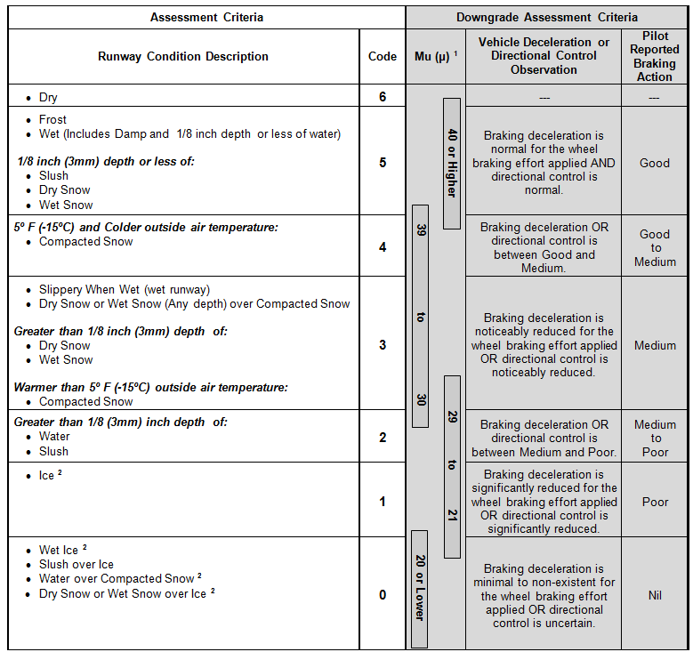
RCAM
R
Runway
C
Condition
A
Assessment
M
Matrix
Notes:
Here’s a quick look at the Matrix.
The Runway Condition Assessment Matrix (RCAM) is the way we are able to tie runway contaminant types and depths to aircraft performance and have it be a functional tool for both aircraft operators and you the airport operators.
This is what airports will use to conduct assessments and use for reporting purposes as well.
On the other end the pilot will use the information being reported and enter that information into their flight computers in a format to be able to conduct pre-landing and pre-departure assessments.
There is a pilot version of the RCAM in their Advisory Circulars and posted on the TALPA website.

Slide 7
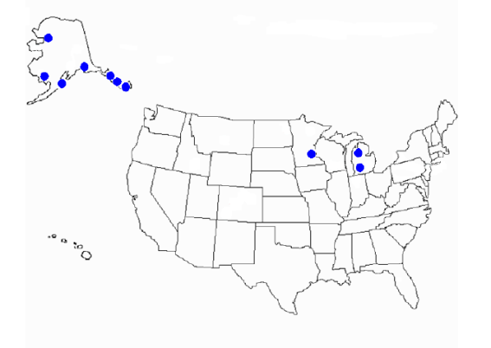
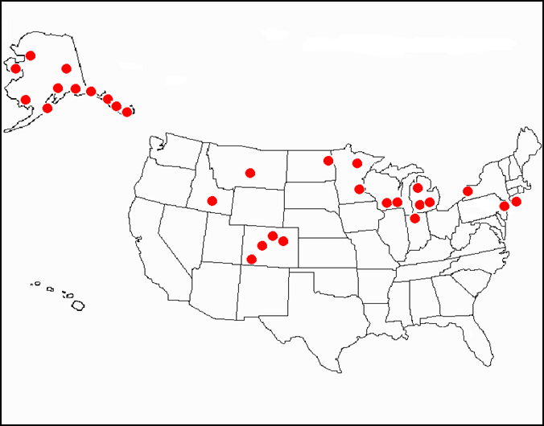
Winter Season Validations
First Validation Winter 2009-2010
Second Validation Winter 2010-2011
7
Notes:
This is a snapshot of the winter season validation that we did following the devolvement of the RCAM. Manufacturer data is what drove a lot of components within the RCAM, and so after we had a solid version of the RCAM, we needed to take that and test it out and see if what the manufacturers had provided was going to align with the real world environment.
So during the first season, as you see on the left-hand side, we had several Alaska airports and a few airports in the continental United States, who volunteered to collect data. During that first season we also had Alaska and Pinnacle Airlines, from an aircraft operator side, participate in collecting data from a pilot standpoint.
Following this testing, we were able to take all these data points and try to align those pilot braking action reports with the airport operator’s assessment using the RCAM. We took all the data, that aligned closely within the same timeframe, and did comparisons to see if the expected braking performance indicated by the RCAM was actually what was being experienced. And for the most part, that first season did validate the relationships in the RCAM. There were just some minor adjustments made based on temperature but for the most part, all of the contaminants that were represented in the particular categories had the effect as anticipated.
On the right-hand side you see the second validation that was done. We expanded the testing to include a significantly larger number of airports in the continental United States and Alaska, and we were also able to get Pinnacle Airlines as well as Alaska again, to participate in data collection from a pilot standpoint. Thousands of data points were eventually reviewed by the FAA and further validated what we saw after the first season. So a lot of work has been done to make sure the associations in the RCAM do work and are relative to what was observed and experienced by industry.

Slide 8
Changes … Already In Effect
2008 AC Changes (Closure triggers, friction testing subjectivity)
Published Reportable Contaminant List
Standardized terminology and reporting methods
Expanded NOTAM System for filing Field Condition (FICON) NOTAMs
Sortable FICON Information for end users
Domestic and International Compatibility
Real-time / Instantaneous reporting.
Notes:
Some of the changes put into effect following the ARC go as far back as 2008. As you recall, we implemented the closure trigger criteria in the Winter Operations Advisory Circular way back in that timeframe ,as well as our start to move away from our reliance on friction testing due to its subjectivity and variability. Some of these changes were driven by the ARC and we started to incrementally change as much as possible over the years following 2008.
We published a standard Reportable Contaminant List. That list identified those contaminants that had a relationship to airplane performance. There are some contaminants that don’t have any relationship to performance that require assessments ; for example, ash or mud. They can still be reported but obviously do not have any available performance data associated with them.
Another component was to standardize terminology and reporting methods. One complaint of pilots on the ARC was that everyone speaks a different language, and we needed to fix that if the information being provided was going to be useful and functional for pilots.
That’s related to the next bullet - the NOTAM system. Those enhancements, including the terminology changes are being incorporated into the NOTAM system to help with the ease and efficiency of transmitting that information. Some of the other enhancements you’ve seen since 2008 were the real time or instantaneous reporting. That was something the ARC asked for, and we thought it was very important. For NOTAM manager users, you can instantaneously report without having to deal with a intermediary or Flight Service check. You are able to provide updates during rapidly changing condition more readily. That was a big improvement to the NOTAM system . The other feature that was built in is the ability for end users, like an airline, a dispatcher, or a flight planning office, to pull raw data out of the NOTAM system and load it into their company system and sort and organize it in a way that is more functional for use. That was another feature that was also added as a result of the ARC.

Slide 9
When is the RCAM Applicable?
Only on Paved Runways
Not on Turf, Dirt, Gravel, or Water Runways,
Codes are NOT generated on Taxiways, Ramps, Heliports, etc…
Codes are generated when the total runway surface or cleared width is more than 25% contaminated (automatically calculated by FNS)
Notes:
One of the questions on everyone’s mind today is “Will the RCAM be used for every portion of an assessment on the airport? And the answer is No. The RCAM, as indicated by the name, is strictly for runway use. And, more specifically, paved runways. We don’t use the RCAM for producing RwyCC on turf runways, dirt runways, gravel, or even on waterways. It’s strictly for a paved runway environment.
What the NOTAM system will be able to do is take an airport’s 5010 data, your Airport Master Record, and populate the NOTAM system with those runways that meet the criteria, as a paved runway, and the NOTAM system already knows what can and can’t receive a RwyCC. It’s all intuitive and built into the NOTAM system.
RwyCC are also not generated for taxiways or ramps, or any low speed environment. You still have the ability to report contaminants there, nothing has changed. One thing we did want to point out, related to RwyCC is that they are only generated when more than 25% of your runway is contaminated. In this case, you will report conditions and contaminants on your runway, but your NOTAM will not contain an RwyCC when it’s below that threshold.
And the NOTAM system has been designed to know when that occurs. So, an airport is going to collect the data as you do today as far as what contaminants are present, and when you go to enter them into the system, the system’s going to determine what is generated, based on what being entered. If your runway is not more than 25% covered, no RwyCC is generated. If it is more than 25% covered you’ll see a RwyCC as part of the NOTAM.

Slide 10
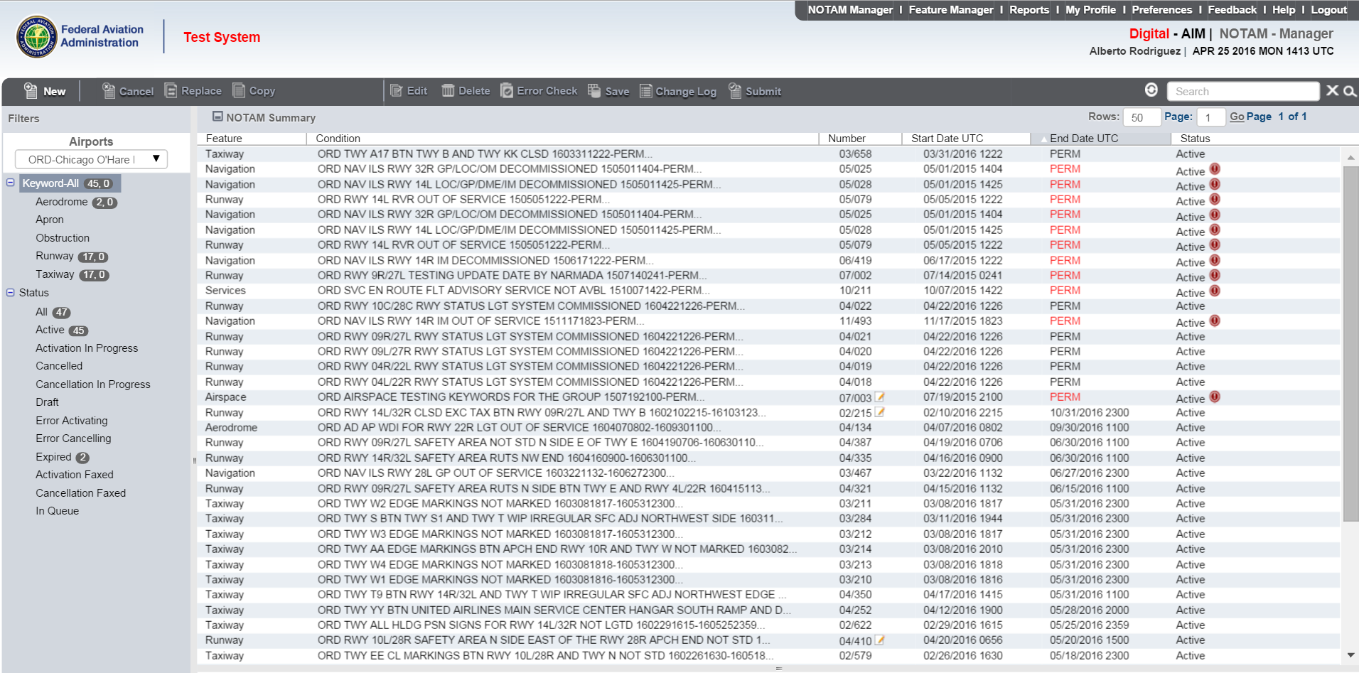
TALPA & NOTAM System(s) Changes
Notes:
As mentioned before, the NOTAM Manager system has been key to this change, and it’s going to do the majority of the work for airport users. The NOTAM system functionality should reduce human error risk. System rules should prevent or reduce situations of incorrect input. The issuance or non issuance of a RwyCC is programmed into the system to ensure objectivity.
So, you as the airport operator report the runway condition by entering the contaminant(s) present into the system and it is going to tell us what the RwyCC will be. That greatly reduces a lot of human factors errors.
As of 01 October, the primary method for reporting conditions must be through the NOTAM system. If airports today are using a website, fax, or hand deliver of a condition report to an airline station manager, we want you to change to the NOTAM system. We want you to use the NOTAM system because it’s going to provide you the widest dissemination to all users, both local and transient. This is another one of the primary reasons we want airports to transition over to NOTAM Manager.

Slide 11
RCAM
R
Runway
C
Condition
A
Assessment
M
Matrix
Notes:
AS for the RCAM itself, airport operators will need to understand how the RwyCCs are generated and the AC covers the detailed information on how to generate a RwyCC.
For the purposes of today’s discussion let’s go ahead and break the RCAM down quickly so you can get an idea of what the thought process is for it’s general use.
So, it’s very simple; read from left to right, you identify the contaminant on your runway, you look at the RCAM, find that contaminant, and then you look over to the right and see what code is associated with it.
And once you’ve determined that, then you can stop there, and report that information. Or, if you have access to additional information, like Mu, because you are able to operate within those parameters, that’s another piece of information that you can use in your assessment.
Vehicle deceleration and directional control is another piece of information, or tool in your toolbox, as well as, pilot reported braking action.

Slide 12
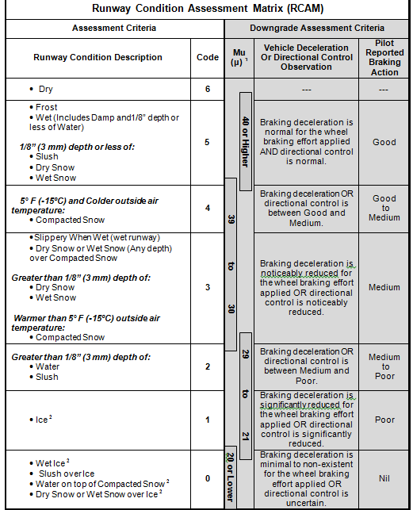
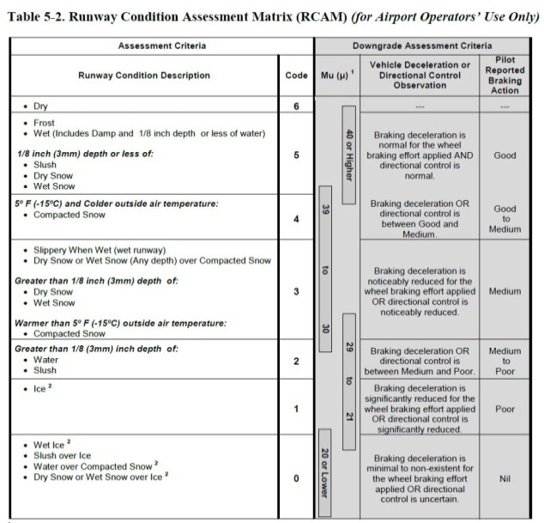
HOW THE RCAM WORKS
Notes:
To be more specific, this section of the RCAM includes contaminant type and depth categories which have been determined by airplane manufactures to cause specific changes in the airplane braking performance. The runway condition description column of the RCAM provides contaminants that are directly correlated to airplane takeoff and landing performance. The description sections, ranging in terms of slipperiness, are categorized based on type and depth of contaminant and sometimes temperature. The contaminant description is applied to each runway third.
This section of the RCAM also includes a Runway Condition Code which correspond to a reportable ‘shorthand’ of the description.
A lot of the contaminants in this area have very specific characteristics effect, depending on it’s depth, and some depending on temperature. As we view the second box from the top of the Runway Condition Description column, you have a description that describes “1/8 inch depth or less”. So, contaminants in this area that are in the 1/8 inch or less depth category, for example, dry snow and wet snow, have a different effect when they are at a greater depth. If you view the fourth box down in that same column, you see that those same contaminants, dry snow and wet snow, are also located in a different category, but at greater depth.
What that means is there is a different performance characteristic of that same contaminant, depending on the depth. We also have a section here, where they refer to compacted snow, and that has temperature associated with it , and that’s because that particular contaminant can have a different effect at one temperature versus another. It is important to know when using the RCAM these nuances whereby some contaminants, but not all, may appear in more than one category.

Slide 13
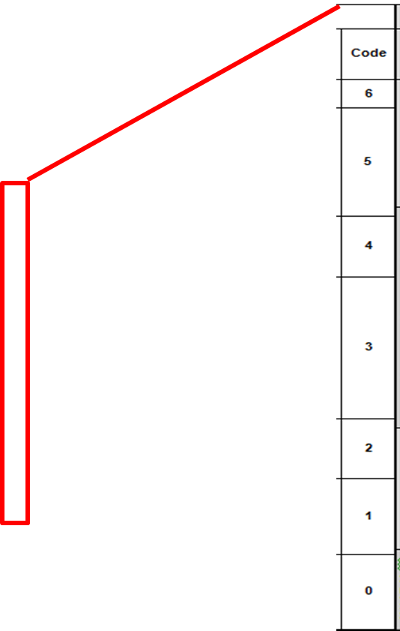
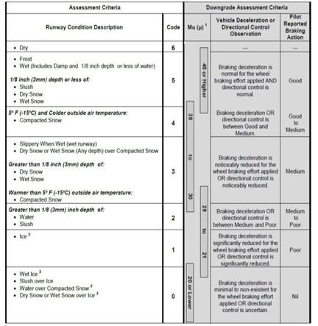
HOW THE RCAM WORKS
Notes:
Runway Condition Codes are assigned when more than 25% of the overall runway (or cleared width when runway edges differ from the treated runway) is contaminated).
These codes represent the runway condition description based on defined terms and increments.
Use of these codes harmonizes with ICAO Annex 14, Aerodrome Design and Operations, providing a standardized “shorthand” format for reporting RwyCC (which replaces the reporting of Mu values).
These codes will be used by pilots to determine landing performance assessments when applicable.

Slide 14
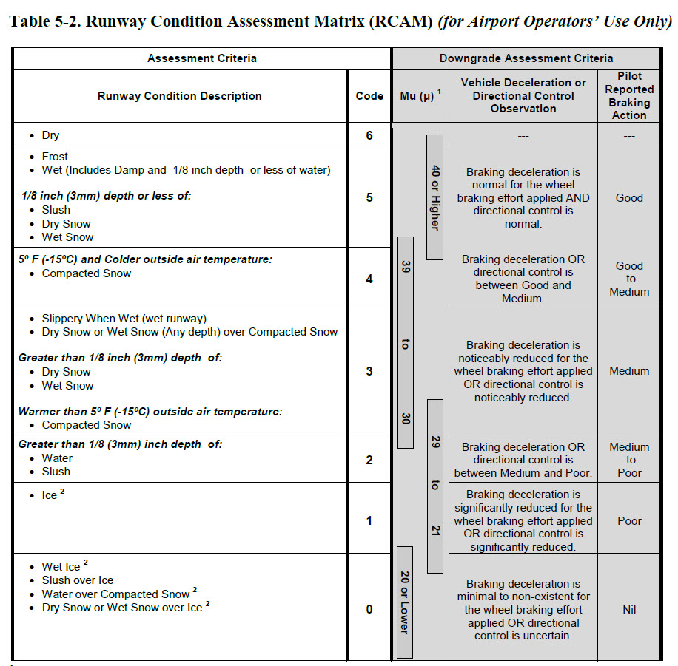

HOW THE RCAM WORKS
Notes:
This greyed out section contains the downgrade assessment criteria, meaning that these are the additional tools in your toolbox that can be used to further assess the runway and validate the RwyCC. Which means if, you have received a particular RwyCC that indicates a particular slipperiness, you can agree with that RwyCC, or if you believe that maybe the conditions are slipperier, or more slick, or less friction, than the RwyCC might indicate, you have the ability to take downgrade actions.
For example, if the RCAM indicates a RwyCC of 5, but you went out and did a vehicle braking test, that RwyCC could be downgraded based on your observation.
Again, this is your judgment and experience as part of the process. Just because a contaminant indicate a particular RwyCC, it does not mean that your can’t be more conservative in reporting. Perhaps it is a RwyCC of 5, but you may be getting a lot of PIREPs in a lower category, this is the downgrade capability that you have, and down grades are completely at your, the airport operator discretion.
It can be based on one of those previous variables; it can be based on all of those variables; or it can be based on experience alone that you believe a given condition wasn’t as great as the RwyCC indicated.
That’s something the airport operator has the flexibility to do and operate differently or be more conservative as needed.
Typically, the RCAM is not made for upgrading RwyCCs. However, there are two very specific instances where an upgrade of RwyCC can take place. And it relates to when you have a contaminant that generates a RwyCC of 1 or 0. We will get into that once we start stepping through some of or NOTAM examples. We will go through that scenario to make it more understandable.
The remainder of the RwyCCs categories do not have an upgrade capability.

Slide 15
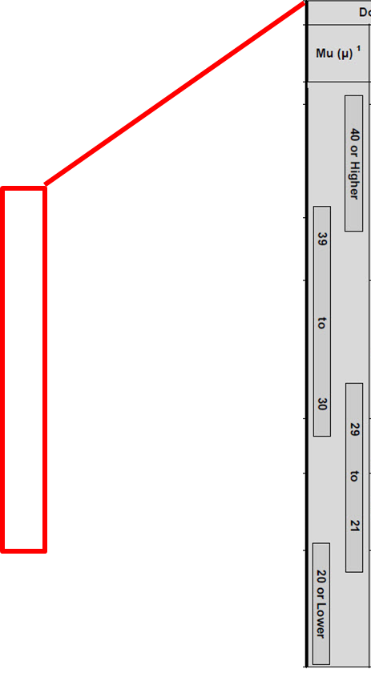
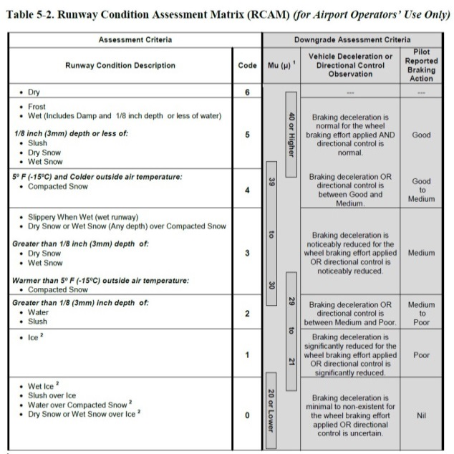
HOW THE RCAM WORKS
Notes:
Mu:
The correlation of the Mu (µ) values with runway conditions and condition codes in the RCAM are only approximate ranges for a generic friction measuring device and are intended to be used only to upgrade or downgrade a runway condition code.
Airport operators should use their best judgment when using friction measuring devices for downgrade assessments, including your experience with the specific measuring devices being used.
Mu is mostly subjective based on the variations of devices used.

Slide 16
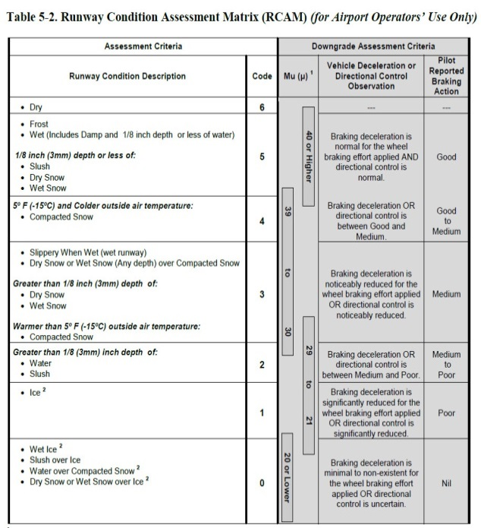
HOW THE RCAM WORKS
Notes:
Vehicle Deceleration or Directional Control Observation:
This column is used to correlate estimated vehicle braking experienced on a given contaminant This description also defines each vehicle braking category, yet it is still considered to be subjective.

Slide 17
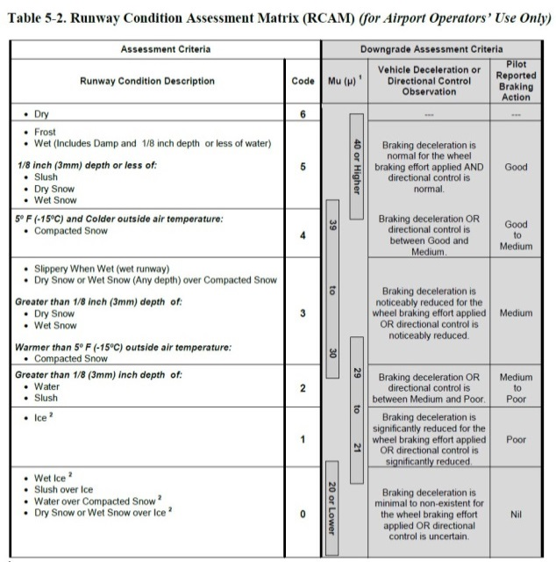
HOW THE RCAM WORKS
Notes:
Pilot Reported Braking Action: This is a report of braking action on the runway, by a pilot, providing other pilots with a degree/quality of expected braking. The braking action experienced is dependent on the type of aircraft, aircraft weight, touchdown point, and other factors and is mostly subjective.

Slide 18
Runway Condition Codes
Why is it better than Mu?
Less subjective
More substantive
What does it mean to the Pilot?
Type and depth of contaminant(s)
Estimated aircraft braking action to be anticipated
Targeted and more computable performance data
Notes:
Why do we believe codes are better than Mu? The answer is, because they mean more.
As was mentioned before, when you get a RwyCC, it’s shorthand for your runway description, it’s shorthand for braking action that can be anticipated by the pilot, and it’s something that is performance based. A pilot can actually do something with the information as it relates to airplane performance.
This is the first time that we are able to correlate a contaminant to a performance variable for aircraft.
Previously all the information we’ve been reporting from an airport condition reporting standpoint has been primarily informational for the pilot.
This revised method provides information that will be a lot more meaningful and will have a greater impact on safety.

Slide 19
Related Changes… 2016 - 2017 Season
NOTAM System will serve as the primary method for disseminating field condition information / FICON NOTAMs
No longer reporting friction values (Mu)
No longer reporting vehicle braking for runway condition Acceptable for low-speed environments (taxiways, ramps etc.)
Percentage based reporting
Reporting runway conditions in thirds
Notes:
Beginning 1 October, the NOTAM system will be serving as the primary system for disseminating field condition information. Airport operators can have secondary systems if they want to continue to maintain them, however, the caution is having outdated information in one place or the other. That is why we don’t recommend dual reporting, but whichever path you choose, the NOTAM system needs to be the primary method.
We are no longer reporting friction values. We want to emphasize that that does not mean we don’t want you to do friction assessments. Friction assessments are a very important part of the assessment process because it still gives you trending information. When you look at it from within those parameters, it may provide a good indicator of whether or not conditions are improving or whether they are degrading.
The same applies for vehicle braking. Vehicle braking is something that is used for assessments, but specific to runway conditions, we are no longer reporting vehicle braking. The primary reason is that vehicle braking does not relate to airplane performance. No matter how you do it or what type of vehicle you are using. It does not relate. It is an assessment tool to give you an idea of your runway’s performance and whether you have any safety issues, but it is not acceptable for a high speed environment like the runway. You can still report vehicle braking on taxiways because there is no RwyCC on taxiways, but it doesn’t correlate to aircraft braking performance.
Another change here is that we are moving away from some of the vague terminology that we’ve been using in the past , like patchy, thin. These types of terminology were not very helpful according to the feedback we got from pilots, so that prompted the move to be more objective by doing percentage based reporting and also reporting runway conditions in thirds.

Slide 20
Reporting Runway Conditions in Thirds
Coverage | Range
10% | 10% or less
20% | 11% thru 20%
25% | 21% thru 25%
30% | 26% thru 30%
40% | 31% thru 40%
50% | 41% thru 50%
60% | 51% thru 60%
70% | 61% thru 70%
75% | 71% thru 75%
80% | 76% thru 80%
90% | 81% thru 90%
100% | 91% thru 100%
9
27
Notes:
Reporting runway conditions in thirds, allows you to not only associate that third with it’s own specific RwyCC, but also it helps to paint a really good picture for the pilot because now you and the pilot will know where the concentration of contaminants is. So for the future, you’re going to select a percentage coverage and identify which third that percentage applies to, so you could say 20% coverage in my first third, 10% in the middle, and 60% at the end, or something to that effect.
That provides a really good visual to a pilot as to where to anticipate the majority of braking issues; or where specific contaminants are if you have varying contaminants. When a different contaminant exists in different thirds, you’ll be able to paint that picture. It’s not so easy to do that now because we’re just reporting for the whole runway and it’s hard to tell where specific contaminant’s exists.
We’re moving to a runway end-specific reporting method. You’re going to start your report with reference to the runway end on which you began your assessment. Ideally, this will correspond with the runway end that is being used by aircraft operators. With respect to the percentage value, it’s not an exact science, you don’t have to be super specific. We’re looking for your best judgment. Everyone from aircraft operators to aircraft manufacturers understands the fact that operators are not going out and taking a tape measure to figure out exactly where the thirds are, or exactly what percentage of what contaminant is present. This is your best professional judgment of what you see as part of your assessment and that’s what we’re looking for your best estimate.

Slide 21
Reporting Airport Condition Information
Runway Condition Codes are disseminated via one or more of the following methods:
Federal NOTAM System, preferably through NOTAM Manager or equivalent system(s);
Air Traffic Control Facility (corresponding Tower, Center, Tracon, etc.);
Flight Service Station (FSS) (as applicable); and
Directly from airport operator via Common Traffic Advisory Frequency (as applicable)
Notes:
How are we reporting these RwyCC in the future?
The same way that we are reporting conditions today.
You are still going to put the information in your NOTAMS.
You will still give it to the air traffic control facility, whether you’re a towered airport that has a control tower, or an uncontrolled facility that has an en route center or TRACON.
Whatever means you currently use to convey Mu and condition information today, you will use that same mean to convey RwyCC and condition information in the future.

Slide 22
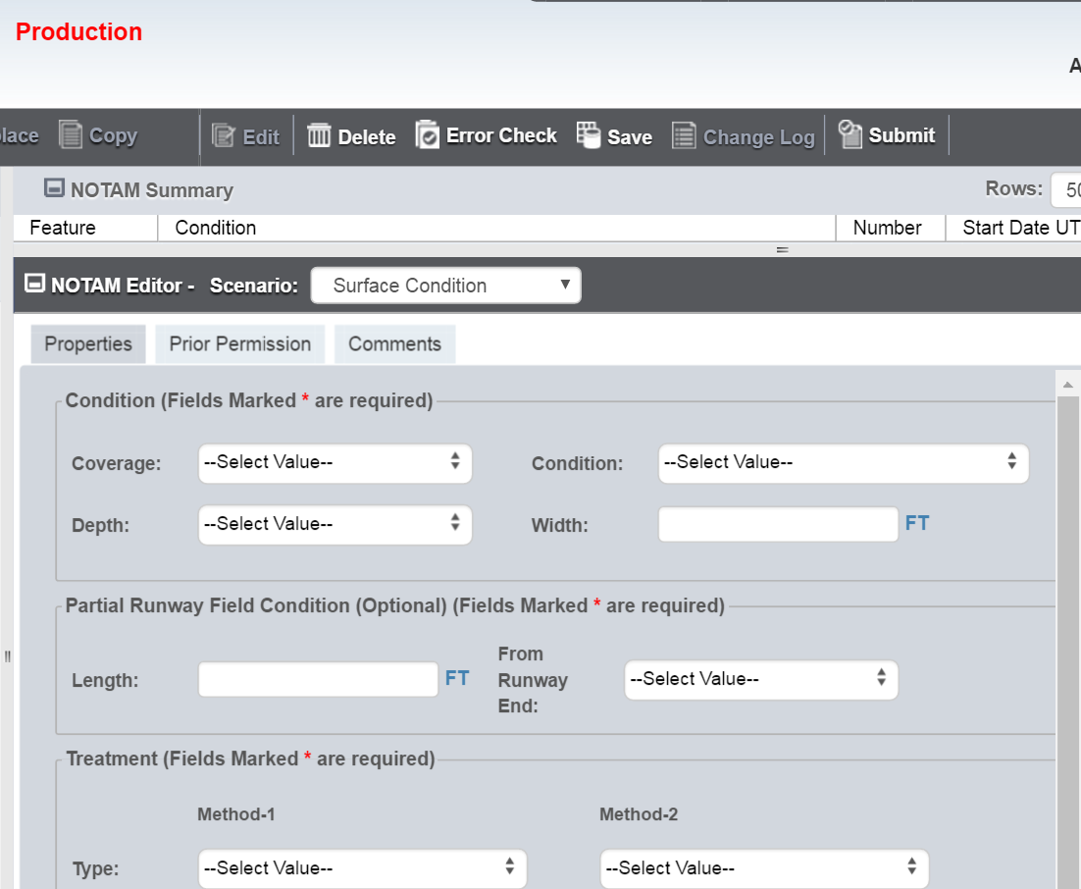
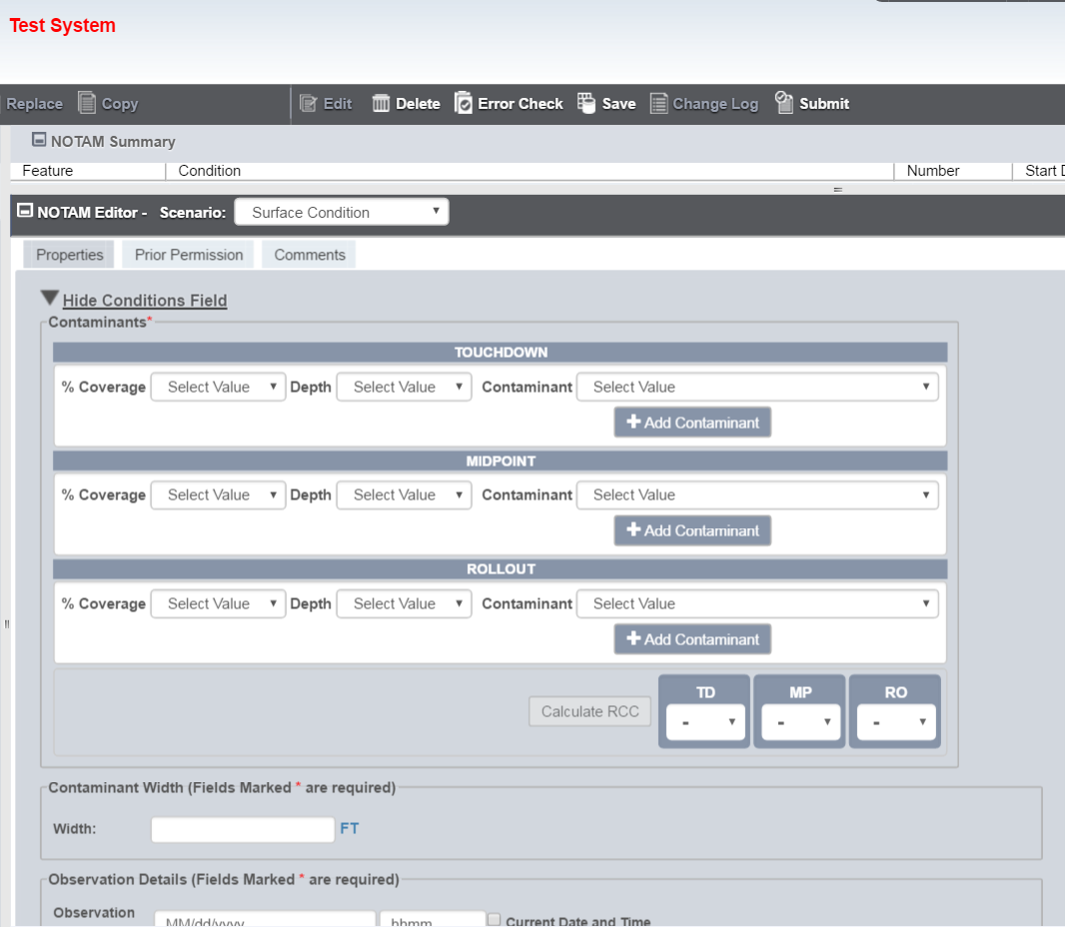
CURRENT SYSTEM - FUTURE SYSTEM
Notes:
Here is s a snapshot of what the NOTAM Manager system looks like today which I am sure many of you are quite familiar with.
And then what it will look like come 01 Oct.
And as you can see if you focus on the center area, where you would normally generate a condition report for the whole runway. The only change you see in the system is dividing the runway into thirds.
That is the primary change in the NOTAM system.

Slide 23
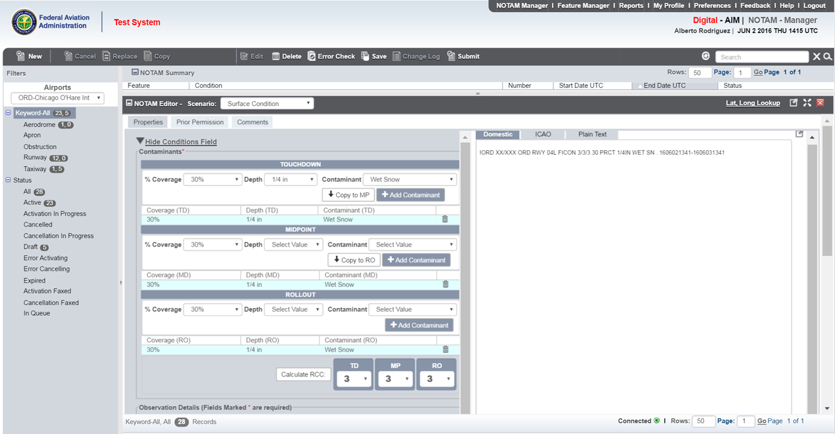
NOTAM Manager
Notes:
Here is a better screen shot. Again, this is NOTAM Manager. The NOTAM Manager system hasn’t really changed except for incorporating runway thirds.
Here you have representation of each runway third, and in the light blue colored window, you have the selected contaminant. In this example, it is 30% ¼ inch Wet Snow.
Much like what you see today, on the right hand side, you start to see your NOTAM sentence being built.
The difference here in the NOTAM sentence, you see RwyCC. Those RwyCC are being generated by the system, and they are also found down below the runway code section.
So as you enter the contaminant information, the RwyCC are being generated. If you are on the E-NOTAM II system, which we would like you to transition off to NOTAM Manager, you are going to see a very similar design.

Slide 24
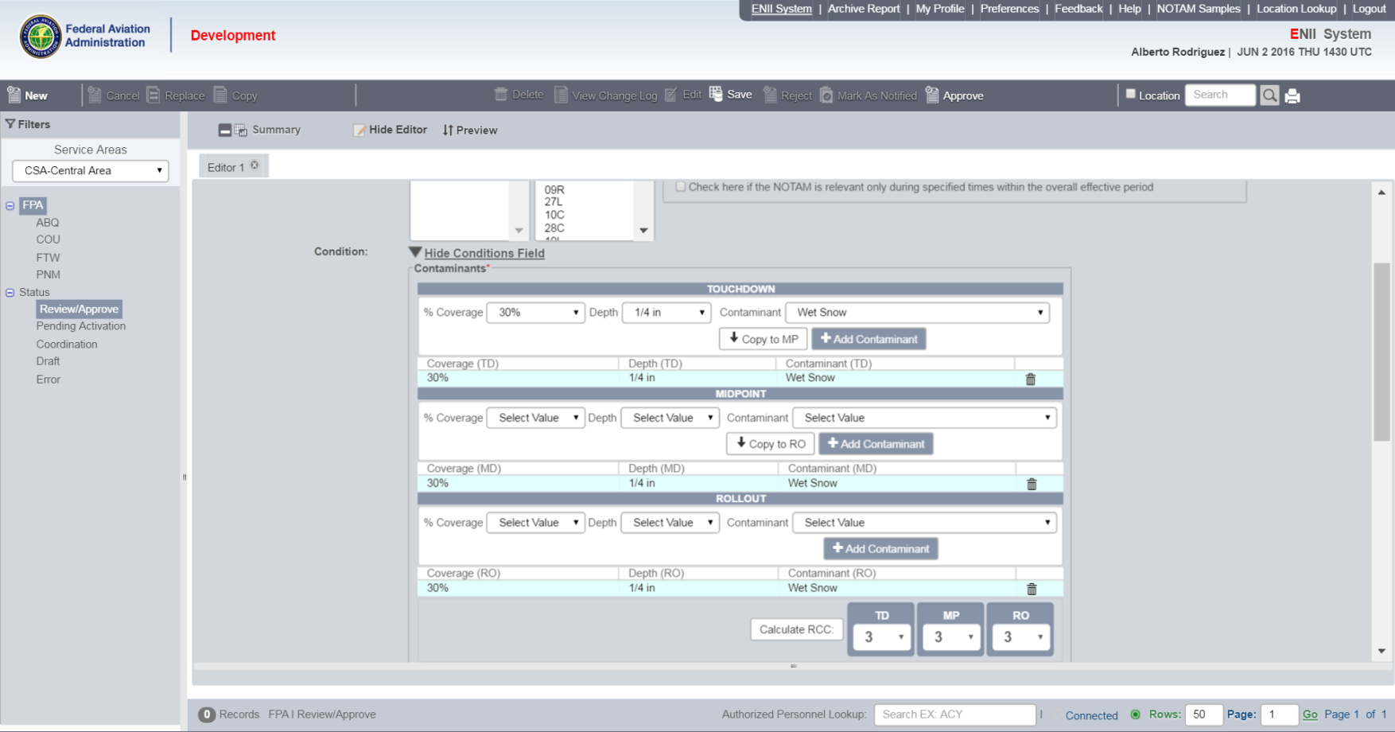
E-NOTAM II
Notes:
For E-NOTAMs II users, here are the runway thirds, the same as in NOTAM Manager.
Again, this system will eventually be phased out.
For certificated airport we want you to make the transition over to NOTAM manager as quickly as possible.

Slide 25
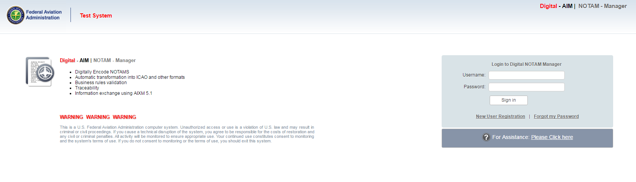
Let’s Issue a NOTAM using the RCAM Rules
Notes:
This is the initial screen shot for the test system called NOTAM Manager.

Slide 26
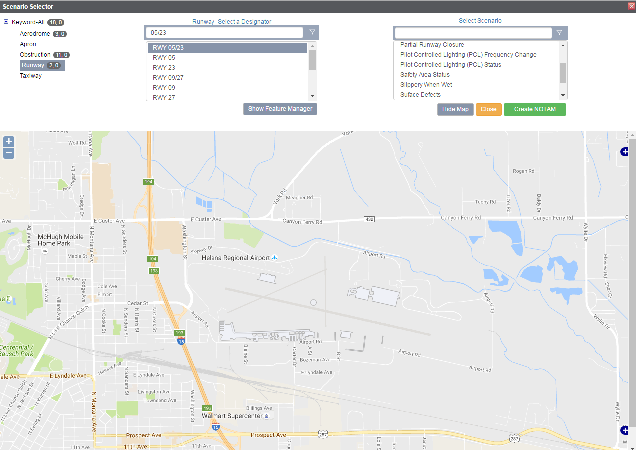
Changes to NOTAM Manager
Entire Runway
No SFC Condition Option
Notes:
This screen shows the initial change of reporting surface condition based on the assessed runway end.
One cannot get to the surface condition reporting option when trying to report surface condition for both ends of the runway simultaneously.

Slide 27
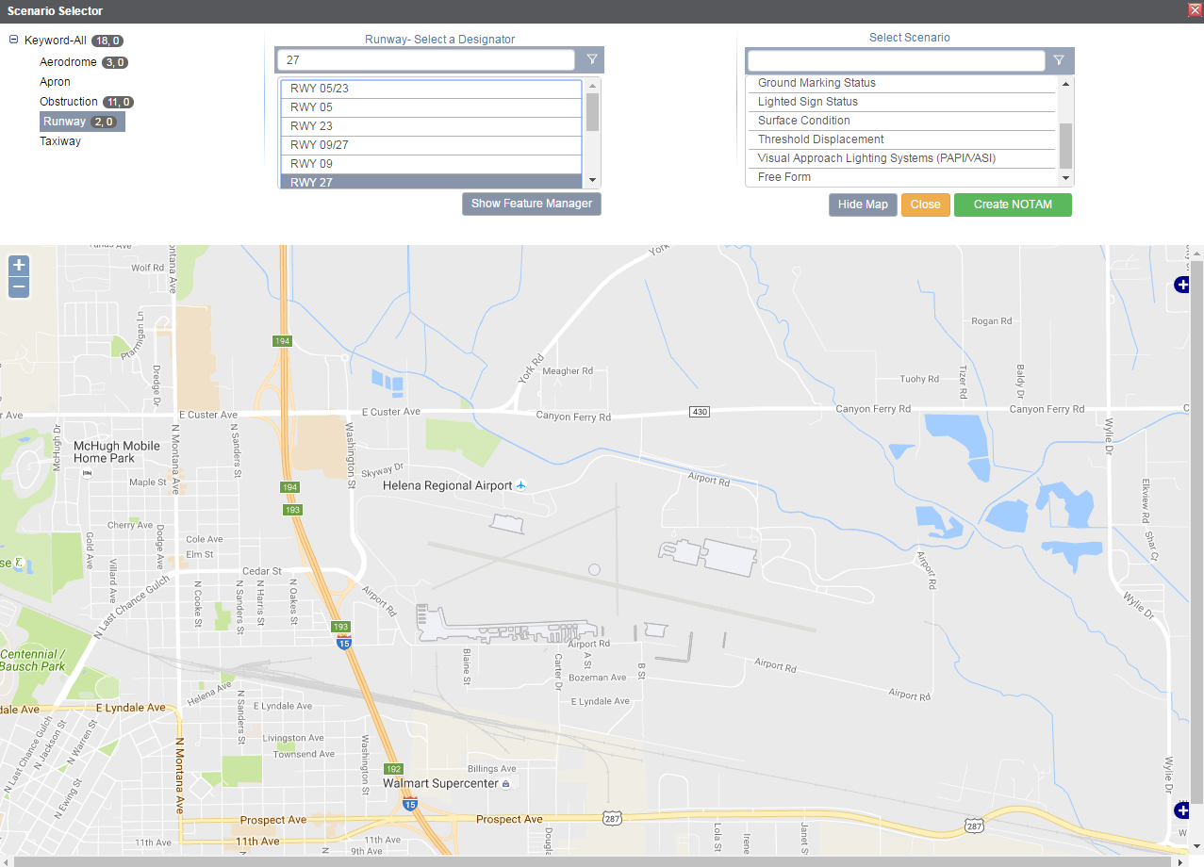
Changes to NOTAM Manager
Directional Runway
SFC Condition Option
Notes:
Surface conditions are determined by the assessed runway end in use.

Slide 28
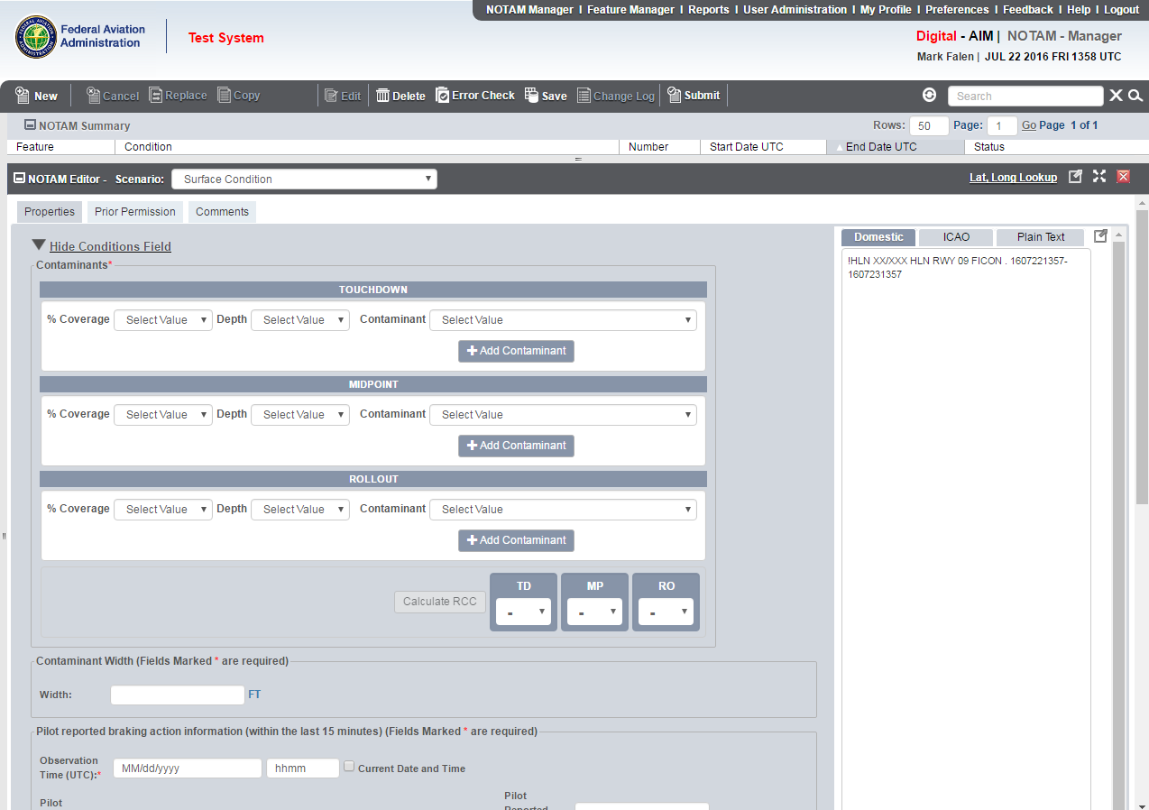

Changes to NOTAM Manager
Similar entries except 3 parts of RWY, and must select % coverage
Notes:
Runway assessments are accomplished based on each third of the runway.
That will include percentage of coverage for a given contaminant.

Slide 29
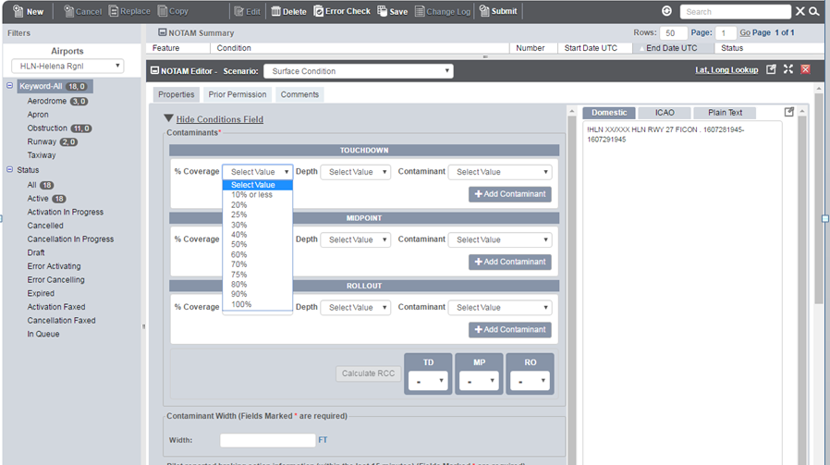
Changes to NOTAM Manager
% Coverage table for each 1/3rd RWY
Notes:
The percentage coverage is a dropdown menu with percent coverage ranging from 10% to 100% that can be applied to each third of the runway.

Slide 30
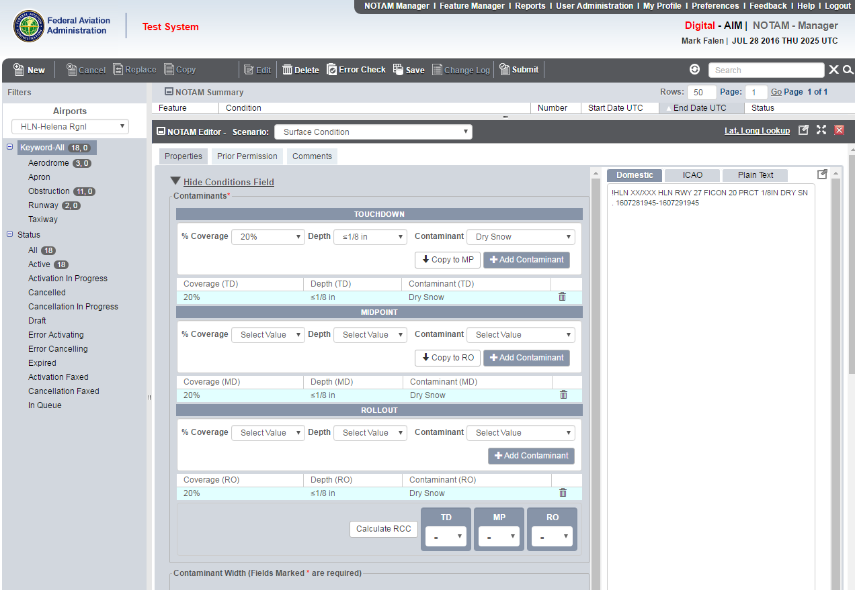
Changes to NOTAM Manager
You must select Add Contaminant to populate in NOTAM -- Can add multiples
If the next 1/3 of the RWY contains the same Contaminant, you can just select Copy
Note RwyCC in NOTAM & conditions for each 1/3 of RWY
Automatically assigns RwyCC for each 1/3 RWY
Notes:
One must select and click on add contaminant in order to populate that contaminant for a given third of the runway.
The selection will appear in the runway third box in the light blue color box.
If the same third will apply to the remaining two thirds of the runway, one can use the short cut key marked copy to midpoint and copy to rollout.

Slide 31
Changes to NOTAM Manager
Conditions reported without RwyCC
If overall length and width of RWY has less than 25% coverage, no RwyCC will be generated (average of 3 sections =25% or less)
Note RwyCC in NOTAM & conditions for each 1/3 of RWY
Automatically assigns RwyCC for each 1/3 RWY
No RwyCC Calculated
Notes:
When all thirds of the runway has been determined, if overall length and width of runway has less than 25% coverage, no RwyCC will be generated or calculated by the NOTAM system.
NOTAM sentence will not have RwyCC illustrated.

Slide 32
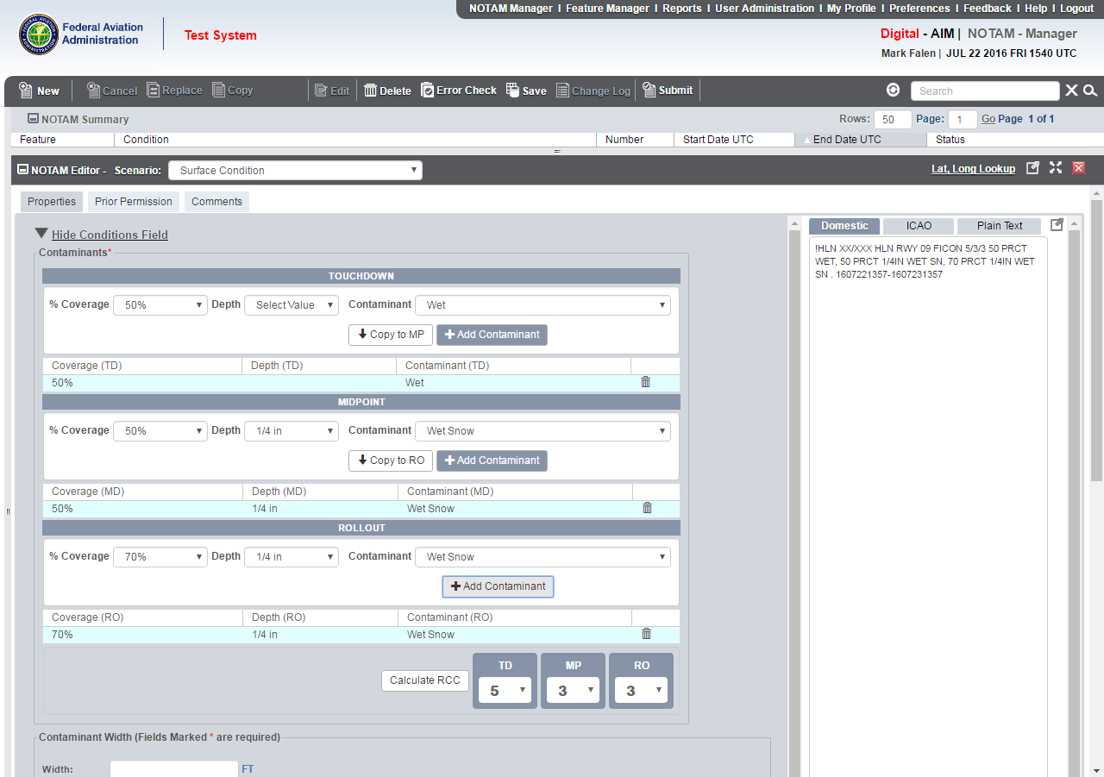
Changes to NOTAM Manager
RwyCC is in NOTAM & conditions for each 1/3 of RWY
When average of 3 sections is >25%, NM automatically generates RwyCC for each 1/3 RWY
RwyCC can be downgraded by using data in RCAM Table and Airport Operator Judgment
Notes:
When more than 25% of the overall runway length and width is contaminated, RwyCC will be generated.
RwyCCs will appear in the NOTAM sentence for each runway third.
The downgrading of RwyCCs is available and the information on how it is applied is in Advisory Circular 150/5200-30, Airport Field Condition Assessments and Winter Operations Safety.

Slide 33
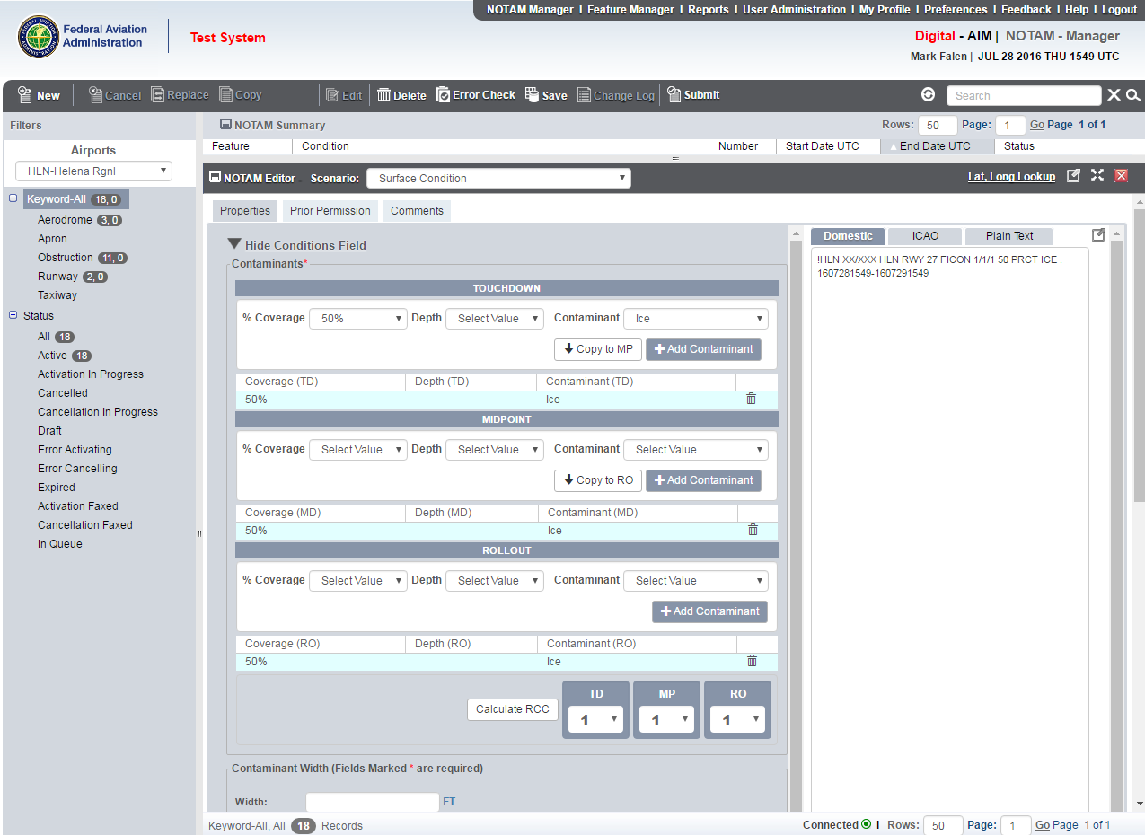
Changes to NOTAM Manager
When RwyCC is a 0 or a 1, they can be upgraded (not higher than 3) if specific circumstances exist involving ice or compacted snow (a 2 cannot be upgraded since the only contaminants that generate a 2 are water and slush.)
Notes:
During an assessment when RwyCCs of 0 or 1 is generated, they may be upgraded to higher codes.
The upgrade cannot be higher than a code 3.
The protocol for upgrading codes are found in Advisory Circular 150/5200-30, Airport Field Condition Assessments and Winter Operations Safety

Slide 34
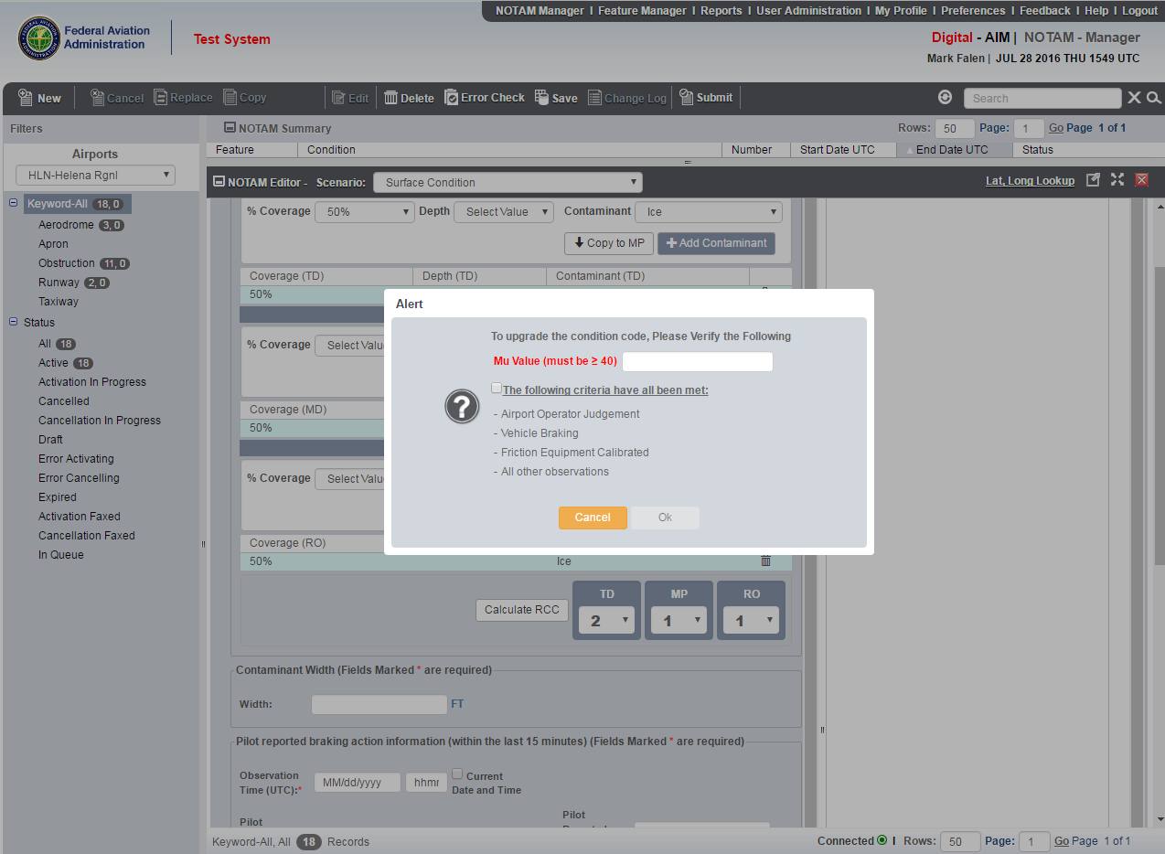

Changes to NOTAM Manager
2. Verify conditions required to upgrade RwyCC
1. Enter desired upgraded Code, not above 3
Notes:
This is an illustration of the screen with the requirements that must be followed in order to upgrade a RwyCC.
The first two steps are covered.

Slide 35
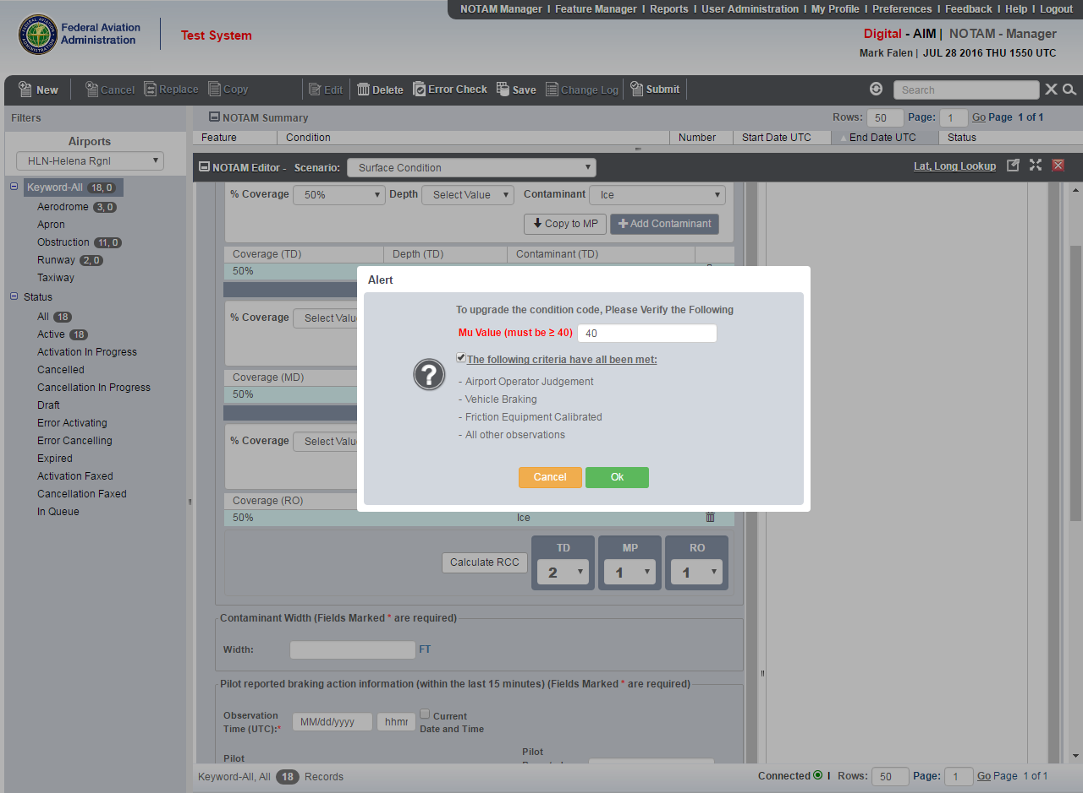

Changes to NOTAM Manager
Once conditions are verified, select OK
Notes:
For upgrading RwyCCs, this is the final step in the process.

Slide 36
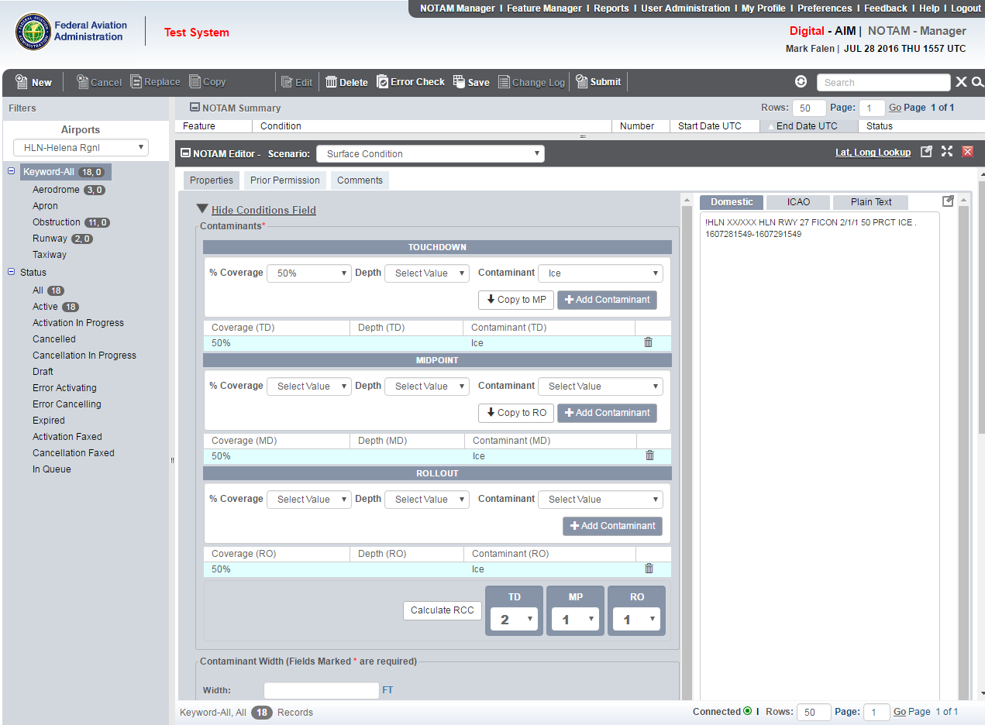
Changes to NOTAM Manager
Upgraded RwyCC in NOTAM
Notes:
The upgraded action is illustrated in the NOTAM sentence.

Slide 37
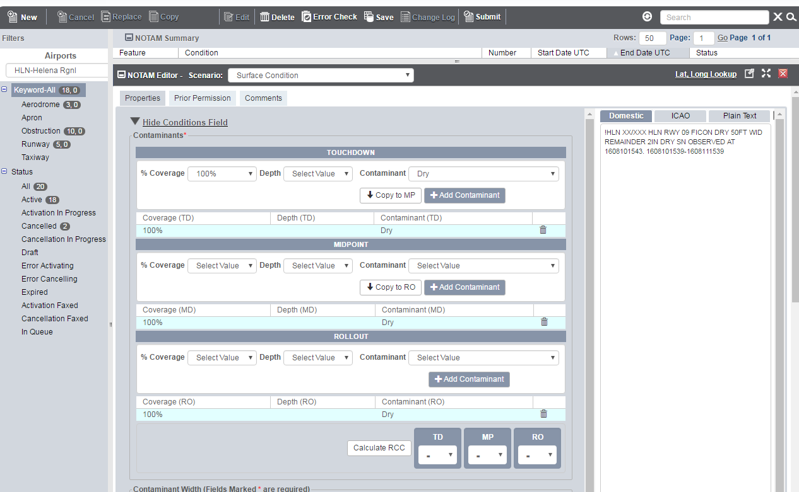
Center Portion of RWY DRY
Note upgraded RwyCC in NOTAM
If center portion of RWY is DRY:
1. Enter each 1/3rd as 100% DRY
Notes:
This shows an example of illustrating a center portion of the runway being dry and the remainder having contaminants.

Slide 38
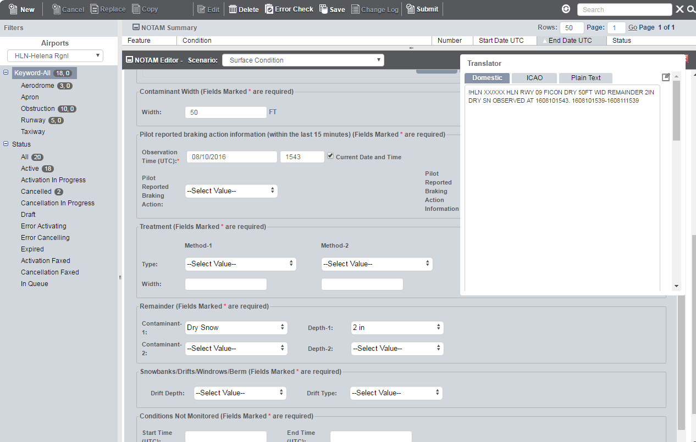
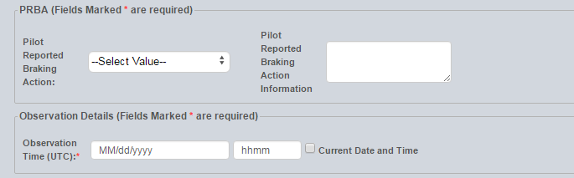
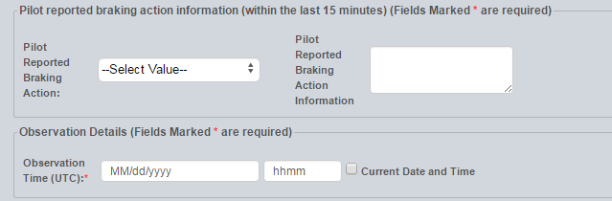
Center Portion of RWY DRY
2. Enter the width in feet of the DRY portion of the RWY
4. Review NOTAM language for accuracy
3. Enter condition of remainder of RWY
Notes:
This is part two of the process where one would enter the width of the portion of the runway that is dry.
For the remaining portion of the surface, there is a section of the NOTAM system that permits identifying any contaminant present.

Slide 39
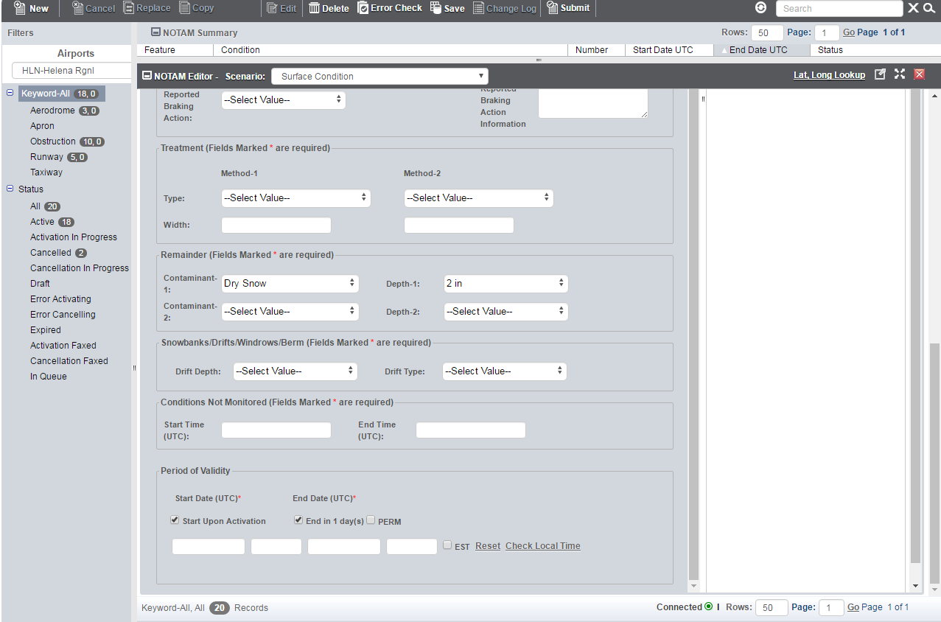

Rest of NOTAM Editor Unchanged
This portion of the NOTAM Editor page remains unchanged
Notes:
The treatment, remainder, and snowbanks/drifts/windrows/berms section of NOTAM manager was unchanged.

Slide 40
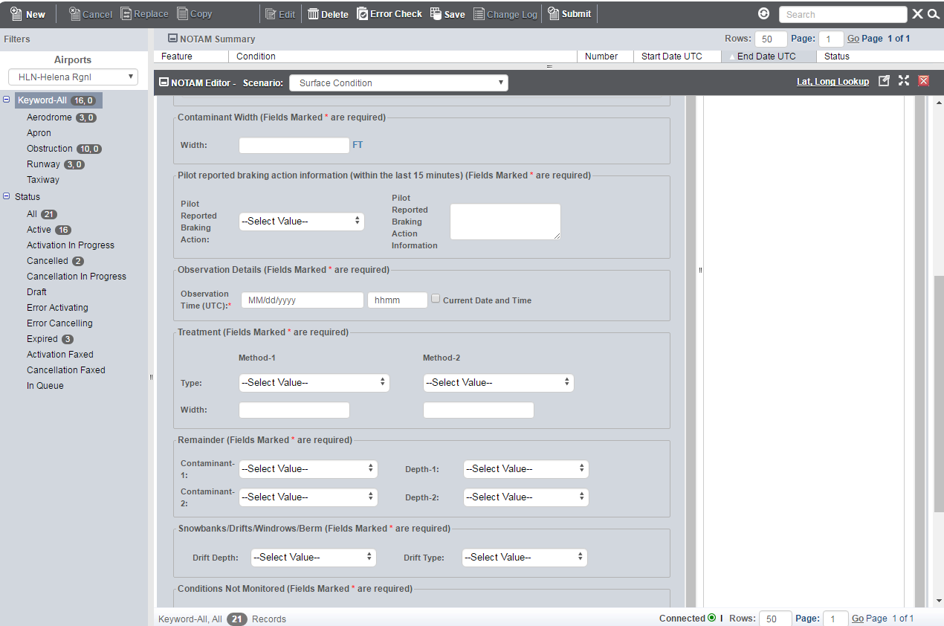
Pilot Reported Braking Action Feature
Information does not go into NOTAM, but into Archive Report – also justification for downgrading RwyCC
The remainder of the NOTAM Editor page remains the same
Notes:
A pilot reported braking action entry section was added where an airport operator can input any pilot reported braking action received.
Information does not go into the NOTAM system, but into an archive report that may be used to evaluate the effectiveness of the RCAM.

Slide 41
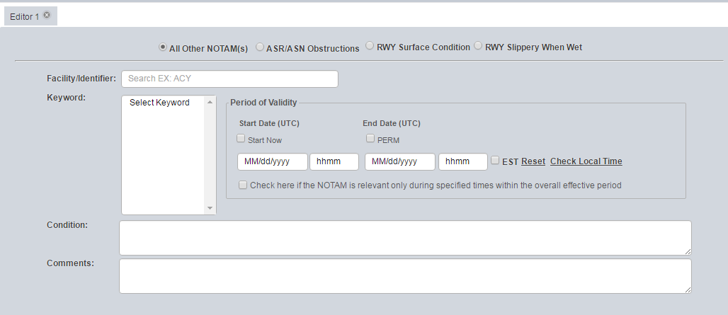
Changes to ENII
2 Options Added:
RWY Surface Condition
RWY Slippery When Wet
Notes:
E-NOTAM II is a similar system to NOTAM Manager, but with less functionality.
E-NOTAM II is being phased out but still being used by airport operator to submit surface condition NOTAMs.

Slide 42
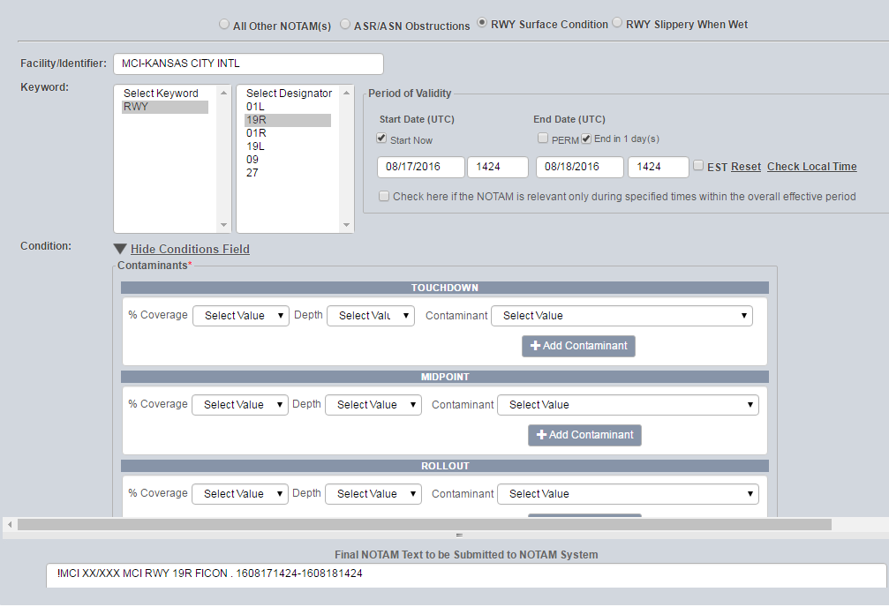
Changes to ENII
To create a Surface Condition NOTAM – you must first select a RWY option
RWY Keyword auto fills
Only Directional RWYs are listed
Conditions are to be entered in thirds
Notes:
Similar access in order to create a surface condition NOTAM exists.
The keyword requirement, runway directional limitations, and windows for entering information into third are similar to NOTAM Manager.

Slide 43
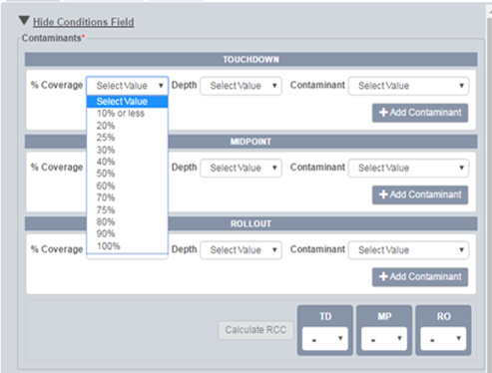
Changes to ENII
Must select % Coverage, Depth, and Contaminant for each RWY 1/3rd
Notes:
The percent coverage dropdown menu are the same as in NOTAM Manager.

Slide 44
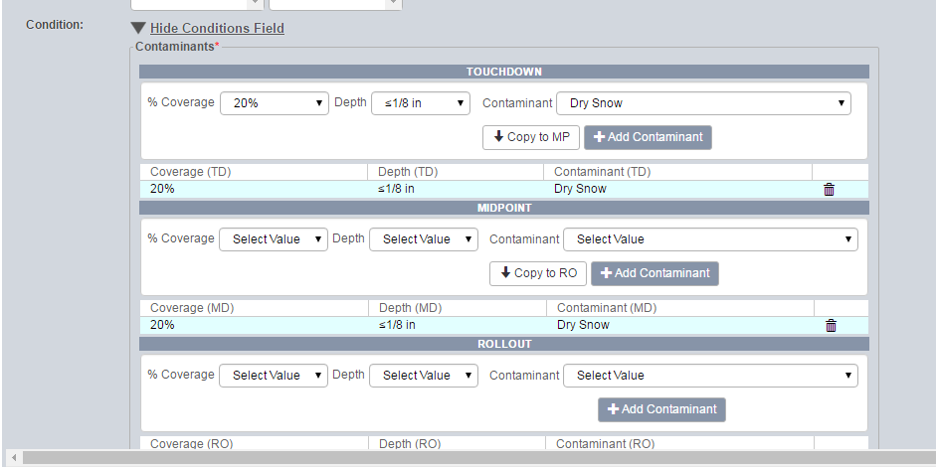
Changes to ENII
You must select Add Contaminant to populate in the NOTAM – can enter 2 conditions per RWY 1/3rd
If the next 1/3 of the RWY contains the same Contaminant, you can select Copy
To delete an existing entry click the trash can icon
Notes:
The application process for selecting, adding, and coping contaminants are the same as in NOTAM Manager.
Like in NOTAM Manager, in order to delete a contaminant, one must click the trash can icon.

Slide 45
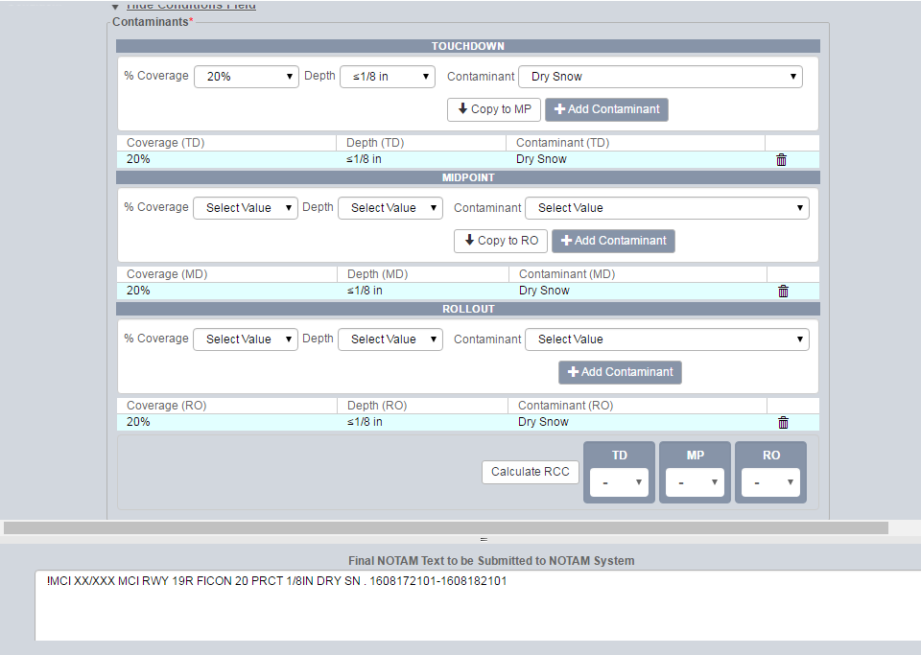
Changes to ENII
If overall length and width of RWY has less than 25% coverage, no RwyCC will be generated (average of 3 sections =25% or less)
No RwyCC Calculated
Conditions reported without RwyCC
Notes:
The overall coverage threshold of 25% is the same as NOTAM Manager.
If the 25% threshold is not surpassed, no RwyCCs will be generated.

Slide 46
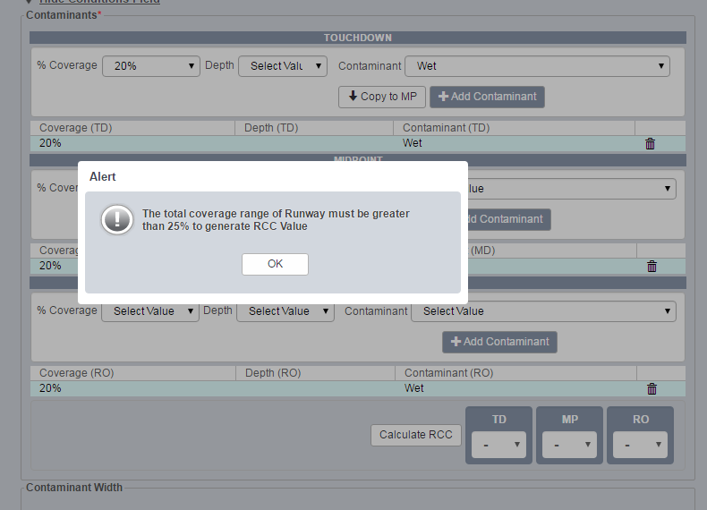
Changes to ENII
Warning message will appear if total coverage range is less than 25%
Notes:
Both NOTAM Manager and E-NOTAM II will provide the popup window alerting the operator when total runway coverage range has not surpassed 25%, and no RwyCCs will be generated.

Slide 47
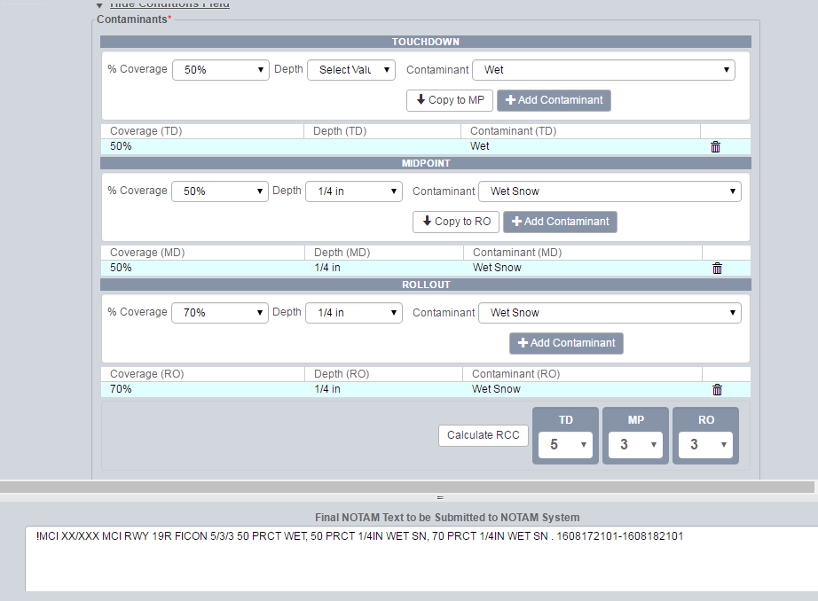
Changes to ENII
When average of 3 sections is >25%, NM automatically generates RwyCC for each 1/3 RWY
RwyCC can be downgraded by using data in RCAM Table and Airport Operator Judgment
RwyCC is in NOTAM and conditions for each 1/3 of RWY
Notes:
Just like NOTAM Manager, when the 25% threshold is surpassed, RwyCCs are generated for each runway third.
The same capability to downgrade a code is available, just like when using NOTAM Manager.

Slide 48
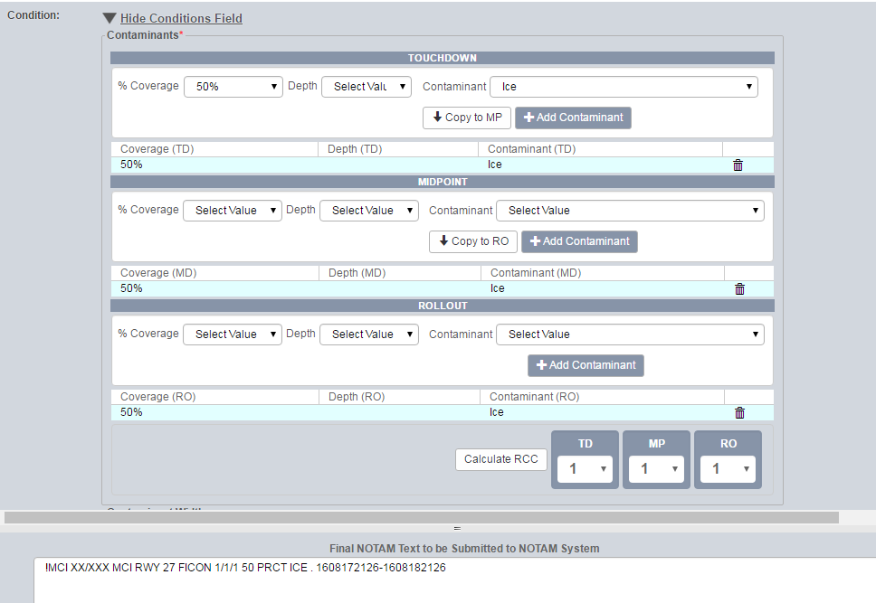
Changes to ENII
When RwyCC is a 0 or a 1, they can be upgraded (not higher than 3) if specific circumstances exist involving ice or compacted snow (a 2 cannot be upgraded since the only contaminants that generate a 2 are water and slush.)
Notes:
The upgrade feature for RwyCCs 0 and 1 is an available application that operates the same as in NOTAM Manager.

Slide 49
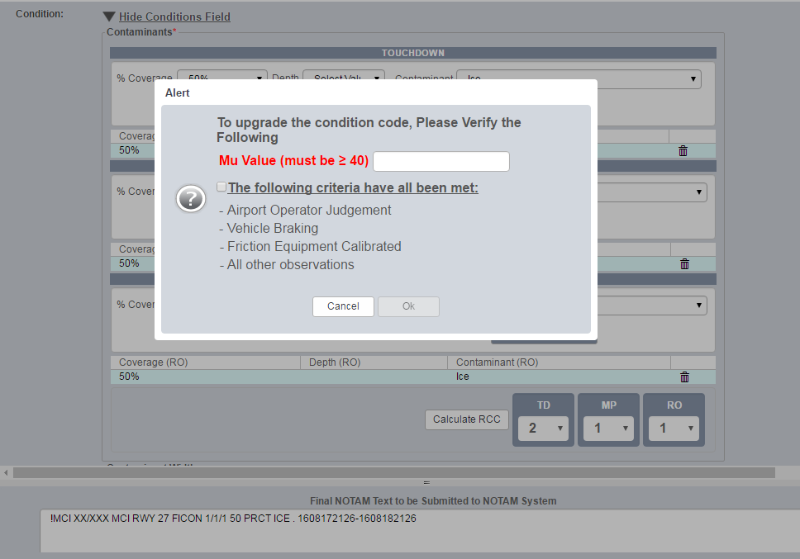
Changes to ENII
2. Verify conditions required to upgrade RwyCC
1. Enter desired upgraded Code, not above a 3
Notes:
The protocol screen in E-NOTAM II mirrors the one in NOTAM Manager for upgrading a RwyCC.
These are the same first two steps as illustrated in NOTAM Manager.

Slide 50
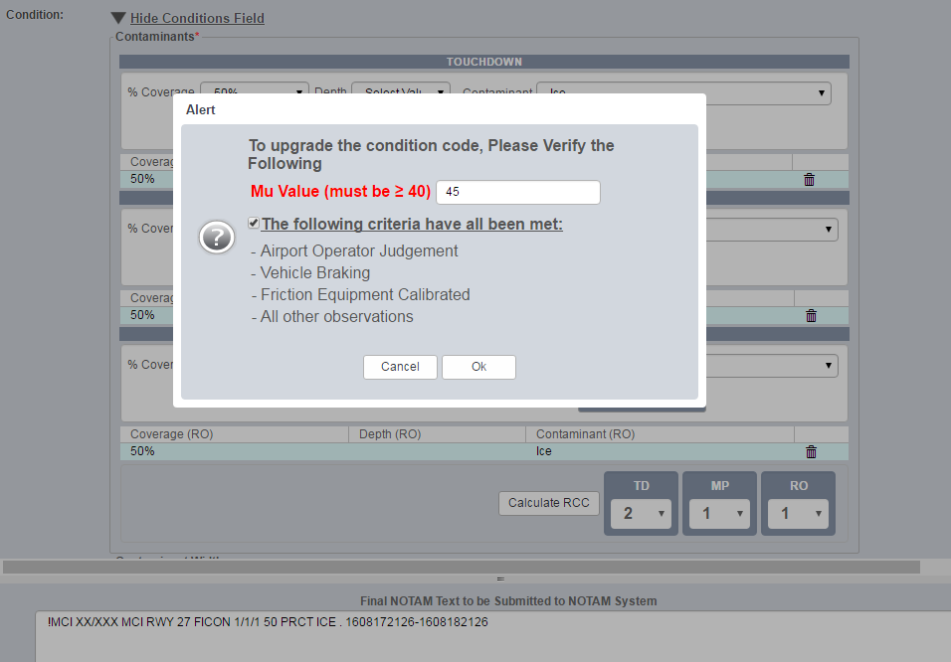
Changes to ENII
Must type in MU value
Once conditions are verified, select OK
Notes:
In E-NOTAM II the same menu activity as in NOTAM Manager is required to verify before a RwyCC can be upgraded.

Slide 51
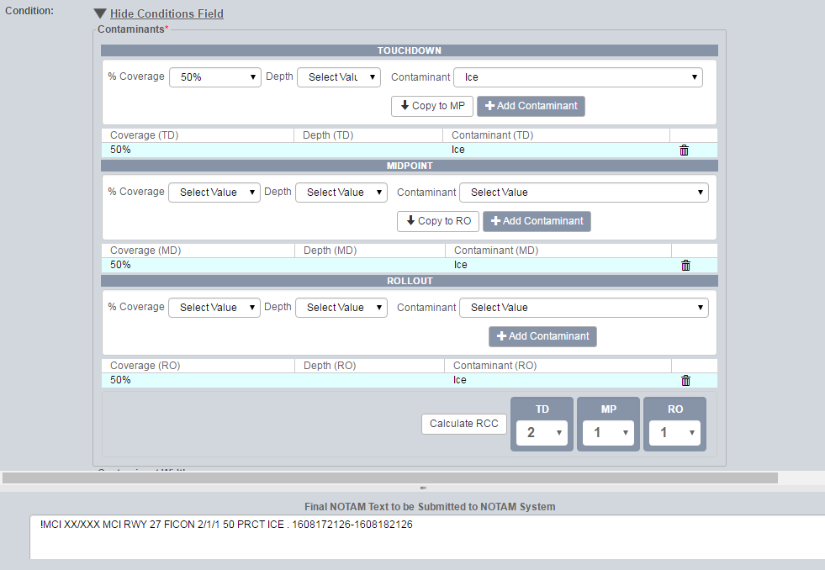
Changes to ENII
Upgraded RwyCC in NOTAM
Notes:
E-NOTAM II has a slight variation of where the NOTAM sentence appears when illustrated, but the upgrade action follows the same process described for NOTAM Manager.

Slide 52
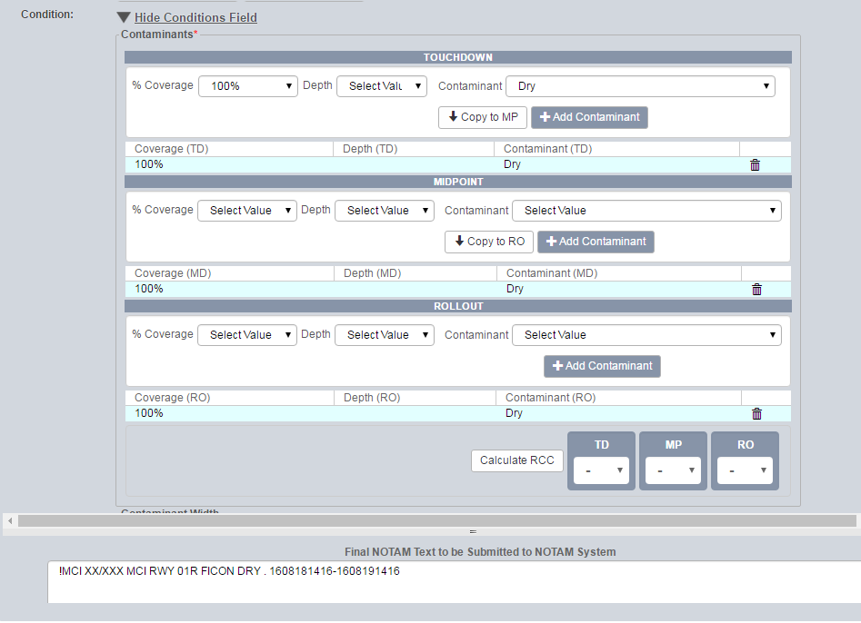
Center Portion of RWY DRY
If center portion of RWY is DRY:
1. Enter each 1/3rd as 100% DRY
Notes:
For E-NOTAM II when addressing portions of a runway being contaminated, the same methodology applies for identifying it in the NOTAM system.

Slide 53
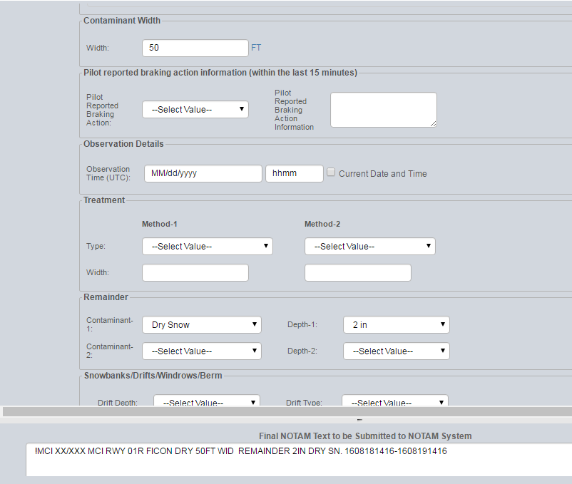
Center Portion of RWY DRY
2. Enter the width in feet of the DRY portion of the RWY
3. Enter condition of remainder of RWY
4. Review NOTAM language for accuracy
Notes:
The same information is enter to describe the width of the portion that is dry.
That is followed by describing the condition of the remainder of the runway.
And lastly, the NOTAM sentence should confirm the entry before publishing.

Slide 54
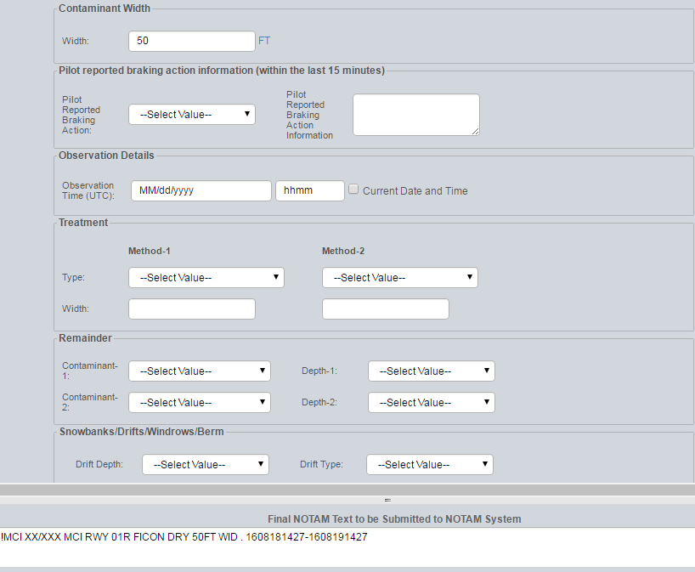
Pilot Reported Braking Action Feature
Information does not go into NOTAM, but into Archive Report – also justification for downgrading RwyCC
Notes:
E-NOTAM II has a pilot reported braking action feature.
The information does not go into the NOTAM system, but it is archived for use to help determine the effectiveness of the RCAM, especially when RwyCC are generated.

Slide 55
RCAM Driven NOTAM Examples
Uniform Coverage example:
!ORD XX/XXX ORD RWY 04L FICON 5/5/5 50 PRCT 1/8IN DRY SN . 1604251625-1604261625
Different Contaminants In Each Third:
!ORD XX/XXX ORD RWY 04L FICON 5/3/5 50 PRCT WET, 50 PRCT 1/8IN WET SN OVER COMPACTED SN, 50 PRCT 1/8IN SLUSH . 1604251625-1604261625
Two Different Contaminants In Each Third:
!ORD XX/XXX ORD RWY 04L FICON 3/5/2 50 PRCT WET AND 50 PRCT 1/8IN WET SN OVER COMPACTED SN, 50 PRCT WET AND 25 PRCT 1/8IN WET SN OVER COMPACTED SN, 10 PRCT 1/4IN SLUSH OVER ICE AND 75 PRCT 1/4IN SLUSH . 1604251625-1604261625
Notes:
Here are some examples similar to the NOTAMs we just built in the NOTAM system based on the RCAM information imbedded.
The first example is a simple one, uniform coverage example, meaning that the majority of the runway is covered in a similar fashion in each third, and as you can see, here are your RwyCC for each respective third. If you had this condition, and you were not above that 25% coverage threshold, the only difference would be that these RwyCC would not be there. And the RwyCC, again, is an indicator to the pilot to look at their performance information and re-evaluate the need for any adjustment, whether it be weight and balance, aircraft configuration, runway length needed, and things of that nature.
The second example is an example of having a different contaminant in each third. And here are the corresponding RwyCC for each third, so the first third being 50% wet, the second third being 50% 1/8 inch wet snow over compacted snow, and the last third being 50% 1/8 inch slush. So you can be very specific as to what contaminant is on what portion of the runway. We all know that not every snow event relates to the exact type of contaminant in each portion of the runway. Sometimes it varies depending on how the runway’s being used by aircraft, and how effective your snow removal operation is.
This last example is the lengthy NOTAM that we talked about where you have two types of contaminants in each third, so again, what we’re trying to illustrate here is that you can go from a very simple to a very complex NOTAM. The capability and flexibility is there for the your benefit.

Slide 56
Reporting Wet Runway
WET: Visible dampness, or water that is 1/8-inch or less in depth on the runway.
No RwyCC if < 25% coverage…just a Wet Runway NOTAM
Change due to the airplane performance differences that exists between wet, dry, or runways with water greater than 1/8-inch in depth
Year round reportable runway surface condition
NOTAM system enables users to establish a reoccurring template
Notes:
Reporting wet runway is a new change as you might have noticed in the Advisory Circular.
Wet is any visible dampness or water less than 1/8 inch in depth, reported year round.
When reported if 25% or less of the runway is WET, then it is just a Wet Runway NOTAM
If there’s more than 25% coverage, just like other contaminants, a RwyCC will be generated.
The RCAM reflects that as RwyCC “5”
We ask that you exercise caution here to distinguish Wet versus standing Water or ponding during heavy rain events.
Heavy rain events without proper sloping or runway grooving could easily move conditions from Wet to Water greater than 1/8 inch resulting in RwyCCs of “2”.
Participants in the ARC saw wet as a contaminant that will have an impact on airplane braking performance differences between, wet, dry, or water greater than 1/8 inch in depth
NOTAM system will enable you to create a short cut for producing and issuing Wet Runway NOTAM

Slide 57
What is Slippery When Wet?
Slippery When Wet: Pavement maintenance evaluation indicates the averaged Mu value on the wet pavement surface is below the minimum friction level classification specified in AC 150/5320-12, Measurement and Maintenance of Skid-Resistant Airport Pavement Surfaces
Contributing factors that can create this condition include rubber buildup, groove failures/wear, and pavement macro/micro textures
Slippery When Wet NOTAM generates RwyCC of 3/3/3
The entire runway is considered “Slippery When Wet” if any portion of the runway fails to meet the minimum friction criteria per the AC guidance.
Downgrades available based on airport operator judgment… No upgrades allowed
NOTAM issued anytime the runway is “Wet” and the degraded friction condition exists.
Notes:
When any portion of the runway falls below the minimum friction levels in accordance with the Pavement AC, the entire runway is considered Slippery When Wet.
The entire surface is identified as Slippery When Wet because it cannot be predicted to where an aircraft will physically interact with runway pavement.
Some of the contributing factors to surfaces identified as Slippery When Wet are rubber deposits, groove failures/wear and pavement texture issues
Slippery When Wet which will generate a RwyCC of 3/3/3.
Downgrades are available but there are no upgrades allowed.
This type of NOTAM should be issued anytime the runway is wet and the degraded friction condition exists, until the degraded friction is fixed.

Slide 58
Examples: Aircraft Operator Side
Notes:
The following are some examples of how the RCAM is already in use by some in industry. A lot of the industry has been working with this information for many years, particularly on the pilot and the aircraft manufacturer side.

Slide 59
Airbus ROPS and TALPA
In flight, predicted stopping point based on TALPA ARC recommendations
Includes 15% operational safety margin
On A350, can select runway condition by either runway surface description or braking action
On ground, predicted stopping point transitions to being based on actual deceleration being achieved
In-flight landing distance check required to ensure alerts will not trigger during a normal approach
Notes:
Here is an example from Airbus’ Runway Overrun Protection System that’s built in to the aircraft computers.
Based on the TALPA ARC recommendations and the information airport operators are going to generate, pilots will be able to enter this into their computer and the computer will automatically determine the necessary safety margins that they need to operate.
So, once the pilot has that data, the computer will tell them a predicted stopping point on the runway. In other words, if you touch down here, you’re going to end up stopping at this point.
It will also check landing distances, and not only know what it’s going to do, given certain values, it’ll also know in advance what values are acceptable.
A pilot perhaps can’t accept a given RwyCC at a particular airport. Maybe the runway is so short, that if you’re at a RwyCC of 1, it may be a problematic operation for a particular aircraft. Therefore, pilot would have to make necessary performance adjustments according to runway length and RwyCC. So a lot of high tech software is being installed into aircraft related to this change.

Slide 60
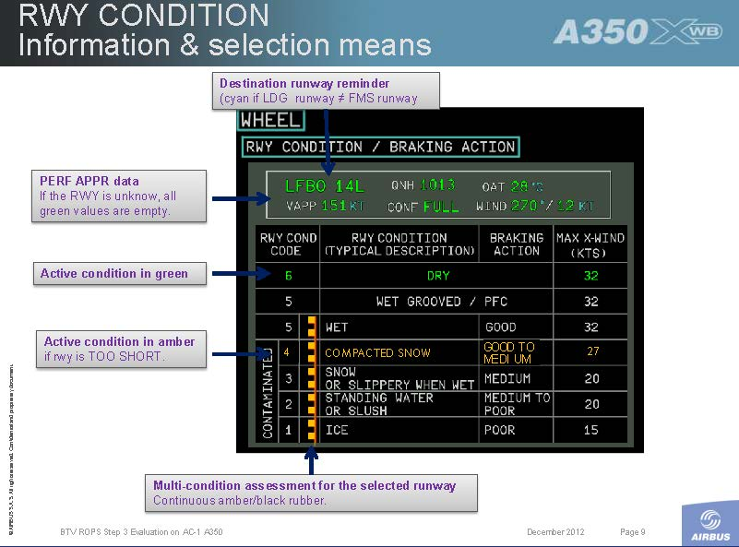
Runway Conditions in the Cockpit
Notes:
Here’s what it looks like in the cockpit.
In the middle of the screen in the black area, with the white letters, you will see Runway Condition Codes.
This is the same information that is in the RCAM.
To the right of that column, Runway Description, showing contaminant information, as located in the RCAM.
Next is the braking action category, not vehicle braking – this is aircraft braking action, in the event that there was a relevant braking action report in that time frame.
This is a good example of how the information provided by airport operators is going to be used.
Before we were not able to correlate contaminants to any particular kind of airplane performance. Now we will begin to do so, and this is a substantial safety benefit to the operator.

Slide 61
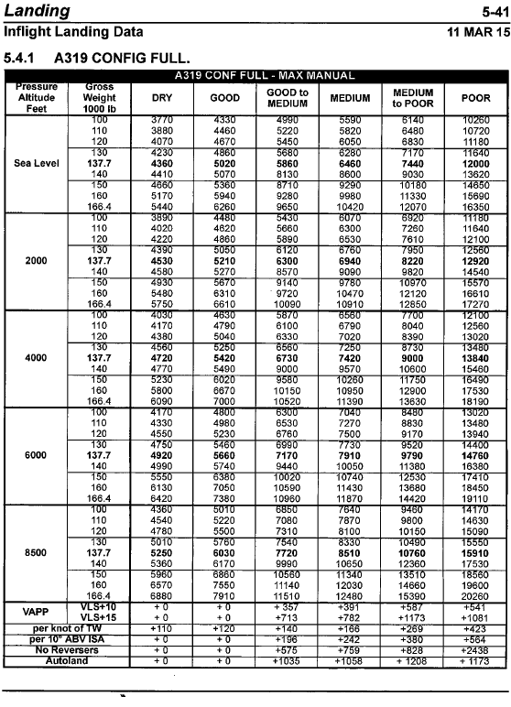
Airline Operating Manuals
Notes:
Here’s a copy out of an airline operating manual.
What we wanted to showcase here is that already in airline manuals today, they associate pilot-reported braking action (which is very subjective, the same as vehicle and Mu), with landing distance needed.
What we envision in the future, is that the RwyCC information will eventually be assimilated into airline operating manual. RwyCCs will tell the pilot they are going to need this much runway, based on this pressure altitude and this gross weight, and it is already going to be part of the aircraft computer operating system.
We just wanted to show you that what we’re providing aircraft operators will be more than basic information.
It’s now truly a functional piece of information aircraft operators can use for braking performance.

Slide 62
ICAO Implementation and Global Harmonization
Transport Canada
Japanese
Italian
British
Scandinavian
Notes:
The implementation efforts for this revised method is not just here in the US.
Our international partners are also planning to implement the ARC recommendations and the RCAM, and ICAO is already working to implement this in their policy and guidelines.
The handful of countries that you see listed have begun implementing this into their national airspace system.
We believe that is good thing, because this whole process will eventually be harmonized globally with all ICAO member states.

Slide 63
Guidance Documents
Advisory Circulars:
150/5200-30, Airport Field Condition Assessments and Winter Operations Safety
150/5200-28, Notices to Airmen (NOTAMs) for Airport Operators
150/5320-12, AC 150/5320-12C - Measurement, Construction, and Maintenance of Skid Resistant Airport Pavement Surfaces
91-79, Mitigating the Risks of a Runway Overrun Upon Landing
25-31, Takeoff Performance Data for Operations on Contaminated Runways
25-32, Landing Performance Data for Time-of-Arrival Landing Performance Assessments
Notes:
These are the aviation documents that are being updated, not just from an airport standpoint, but also from a Flight Standards standpoint.
A lot of information is being changed and driven by the RCAM and the recommendations provided by the ARC.

Slide 64

Internal Guidance Documents
Orders:
JO 7930.2, Notices To Airmen (NOTAM)
JO 7110.65, Air Traffic Control
JO 7210.3, Facility Operation Administration
JO 7110.10, Flight Services
Notes:
Internal FAA documents are also be changed or amended.
The ATC order is going to be updated - obviously controllers need to know what to do when you give them a runway condition code.
That’s a new piece of information for them.
They’re going to treat it similarly to how they’ve treated Mu reports in the past.
Some of the other orders as well that affect the different parts of the FAA are being revised.
So, it’s required a great deal of collaboration, both internally and externally.
The Air Traffic organization is rolling out their training to their workforce in September on this TALPA initiative.

Slide 65


Resources for Airport Operators
FAA Website: http://www.faa.gov/airports/
RCAM FAQs
SICP Template
FAA Training Aide
FAA Webinars
NOTAM User Telecons
Notes:
Here are some resources available to aid you in the transition.
We have the FAA website for all things airports, but in this particular case, the FAA Airports section has TALPA information.
There is a section where you can get background information, FAQs about the RCAM, and the Snow and Ice Control Plan template.
There will be an FAA training aide (a narrated Powerpoint) on the RCAM and walking through field condition NOTAMs somewhat like we did today.
Additional webinars for the airport operator will be posted here similar to today’s.
And then for all those airports who are on NOTAM manager, there is a monthly user telecon which is a good question and answer exchange forum between airport operators and NOTAM system management personnel.

Slide 66
Changes for the Airport Operator
ACM Updates
Section 139.339 Airport Condition Reporting
SICP Update (Template on website)
Air Traffic LOA (if specifically referencing Mu.)
Training on reporting changes
Communication of Reporting Method to the Air Carriers and local tenants. (If not already reporting via the NOTAM system.)
Notes:
What are the big impacts to you? That depends on what you have in place today.
For example, ACM updates – section 339 needs to be updated, if you’re not already reporting via the NOTAM system.
So, if in section 339 you reference some other methodology for reporting conditions, you will need to change that and the NOTAM system needs to be the primary method.
If you are already providing field condition information through the NOTAM system, obviously this will not be an impact.
Snow and Ice Control plan updates are required. All we are requiring is that you update the plan already in place with the appropriate information that’s not in there today.
With the release of the AC, a template was provided that highlights those areas that are new or changed and how they fit into your SICP.
If there are existing Letter Of Agreements with the tower, you will need to just take a look at those and if any of them specifically reference Mu, they need to be revised.
The NIL closures, the two Poor PIREPs actions, those have not changed. That’s all staying the same. The only piece that we want to remove is that they are no longer providing Mu to anyone because now it is used purely as an assessment tool in your toolbox.
Lastly, you need to inform all your carriers and your local tenants that as of October 1st, if they want updated runway conditions, go to the NOTAM site. That’s where the information will come from if they are not already using the NOTAM system.

Slide 67
COMMENTS and QUESTIONS?
Notes:
This concludes the presentation on Airport Condition Reporting and the Runway Condition Assessment Matrix (RCAM)

