Slide 1
Runway Collision Risk Measurement using ADS-B
Marco Merens
Chief, Integrated Aviation Analysis
Air Navigation Bureau
ICAO
Brussels
6 June 2017

Slide 2
Runway Safety
ACFT Land/Take Off
Runway crossings
Weather
Collisions
ADRM Layout
Loss of Separation
Dual Aircraft
Barriers
ACFT Attitude
RWY Condition
Excursions
… with edge of runway
… with other aircraft/vehicle
Single Aircraft

Slide 3
Gaining Insight
Level 1
  Reactive analysis and investigation of high consequence events (accidents, serious incidents)
Level 2
  Monitoring of everyday operations and hazards and combined realtime analysis
  Define, separate and track Normal vs Abnormal operations

Slide 4
Level 2 Data Analysis Process
Analysis
Indicators
Metrics
Oversight Audits
NOTAMS
METARS
ADSB Ground Tracks
Latitude, Longitude
Heading
Ground speed
Flight Id
ACFT Type
Hazards
…by the second

Slide 5
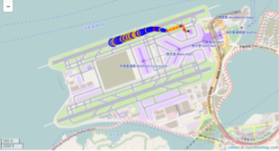
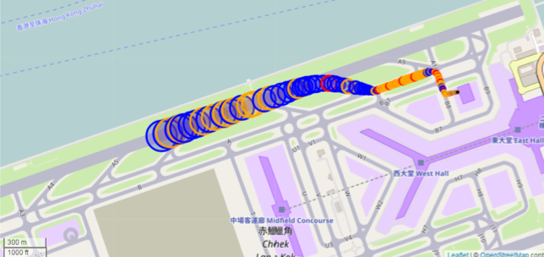
Visualizing the data
Deceleration
Acceleration
Circle size proportional to speed
Circle center is aircraft position
Circles spaced by 1 second
Const. Speed
Stop (0 speed)
HongKong VHHH

Slide 6
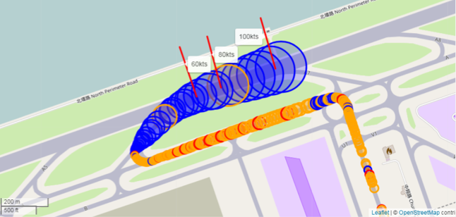
Speed Marks
Marks
Exit Speed
43kts
HongKong VHHH

Slide 7
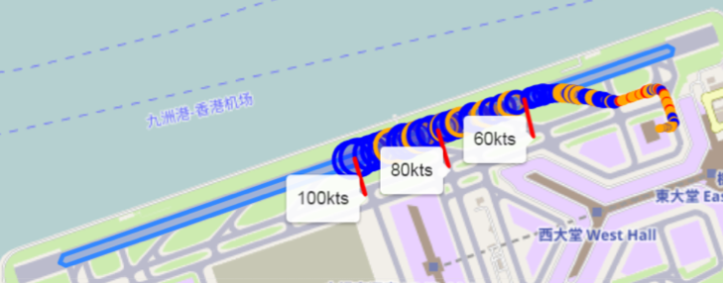
Runway Remaining
Monitor the separation with runway end

Slide 8
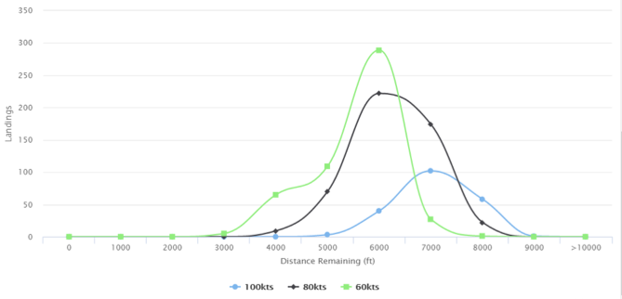

Runway Remaining
$$Distance= \frac{{Speed}^{2}}{2∙Deceleration}$$
Distances after which it is not possible to stop before the end of the runway at the given speed and deceleration
Number of landings vs speed and remaining distance for 1 day in VHHH
60kts
80kts
100kts
0.4g
HongKong VHHH

Slide 9
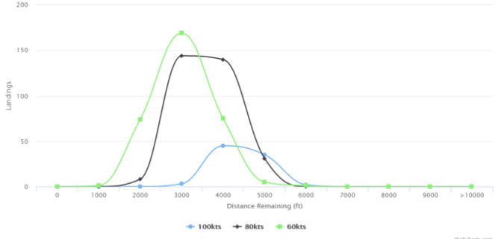
Runway Remaining
Number of landings vs speed and remaining distance for 1 day in KATL
One aircraft was at 60kts with 1000 feet remaining
60kts
80kts
100kts
0.4g
Atlanta KATL

Slide 10
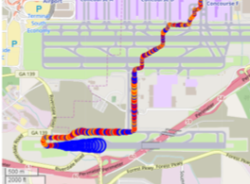
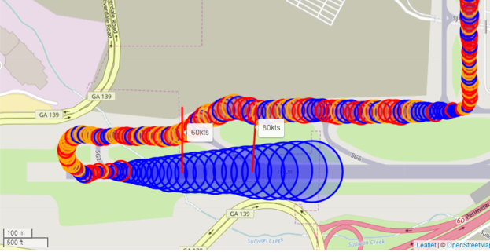
Reduced separation with runway end
1300 feet
2000feet
Exit Speed
20kts
Atlanta KATL

Slide 11
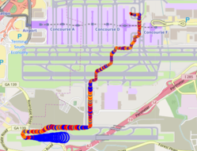
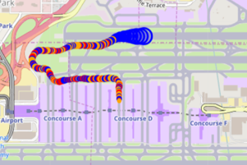
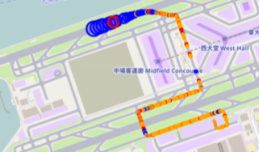
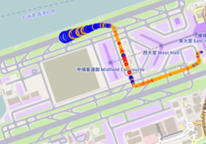
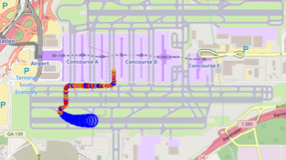
Runway Crossings
Atlanta
Atlanta
0
2
1
Hong Kong
1
0
Atlanta
Hong Kong

Slide 12
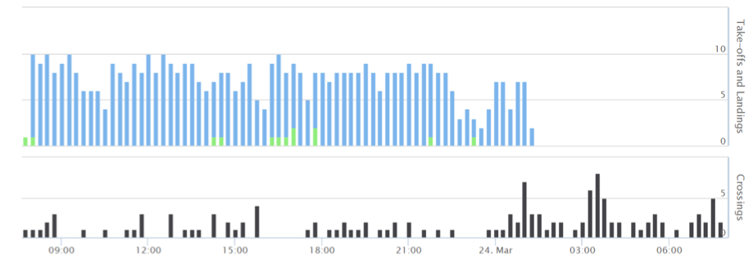


Monitoring Usage
Operations
Nb. of Crossings
Nb. of Landings
Ops Mix
Nb. of Take-Off
$$\frac{Landings+Takeoffs}{F(Crossings)}$$
Runway Availability
F$\left(\frac{Landings}{Landings+Takeoffs}\right)$
X Crossings per Day
One day at Hong Kong RWY 07R/25L
per nb of Operations per 15 min

Slide 13
Monitoring Separation
Seconds between Take-offs and Landings
Seconds between Crossings and Landings / Takeoffs
X Crossings per Day
One day at Hong Kong RWY 07R/25L
per nb of Operations per 15 min

Slide 14
Future Work
Define Indicators relevant for monitoring of runway collision risk
Connect to ADSB data on ground level and hazard data
Automate the real-time generation of those indicators
Feed applications and visualizations via ICAO SIMS
Contact iaa@icao.int for more information and collaboration

