Slide 1


Understanding and Managing Risks of Airport Surface Traffic
Dr. Ivan Sikora & Dr. Simone Colombo
2017 Safety Forum: Preventing Runway Collisions

Slide 2
Imagine…
Risk Profile and Benefit Comparisons @ your Fingertips (or Executive Dashboard)
Solution 1
Solution 2
Solution 1+2
Total Risk | ∆ Risk
1,66E+01
1,48E+01 | -10,7 %
Total Risk | ∆ Risk
1,66E+01
1,64E+01 | -0,95 %
Total Risk | ∆ Risk
1,66E+01
1,46E+01 | -11,62 %

Slide 3
Imagine…
Complex problems properly understood and managed
Complex HTO systems designed and managed by properly balancing humans and automation
Human Cognition complemented by Artificial Logic

Slide 4
Premises and Assumptions

Slide 5
Premises
The study was performed by:
Analysing a hypothetical (and simplified) airport condition (the attempt was to identifying commonalities)
Capitalising the available reports on the topic
Involving 3 different profiles, namely:
Pilots
Air Traffic Controllers
System analysts (primarily academics)

Slide 6
Premises
The preliminary outcomes are the result of:
A study performed over a period of 3 months
A 240 hrs. work (i.e. 30 person days) of mixed competencies
A 30-35 hrs. computational time of a cloud computing server:
4 CPU (Quad 1.7 GHz Xeon)
8 GB RAM

Slide 7
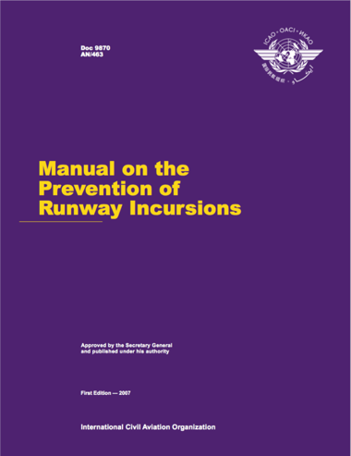
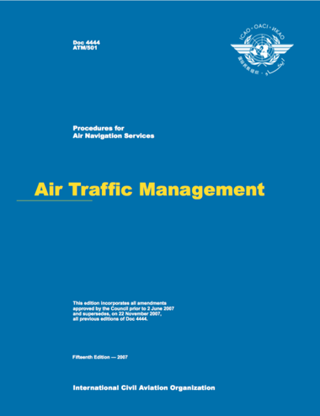
The reference reports

Slide 8
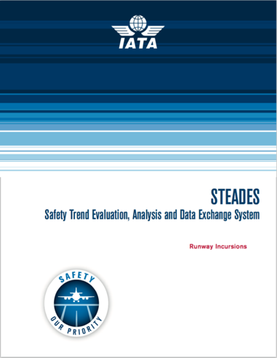
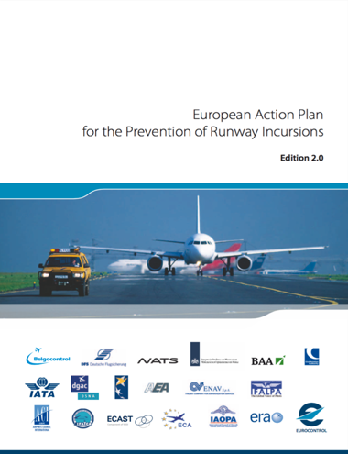
The reference reports

Slide 9
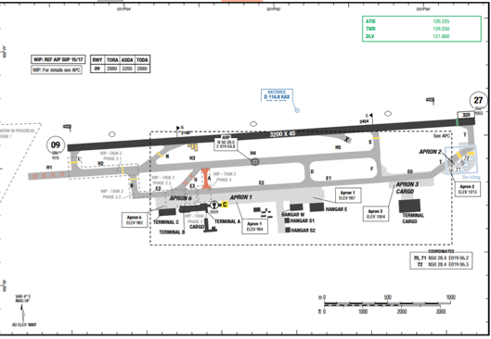
Assumptions
Assumptions made are as follows:
The airport has one runway

Slide 10
Assumptions
Assumptions made are as follows:
The airport has 4 communication frequencies:
1 ATIS frequency (ATIS)
1 Delivery frequency (DEL)
1 Ground frequency (GND)
1 Tower frequency (TWR)
There are 4 ATC Operators:
1 for DEL frequency
1 for GND frequency
1 for TWR frequency
1 supervisor

Slide 11
Assumptions
Operations are in good general visibility
Signs are as per Annex 14
DEL, GND and TWR frequencies work properly
ATC Operators have proper qualifications
Pilots have proper qualifications
No Low Visibility Procedures (LVP) are in progress
No emergency procedures are in progress
No significant adverse meteorological conditions are ongoing
The sole trespassing of the runway entering limit (after holding point) was considered an incursion
The outcomes consider the Aircraft moving from the parking stand until the Aircraft enter on the active runway

Slide 12
Problem’s schematization

Slide 13
Problem’s schematization
From a problem modelling viewpoint it was assumed there might be 2 types of RI processes, namely:
RI as a failure of entering the runway (aircraft only – take off)
RI as a failure of crossing the runway (aircraft, take off and landing, and vehicles)

Slide 14
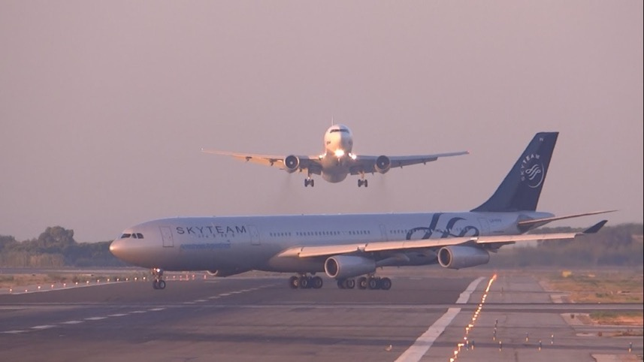
Problem tackled: entering for take off

Slide 15
The ALBA ANALYSIS

Slide 16
The ALBA Analysis*
The analysis has been performed by using the Artificial Logic Bayesian Algorithm (ALBA) method that allows to:
Create a complete partition (i.e., the entire universe of possible scenarios/stories)
Manage scenarios at different level of abstraction
Identify the criticalities prioritised by contribution to the risk
*Risk-based decision making in complex systems: The ALBA method - 10.1109/IEEM.2016.7797921

Slide 17
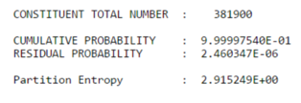
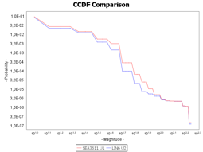
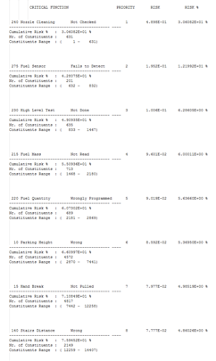
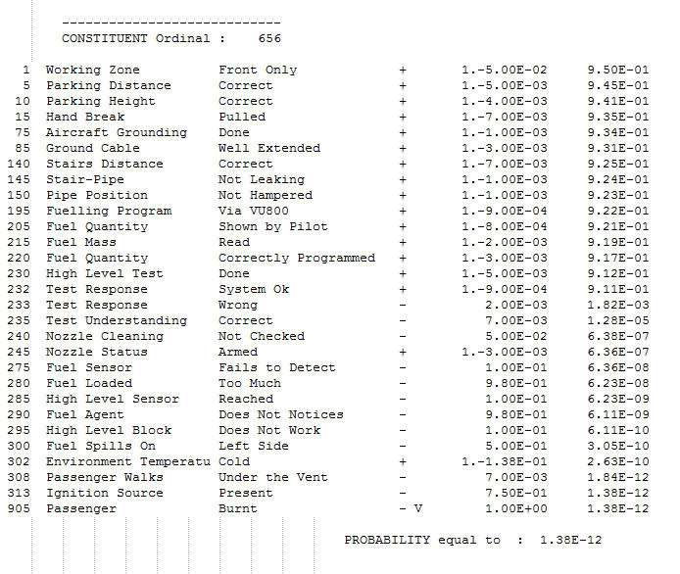
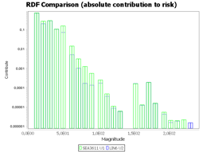
Decision making tools
Logic-Stochastic
Simulation
Risk Profile
Comparison
Critical Functions
Identification

Slide 18
The risk level/profile identification
This ALBA process that consists of 5 steps:
the input file creation
the semantic check
the consequences definition
the risk profiling
the critical functions identification

Slide 19
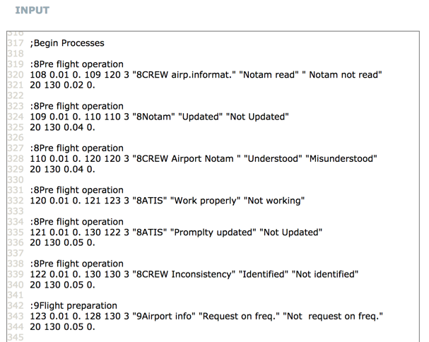
The input file creation
The creation of the input file consists of:
The identification of the elective variables
The identification of their logical and stochastic correlations

Slide 20
The semantic check
The semantic check is aimed at guaranteeing that:
The universe generated correctly represent the system being analysed
There are no logical inconsistencies present in the scenarios
There are no stochastic inconsistencies with the empirical evidence (if any) or with the design intent

Slide 21
The universe analysed
Size of Generated Universe: 8,019,619 scenarios
Perfect scenario
1,99E-01 (~ 20%)

Slide 22
The consequences definition
This step is aimed at defining/calculating the consequence a variable produces should it manifest (both negatively and positively)
TWR LW/TO instr. RI conflict
100
CREW Doesn't stop H.P.
90
80
Hold. position signs Not Clearly visible
70
TWR oper. identifies Wrong a/c
60
CREW Taxi instr. Read-back not done
50
TWR Doesn't ident.problem
40
DEL Flight ident. Incorrect
30
CREW airport Map Not completed
20
10
CREW Clear.readback Not correct

Slide 23
The risk profiling
The risk profiling is achieved through the creation of:
the well known CCDF (also known as risk curve)

Slide 24
The risk profiling
The risk profiling is achieved through the creation of:
the well known CCDF (also known as risk curve)
the newly defined Risk Distribution Function (risk spectrum)

Slide 25
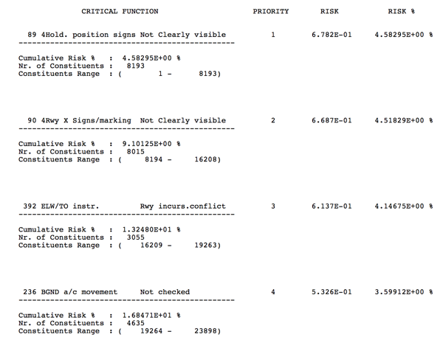
The critical functions identification
This step is aimed at identifying/calculating the critical functions prioritised by contribution to the overall risk

Slide 26
The risk treatment
The risk is then “treated” by acting on the critical functions
In the specific case the first 3 critical functions are as follows:
Holding position signs not clearly visible (4.58%)
Runway crossing signs/marking not clearly visible (4.52%)
TWR instructions to LW/TO giving rise to RI conflict (4.15%)
The input file is then modified to model the solutions

Slide 27
The risk treatment
The new input file generates:
A new universe (that is to be semantically checked)
A new CCDF (risk curve)
A new RDF (risk spectrum)
A new CFL (critical functions)
This done, the effectiveness of the solutions is to be checked

Slide 28
The risk comparison
Total Risk | ∆ Risk
1,66E+01
1,48E+01 | -10,7 %
Expected Damage | ∆ Expected Damage
4,63E+01
4,45E+01 | -3,71 %
Solution 1:
Signs clearly visible
Total Probability | ∆ Probability
3,58E-01
3,32E-01 | -7,29 %

Slide 29
The risk comparison
Total Risk | ∆ Risk
1,66E+01
1,48E+01 | -10,7 %
Expected Damage | ∆ Expected Damage
4,63E+01
4,45E+01 | -3,71 %
Total Probability | ∆ Probability
3,58E-01
3,32E-01 | -7,29 %

Slide 30
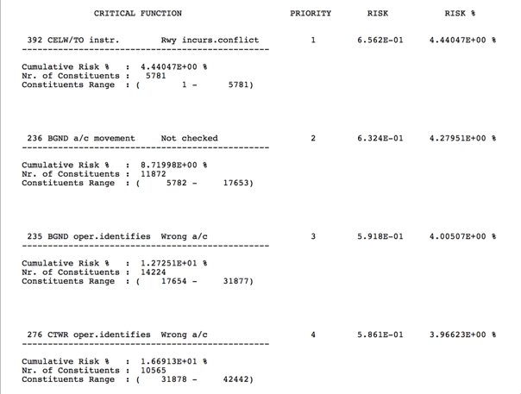
The risk comparison
Total Risk | ∆ Risk
1,66E+01
1,48E+01 | -10,7 %
Expected Damage | ∆ Expected Damage
4,63E+01
4,45E+01 | -3,71 %
Total Probability | ∆ Probability
3,58E-01
3,32E-01 | -7,29 %

Slide 31
The risk comparison
Total Risk | ∆ Risk
1,66E+01
1,64E+01 | -0,95 %
Expected Damage | ∆ Expected Damage
4,63E+01
4,60E+01 | -0,55 %
Solution 2:
Supervisor approval in TWR
Total Probability | ∆ Probability
3,58E-01
3,56E-01 | -0,40 %

Slide 32
The risk comparison
Total Risk | ∆ Risk
1,66E+01
1,64E+01 | -0,95 %
Expected Damage | ∆ Expected Damage
4,63E+01
4,60E+01 | -0,55 %
Total Probability | ∆ Probability
3,58E-01
3,56E-01 | -0,40 %

Slide 33
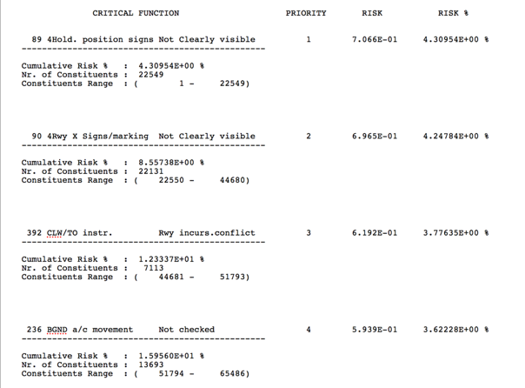
The risk comparison
Total Risk | ∆ Risk
1,66E+01
1,64E+01 | -0,95 %
Expected Damage | ∆ Expected Damage
4,63E+01
4,60E+01 | -0,55 %
Total Probability | ∆ Probability
3,58E-01
3,56E-01 | -0,40 %
Current value → - 8,93%

Slide 34
The risk comparison
Total Risk | ∆ Risk
1,66E+01
1,46E+01 | -11,62 %
Expected Damage | ∆ Expected Damage
4,63E+01
4,43E+01 | -4,30 %
Solution 3:
Signs clearly visible
+
Supervisor approval in TWR
Total Probability | ∆ Probability
3,58E-01
3,31E-01 | -7,62 %

Slide 35
The risk comparison
Total Risk | ∆ Risk
1,66E+01
1,46E+01 | -11,62 %
Expected Damage | ∆ Expected Damage
4,63E+01
4,43E+01 | -4,30 %
Total Probability | ∆ Probability
3,58E-01
3,31E-01 | -7,62 %

Slide 36
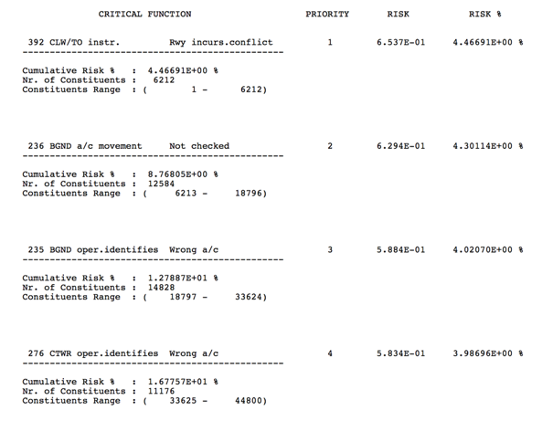
The risk comparison
Total Risk | ∆ Risk
1,66E+01
1,46E+01 | -11,62 %
Current value → + 7,16%
Expected Damage | ∆ Expected Damage
4,63E+01
4,43E+01 | -4,30 %
Total Probability | ∆ Probability
3,58E-01
3,31E-01 | -7,62 %

Slide 37
Conclusions
Complex problems require adequate approaches and tools to be understood and properly managed, on penalty of failing to identifying the real criticalities and potentially increasing risk
When complex HTO systems are at stake a systemic approach is necessary, on penalty of:
Overbalancing the attention to the technological side
Privileging automation as a solution and not as a support
Artificial Logic can provide a significant help in identifying what human cognition alone cannot even dream to reach

Slide 38
Thank you!
Dr. Ivan Sikora: ivan.sikora.1@city.ac.uk (@Master_Mentor)
Dr. Simone Colombo: simone.colombo@polimi.it

