Slide 1


Alert Vehicule Drivers @ Paris CDG Airport
Safety Forum June 6th of 2017
This project is Co-funded by
the European Union

Slide 2
01
CONTEXT

Slide 3
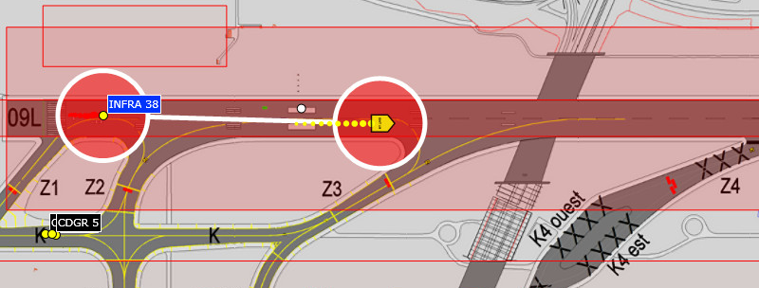
1 CONTEXT
THE SESAR CONCEPT
  SESAR 6.7.1 : Airport Safety Support tools – Alert for vehicle drivers
  what:
      provide alerts to drivers when there is a risk of collision with an aircraft
  Why:
      Provide drivers with a safety net and enable quicker reaction
  How:
      Visual alerts through a moving map (increase situational awareness)
      Sound alerts

Slide 4
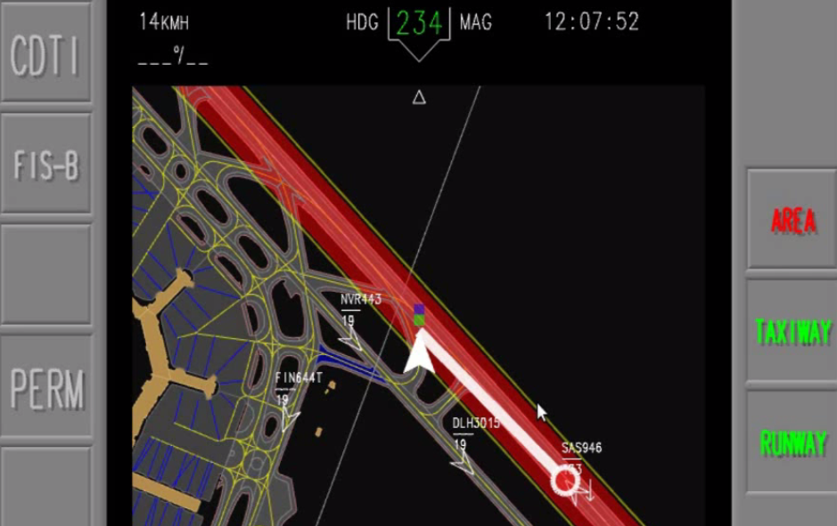
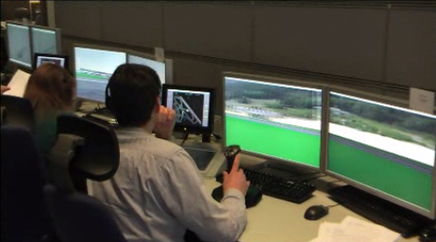
1 CONTEXT
PROJECT’s HISTORY
  2011 and 2014: Simulated tests in Malmö airport
  2015: Live trials @ Dublin and Paris-CDG (VP-724 and VP-769)

Slide 5
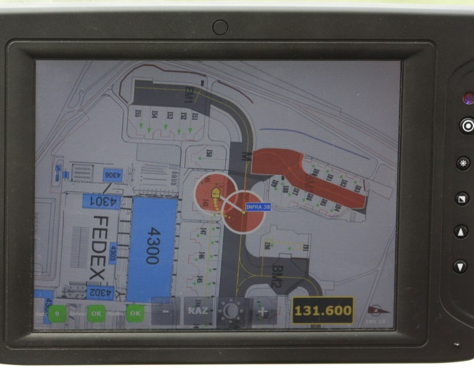
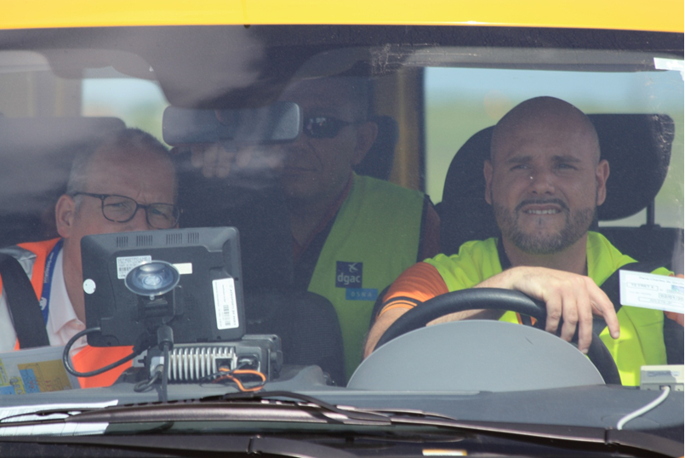
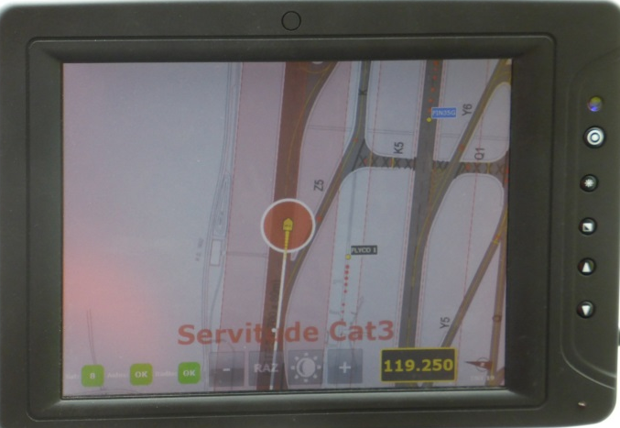
1 CONTEXT
Live Trials @ CDG : Two steps
  1st Step: Technical trial – May 2015
      Two vehicles: one equiped with a transponder to « play » the aircraft
      All alerts triggered to check the system capabilities
      collecting « test drivers » feedback

Slide 6
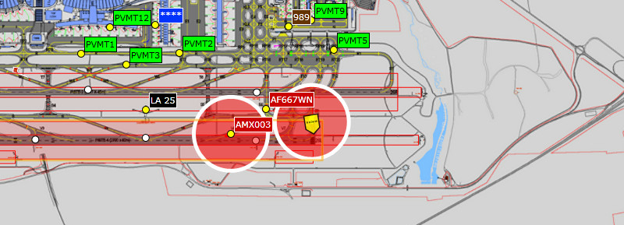
1 CONTEXT
Live Trials @ CDG : Two steps
  2nd step: « Real life » : May 21st to July 15th, 2015
      5 vehicles equiped in operations vehicle
      Feed-back organized throughout trials

Slide 7








1 CONTEXT
Live Trials @ CDG : Validation partners

Slide 8
02
The ALERTS

Slide 9
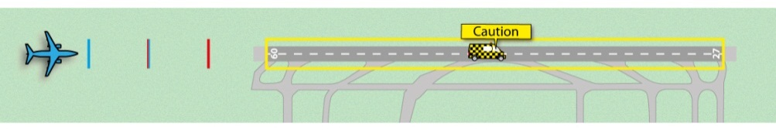
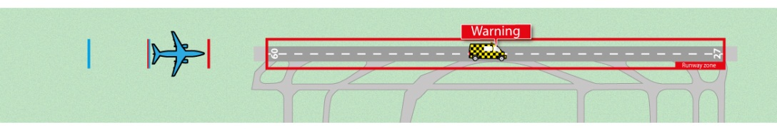
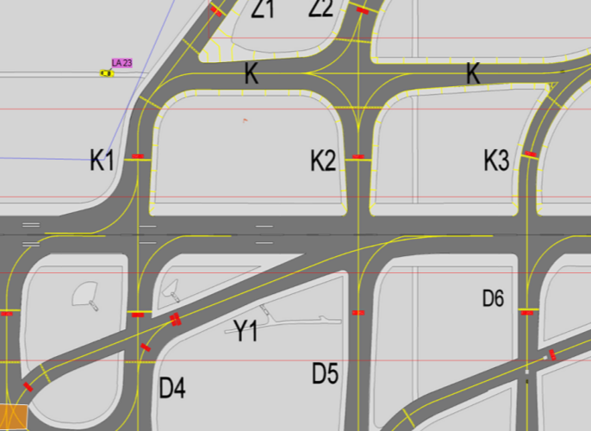


2 THE ALERTS - RUNWAY
Situation 1: vehicule on the runway in clonflict with an approaching aircraft.
Orange “Landing” Alert:
Approaching aircraft between 40 and 25 sec away from runway extremity
Red “Landing” Alert:
Approaching aircraft less than 25 sec away from runway extremity
Sound: « Bip » *3
Sound: « landing » * 3

Slide 10
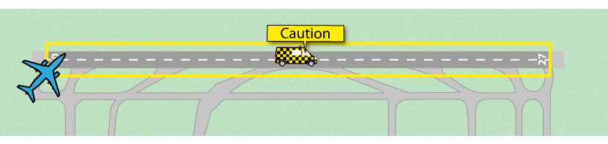
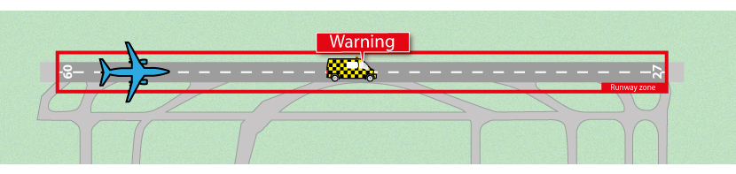
2 THE ALERTS - RUNWAY
Situation 2: vehicule on the runway in clonflict with an departing aircraft.
Orange “take-off” Alert:
Aircraft lining up, speed<20kts
Red “take-off” Alert:
Aircraft speed >20kts
XY123
XY123
Sound: « Bip » *3
Sound: « take-off » * 3

Slide 11
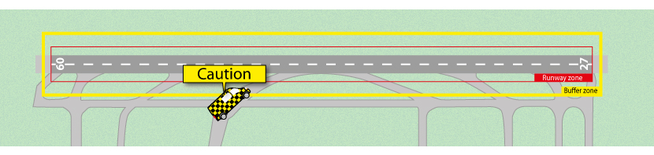
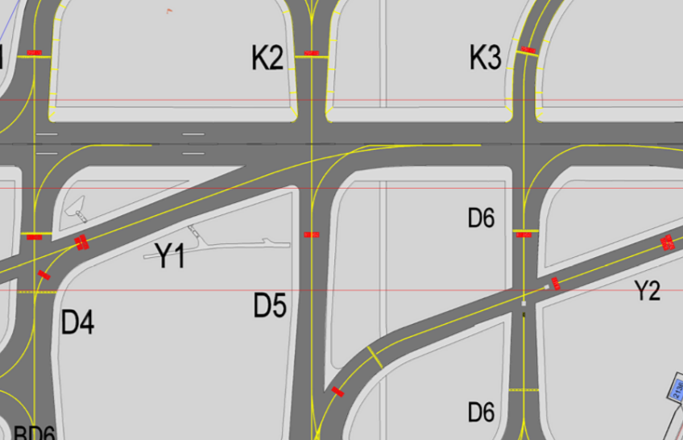
2 THE ALERTS - RUNWAY
Situation 3: vehicule entering a buffer area close to the runway
Orange “buffer area” Alert
Sound: « bip » * 3

Slide 12
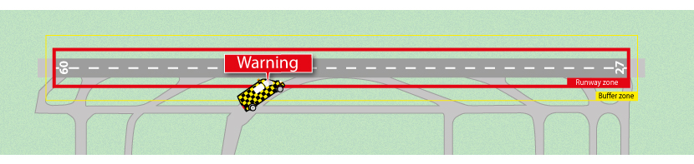

2 THE ALERTS - RUNWAY
Situation 4: vehicule entering the « runway protected area » (pre-existing alert)
Orange “protected area” Alert
Sound: « bip » * 3

Slide 13
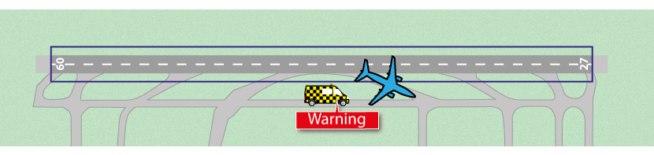
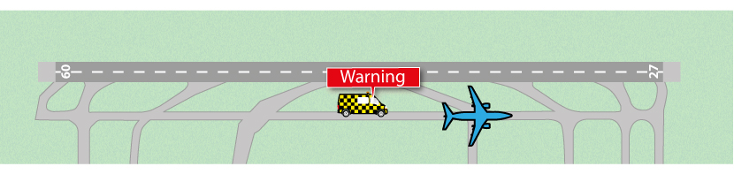
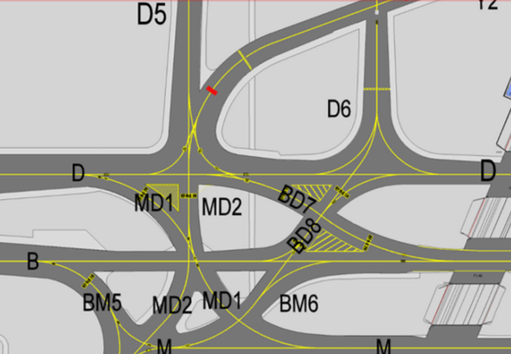
2 THE ALERTS - TAXIWAY
Situation 5 : vehicule on a taxiway in clonflict with an taxiing aircraft.
Red “trafic” Alert:
Merging path
Red “trafic” Alert:
Vehicle following an airfraft too close
XY123
XY123
Sound: « traffic » * 3

Slide 14
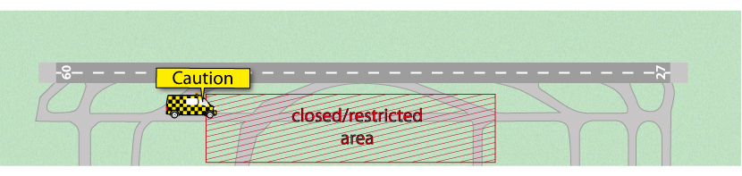
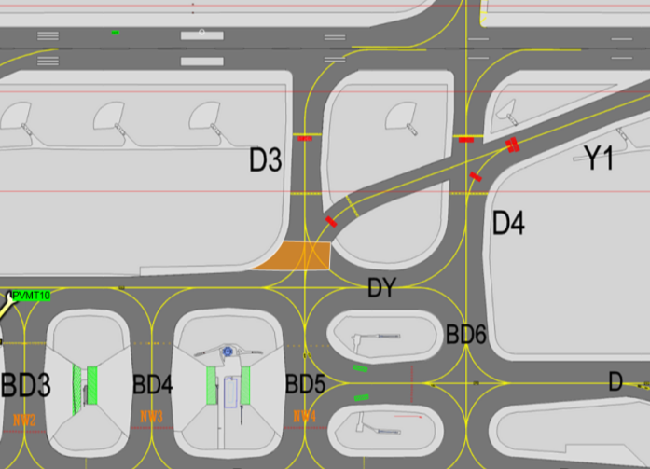
2 THE ALERTS
Situation 6: vehicule entering a closed/restricted area
Orange “restricted area” Alert
Sound: « bip » * 3

Slide 15
03
RESULTS

Slide 16
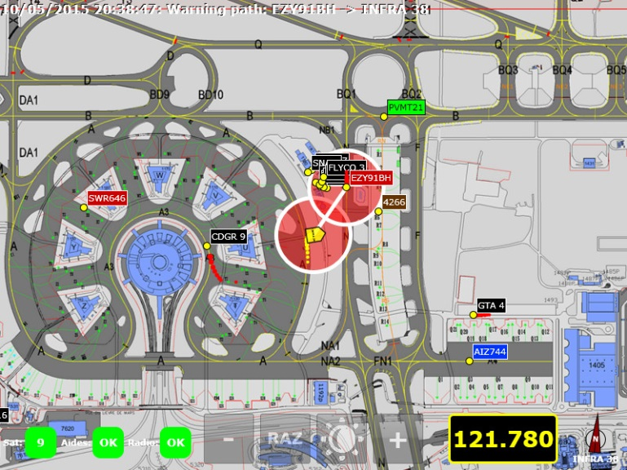
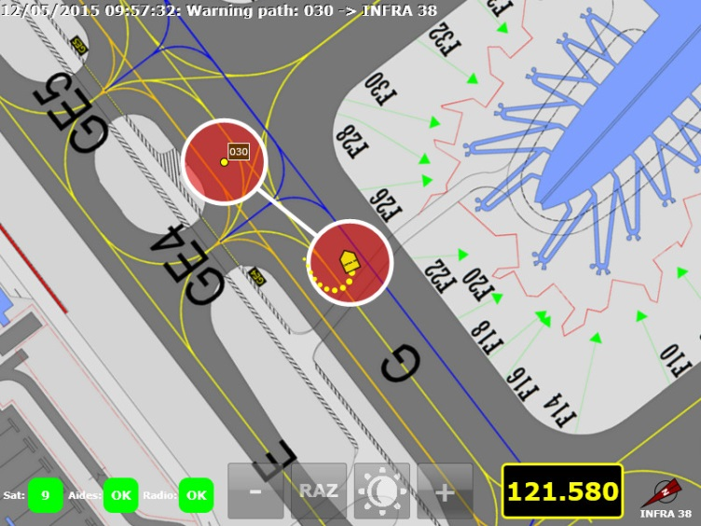
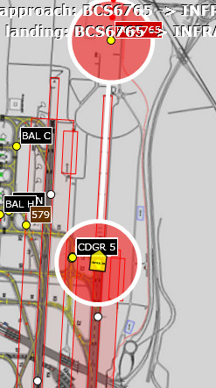
3 RESULTS
Very good overhall feed back from drivers, but room for improvement:
  system useful, especially runway alerts
  Orange/red alerts very efficient to get a feeling of the danger degree
  Need to enhance ergonomy
  Need to reduce the number of nuisance alerts
Ergonomy
  Need for better distinction of the vehicule and the aircraft on the screen
  Need for an explicit sound even for orange alerts

Slide 17
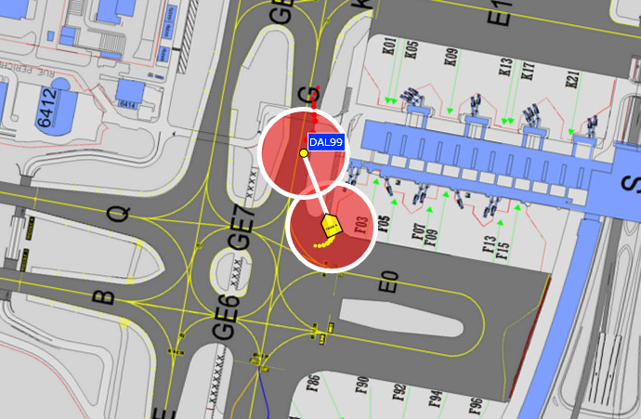
3 RESULTS
Settings: Too many alarms, especially for taxiways, need to take into account :
      LVP/ Non LVP conditions
      On runways, distance between aircraft and vehicle.
      Aircraft type (i/o A380 by default)
      airport layout (merging path not possible)

Slide 18
04
What’s Next?

Slide 19

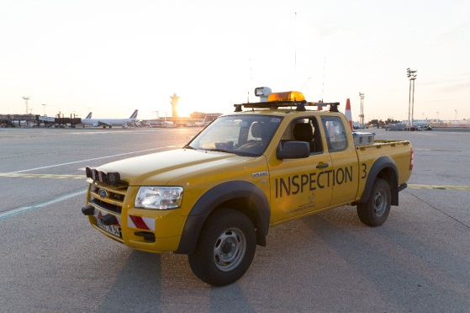
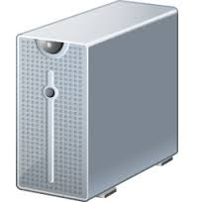
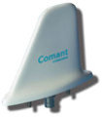
4 WHAT’S NEXT – Planning for AVD Deployment
Ergonomy enhancement
  Implement VLSD recommandations
  Make more live trials
Settings enhancements
  Calculate alerts from the central system: more precise
  Improve central system to get more detailed information (LVP, Rwy status)
Central system:
Alarm trigger
Other traffic
Alarm
Transponder data,
Radar
Alarm trigger
Own ship position

Slide 20


4 WHAT’S NEXT – Planning for AVD Deployment
Pre-requisit
  Central system improvement (SMAN Airport):
      LVP information
      Runway status (open/closed)
    Expected for Mid 2017
  New vehicle geolocalization system (SMAN Vehicle):
      More precise vehicle position
      More bandwidth needed to send alert to the vehicle
        => Expected early 2019

Slide 21


Slide 22
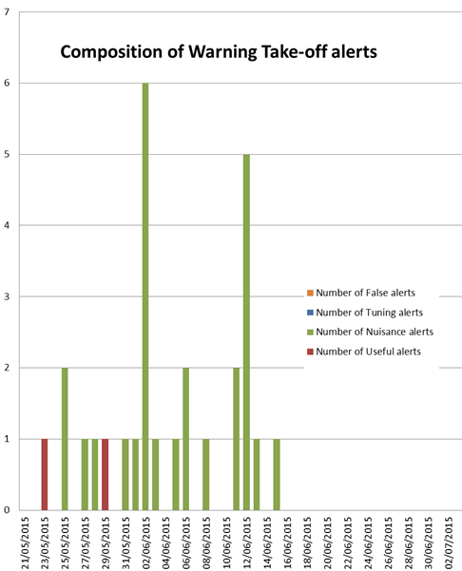
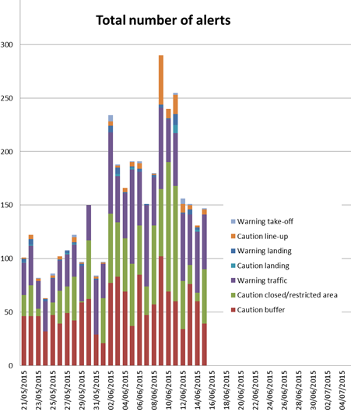
ANNEX: RESULTS – EXERCISE 2

