Slide 1

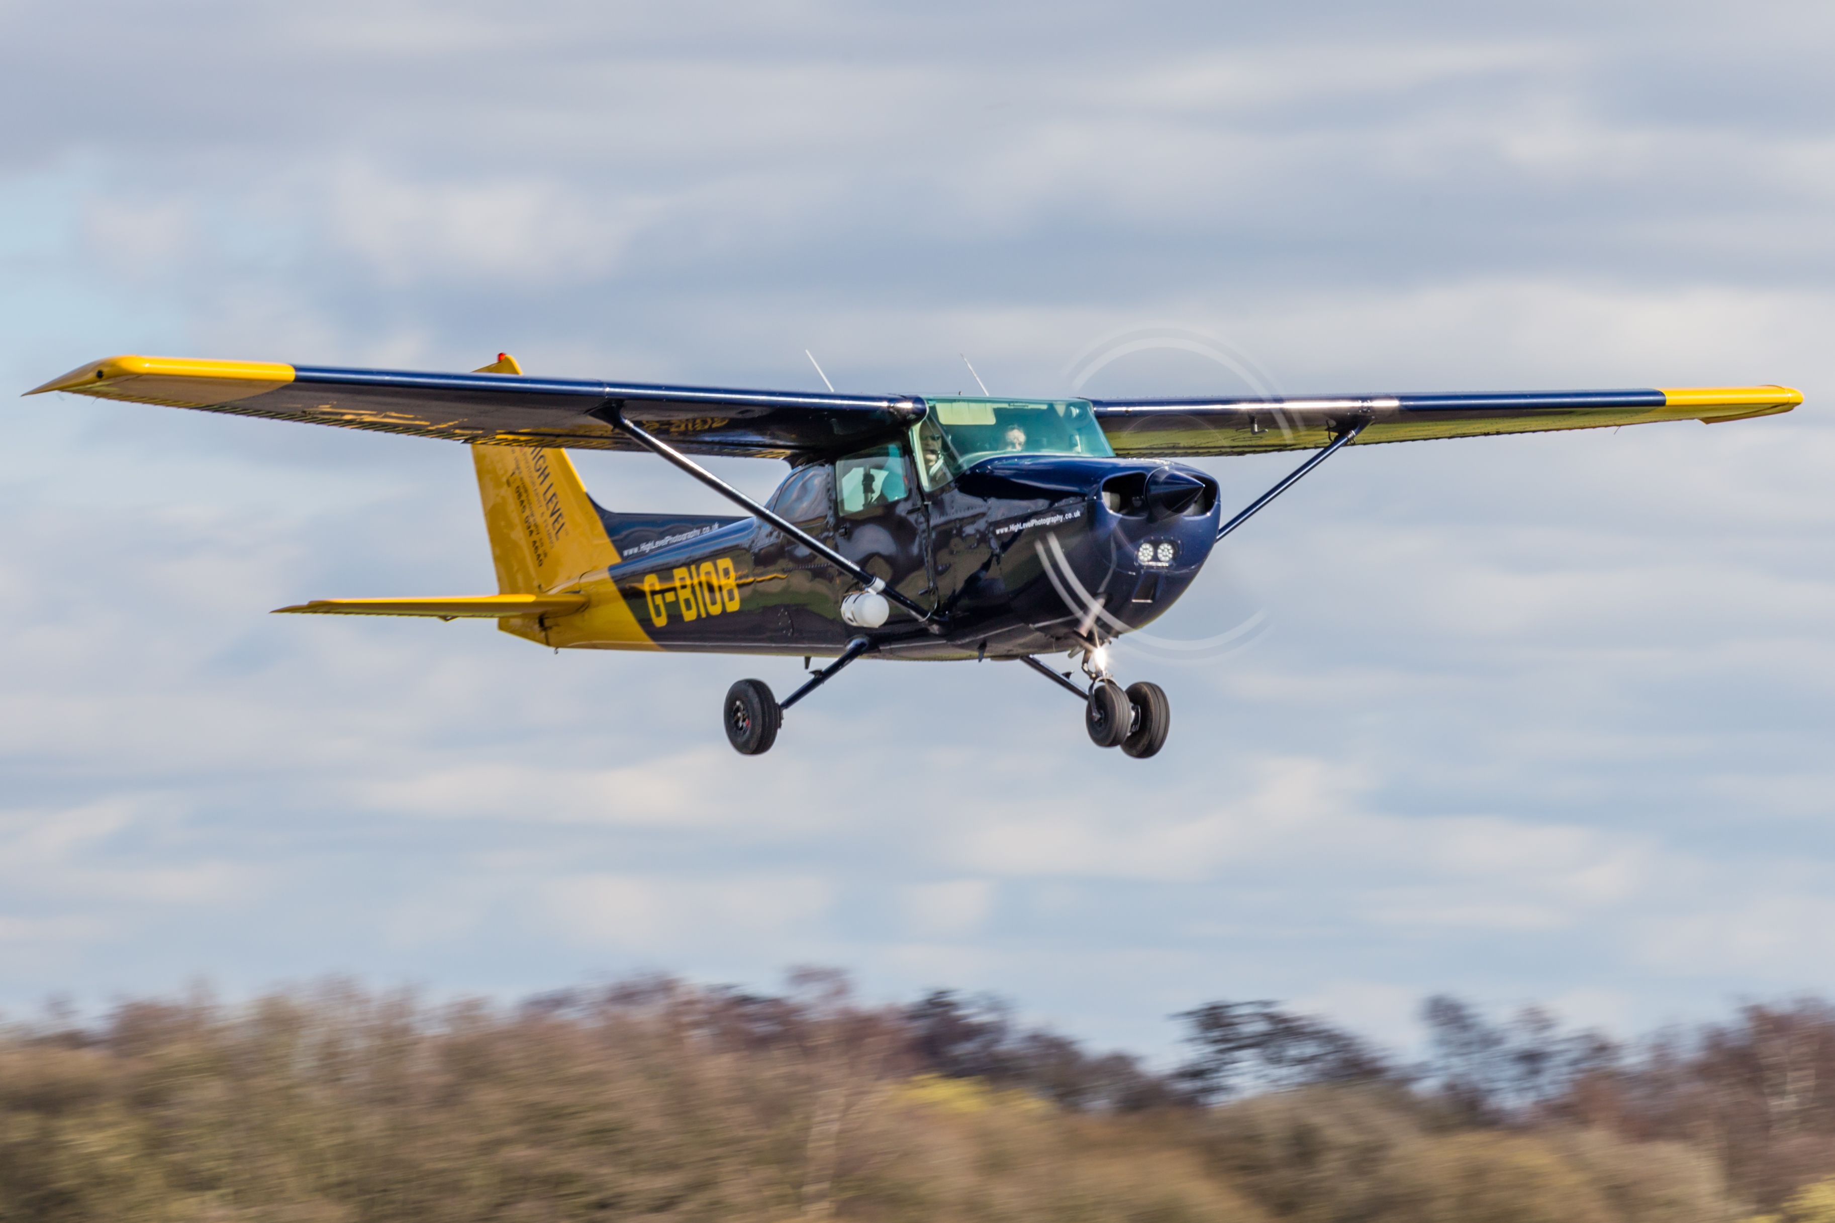
Aerial & ground survey specialists
+44 (0)20 3355 0274
info@highlevel.co.uk
www.highlevelphotography.co.uk

Slide 2
Airport safety considerations
Runway incursions & excursions – EAPPRI
Ground handling vehicles
‘Hotspots’
Signage – visibility and positioning (vehicle & aircraft)
Visibility on stands – pilot perspective
Visibility of ground markings from flight deck
Operating environment
Training structure
Human factors

Slide 3
What issues did Gatwick want to address?
Lead the way in UK airport training standards
Looking for a runway/taxiway incursion prevention tool
Live ‘up to date’ media
Investigations following incidents on the airfield
Project/development of the airfield – part of the design concept phase
Displaying real world views to consultants and designers
Visualization
Aid for computer imagery post change
Alternative perspective to ‘van runs’ – images are often in the drivers head!
Accurate training/briefing information for new pilots & drivers

Slide 4
Planning & preparation
Pre-meetings with airport authorities
Routes
Hot spots
Security
H&S in collaboration with airport policies
Vehicle considerations -
Signage
Backup
Manpower/resources
Different height image capture (vehicle or aircraft view)

Slide 5
Project execution
Security clearance
Liaison and planning with ATC
Airport staffing requirements
Vehicle/camera preparation
Briefing and resource assignment
Capture and verify
Integrating with aircraft traffic and other vehicles

Slide 6
Delivery & results
Address many of the EAPPRI recommendations – 1.1.4, 1.1.5, 1.2.5, 1.2.9, 1.2.13, etc.
Airside ‘street view’ – 360º images with 2 meter spacing
Web viewer selectable by area – virtual driver view
Used in training, briefing & incident reviews
Images at different heights – vehicle, small/large aircraft, etc.

Slide 7
60 second film

Slide 8
WHY NOT?

