Slide 1


Working Together
Preventing Runway Incursions (an integrated approach)
Conor Nolan – Aer Lingus
Dragos Munteanu - IATA

Slide 2
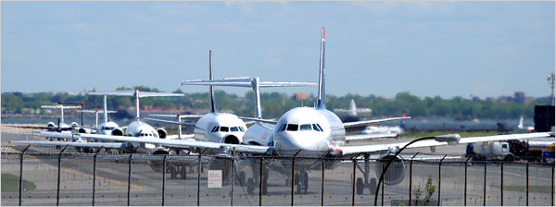
Runway Safety – A Common Approach?

Slide 3
Runway incursion: 5 Years Rate
 | Total STEADES Database-RWY Incursion (Q1 2012-Q4 2016) | Total STEADES Database (Q1 2012-Q4 2016)
Number of reports | 1,971 reports | 952,031 reports
Rate* | 0.038 reports per 1,000 flights | 18 reports per 1,000 flights
Frequency | 1 reports per 26,507 flights 1 reports per day | 1 reports per 55 flights 522 reports per day
*Sectors are based on IATA SRS (Schedule Reference Service) Database.
STEADES flights represent 36 percent of global SRS flights.
The above rate represents the lower measure of the true number of such events that are occurring, due to the different reporting cultures of members, as such the true number of events occurring could be higher.
Copyright ©2017 International Air Transport Association. All rights reserved.
Subject to restrictions and disclaimer.

Slide 4
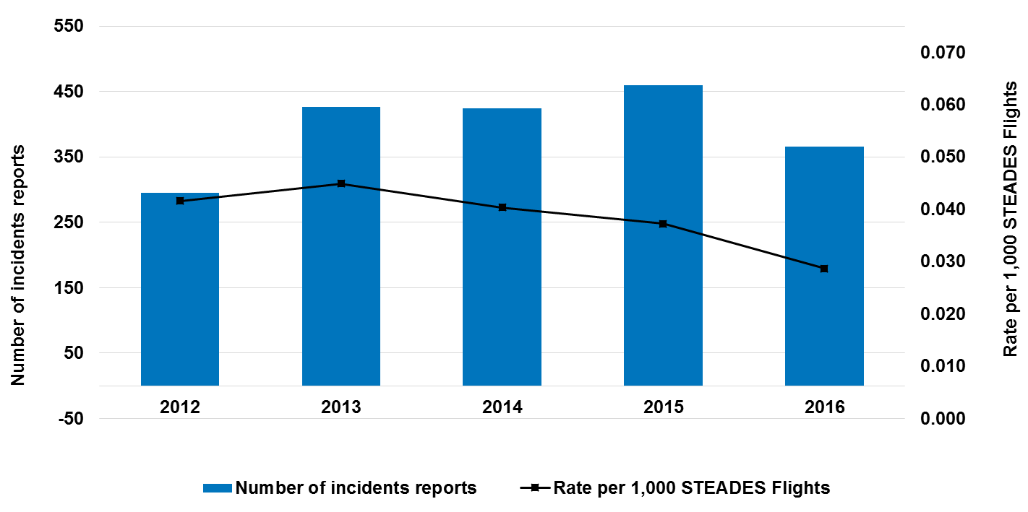
Runway incursion: Global Yearly Distribution
This graph shows the yearly distribution of the total number of reports (1,971) for the period 2012 Q1 to 2016 Q4 inclusive.
2013 had the highest rate with 0.045 reports per 1,000 STEADES flights.
The lowest rate was for 2016 with 0.029 reports per 1,000 STEADES flights.
*Sectors are based on IATA SRS (Schedule Reference Service) Database.
Copyright ©2017 International Air Transport Association. All rights reserved.
Subject to restrictions and disclaimer

Slide 5
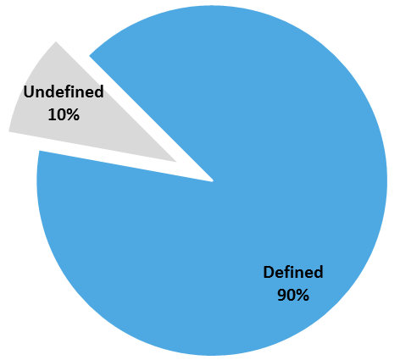
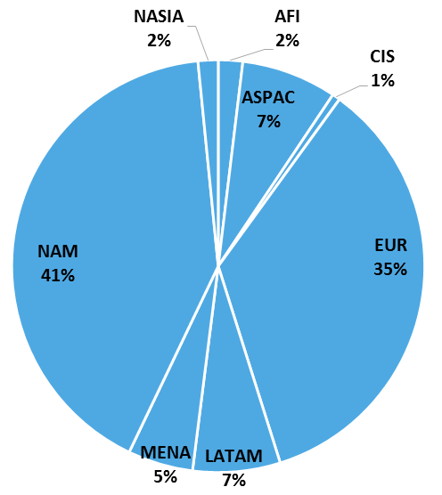
Runway incursion: Region of Occurrence
90% (1,781) of reports contained information regarding the region of occurrence
For these reports, the regions with the highest number of occurrences were NAM (41%) and EUR (35%).
Copyright ©2017 International Air Transport Association. All rights reserved.
Subject to restrictions and disclaimer

Slide 6
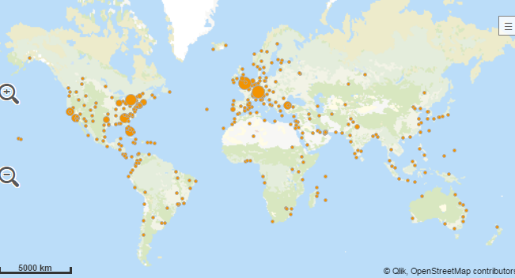
Runway incursion: Map Distribution
The map shows the airport of occurrence distribution for the reports which contained this information (90%, 1,781 reports)
Copyright ©2017 International Air Transport Association. All rights reserved.
Subject to restrictions and disclaimer

Slide 7
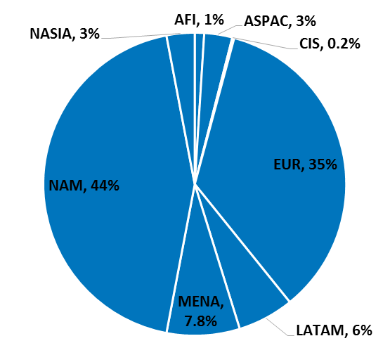
Runway incursion: Region of Operator
NAM operators had the highest number of reports with 863 reports. This represented 44% of the total number of reports (1,971).
The second position in the ranking was for EUR operators with 35% (689 reports).
Copyright ©2017 International Air Transport Association. All rights reserved.
Subject to restrictions and disclaimer

Slide 8
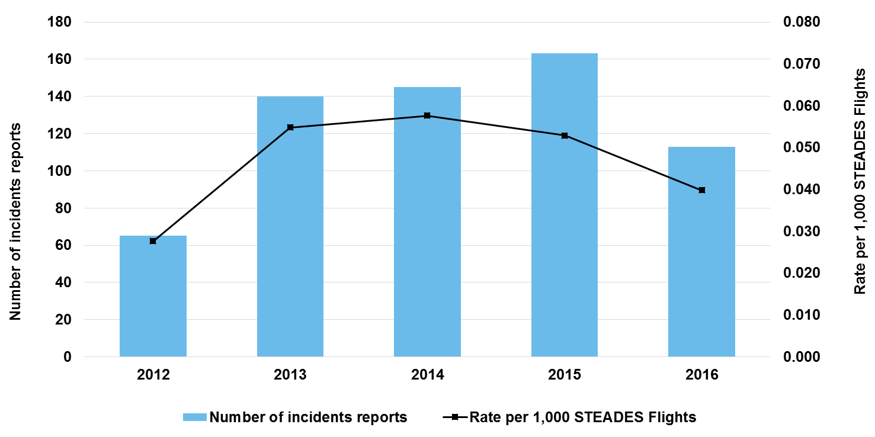
Runway incursion: Yearly Distribution - EUR
This graph shows the yearly distribution of the reports with EUR as a region of occurrence (626 reports).
2014 had the highest rate with 0.058 reports per 1,000 STEADES flights.
The lowest rate was for 2012 with 0.028 reports per 1,000 STEADES flights.
*Sectors are based on IATA SRS (Schedule Reference Service) Database.
Copyright ©2017 International Air Transport Association. All rights reserved.
Subject to restrictions and disclaimer

Slide 9
Sample STEADES narrative
“After start sequence completed, aircraft requested taxi instructions. The received clearance was to enter and backtrack runway 32. The clearance was read back exactly as heard. The aircraft was moving taxi out and its nose landing gear has already crossed the runway holding point to enter the runway, Flight Crew heard that AFIS zzz instructed to hold on short. In the meantime, a small traffic, reported as registration XX-XXX was doing a touch and go. At that moment, both Flight Crew saw a single engine airplane already occupying the runway in front of aircraft. The traffic made a touch and go and avoided collision by only a few meters.”

Slide 10
Runway incursions – still a “hot” topic?
Is past performance a guarantee for the future?
Constant update and improvement of all involved actor’s Safety Management Systems is necessary with the aim of identifying conditions leading to potential runway incursions.
The actors must collaborate to integrate their safety systems and activities relating to the runway environment considering the high number of parties involved: Aircrew, ATC, Ground vehicles of different types.
Sharing of safety information is vital in order to identify and react to safety concerns.
Harmonization of procedures and practices at the global level is a necessity to ensure safe runway operations

Slide 11

Identification - Preventing Runway Incursions?
Hazard Identification and Risk Analysis
  Landing and vacating
  Taxi in – crossing runways
  Taxi-out – crossing runways
  Use of runways as taxiways
  Red-stop bar protocols
  Low vis Procedures
  Runway vehicle ops, construction
  Airport specific – hot-spots, language, non-standard markings/signs
SOPs – Effectiveness, Best Practice
Local Runway Safety Teams – Risk Knowledge

Slide 12
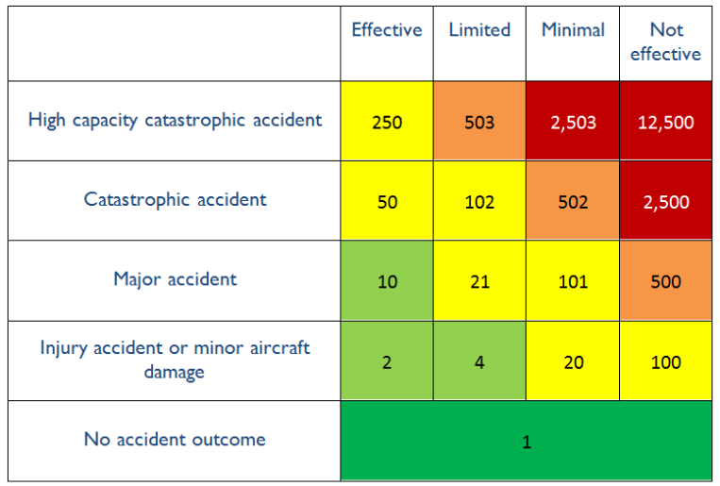
Collaboration - Reducing RI risk
Low Frequency but High Severity – High Risk
Most Credible Outcome – Catastrophic
Effectiveness of Barriers - ?
Low number of accidents compared to other accident types – Data poor
Collaborative approach to further reduce the frequency of runway incursions
  Involve all stakeholders
  Identify hazards
  Document mitigations
  Promote best practice – IOSA Standards
  Share information and experience
  Ensure message is heard
  Monitor effectiveness

Slide 13
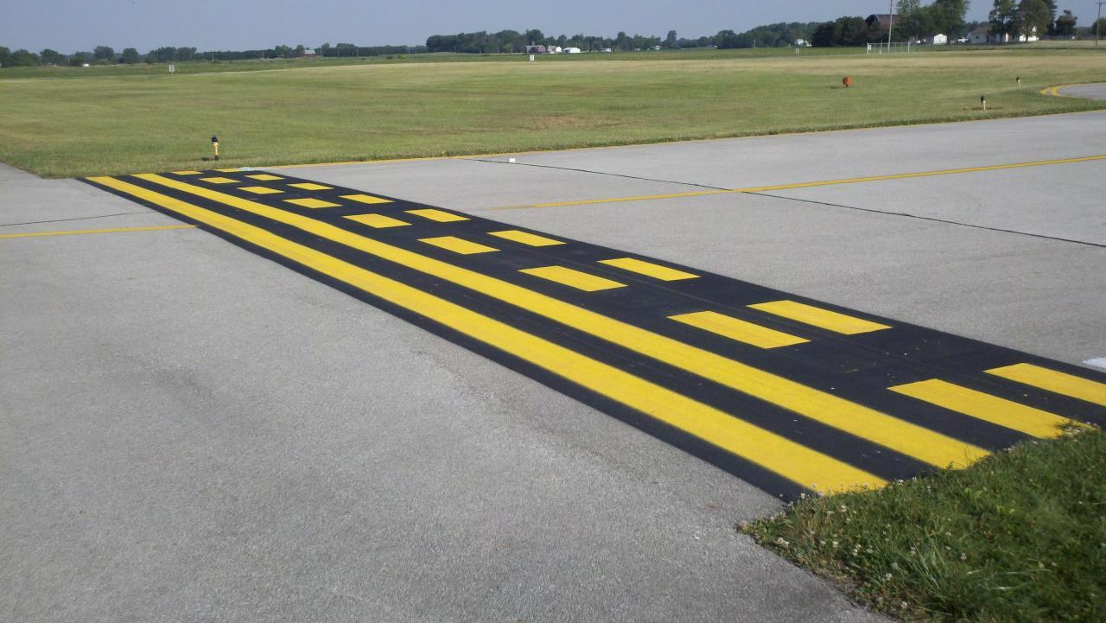
Integration – LRST Best Practice
NAA Sponsored
Airport Authority Coordination
Aircraft Operator Support
Airport User Participate
Safety Information Exchange
Shared Definitions, Metrics
Action Plans

Slide 14
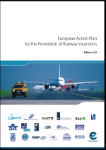
Harmonization - Promoting Best Practice (EAPPRI)
Pre-flight briefing
  Airport knowledge, normal parking, normal taxi-route, hot-spots
  PA complete prior to push back
Taxi clearance
  Shared plan, clear route understanding
  Task sharing, heads in/out
  No PA, minimal cabin comms (use of ECAM Cabin Ready)
  Use of lights as aide-memoir
Taxi-phase
  Progressive confirmation, next turn, agreed between crew, use of charts
  Healthy doubt, appropriate clarification
  See and avoid, trust no-one
Approaching any runway
  Intersection confirmation
  Red stop bar protocol
  Use of lights, strobes, TCAS
  Clearance heard, confirmed (both pilots) and readback
  Visual check
  Runway identification, alignment, cross wind, crossing traffic

Slide 15
Conclusions
Sharing of data is vital – MoRs, Eurocontrol, ICAO, IATA (STEADES, HITF) etc.
Working together with all the affected stakeholders – Runway Safety Teams, integration of SMSs
Adoption and usage of international best practices
Training and awareness

Slide 16


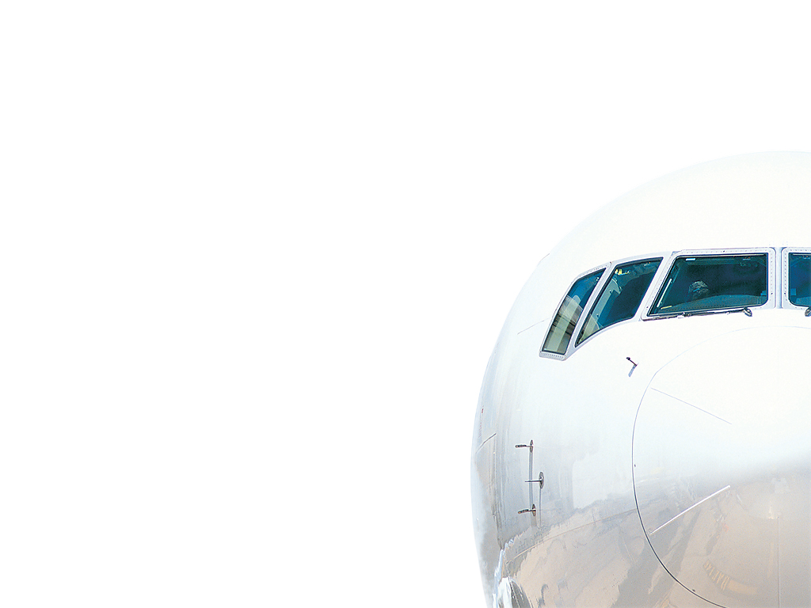
For information on this or any other GADM analysis products, please e-mail us at:
gadm@iata.org

