Slide 1
Work in Progress Build Safety Together
Safety Forum Eurocontrol
Geoffroy Chevalier – French DGAC
Airport and Air Navigation Safety Directorate

Slide 2
Introduction
Work in Progress at airports contribute to the risk of runway incursions
In the situation of work in progress, interfaces between different actors have to be properly managed to ensure safety
DSAC organizes its annual symposium on work in progress at airports

Slide 3
Agenda
DSAC Symposium
The example of Lyons ground quasi-collision in september 2013
Coordination with platform’s users

Slide 4

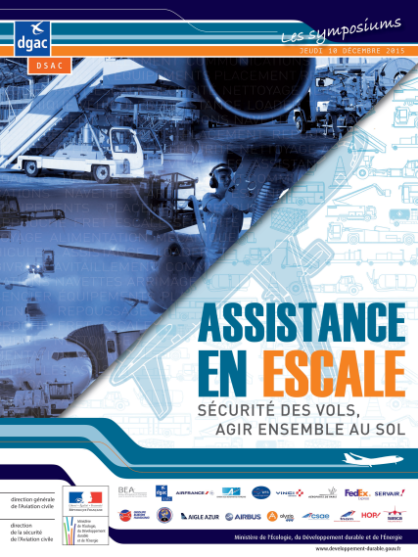

DSAC Symposium
DSAC : French National Supervision Authority
7th December 2017 : DSAC’s Symposium
Theme : work in progress
Creation of a working group to organize the event : DSAC, French ANSP, BEA, French Airport operators, Airlines, French Aviation Technical Service, Airports Organisations…
4 main subjects related to work in progress :
Coordination with platform’s users
Coordination between the operator and the ANSP during and after the construction
Coordination between the actors involved during construction preparation
Training the construction field operators

Slide 5
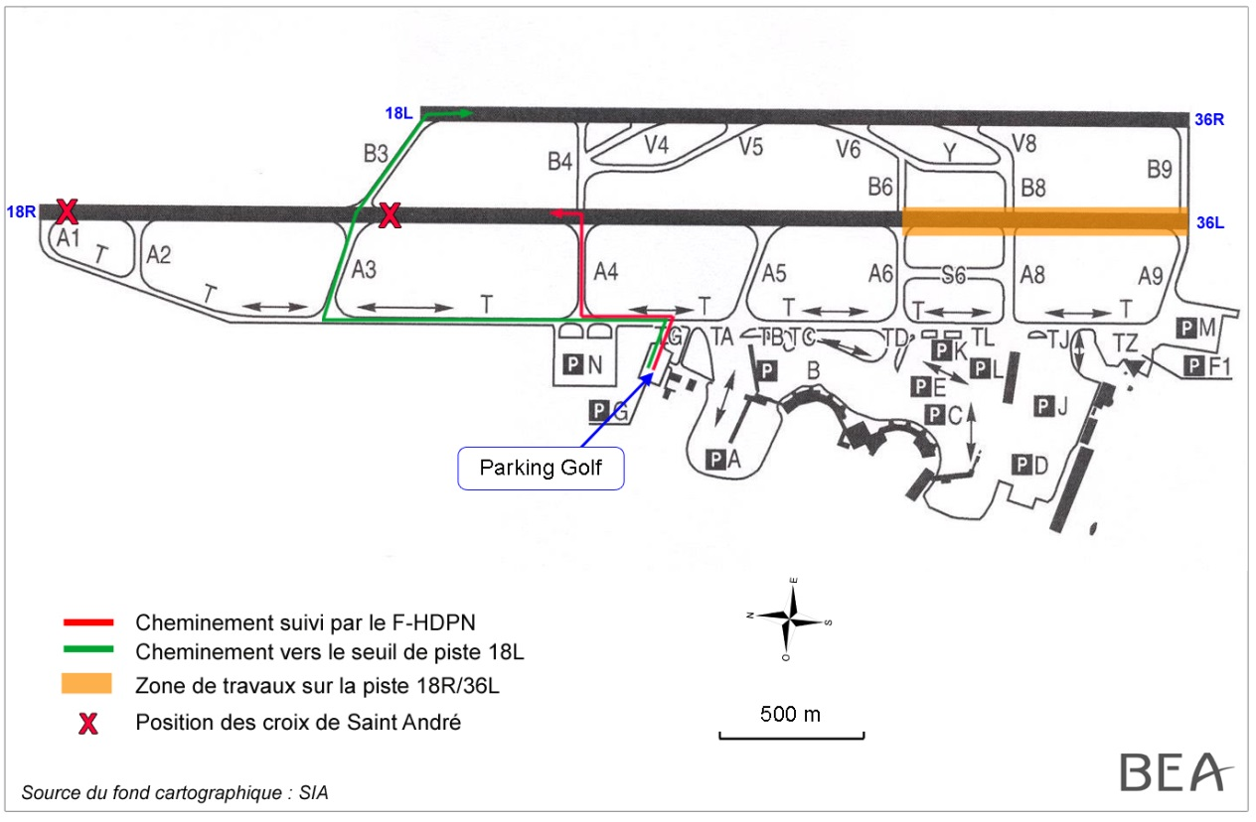
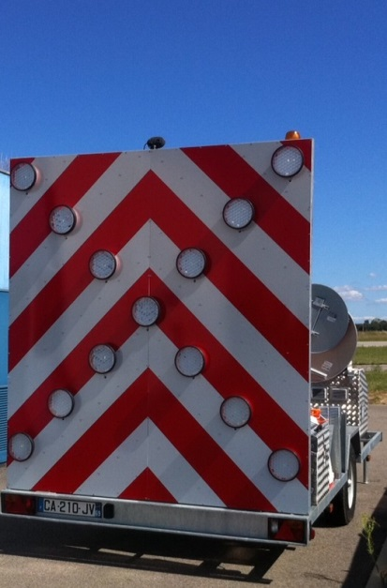
Lyons ground quasi collision
September 5th 2013. 3:35 AM local time

Slide 6
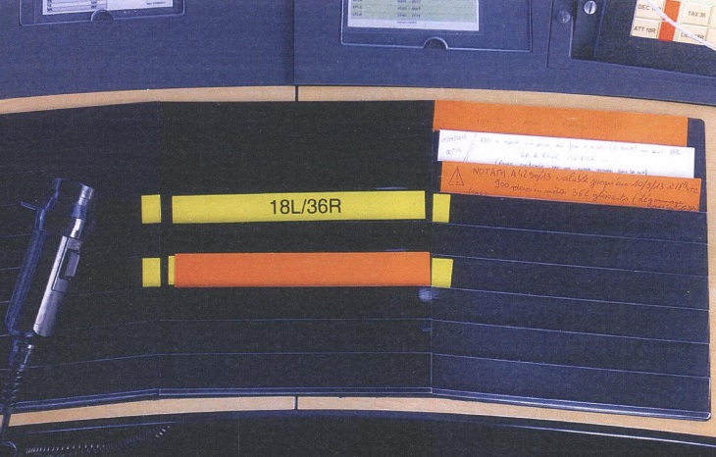
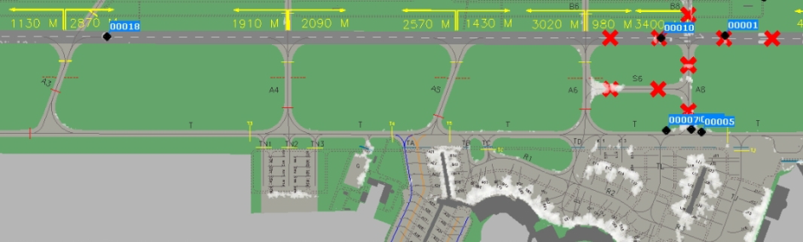
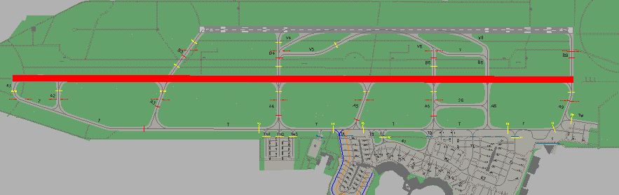
Lyons ground quasi collision
Contributive factors :
Work in Progress preparation
Airport infrastructure and lighting
Ground surveillance and HMI
Strip management
Control working methods
Service organization
Urgence feeling of a sanitary evacuation
Low traffic at night

Slide 7
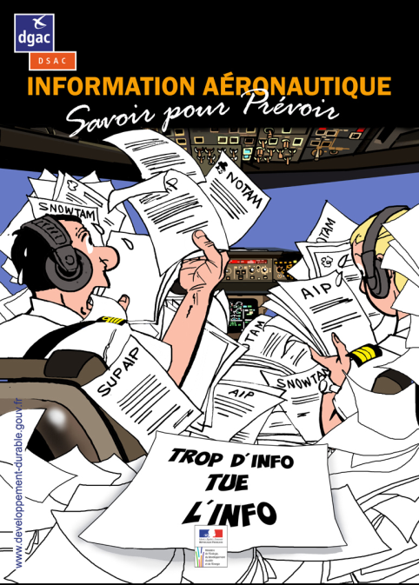
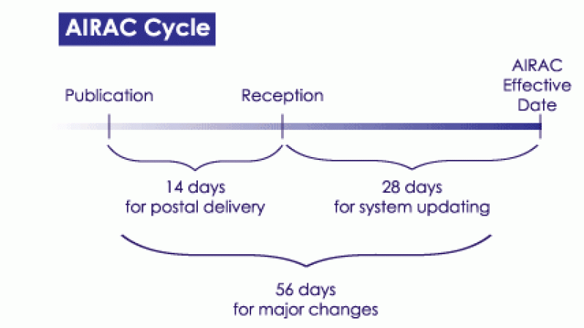

COORDINATIOn with users – AEROnautical information
The aeronautical data provider should be trained to AIRAC specifications and respect the AIRAC cycle to avoid NOTAM proliferation

Slide 8

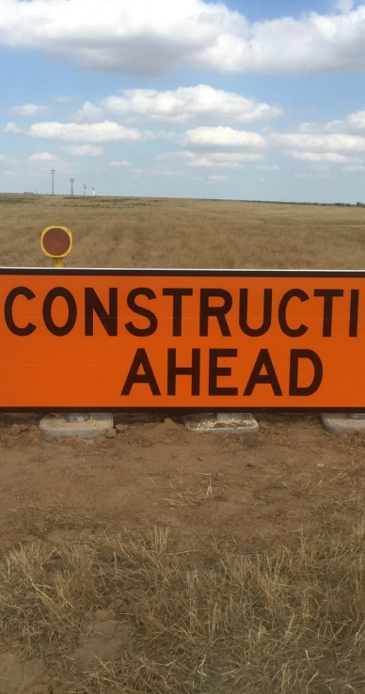
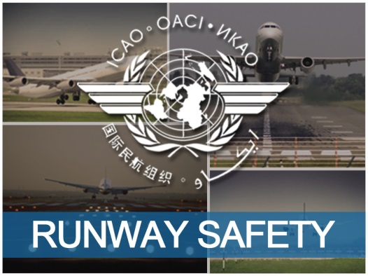
COORDINATIOn with users – Going further than Aeronautical information
Collaborative Decision Making (CDM)
Specific meetings with platform’s users
Presentation to the citizen living close to the airport
Presentation to the Local Runway Safety Team
Take into account the airlines in safety studies
Use of signs and markings related to work in progress

Slide 9
Conclusive remarks
Lyons ground quasi collision (plus other events) highlight the need of more coordination between actors involved in work in progress at airports
Coordination with platform’s users is one way to enhance safety
DSAC symposium will tackle many more subjects → rendez-vous on Thursday, December 7th 2017 at DGAC headquarters in Paris

Slide 10

Questions & answers

