Slide 1



Ground Movement Control System
Effective Organisational Safety Collaboration
Bruce Evans
Heathrow Airport Ltd.
John Holmes
NATS Ltd.

Slide 2
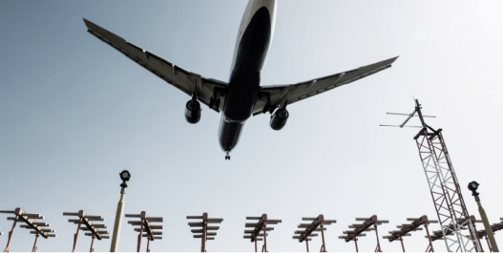
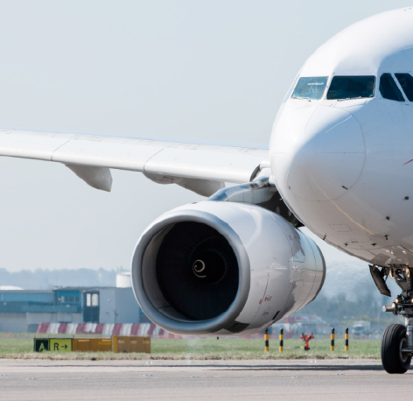
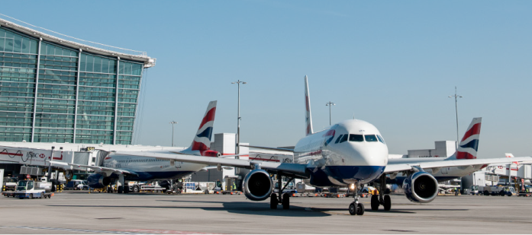
Heathrow Airport
4
Daily average of
Annually
1,350
477,000
movements
movements
Monthly movement record of
75,000,000
Passengers
Daily record of
Hourly record of
42,030
1,390
100
July 2011
movements
movements
26th June 2015

Slide 3
What Are We Doing?
Existing AGL system at Heathrow
  Used for visual indication to pilots and other users of ATC instructions (ground movement)
  Controls access to the runway
  “Follow the Greens” route assistance to pilots
Control System requires replacement
  Existing AGL luminaires & block control retained
  Required for business resilience

Slide 4
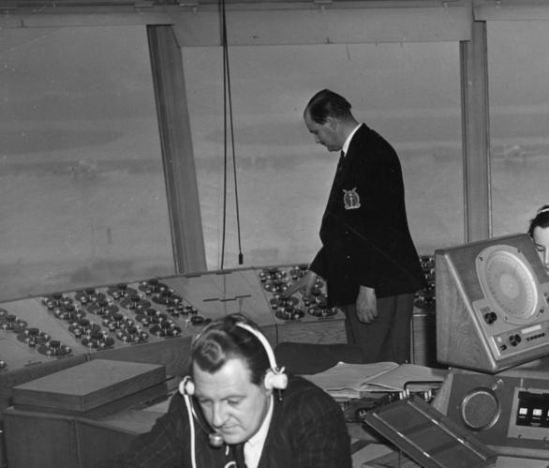
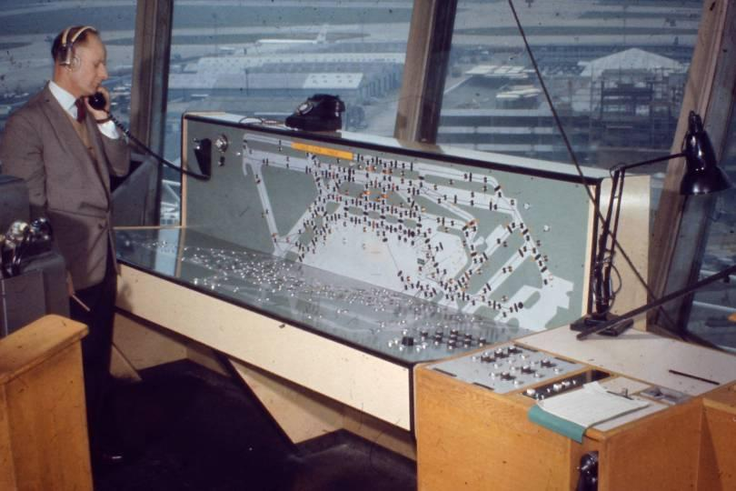
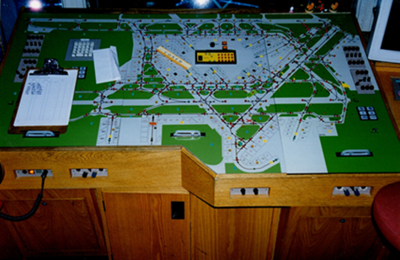
Follow the greens at Heathrow since 1950s

Slide 5
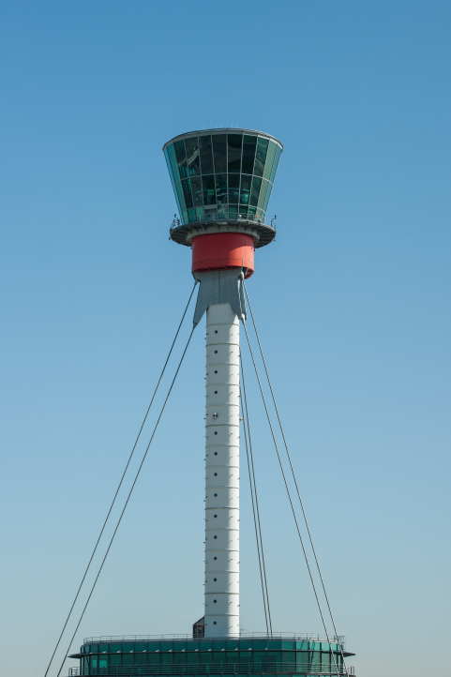
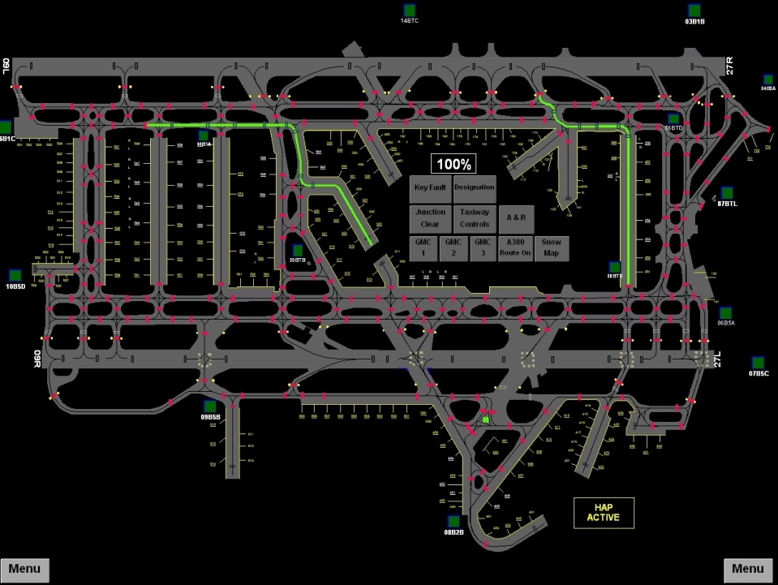
Last Design Approach (2003)
ATS Approval
Safety Case
ATS Risk
Aerodrome Approval
Safety Assurance
Aerodrome Risk
Design Assurance

Slide 6
Heathrow Strategic Partnership
HAL and NATS signed a Partnership Agreement in April 2015.
    jointly created a long term business partnership with shared objectives aligned to what Heathrow is seeking to deliver
    performance led in areas such as delay, service resilience, safety and aircraft noise reduction
    drives year on year performance improvement through innovations in service and technology
Set up a Partnership Joint Project to replace GMCS/AGL

Slide 7
New Approach
Single Cross-Organisational Project Team
Development of single ‘End to End’ Risk Scheme
  Directly linked to Aircraft Consequence
    Catastrophic Minor (EASA CS-25.1309)
  Single Integrated E2E Hazard Identification
  Severity Assessment
  Layers of Protection Analysis
    People (Pilot / ATCO /LPO) - these are the only independent layers
    Equipment
    Procedures
Building an understanding of Pilot Behaviours
  Direct Input to Hazard Identification
  Survey of Pilots
  E.g. Positive Expectation Bias ‘Lit Greens ≡ ATCO Intent’

Slide 8
Holistic Design
True understanding of AGL in Service Delivery
  What is the system protecting?
    How is it actually used by Pilots / Drivers?
    How is it used by LPOs?
    How is it used by ATCOs?
    Known operational and functional shortcomings in existing system?
  What is existing system designed to deliver?
  Delta (difference - what needs to change)?
Design Holism
  System / Infrastructure
  Operational and Technical Processes / Transition

Slide 9
Expected Safety Improvements
System Harmonisation (HARD)
  Design Specification
  Design Process agreed
  Builds justification for investment decisions
System People and Procedures (SOFT)
  Operational Functional Narrative
    Improvement based upon Delta and Experience
  Flexible Adaptation - increased speed of changes and fewer core software changes
  Integration of culture and behaviour
Combined to deliver Person Centred led Design Approach
Results in Truest understanding of AGL (Ground Movement) in Aircraft Safety

Slide 10
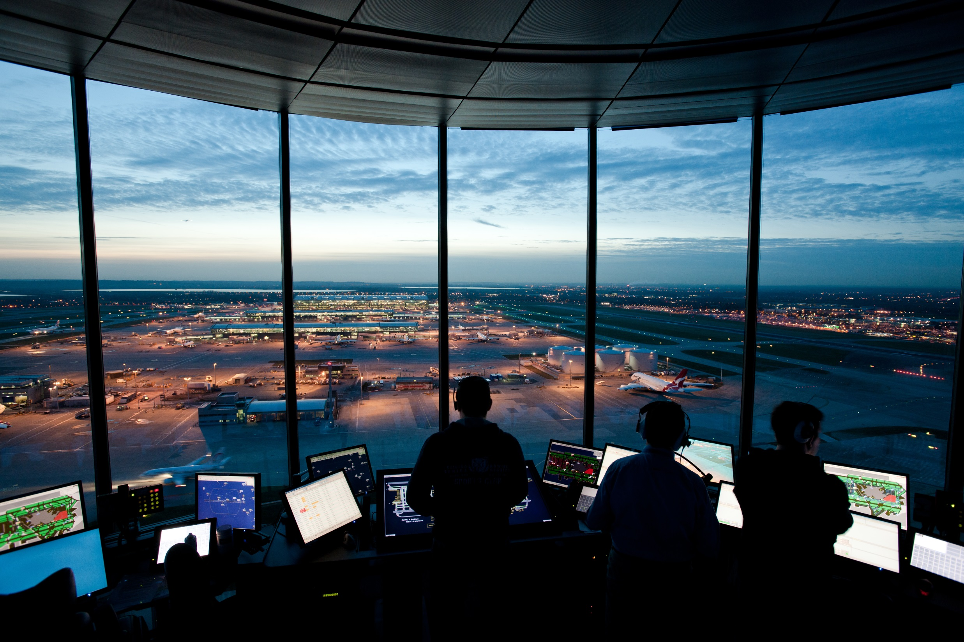
Questions?

