Slide 1

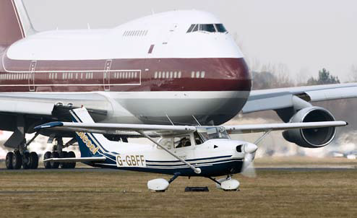
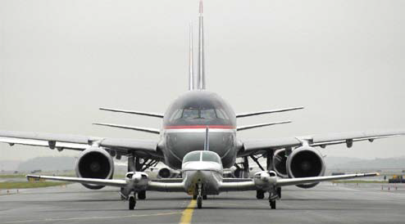
Runway Safety Strategic Plan 2018-2020

Slide 2
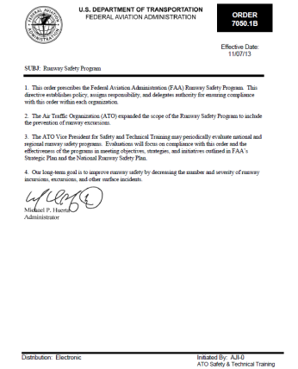
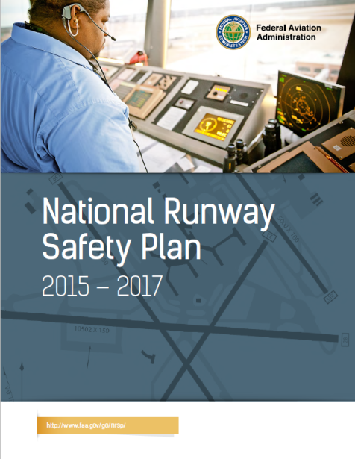
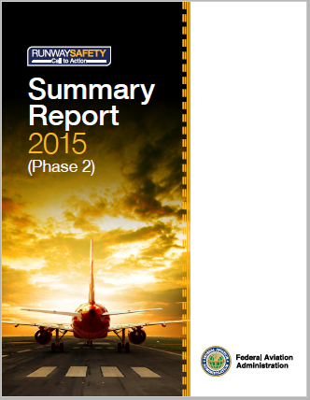
FAA Runway Safety Program Requirements
FAA Runway Safety Program Order
This order prescribes the Federal Aviation Administration (FAA) Runway Safety Program.
This directive establishes policy, assigns responsibility, and delegates authority for ensuring compliance with this order within each organization.
The Air Traffic Organization (ATO) expanded the scope of the Runway Safety Program to include the prevention of runway excursions.
The ATO Vice President for Safety and Technical Training may periodically evaluate national and regional runway safety programs. Evaluations will focus on compliance with this order and the effectiveness of the programs in meeting objectives, strategies, and initiatives outlined in FAA’s Strategic Plan and the National Runway Safety Plan.
Our long-term goal is to improve runway safety by decreasing the number and severity of runway incursions, excursions, and other surface incidents.
FAA National Runway Safety Plan
The National Runway Safety Plan is a living document that incorporates these objectives and outlines the FAA’s medium-term runway safety strategic vision.
The 2015-2017 National Runway Safety Plan (referred to herein as the “Plan”) directly supports the Administrator’s Strategic Priorities, including the initiatives to make aviation safer and smarter in the nation’s airports by moving to risk-based decision making; enabling the safe and efficient integration of the Next Generation Air Transportation System; and demonstrating glob-al leadership in improving air traffic safety and efficiency through data-driven solutions that shape international standards.
FAA Call to Action
The Runway Safety Call to Action (C2A) convened on June 24, 2015, with 108 representatives from industry, labor, and government.
The “Call” was summoned by the FAA Administrator and was a follow-up to the 2007 Call to Action Safety Summit. Here, the Summit established a five-point, short-term Call to Action Plan that was completed, while the mid- and long-term Call to Action Plans involving technology improvements are either complete or are now in their final stages of deployment.
Notes:
Describe exactly what your team does:
-Serves as the focal point for all FAA runway safety efforts and as the agency’s primary representative to industry, national, and international aviation bodies on runway safety.
As prescribed by FAA Order 7050.1B – Runway Safety Program:
Runway Safety Group (Runway Safety).
a. Works with other FAA organizations and the aviation community to improve runway safety.
b. Develops policy on the proper classification and risk assessment of surface events, maintains appropriate metrics, and collects and classifies official data on surface events for the FAA.
c. Determines whether surface events are runway incursions, runway excursions, or surface incidents, and classifies the severity of runway incursions.
d. Conducts periodic reviews of the Runway Incursion Assessment Team results.
e. Conducts analysis of individual surface events and overall runway incursion and excursion statistics and documents and publishes information on trends, risk factors, and lessons learned.
f. Identifies runway incursion and excursion risks and influences their reduction.
g. Researches, develops, and distributes products associated with safe surface operations on runways and taxiways.
h. Collects and publishes information on runway safety best practices for airport operators, pilots, and air traffic controllers.
i. Periodically reviews the effectiveness and impact of procedures, policies, and practices on surface safety.
j. Determines locations for regional and special focus RSAT meetings in cooperation with the Service Area Runway Safety Team Manager, the RRSPM and the RRST(s).
k. Establishes and maintains standard procedures for regional and special focus RSATs.
l. Provides recommended standards and practices for the conduct of local RSATs.
m.Provides at least one member of the Airport Construction Advisory Council.
n. Participates in the Regional Runway Safety Governance Council.
o. Ensures that Service Area Runway Safety Teams are executing national priorities and initiatives, and that a level of standardization across service areas and regions is maintained.
p. Ensures that the Runway Safety Web page is updated with current information and that any links are valid.
q. Develops and maintains a Runway Safety Maturity Model (RSMM) in collaboration with appropriate FAA lines of business and aviation industry partners, as appropriate.
r. Coordinates requests for data on surface events from person(s), operator(s), certificate holder(s), or any related organization(s) which may be the subject of an investigation surrounding the surface event with the organization that has investigative authority for the subject event. Refrains from contacting such personnel directly unless the investigative authority grants permission for direct contact.
Service Area Runway Safety Team Managers.
a. Manages and allocates all ATO resources as required to execute the Runway Safety Program in the service area.
b. Provides a single point of contact for the Runway Safety Program for ATO organizations within the service area.
c. Ensures that Runway Safety initiatives involving ATO organizations are common throughout the regions comprising the service area.
d. Identifies key initiatives included in the National Runway Safety Plan for possible inclusion into the Regional Runway Safety Plans within the service area.
e. Reviews and approves Regional Runway Safety Plans and submits them to the Runway Safety Group Manager for final approval.
f. Manages the process of determining whether events reported as Mandatory Occurrence Reports (MOR) are determined to be runway incursions, runway excursions, or surface incidents, and supports entry of the incursion data into the national database.
g. Represents the Runway Safety Group in all matters involving surface safety at the service area level.
h. Monitors and participates in the National and Regional Runway Safety Governance Councils.
i. Analyzes individual surface events and identifies and forwards appropriate follow up actions to the appropriate FAA line of business.
j. Analyzes data on surface events to identify service area and regional runway safety trends and issues, best practices, and lessons learned.
k. Works with RRSPMs within the service area to determine appropriate locations for regional and special focus RSATs.
l. Provides support for local RSATs whenever possible.
m. Identifies, coordinates, and initiates activities to improve runway safety that involve ATO organizations.
n. Tracks the status of action items assigned in RSAP for all airports within the Service Area.
o. Supports the execution of the Surface Risk Assessment Program and the Air Traffic Safety Action Program in the ATO Safety and Technical Training Service Area Office.
p. Informs the Runway Safety Group Manager of all matters involving systemic surface safety issues occurring within the service area.
Regional Runway Safety Program Managers (RRSPM).
a. Represents the Runway Safety Group in activities within the region.
b. Coordinates all runway safety activities, issues, and objectives with the Regional Administrator and regional Line of Business (LOB) team members.
c. Leads the RRST. (Note: The RRSPMleads those key members assigned to the team on a collateral basis only when they are performing runway safety duties.)
d. Develops and implements the Regional Runway Safety Plan to support the surface event reduction initiatives and strategies in the NRSP.
e. Initiates and implements runway safety outreach programs and activities, and conducts and participates in activities such as:
(1) Pilot seminars, flight instructor refresher clinics (FIRC), flight schools, and Aviation College programs.
(2) Air shows and fly-ins.
(3) Meetings with the aviation community.
(4) RSAT meetings.
(5) Aviation Maintenance Technician Workshops (AMTs) and Certified Flight Instructor/Designated Pilot Examiners Workshops/Conferences (CFIs/DPEs).
(6) State aviation conferences.
(7) Regional airport conferences and safety expos.
(8) Outreach visits to airports, ATCTs, and other locations.
f. Works with the RRST to submit proposed regional RSAT locations to the Runway Safety Service Area Team Manager.
g. Schedules and accomplishes regional RSATs at airports within and occasionally outside the region.
h. Participates in and/or supports local RSAT meetings.
i. Determines whether RSAPs meet the requirements of this order, provides feedback to RSAT chairpersons on compliance, and accepts all RSAPs within their region.
j. Approves RSAPs for regional RSATs.
k. Identifies, coordinates, and initiates activities to improve runway safety, including those that cross the responsibilities of two or more FAA organizations within the region.
l. Measures the effectiveness of implemented recommendations (primarily resulting from RSAP) intended to reduce surface events. 11/07/13 7050.1B 7
m. Participates in Safety Risk Management (SRM) panels when possible and reviews Safety Risk Management Documents (SRMD) for surface movement risks. Support requests from SRM panels for data or input when participation is not possible.
n. Collects data on surface events when necessary to support severity classification and/or analysis of individual events or trends.
o. Participates in the Regional Runway Safety Governance Council (if applicable).

Slide 3
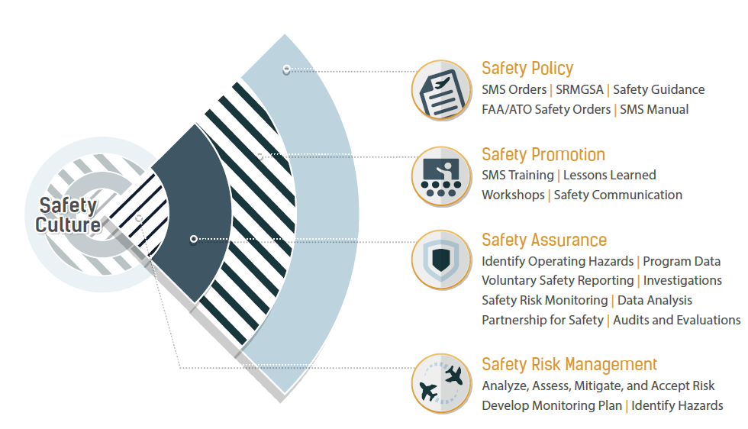
Program Review
Supporting FAA’s core mission
FAA Runway Safety Program Order
This order prescribes Roles and Responsibilities in the FAA’s Runway Safety Program
Notes:
ATO Safety and Technical Training.
a. Serves as the focal point for all FAA runway safety efforts and as the agency’s primary representative to industry, national, and international aviation bodies on runway safety.
b. Develops, coordinates, maintains, and executes a National Runway Safety Plan (NRSP), which describes a comprehensive and cohesive runway safety strategy.
c. Allocates and manages resources as necessary to achieve program objectives.
d. Provides executive level oversight and direction for the Runway Safety Program.
e. Provides for the integration of surface events into the ATO Quality Assurance Program.
f. Sponsors the Airport Construction Advisory Council and provides contract and travel funding support as defined in Appendix 4 of this order.

Slide 4

Runway Safety Metric: Background
The primary goal of safety metrics is to gauge the safety performance of the National Airspace System (NAS), at the system and facility levels.
Existing runway safety metrics focus solely on runway incursion type counts, not accidents and excursions.
RSM Goal: Develop a runway safety metric that includes accident, Runway Excursion (RE), Runway Incursion (RI), and Surface Incident (SI) data.
Notes:
Our current metrics can be deceiving:
Better reporting participation increases incident counts but should not be counted negatively.
If more incidents turn into accidents, our incident count-based metrics would decrease, but this should not be viewed positively.
Conversely, if we are doing a better job keeping incidents from becoming accidents, our incident count-based metrics would increase, but this should not be viewed negatively.
We can improve metrics by:
Combining accident and incident data in a single metric
Focusing on event risk rather than incident counts

Slide 5
Approach
Collect applicable accident and incident data.
  National Transportation Safety Board (NTSB), RI-SI, and RE data sources
Use modeling to assign risk weights to all kinds of outcomes.
  Weighted outcomes include injuries, damage, incursion types, surface incidents, and excursions
  Weights are based on outcomes’ “proximities” to fatality and are ordered based on SME input [Injury → Damage → Incident]
  For accidents, weighting gives some credit for saving lives and minimally-damaged aircraft
Aggregate all event weights for each fiscal year to get a FY score.
Notes:
General approach
Collect all surface movement area accident and incident data
NTSB data (publicly available)
RI-SI, Runway Incursion and Surface Incident, data from the Runway Safety Group (AJI-14)
RE, Runway Excursion, data from the Office of Accident Investigation and Prevention (AVP-210)
Assign weight values to every type of event using quantitative modeling
Aggregate weights per Fiscal Year

Slide 6
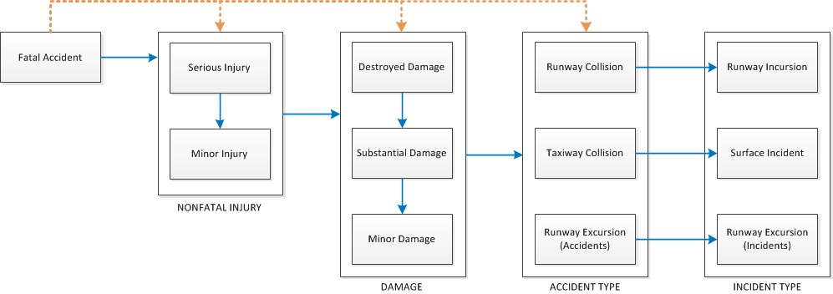
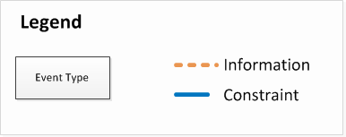
Weighting Schematic
Notes:
Weighting is probability-based
“Given what actually happened in an event, what was is the chance it could have become fatal?”
Uses a combination if Information Theory and SME-recommended constraints

Slide 7
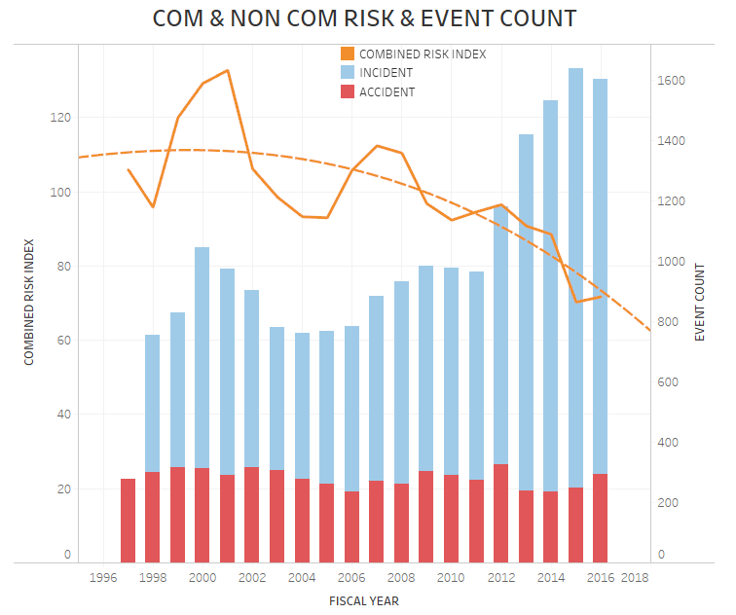
Combined Risk & Event Count
Observations:
Risk decreased, incident increased, accident relatively constant over time
Notes:
Combined Risk (Commercial and Non-commercial)
Despite increase in incident counts, overall risk has decreased
Fits SME intuition that, despite increased incident counts, the NAS has been safer recently

Slide 8
Conclusion
Systematic approach followed to develop Runway Safety metric
Inclusive of all relevant datasets
Quantitative technique to assign severity weights
Baseline/target is in development
Expected deployment date: FY 18
Formal reporting date: FY 19
Notes:
Systematic, quantitative approach
Includes all relevant datasets
Avoids pitfalls of using just incident counts
Now developing metric performance targets

Slide 9
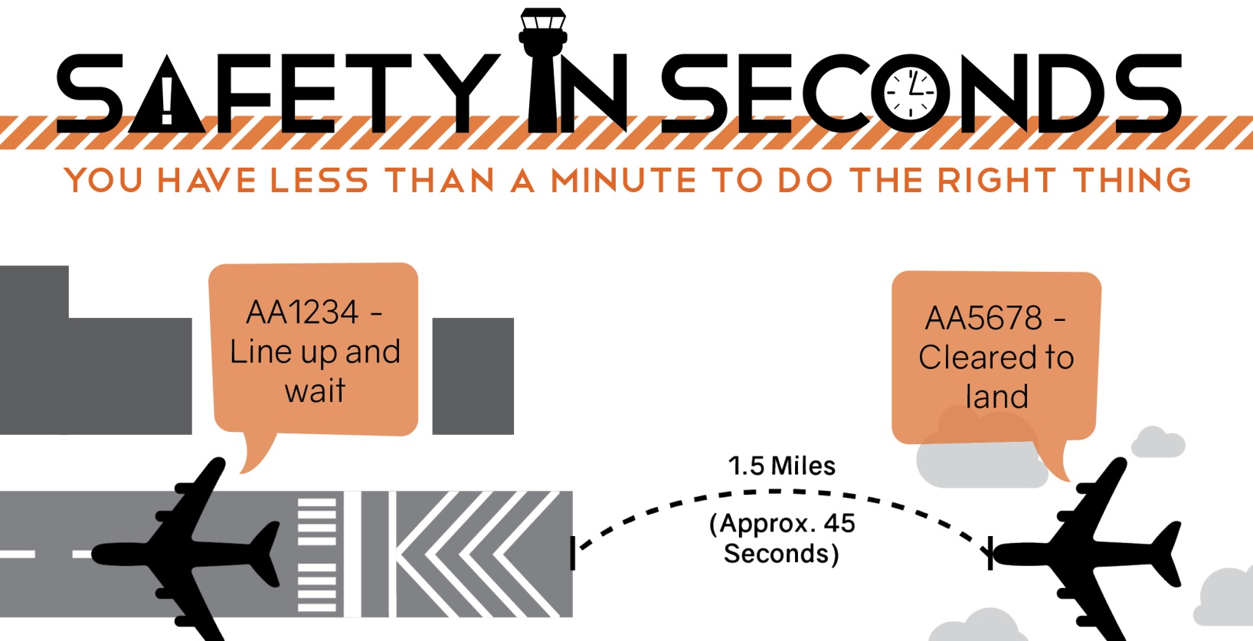


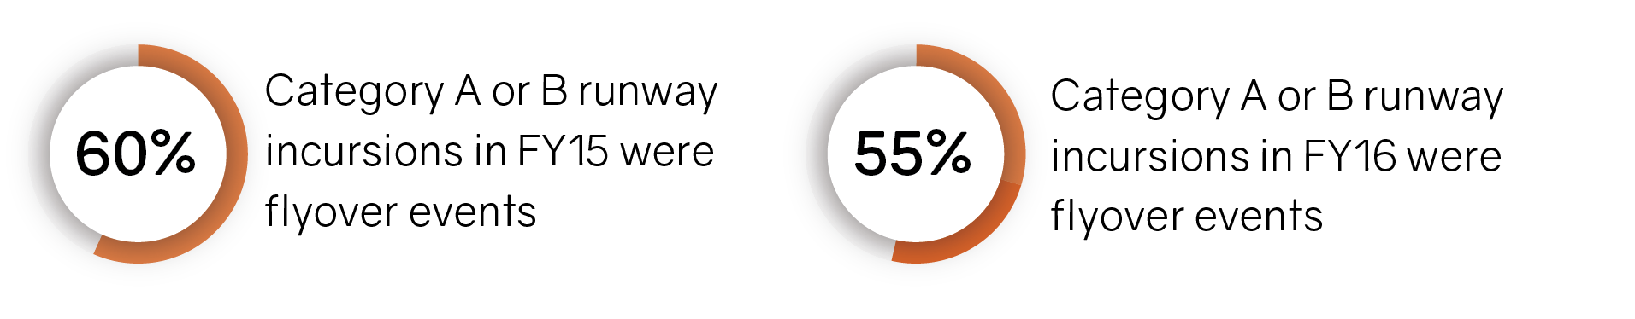
What Is A “Flyover” Runway Incursion?
Working together to make aviation safer for everyone, everywhere, everyday
Notes:
It takes approximately 45 seconds for a plane to go 1.5 miles, but takes approximately 60 seconds for a plane to take off.
This safety in seconds addresses the contributing factor “same runway separation” referred to in previous slide.

Slide 10

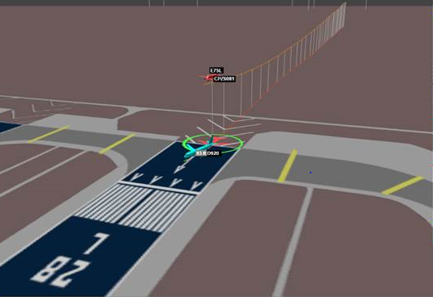
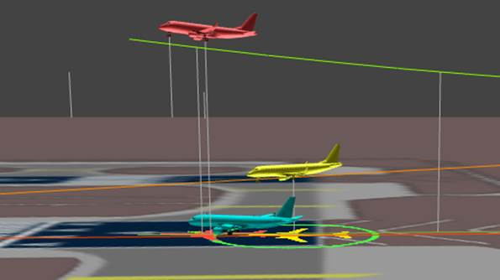
Reducing the severity of Runway Incursions
Working together to make aviation safer for everyone, everywhere, everyday

Slide 11
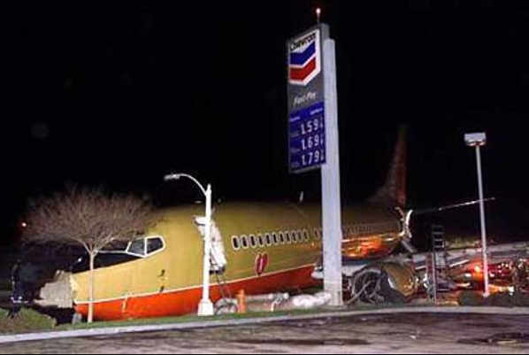
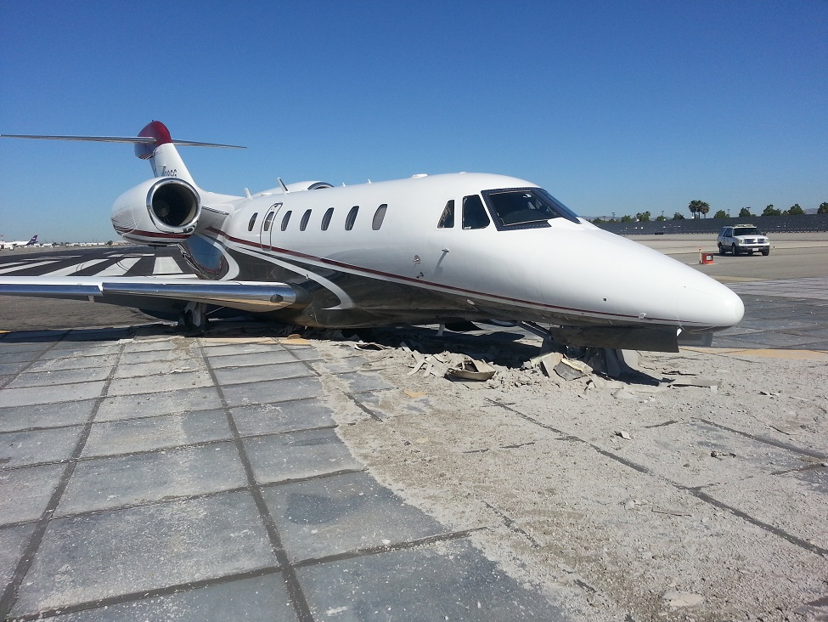
Reducing the severity of Runway Excursions

