Slide 1
“Effectiveness of implementing Industry Practice, Recommendations and Technology at Airline level”
Capt. Mattias Pak
VP Aviation Safety

Slide 2
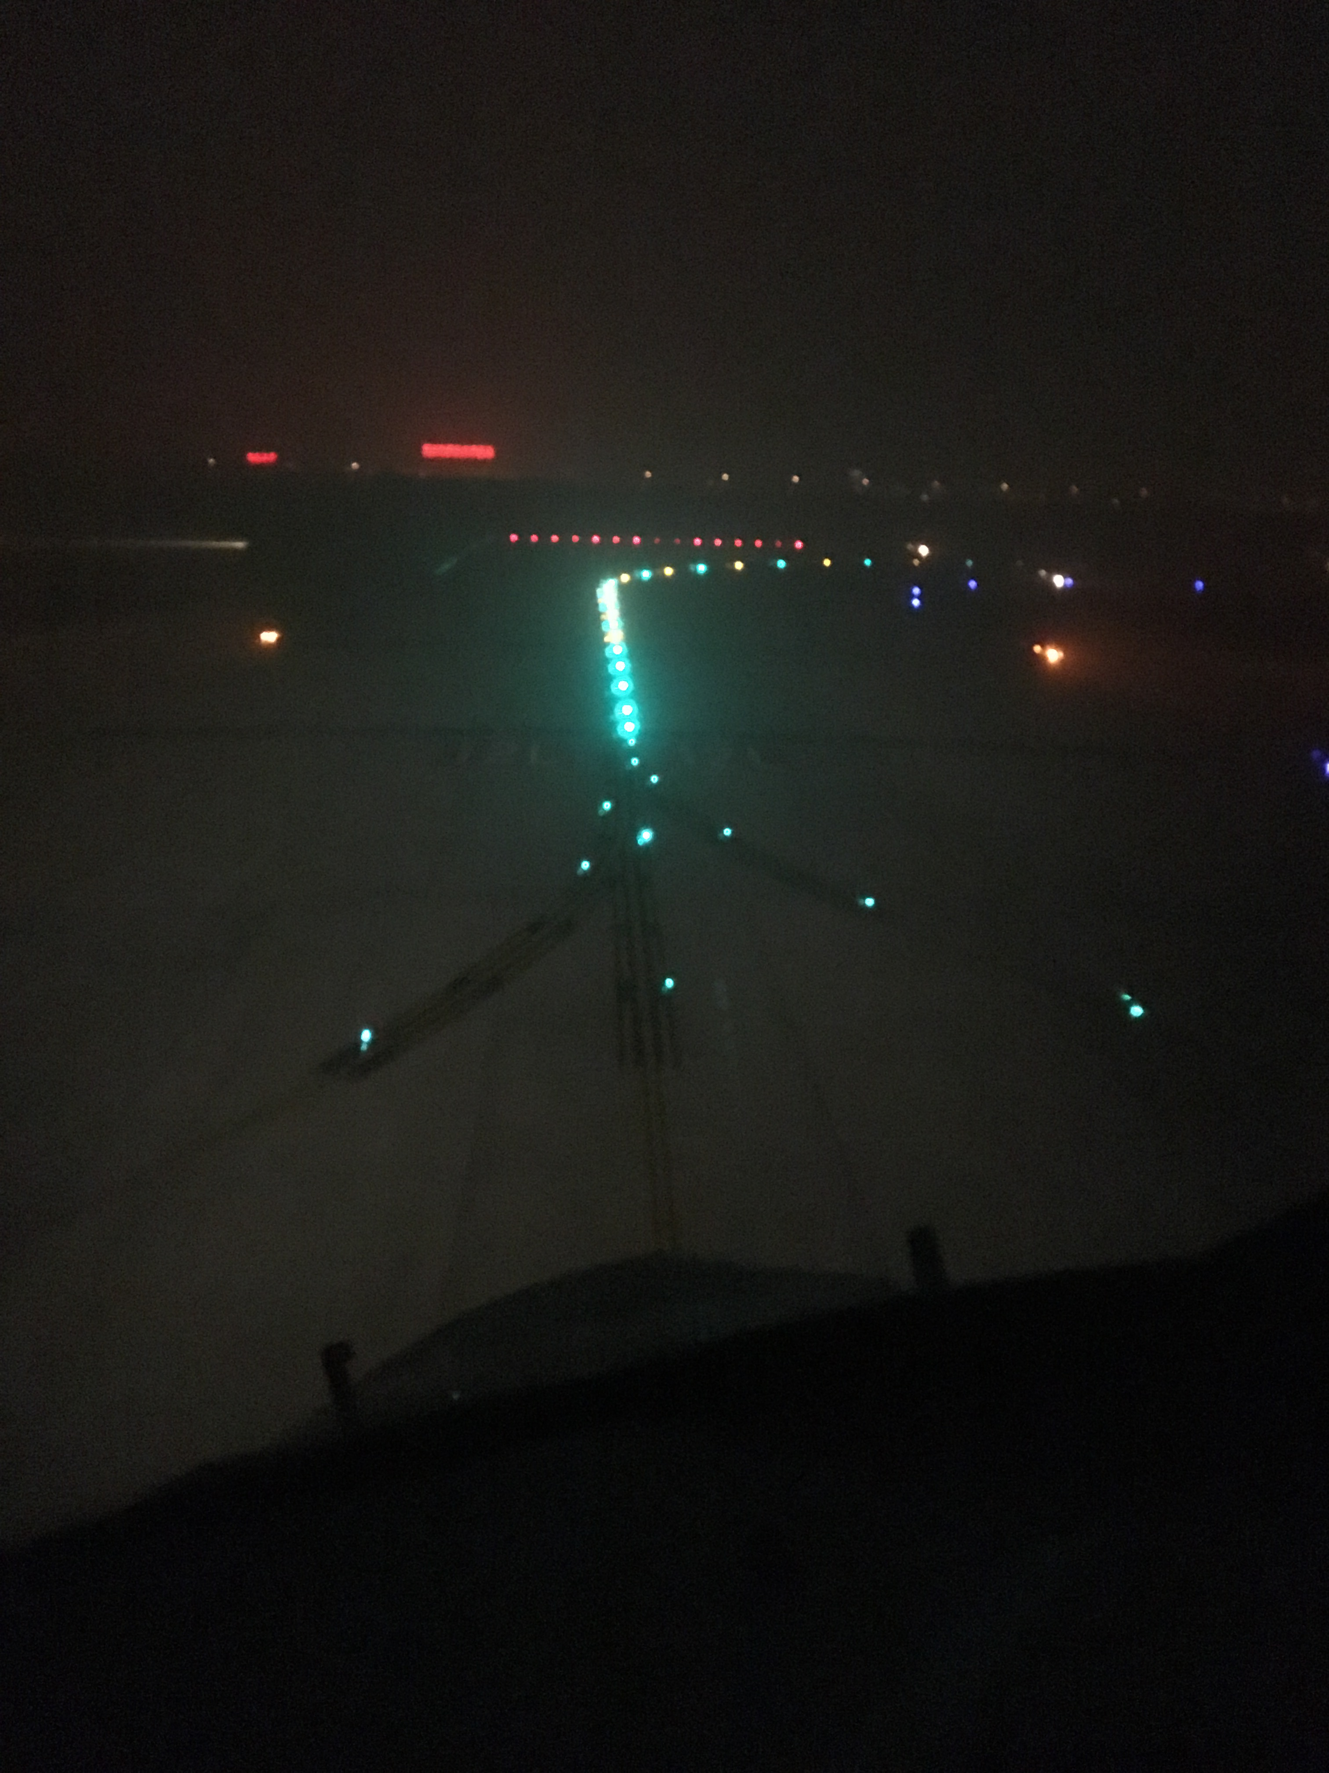

Slide 3
This presentation is not intended to present something new, but rather an example on how using risk management and recommended practices we were able to achieve good results.

Slide 4
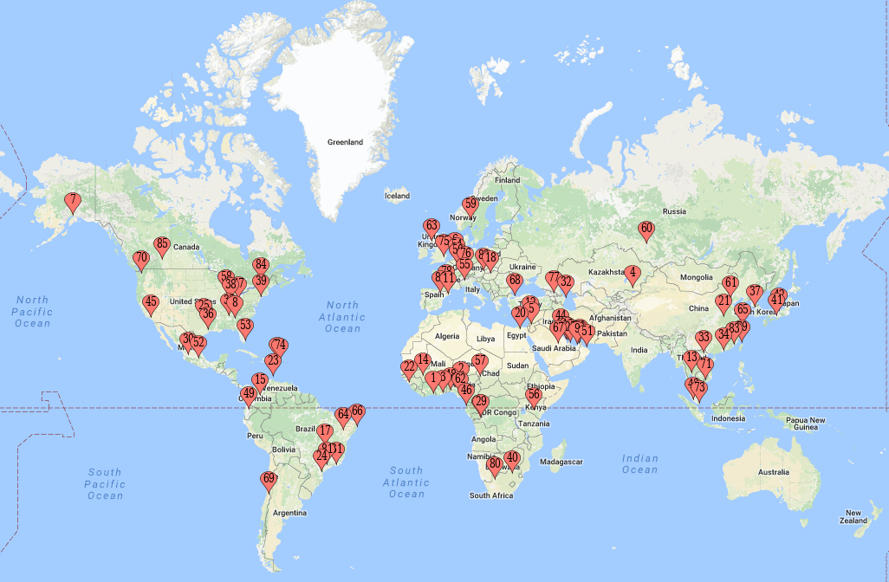
Complex Operation
26 B747-400/-8
Worldwide network
Small secondary type airports
Major airports
Busiest airports of the world
0ft MSL / 9200ft MSL Airports
+500 Pilots
+30 Nationalities
+20 mother tongues

Slide 5
Runway Incursion Barriers
Non-Engineered
Engineered
Runway Awareness /Advisory System
EFB with NAV Charts and Own Ship Position
Moving Map with own ship position
Taxi Procedures
Lineup Processes
Phraseology & Callouts
Training & Checking

Slide 6
Non-Engineered Barriers
Centered on Crew Coordination / Standard Operating Procedures
Taxi / Lineup
Phraseology and Callouts
Training & Checking
Taxi Briefing Procedures
Non-Essential tasks
Increase Situational Awareness
Based on ICAO
Strong SOP
Sterile Cockpit
Situational Awareness
Low Visibility Taxi
Use of Engineered Barriers

Slide 7
Guidelines to enhance situational awareness during ground operations
review NOTAMS / ATIS
brief using airport diagrams (incl. hold short lines)
focus on Hot-Spots
in low visibility conditions brief CAT II/III holding points
ensure both crewmembers understand the expected taxi route
write down complex taxi clearances
an airport diagram should be readily available to each crewmember during taxi
Operations Manual
Before Taxi / Landing Procedures

Slide 8
Guidelines to enhance situational awareness during ground operations
progressively follow taxi position
systematically verify position by signs and markings
use Moving Map
if in doubt regarding the clearance, verify taxi routing
stop the airplane if in doubt
do not allow ATC or anyone else to rush you
verify the runway is clear (both directions) and clearance is received prior entering any runway
Operations Manual
During Taxi / Landing

Slide 9
Phraseology and Callouts
Operations Manual
General
clarify any clearances with ATC if in doubt
two flight crewmembers shall monitor and confirm clearances – this includes instructions for holding short of a runway.
read back clearly
read-back of a hold short, crossing, takeoff or landing instruction shall always include the runway designator.

Slide 10
Training & Checking
Operations Manual
OM-C
Low Visibility Taxi during Simulator Training
simulator Scenarios including Taxi segment
Line Checks with emphasis on phraseology
Line Checks with emphasis on SOP

Slide 11
Engineered Barriers
Centered on Available Technology
RAAS
EFB with NAV Charts & Own Ship Position
Moving Map with Own Ship Position
The RAAS provides voice annunciations & NAV Display messages during ground operations, approach to landing, and go-around.
Retrofitted on
B747-400 with EBF Installation
Factory Installed on B747-8

Slide 12
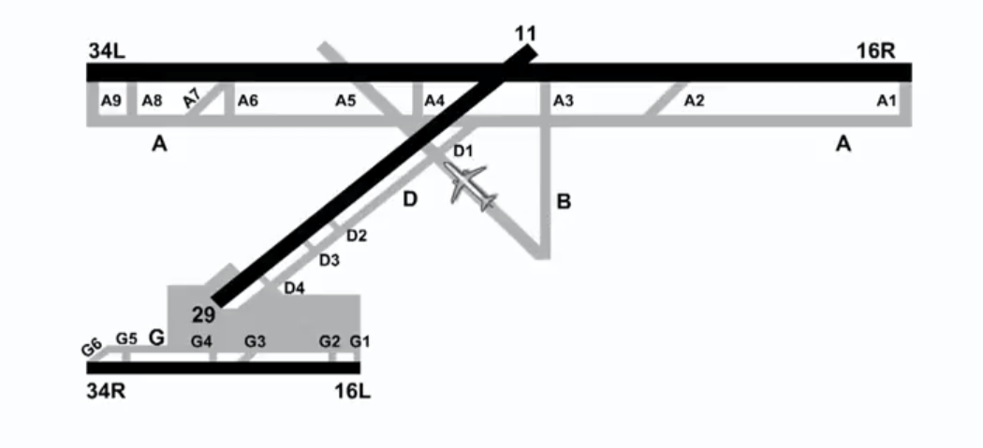
Runway Awareness and Advisory System
Voice Alerts
e.g. Approaching Runway (On Ground)
Approaching Runway (On Ground)
On Runway
Extended Hold On Runway
Taxiway Takeoff (advisory)
Taxiway Takeoff (caution)
Approaching Runway (Landing)

Slide 13
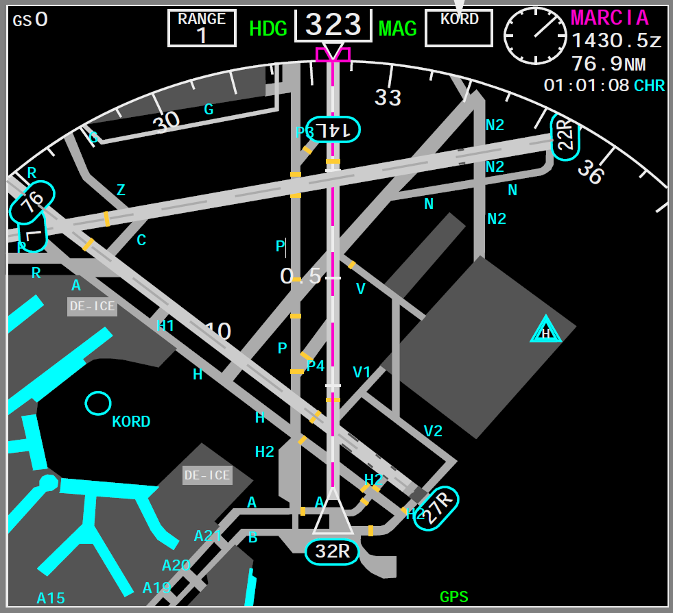
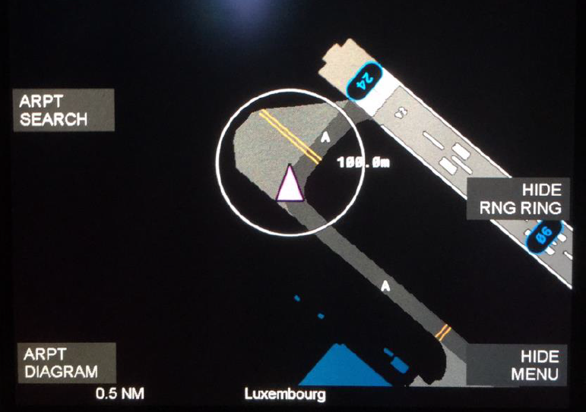
Moving Map Display with Own Ship Position
EFB with NAV Charts & Own Ship Position
Moving Map with Own Ship Position

Slide 14
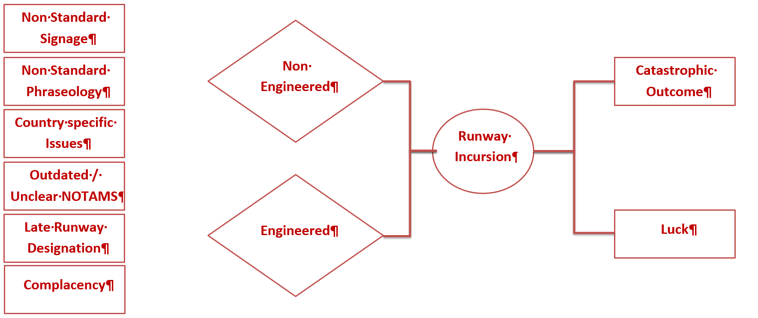
Over simplistic Bow-Tie

Slide 15
Conclusion
Using:
Non-Engineered & Engineered Barriers
Promoting:
High compliance of SOP
Combining:
Recommended Practices with Risk Management Procedures
SUCCESS

