Slide 1

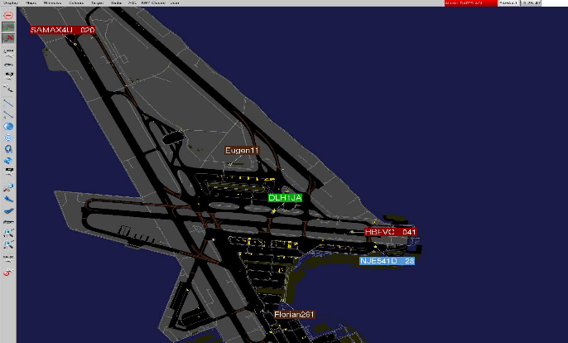

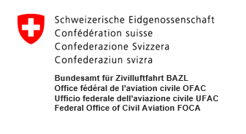
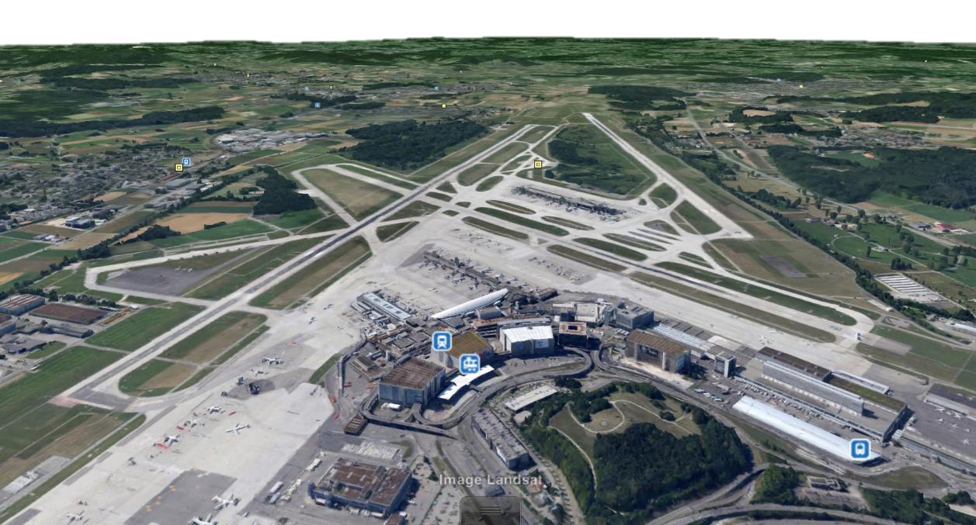
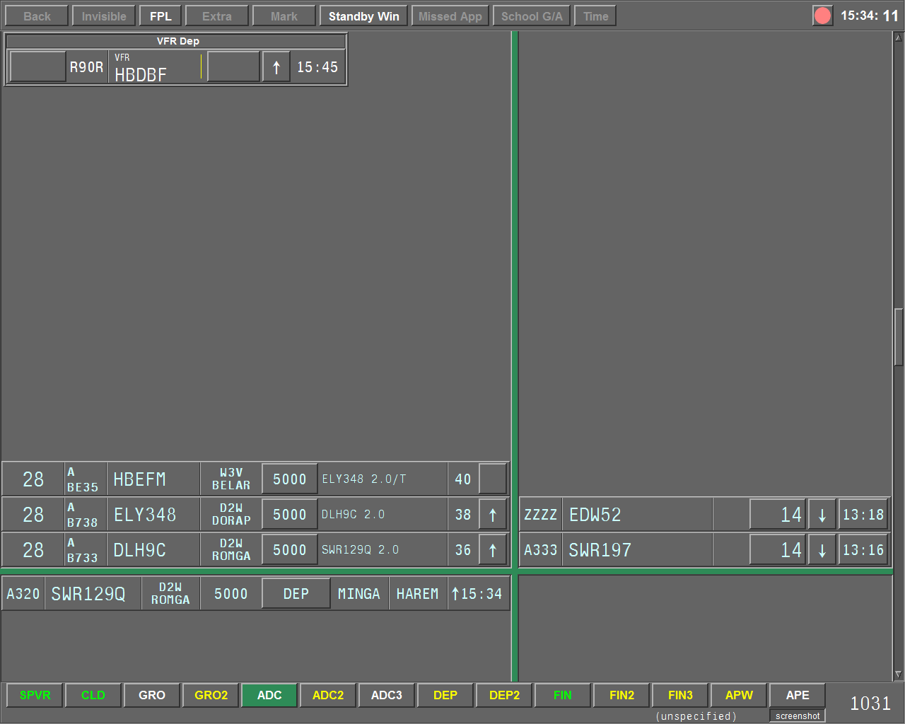
ARSI – Advanced Runway Safety Improvement
Safety Forum 2017, Brussels, 07 June 2017

Slide 2
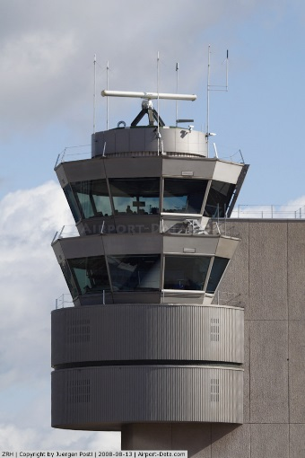
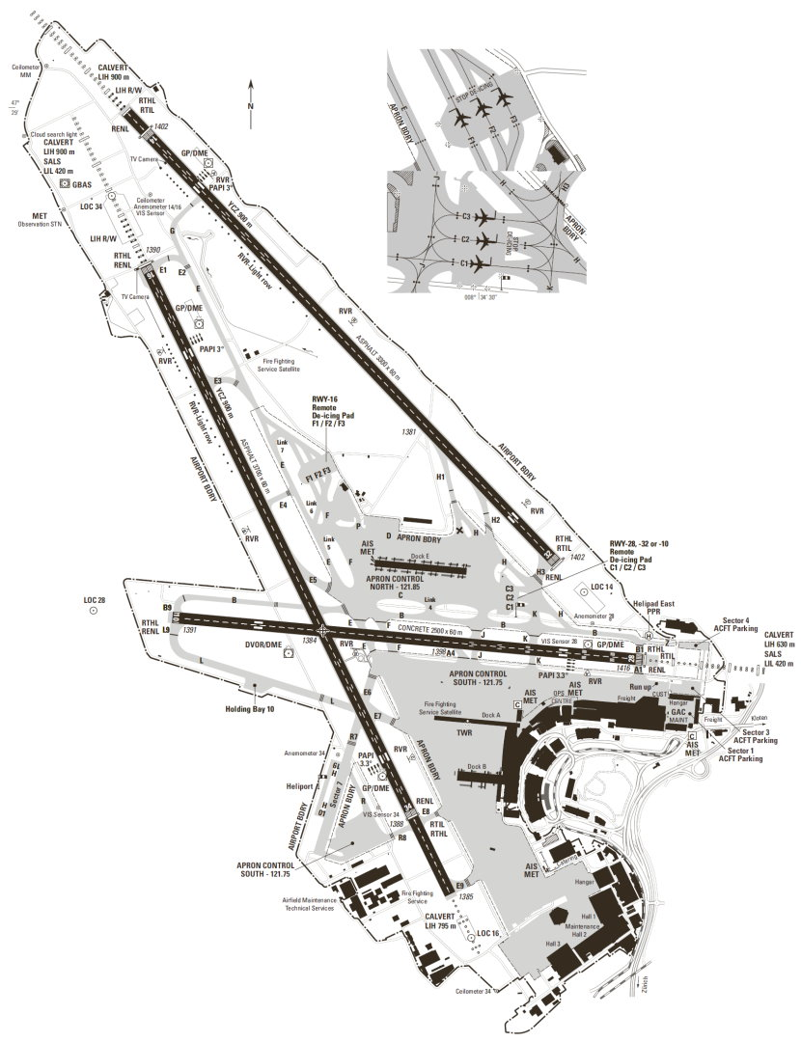
Zurich Airport
14
16
10
32
28
RWY Intersection 16/34-10/28
RWY Crossings
34

Slide 3
Safety measure I – North Flow
14
16
Performance only
10
32
28
34

Slide 4
Safety measure II – South Flow
14
16
10
32
28
34

Slide 5
Substantial capacity loss throughout the last years

Slide 6
Departure punctuality at unacceptable levels

Slide 7
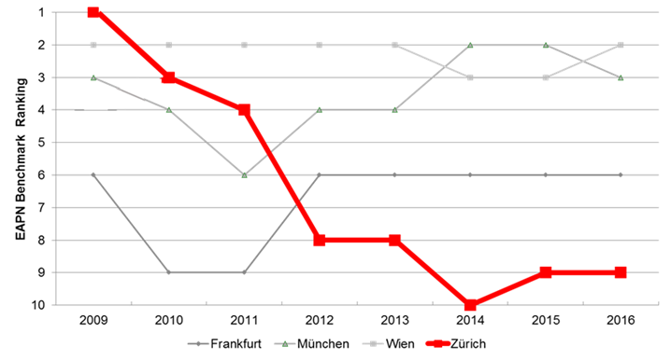
From best to worst in class in terms of punctuality

Slide 8
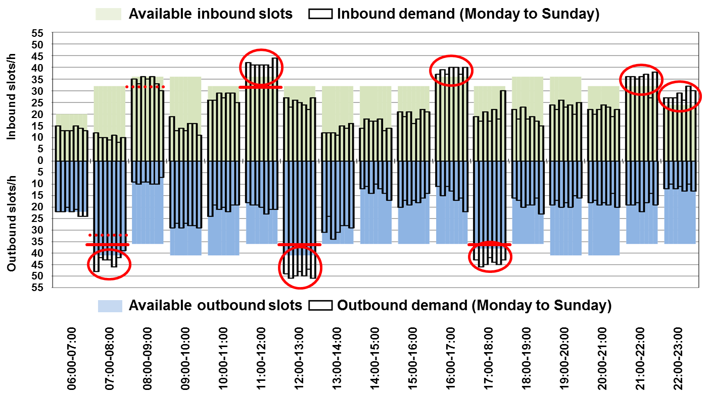
Negative impact amplified by hub operation

Slide 9
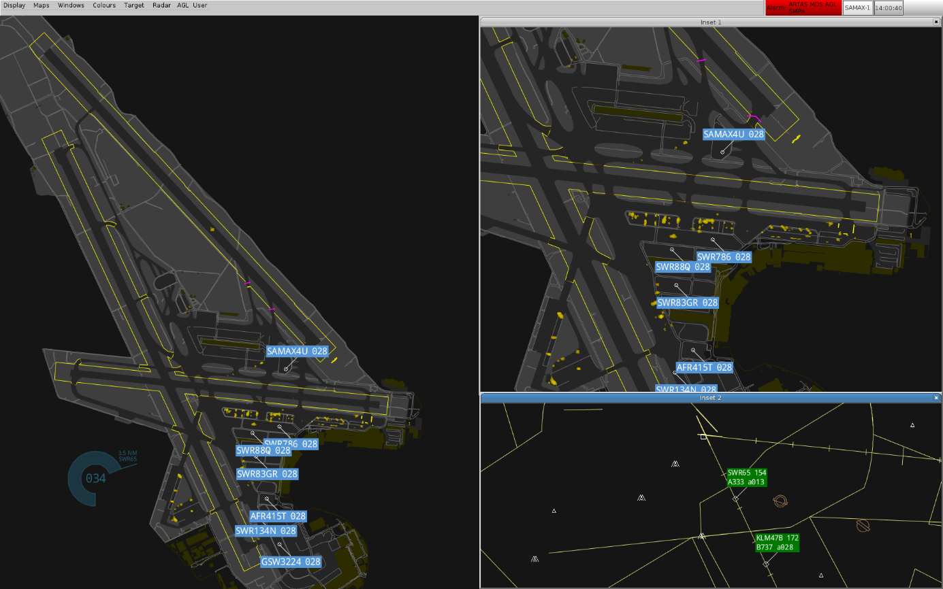
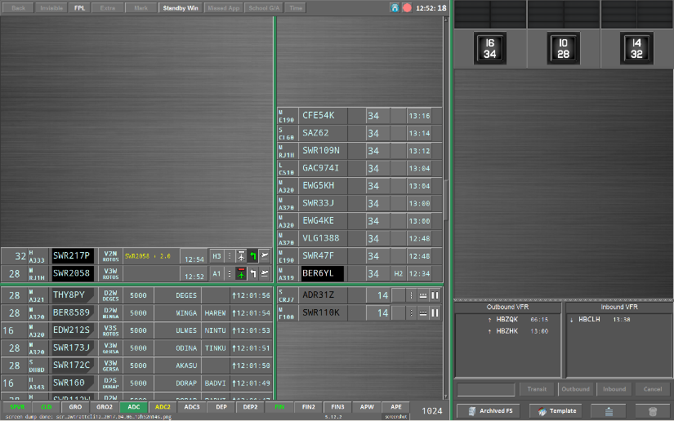

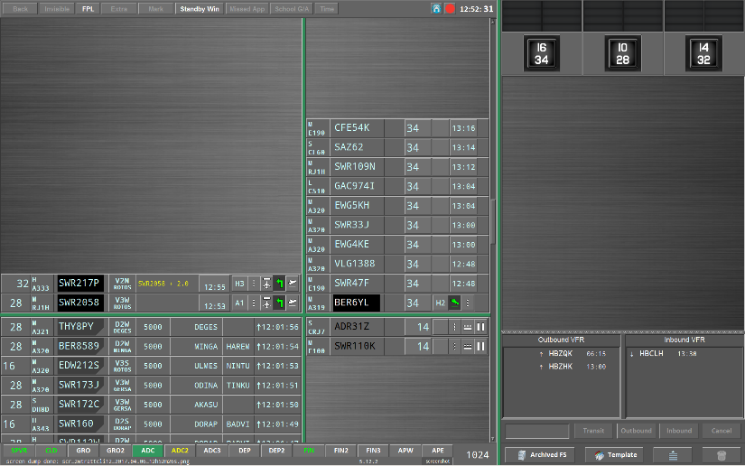
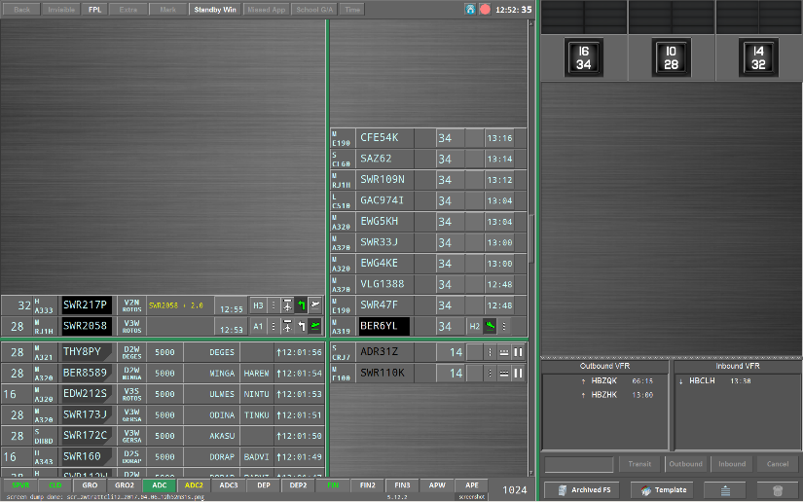
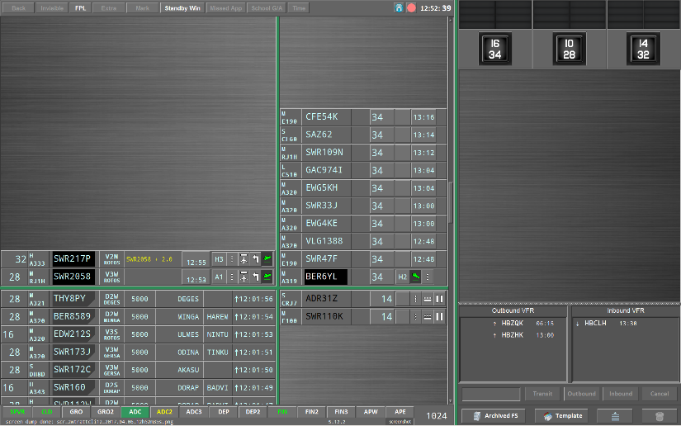
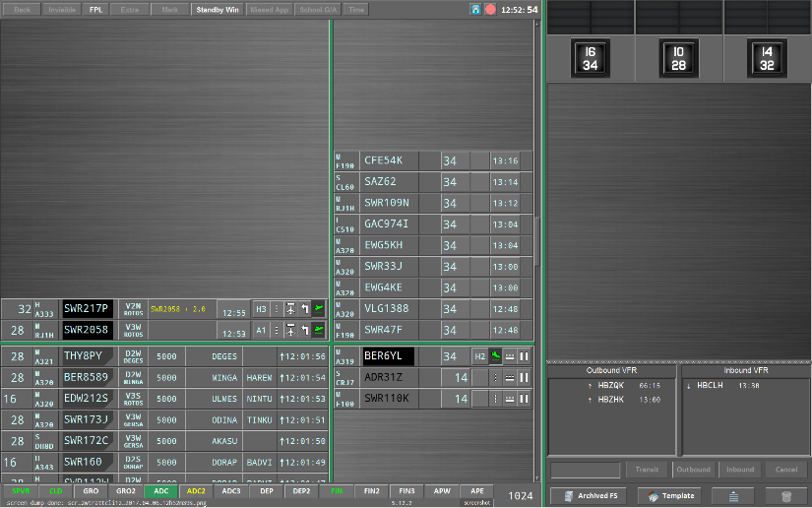
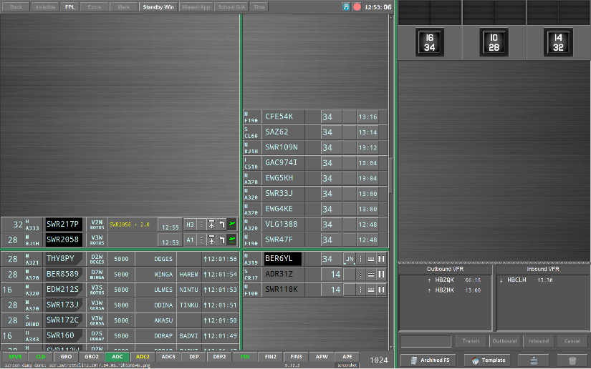


ARSI Principle
SWR47F 34
SWR217P 32
SWR2058 28
SWR2058 28
SWR47F 34
SWR2058 28
SWR47F 34
Line-up Clearance RWY28 SWR2058
Landing Clearance RWY34 SWR47F
Take-off Clearance SWR2058
Conflicting Clearance SWR47F / SWR2058
Take-off Clearance RWY32 SWR217P
Landing event SWR47F
Vacating RWY, Clearance completed SWR47F
Airborne SWR2058

Slide 10
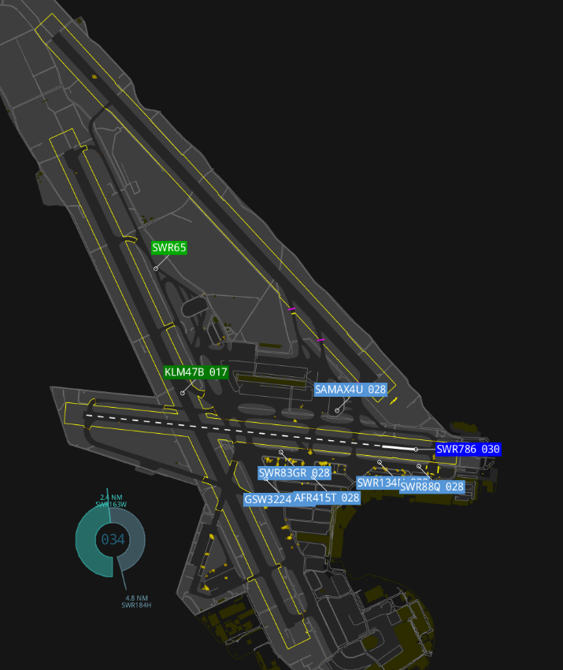
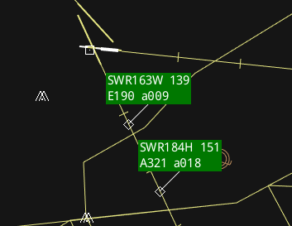
Impending Arrival Tool
Time and distance to threshold
Updated every 0.5 to 1 second

Slide 11
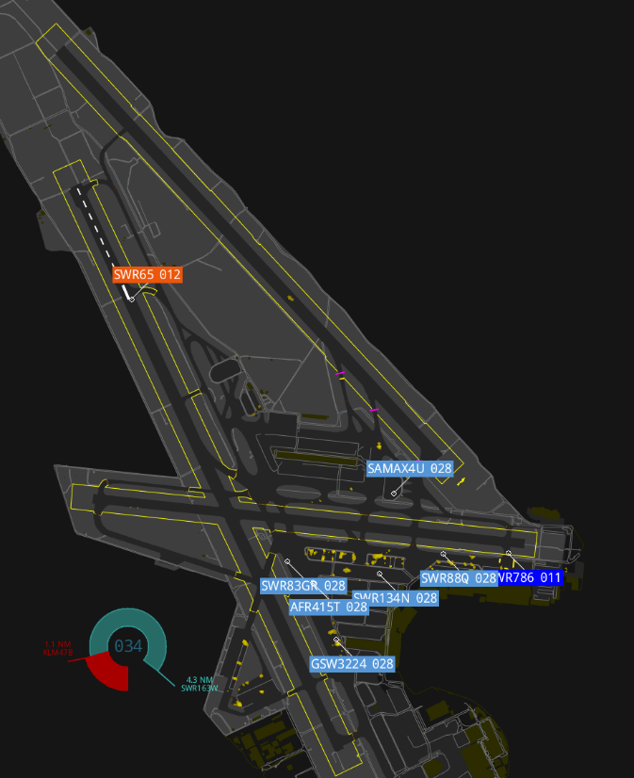
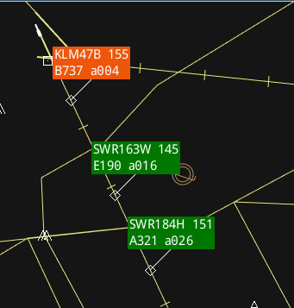
Issues
Notes:
ARSI functionality depends on correct controller inputs > Click as you speak > Head down time / confident that ATCOs will adopt new working method quickly
Prioritization of multiple alerts, taking into account ARSI and RIMCAS alerts > defined a clear order in which alerts are issued to ATCO
1st step: Implementation of new working methodology (February 18), 2nd step intro of alerting functions after a couple of month finetuning in shadow mode.

Slide 12
Financial contribution linked with high expectations
Zurich Airport expects:
Substantial increase of safety and efficiency
Re-establish former capacity levels
Increased and common situational awareness in daily operation
Early implementation of PCP functionalities (airport safety nets)
Zurich Airport’s substantial contribution:
Financial contribution of one third of overall project cost
Update apron control systems and procedures
Considering enhanced lightening system for pilot visualization

Slide 13
Cooperation and innovation are key to success
Key success factors
Close cooperation between air navigation service provider, airport operator and regulator
Strive for options increasing both capacity and safety
Availability of funding opportunities (national or international)

Slide 14

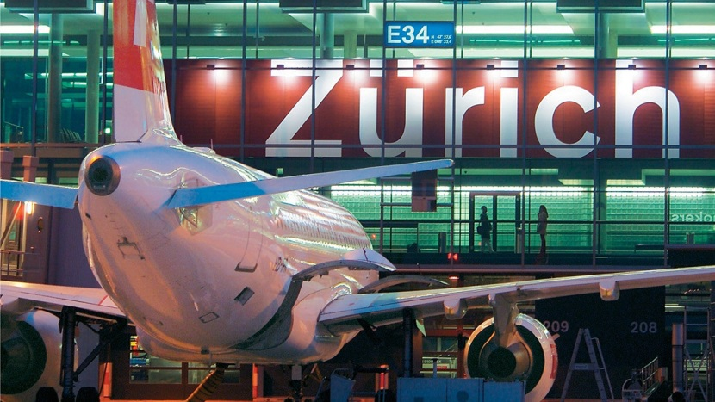
Questions & Answers

