Slide 1
Mindlessness and Mindfulness in Runway Incursions A study on the runway incursions at HongQiao Airport, Shanghai, China on the 11th of Oct, 2016 Pang Ying Qun Boeing 737NG Captain, CAAC examiner Xiamen Airlines, P.R. of China Email: captpang@me.com
Notes:
Good morning, ladies and gentlemen, aviation pioneers and experts.
My speech is about human nature through a incident which has happened not very long ago, on Oct. 2016 in HongQiao Airport.
We have many excellent speeches and ideas on how to improve the systems during the two days conference. Here I like to raise the idea of how does the individual can contribute their efforts with a positive manner and attitude.

Slide 2
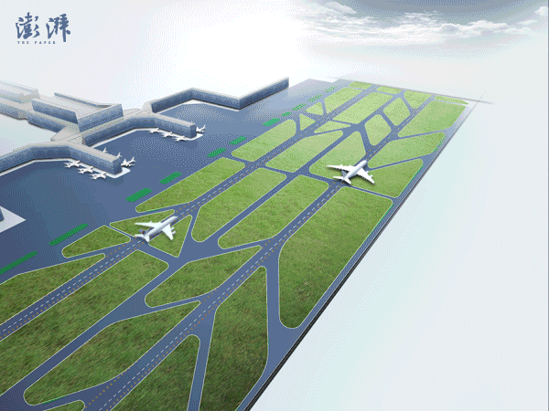
3D Simulation
Notes:
The Simulation is showing the A320 was taking off while the other A330 was crossing runway 36L.In the morning on 11th Oct.2016, before I left my home, I was telling a story to my twins.
Once upon a time, there was a mindless little girl named little Red Riding Hood.
One day, she went to see her ailing grandmother, she was greeted by a wolf dressed in her grandmother’s nightclothes.
“What big eyes you have, Grandma ,” she exclaimed.
Clueless as ever, although she had seen her grandmother’s eyes countless times before.
“What big ears you have, Grandma,” she said, although it was unlikely that they would have changed since her last visit.
“What a deep voice you have, Grandma.” she said, still oblivious to the shaggy imposter beneath the familiar lacy nightcap. “What big teeth you have,” she said, too late, also, to begin paying attention.
After the incident, my boss said to me, “It’s ok, it happens sometimes, youre only having s a bad day.”
“No, it’s not a bad day, it’s a disaster. I cried out.”
“Actions speak louder than words.” One hand we teach our children paying attention, in the other hand we are still doing our job mindlessly.

Slide 3
Investigation Report of Runway Incursions
Runway Incursions
China Eastern Airlines
A330/B-6506
HongQiao International Airport
11th, Oct, 2016
CAAC-AS/AIR-2016001
Published on 16th, DEC, 2016
Civil Aviation Authority of China
Notes:
The investigation report came out on 16th Dec. 2016 from CAAC.

Slide 4
Summary
On 11^{th,} Oct, 2016
China Eastern Airlines
Flight MU-5643 from ZSSS to ZBTJ. Aircraft A320/B-2337,
POB 158, Crew 10
Flight MU-5106 from ZBAA to ZSSS. Aircraft A330/B-6506,
POB 269, Crew 16
West Tower Controller:
12:04:35 Clearance to MU-5643/A320 for take off on 36L
12:05:12 Clearance to MU-5106/ A330 to crossing runway 36L
MU-5643 A320 was rolling on 36L at the same time that
MU-5106 A330 was cleared to crossing runway 36L
Notes:
A320 has 158 passengers and 10 crews, A330 has 269 passengers and 16 crews. This incident recalled my memory of the accident of Pan Am and KLM accident, 500 more people died, the whole world was crying at that time, but mistakes have happened again and again. We call this human factors. We made the conclusion of “ People make mistakes.”

Slide 5
Airport operation status
METAR ZSSS 110400Z 06005MPS CAVOK 25/11 Q1018 NOSIG
From the investigation report, all the facilities in the control tower worked well, no faults were recorded, communication was normal, continuous and clear.
Notes:
The weather was good and the facilities were functioning normal on the day. People also functioning normally in the control tower since the mindlessness was becoming second nature.

Slide 6
Serious Incident ( Cat A ) Runway Incursion
According to the QAR Date:
The height of A320 flew over H3 (which was the taxiway used by A330 to crossing the runway) is 119 feet.
The two airplanes had a vertical separation of 64 feet at the time the A320 flew over H3.
The horizontal separation between the left wingtip projection of the A320 and the tail projection of the A330 was 41 feet.
Notes:
The closest separation of the two aircraft was 41 feet between the left wingtip projection of the A320 and the tail projection of the A330. Does anyone have a answer of “How close is too close?”

Slide 7
Causation
The West Tower controller issued a clearance to A330 to cross runway 36L. After he issued the clearance to A320 for take off. The controller violated the CAAC flight rules, Air Traffic Control operation manuals (standards, requirements and procedures), and failed to monitor and observe the movements of traffic efficiently and continuously in any way.
Notes:
The investigation report said the causation is the controller failed to monitor and observe the movements of traffic efficiently and continuously. Is that all? How does this happen?

Slide 8
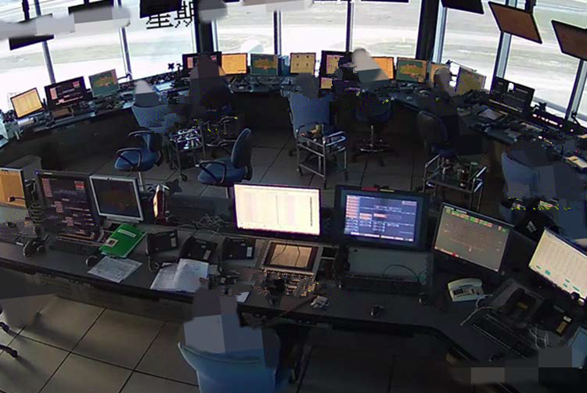
Tower working structure
ET
controller
WT
controller
WT
assistant
Ground movement
Seat
ET assistant
Dispatch
Coordinate
Supervisor
Assistant of Supervisor
Notes:
This is a structure of the exterior of the HongQiao tower, the WT controller was sitting in the middle.

Slide 9
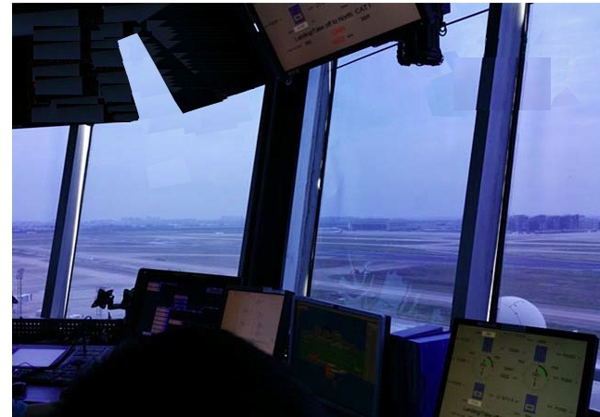
The “little devil” corner
The strut of the south side of the west window
The controller can see the south end of 36L if he leans his body backwards
Notes:
From the picture above, the WT controller has difficulties to see his left because the strut of the window, I called this “ The little devil” corner. The controller needs to move his body to see the threshold of the 36L.

Slide 10
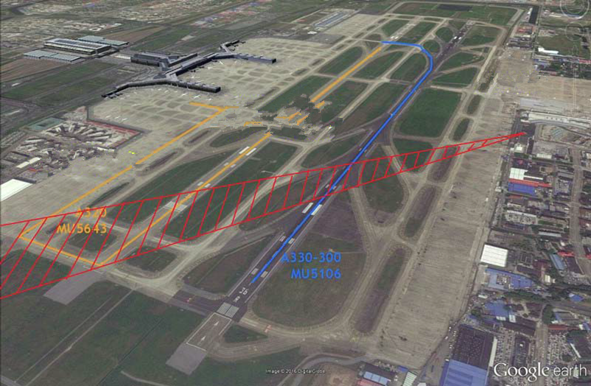
The controllers field of view
Tower location
South end of
36L
The area may hide
From the controller
Notes:
This diagram shows the area where the WT controller could not to see from his position.

Slide 11
The possible effects of fatigue
At 12:05:37, while the A320 crew reminded the controller that other a/c crossing the runway, 13 mins before this event, the video shows the controller’s behavior and his position, this possibly indicated his fatigue is not at a satisfied level. The west controller sits with the position leant to the left and comforts himself by resting his left arm on the armrest.
11:52:55, he massages his face, he uses his left hand to support his head, his head leant to the left parallel with the table surface, his position satisfied the rest status. The status is totally not fitting with his required arousal level. This position continued for 55s, and was unlike his colleagues.
Notes:
Our body never lies, only our mind and our words lie. The video showed the WT controller was displaying signs of sleepiness.

Slide 12
Other factors
management system failure
Hidden/latent errors in the system are also the dangerous mistakes
Notes:
We sometimes think we are big to change the small world, we probably can think the other way that we are too small to change the big world. Only things can change if we united as one to face the obstacles, I think this is the reason we sit together to work as one. Change is not easy, otherwise, The president wouldn’t fail in his 8 years. The new president will also not having so many headaches.

Slide 13
The individuals or the systems?
Who are the victims of the incident?
The passengers are the most vulnerable and have the highest likelihood of being hurt;
The teams in the organizations will be damaged first if the incident is serious enough;
The individuals will also be hurt since they have the opportunity to cause the error or incident
Notes:
One day, a team leader in the flight operation made a mistake, he sent a message to the management team, it seems he has a lot of pressures, I showed the message to my wife. My wife said, “why he apologize to the management team, he should apologize to the passengers first.”If the Captain has the passenger as the first priority in his sub consciousness, he would not make any silly mistakes. Sometimes we can forget why we are doing our job----To complete the commitment.

Slide 14
News of the incident on 21stOct,2016
With the investigation, CAAC considered this incident is caused by the controller with his wrong management and lapse of activities and procedures, since the matter is serious, the controller will no longer be allowed to work as a controller in his life time. Totally 13 people involved in the incident, people received warnings or lost their jobs or positions after the incident.
Notes:
The news showed many people have been punished. I’m not making any judgments on the punishments. The punishments are huge for individuals but could be omitted compared with people’s lifes.

Slide 15
Concepts of safety:
The proper definition of safety should be:
“the state in which the possibility of harm to persons or of property damage is avoided or reduced to the level is conformance to the requirements of the progress through a continuing process of hazard identification and safety risk management.”
Within the context of aviation, safety is “the state in which the possibility of harm to persons or of property damage is reduced to, and maintained at or below, an acceptable level through a continuing process of hazard identification and safety risk management.” (SMS Manual)
The AL is immeasurable since the definition is not clear.
The damage extends to various parties including :
People (related stakeholders)
property (aircraft, etc.)
The organization
Notes:
While the elimination of aircraft accidents and/or serious incidents remains the ultimate goal, it is
recognized that the aviation system cannot be completely free of hazards and associated risks. Human activities or
human-built systems cannot be guaranteed to be absolutely free from operational errors and their consequences.
Therefore, safety is a dynamic characteristic of the aviation system, whereby safety risks must be continuously mitigated.
It is important to note that the acceptability of safety performance is often influenced by domestic and international
norms and culture. As long as safety risks are kept under an appropriate level of control, a system as open and dynamic
as aviation can still be managed to maintain the appropriate balance between production and protection.

Slide 16
Mindfulness VS Mindlessness
The cost of mindlessness?
Mindfulness on the job!
Notes:
A familiar structure or rhythm helps lead to mental laziness, acting as a signal that there is no need to pay attention. The rhythm of the familiar lulls us into mindlessness:
Q. What do we call the tree that grows from acorns?
Oak.
Q. What do we call a funny story?
Joke.
Q. What do we call the sound made by a frog?
Croak.
Q. What do we call the white of an egg?
Yolk.
What’s wrong?
It no harm we speak out Yolk or anything, it’s so much cost if we do our job mindlessness in the tower or cockpit.
Other than mindlessness, being mindfulness allows us to be joyfully engaged in what we are doing. Time races by, and we feel fully alive. Anything can be made interesting.
Being mindful is to be in the present, noticing all the wonders that we didn’t realize were right in front of us.
Being mindful is process-oriented, not oriented by the outcome.
Being mindful is following a simple concept of “know exactly what you are doing and doing exactly what you think you are doing.”---Moshe Feldenkrais
Being mindful is event at the present, noticing things and sensitive to context and perspective, with the results of without chaotic. We have our rules and routines should be guiding what we are doing, not overly determine what we do. The phenomenological experience in this mindfulness is the felling of engagement, the feeling that people often envy when they see somebody else seems to have a passion.

Slide 17
Can we manage our mind?
Know your mind’s limit!
We have a key to help the individuals!
DIRFT VS Dirty Dozen.
Doing it right the first time, doing it right every time!
“Doing it right the first time” will cycle your mind everyday and focus your attention on the matter!
Think it, See it, Act on it, Check on it!
Notes:
To alert our mind being mindful, we need aware the attention is the gate of the mind. Since audience try to focus on the speech, it’s the controlled attention. When someone’s cup dropped on the floor to disturb the audience, it’s the stimulus-driven attention starts to work. When you tired to listen my boring speech, this is called the arousal attention. No matter which kind of attentions, all could be awaked by the phrase of DIRFT. DIRFT is not only a wake up call, it’s a meaningful phrase, it has it’s magic. Aviators knew people have 12 weaknesses, which we call them “Dirty Dozen”, it may be more than 12. People still can do their job right while they are having the weaknesses, as long as people realize the weaknesses and being mindfulness on the process.
Some people are focused on getting less of what we don’t want, the others focused on getting more of what we do what.
The best solution is to maintain balance between the two, understood “ people make mistakes” as the root but with the DIRFT as the target.

Slide 18
Understanding VS Choose?
God gives people one chance at life.
The life will only credit you for the first time.
If you choose “everybody makes mistakes!”?
You’ll have difficulties!
If you choose “Doing it right the first time!”?
You are going to have a bright life and a brighter future if you act on it!
Which you feed more, which you stand on!
Notes:
Understood “people make mistakes” is not a fence but the root to do job right.
When we realize our weaknesses, with mindful attention, this will help us “avert the dangers not yet arisen.” It’s totally different than people accept “people make mistakes” as an excuse for their wrong doing. You choose DIRFT, you stay high, you believe it, you will have it’s magic.
If you fly with me to Roma tomorrow, from the prospective of the passenger, how much more do you accept the potential mistakes of the Captain and his ability to have a incident? How much guarantee you would like to have from the Captain for your safety? The answer is clear, Zero for incident but 100% for safety.

Slide 19
What are the rules I can follow whilst performing my job?
The Art of Certain!
ZD theory ---Risk Free Management
Notes:
The Zero Defect theory was established by Philip. Crosby, it focus on “Doing It Right the First Time.” The Zero Defect theory is the performance standard of your work. It doesn’t matter what work you are doing, it’s obviously more important during the safety management activities. It requires us to do the job mindfully to prevent and avoid the mistakes. Not to detect and correct after. Since people believe “people make mistakes”, we are not only accept our mistakes, but also predict it’s coming. We prefer use the appraisal to measure our performance, but all the accidents and incidents are come from the minor problems. “A horseshoe nail destruction of a country.” You are lucky if you have the chances to learn from the mistakes, but in many lessons, people had never have the chances to learn from the accidents. We prefer to have two set of standard for ourselves and others, one hand we refuse to have any shortage of our payroll check, in the other hand we tolerate ourselves for mindlessness. The Zero Defect has four major principles. 1, Conformance to the requirements. 2, Safety is achieved by Prevention not detection and correction. 3, The performance standard is zero defect, not “that’s close enough”. 4, The measurement is the price of nonconformance.
Uncertainty is becoming the most popular word in the world, but certain is the goal for the safety management, to make the safety certain is the way to minimize the risks. The safety is a mindfully journey, only with the mindfully process management, it will bring us to the destination safely. Certain means Risks Free, with the public transportation business, it is not a industry to focus on profit, but mainly focus on the public transport to serve for people.
情景管理失误的绩效评价——情景管理失误产生的影响和代价就是评定情景管理的负绩效（我们常常对此进行过度的谴责，因为结果的轰动性，我们聚焦和放大了事件本身和潜在的影响，却回避了系统的缺陷和不完整性）。
情景管理成功的绩效评价——情景管理成功所可能避免事件的代价就是情景管理的正绩效（我们经常忽视正评价，因为情景管理本身不是目标，而管理过程产生的效果因为没有事件出现的轰动效应而被忽略）。

Slide 20
Can we do our work well and successfully?
1, Don’t focus on the outcome but the process itself. The target is to act on each step correctly to active the system’s work norm.
2, Master the changes in the process and capture any single indication, this is the key to capture the unexpected in the first sight and kill it!------Balance and Harmony
Notes:
The Four Artful Brothers.
------The Brothers GRIMM
Once upon a time, there has a king with a beautiful daughter. The daughter was carried off by a dragon.
There are four brothers each of them has their own skill. They have the words from the King one of them could marry the daughter if he could bring the daughter back.
One brother finds the daughter use his telescope;
One brother stole the daughter out from under the dragon;
One brother shot the dragon while the dragon waked up, but deadly body of the dragon smashed the whole ship;
The last tailor brother took his miraculous needle and sewed the planks together with a few big stitches. Sewed other parts and sailed safely home.
After the princess home, who do you think could marry the princess? Why?
The King wisely told the four brothers that they all have equal claims, but they can’t all marry with the princess, the King reward them each with an equal part of a kingdom. That suited the brothers, who each settle down to enjoy the fortune he so rightly deserved.

Slide 21
It’s up to me, and It’s up to you!
I want a workplace, that’s Injury Free
I must, take the time, with each task I do
To look for the hazards, think the job through
To check the procedures and follow them all
And reject taking shortcuts, no matter how small
I must question each unsafe behavior I see
I will always give safety, the best I can do
For the safety of one, is the safety of all
DIRFT, what do we believe it’s up to me, and it’s up to you!
Notes:
Here I have the poem from Don Merrell as the end.

Slide 22
References
The investigation report of runway incursions, HongQiao Airport, Shanghai, P.R. of. China
Mindfulness, The Power of Mindful Learning,
------ by Ellen J. Langer
Zero Defect Theory, Philip B. Crosby
Wikipedia
Internet news report & photos
5 aggregate model
Safety Poems, by Don Merrell
THANK YOU! 谢谢
Notes:
The last is also the most important, better not ring the wrong bell, the family is expecting your safely and mindfully journey home.

Slide 23
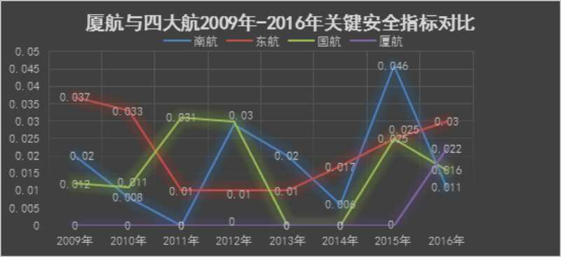
The safety status of some Chinese Airlines, reference only.

Slide 24

Download wechat app, register and then scan the QR Code. You will find Pang.

