Slide 1
Scenario of a
Commercial Aviation Runway Collision
Prevented:
Runway Collision Prevention Strategy, with Procedures
Captain paul miller PaulMiller@Safetyforecast.com
PREVENTING RUNWAY COLLISIONS
Eurocontrol Safety Forum June 6-7, 2017
Eurocontrol Headquarters, Brussels Belgium EU

Slide 2
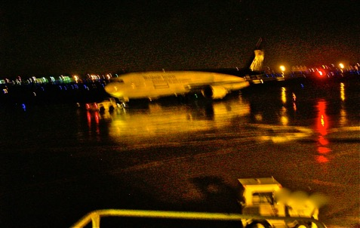
Scenario of a
Commercial Aviation Runway Collision
Prevented:
Runway Collision Prevention Strategy, with Procedures
Captain paul miller PaulMiller@Safetyforecast.com
PREVENTING RUNWAY COLLISIONS
Eurocontrol Safety Forum June 6-7, 2017
Eurocontrol Headquarters, Brussels Belgium EU

Slide 3
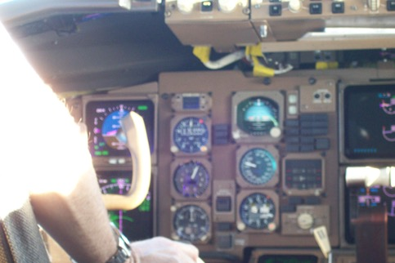
Scenario of a
Commercial Aviation Runway Collision
Prevented:
Runway Collision Prevention Strategy, with Procedures
Captain paul miller PaulMiller@Safetyforecast.com
PREVENTING RUNWAY COLLISIONS
Eurocontrol Safety Forum June 6-7, 2017
Eurocontrol Headquarters, Brussels Belgium EU

Slide 4
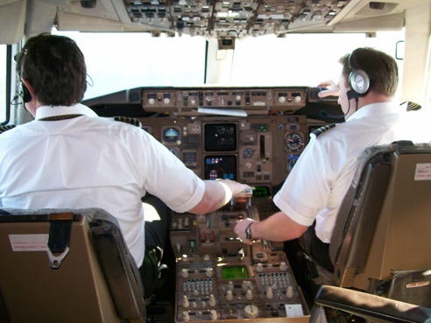
Scenario of a
Commercial Aviation Runway Collision
Prevented:
Runway Collision Prevention Strategy, with Procedures
Captain paul miller PaulMiller@Safetyforecast.com
Prevented:
PREVENTING RUNWAY COLLISIONS
Eurocontrol Safety Forum June 6-7, 2017
Eurocontrol Headquarters, Brussels Belgium EU

Slide 5
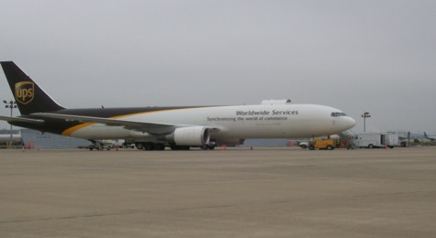
Scenario of a
Commercial Aviation Runway Collision
Prevented:
Runway Collision Prevention Strategy, with Procedures
Captain paul miller PaulMiller@Safetyforecast.com
PREVENTING RUNWAY COLLISIONS
Eurocontrol Safety Forum June 6-7, 2017
Eurocontrol Headquarters, Brussels Belgium EU

Slide 6
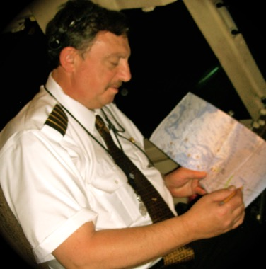
Scenario of a
Commercial Aviation Runway Collision
Prevented:
Runway Collision Prevention Strategy, with Procedures
Captain paul miller PaulMiller@Safetyforecast.com
PREVENTING RUNWAY COLLISIONS
Eurocontrol Safety Forum June 6-7, 2017
Eurocontrol Headquarters, Brussels Belgium EU

Slide 7
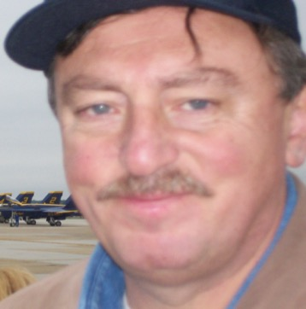
Scenario of a
Commercial Aviation Runway Collision
Prevented:
Runway Collision Prevention Strategy, with Procedures
Captain paul miller, retired PaulMiller@Safetyforecast.com
PREVENTING RUNWAY COLLISIONS
Eurocontrol Safety Forum June 6-7, 2017
Eurocontrol Headquarters, Brussels Belgium EU

Slide 8
Scenario of a
Commercial Aviation Runway Collision
Prevented:
Runway Collision Prevention Strategy, with Procedures
Captain paul miller, ret PaulMiller@Safetyforecast.com
Add my Welcome to
Safety Managers
PREVENTING RUNWAY COLLISIONS
Eurocontrol Safety Forum June 6-7, 2017
Eurocontrol Headquarters, Brussels Belgium EU

Slide 9
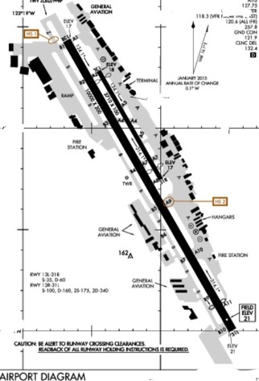
The story begins on the south east end of Runways 31 left and 31 right
PREVENTING RUNWAY COLLISIONS
Eurocontrol Safety Forum June 6-7, 2017
Eurocontrol Headquarters, Brussels Belgium EU

Slide 10
Runways 31 left and 31 right
PREVENTING RUNWAY COLLISIONS
Eurocontrol Safety Forum June 6-7, 2017
Eurocontrol Headquarters, Brussels Belgium EU

Slide 11
Runways 31 left and 31 right
PREVENTING RUNWAY COLLISIONS
Eurocontrol Safety Forum June 6-7, 2017
Eurocontrol Headquarters, Brussels Belgium EU

Slide 12

Ah,Ha! Moment
PREVENTING RUNWAY COLLISIONS
Eurocontrol Safety Forum June 6-7, 2017
Eurocontrol Headquarters, Brussels Belgium EU

Slide 13
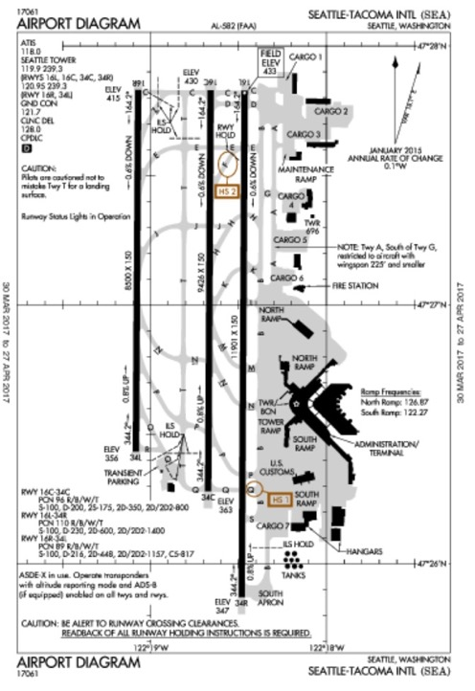
Rw 34 L, C, R with taxiways between 34 L and 34 C and some distance on connecting taxiways between 34 L, 34 C and 34 R
Ah,Ha! Moment
PREVENTING RUNWAY COLLISIONS
Eurocontrol Safety Forum June 6-7, 2017
Eurocontrol Headquarters, Brussels Belgium EU

Slide 14
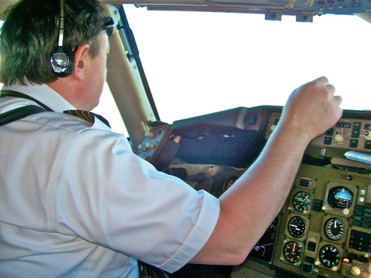
Runways 31 left and 31 right
PREVENTING RUNWAY COLLISIONS
Eurocontrol Safety Forum June 6-7, 2017
Eurocontrol Headquarters, Brussels Belgium EU

Slide 15
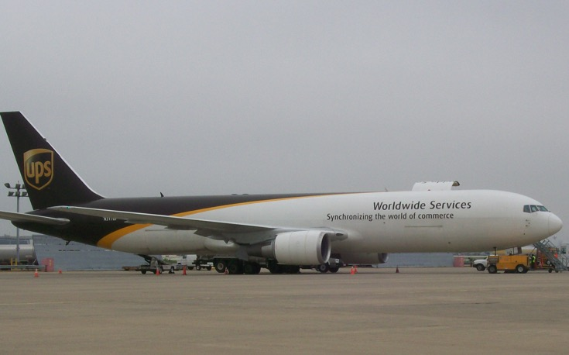
Runways 31 left and 31 right
PREVENTING RUNWAY COLLISIONS
Eurocontrol Safety Forum June 6-7, 2017
Eurocontrol Headquarters, Brussels Belgium EU

Slide 16
Runways 31 left and 31 right
Landing Rw31R
Holding short Rw31L
PREVENTING RUNWAY COLLISIONS
Eurocontrol Safety Forum June 6-7, 2017
Eurocontrol Headquarters, Brussels Belgium EU

Slide 17
Runways 31 left and 31 right
Landing rollout Rw31R
“Position and hold Rw31L”
PREVENTING RUNWAY COLLISIONS
Eurocontrol Safety Forum June 6-7, 2017
Eurocontrol Headquarters, Brussels Belgium EU

Slide 18
Runways 31 left and 31 right
Exit Rw31R to the right for parking
“Cleared for takeoff Rw31L”
PREVENTING RUNWAY COLLISIONS
Eurocontrol Safety Forum June 6-7, 2017
Eurocontrol Headquarters, Brussels Belgium EU

Slide 19
Runways 31 left and 31 right
Taxi off Rw31R left onto A4
“Cleared for takeoff Rw31L”
PREVENTING RUNWAY COLLISIONS
Eurocontrol Safety Forum June 6-7, 2017
Eurocontrol Headquarters, Brussels Belgium EU

Slide 20
Runways 31 left and 31 right
Taxi onto and along Rw31L
“Don’t do anything, Don’t say anything”
PREVENTING RUNWAY COLLISIONS
Eurocontrol Safety Forum June 6-7, 2017
Eurocontrol Headquarters, Brussels Belgium EU

Slide 21
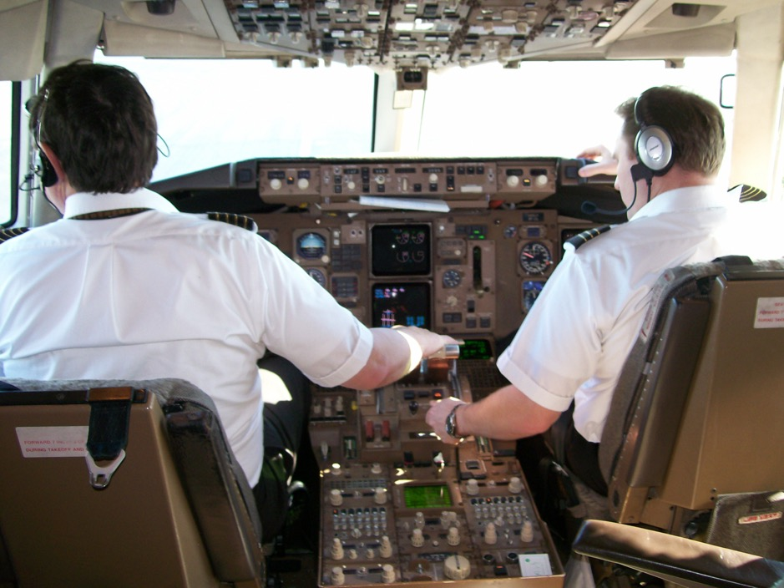
Runways 31 left and 31 right
Taxiing onto and along Rw31L
PREVENTING RUNWAY COLLISIONS
Eurocontrol Safety Forum June 6-7, 2017
Eurocontrol Headquarters, Brussels Belgium EU
“Wait for Tower to catch up””

Slide 22

Runways 31 left and 31 right
Taxiing onto and along Rw31L
“Wait for Tower to catch up”
PREVENTING RUNWAY COLLISIONS
Eurocontrol Safety Forum June 6-7, 2017
Eurocontrol Headquarters, Brussels Belgium EU

Slide 23
Runways 31 left and 31 right
Taxiing up Rw31L, debating location with Tower
Aborting Take off Clearance and Holding in Position
PREVENTING RUNWAY COLLISIONS
Eurocontrol Safety Forum June 6-7, 2017
Eurocontrol Headquarters, Brussels Belgium EU

Slide 24

Runways 31 left and 31 right
Taxi across Rw31R on A2 to park
Holding in Position
PREVENTING RUNWAY COLLISIONS
Eurocontrol Safety Forum June 6-7, 2017
Eurocontrol Headquarters, Brussels Belgium EU

Slide 25
Runways 31 left and 31 right
Taxi to A and ramp
Cleared for takeoff
PREVENTING RUNWAY COLLISIONS
Eurocontrol Safety Forum June 6-7, 2017
Eurocontrol Headquarters, Brussels Belgium EU

Slide 26
Runways 31 left and 31 right
Taxi to parking
Acknowledge Takeoff Clearance
PREVENTING RUNWAY COLLISIONS
Eurocontrol Safety Forum June 6-7, 2017
Eurocontrol Headquarters, Brussels Belgium EU

Slide 27
Rw 34 L, C, R with taxiways between 34 L and 34 C and some distance on connecting taxiways between 34 L, 34 C and 34 R
Ah,Ha! Moment
PREVENTING RUNWAY COLLISIONS
Eurocontrol Safety Forum June 6-7, 2017
Eurocontrol Headquarters, Brussels Belgium EU

Slide 28
Runways 31 left and 31 right
Our takeoff
PREVENTING RUNWAY COLLISIONS
Eurocontrol Safety Forum June 6-7, 2017
Eurocontrol Headquarters, Brussels Belgium EU

Slide 29
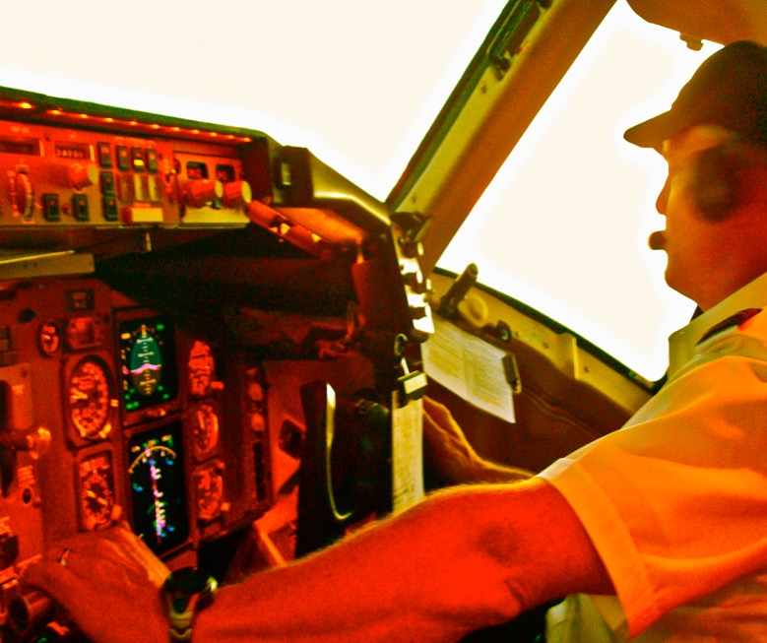
Runways 31 left and 31 right
Our takeoff
PREVENTING RUNWAY COLLISIONS
Eurocontrol Safety Forum June 6-7, 2017
Eurocontrol Headquarters, Brussels Belgium EU

Slide 30

Runways 31 left and 31 right
Our takeoff
PREVENTING RUNWAY COLLISIONS
Eurocontrol Safety Forum June 6-7, 2017
Eurocontrol Headquarters, Brussels Belgium EU

Slide 31
Actual Events as they happened June 2004 at a major US west coast airport
A. Actual Events: a day in 2004 at a major US west coast airport?
While holding short of Runway 31 Left for an instrument departure, our flight was directed to position and hold on Runway 31 Left (Rw31L). At about this same time, a light civilian aircraft was given landing clearance on Runway 31 Right (Rw31R). Note: (I have chosen not to mention the airport because in my opinion this event could have taken place at any airport, and I do not want to misdirect the purpose of this paper by focusing attention on the airport name, since commercial airports around the world operate with similar standard procedures and configurations.)

Slide 32
Actual Events as they happened June 2004 at a major US west coast airport
Our flight was a fully loaded B757-200, carrying cargo, headed to another US airport hours away in the eastern part of the country. After the light plane landed on Rw31R, our flight was given clearance to depart on Rw31L. As the captain of the flight and the pilot monitoring (PM) for this leg, I rescanned the cockpit, radios, and flight management settings. I rogered the take-off clearance to tower and then scanned, what mere moments before had been, a clear runway ahead.

Slide 33
Actual Events as they happened June 2004 at a major US west coast airport
Much to my surprise, in the few moments during which my attention was inside, the light airplane had exited Rw31R, crossing over to and joining onto, what they had perceived to be the parallel taxiway via the connecting taxiway, but in fact was Rw31L. They were nearly two miles dead ahead of our flight, and they began to taxi up our departure runway, proceeding away from us. It thus appeared to me that the pilot of the light aircraft had mistaken our Rw31L for a parallel taxiway, that was to the west, when in fact the parallel taxiway they were headed for and cleared for was to the right. This all happened in a matter of moments, mere seconds.

Slide 34
At that moment, Tower had not yet noticed this situation and from the sound of the voice calls over tower and ground frequency, it was discernible to me that the tower controller was manning both the tower position and the ground control position.
-Our 757 was at the far-right end of the runway from Tower’s point of view
-Light airplane was now closer the far-left end from Tower’s point of view
-Angular split of more than 120 degrees between our two acft positions probably exceeded the controllers peripheral vision.
-Small light aircraft was nearly 2 miles away from us
-In the dimming light of a cloudy afternoon, Tower had not yet noticed the runway incursion, but soon would.

Slide 35
-I put a very firm grasp on the engine power control levers to hold them in the idle position.
-I then redirected the attention of the first officer, the pilot flying (PF), from inside the flight deck, to the far end of the runway
-I said to the first officer, “We are not going to do anything, we are not going to say anything. Let’s let Tower catch up and handle this.”

Slide 36
In what seemed to be an eternity of the next 5 seconds,
-Tower controller must have rescanned up runway,
-Noticed the light aircraft
-Issued a rapid call for us to abort our take off.
-Our call back to tower was, “Roger, we are not moving.”
-I wanted to reassure Tower with both our words and our radio tone, that we were calm, holding our position at idle power, and aware of the incursion and for the moment, did not need further attention from Tower, allowing Tower the golden opportunity manage the incursion, focusing on the light aircraft, while

Slide 37
-At this point a radio exchange between Tower and the light aircraft pilot commenced
-Tower telling the light aircraft to rapidly exit Rw31L onto the adjacent taxiway to the right
-Light aircraft pilot telling tower that he was not on the runway but on that taxiway.
-This exchange shot back and forth for about five or six rounds, with Tower eventually prevailing.
-The light aircraft pilot, realizing its error, in silence, exited the Rw31L to the right and onto the taxiway.

Slide 38
After RW 31L was once again clear, our flight was given take off clearance for an otherwise uneventful flight.
-We were able to prevent what would have been invariably a disastrous runway collision after the hazard of this incursion, by
keeping track of other flights operating in our general vicinity and
comparing their actions to cleared and standard procedures.
By plotting not only the current position of every local flight talking on tower and ground
But also by plotting in our mind their intended or cleared or even possible courses of action.
Anticipate where everyone should be, where everyone should be going
Recognize quickly, any action that was out of place and posed a serious conflict hazard
Allowed us to take action to both prevent a collision and to prevent our actions from adding to the hazardous events unfolding, making it more difficult for Tower to unravel any conflict or, as in our case, a runway incursion.

Slide 39
After RW 31L was once again clear, our flight was given take off clearance for an otherwise uneventful flight.
-We were able to prevent what would have been invariably a disastrous runway collision after the hazard of this incursion, by
keeping track of other flights operating in our general vicinity and
comparing their actions to cleared and standard procedures.
By plotting not only the current position of every local flight talking on tower and ground
But also by plotting in our mind their intended or cleared or even possible courses of action.
Anticipate where everyone should be, where everyone should be going
Recognize quickly, any action that was out of place and posed a serious conflict hazard
Allowed us to take action to both prevent a collision and to prevent our actions from adding to the hazardous events unfolding, making it more difficult for Tower to unravel any conflict or, as in our case, a runway incursion.

Slide 40
Even though the light aircraft pilot made no radio calls stating any intention to use Rw31L as a taxiway, since we had been keeping track of the location and clearance of that flight, as soon as we saw them on our runway, we knew who they were and why they were erroneously on our runway.
Moreover, we also knew that as soon as Tower saw this, that they would issue an abort for us and try to clear the light aircraft off of the runway back onto the appropriate taxiway.
This allowed us to keep our engines at idle, not get our aircraft powered up and to remain calm in the cockpit, remain calm over the radio, listening for what was next, prepared to let Tower take charge.

Slide 41
We also knew one other not uncommon element. One controller manning tower and ground can and does work just fine at many airports around the world. During overnight or non-busy hours at major airports and at many regional airports during less busy times, one controller can and often does manage tower, ground and clearance. If all goes well, it is seldom a problem.
But when hazardous events begin to unfold, one controller can become hazard-distracted and time-challenged, placing flight crew in position to think ahead and try to act in concert with the controller, not just reacting to controller instructions.
At times like this, this author believes that it is safer for flight crew to try to keep a big picture, similar to the controller’s picture, of the air traffic so as to recognize hazardous situations more quickly and be in synch with the controller.

Slide 42
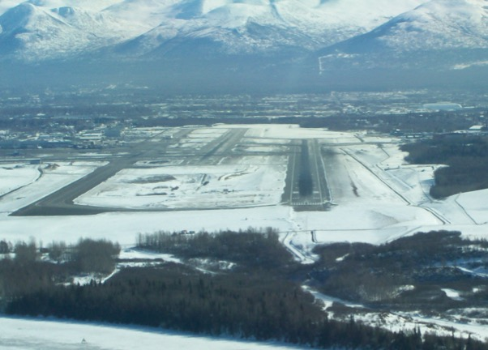
B. Flight Crew Talking Points and Briefing Points:
1. Keeping the big picture- flightcrew should visit air traffic control towers, ground control and approach control positions, as part of normal commercial flightcrew training, to understand controller on other end of radio, what ATC sees in front of them, what are ATC procedures, capabilities, limitations, general level of commercial aviation flightcrew knowledge.
2. Consider formal procedure for flightcrew members to keep track of local traffic in, on and around the airport, for phase of flight, direction of travel.
3. Consider formal procedure for flightcrew to continually brief location, movement of other air, ground traffic, conflicts may arise in space and time.

Slide 43
B. Flight Crew Talking Points and Briefing Points:
1. Keeping the big picture- flightcrew should visit air traffic control towers, ground control and approach control positions, as part of normal commercial flightcrew training, to understand controller on other end of radio, what ATC sees in front of them, what are ATC procedures, capabilities, limitations, general level of commercial aviation flightcrew knowledge.
2. Consider formal procedure for flightcrew members to keep track of local traffic in, on and around the airport, for phase of flight, direction of travel.
3. Consider formal procedure for flightcrew to continually brief location, movement of other air, ground traffic, conflicts may arise in space and time.

Slide 44
B. Flight Crew Talking Points and Briefing Points:
1. Keeping the big picture- flightcrew should visit air traffic control towers, ground control and approach control positions, as part of normal commercial flightcrew training, to understand controller on other end of radio, what ATC sees in front of them, what are ATC procedures, capabilities, limitations, general level of commercial aviation flightcrew knowledge.
2. Consider formal procedure for flightcrew members to keep track of local traffic in, on and around the airport, for phase of flight, direction of travel.
3. Consider formal procedure for flightcrew to continually brief location, movement of other air, ground traffic, conflicts may arise in space and time.

Slide 45
B. Flight Crew Talking Points and Briefing Points:
1. Keeping the big picture- flightcrew should visit air traffic control towers, ground control and approach control positions, as part of normal commercial flightcrew training, to understand controller on other end of radio, what ATC sees in front of them, what are ATC procedures, capabilities, limitations, general level of commercial aviation flightcrew knowledge.
2. Consider formal procedure for flightcrew members to keep track of local traffic in, on and around the airport, for phase of flight, direction of travel.
3. Consider formal procedure for flightcrew to continually brief location, movement of other air, ground traffic, conflicts may arise in space and time.

Slide 46
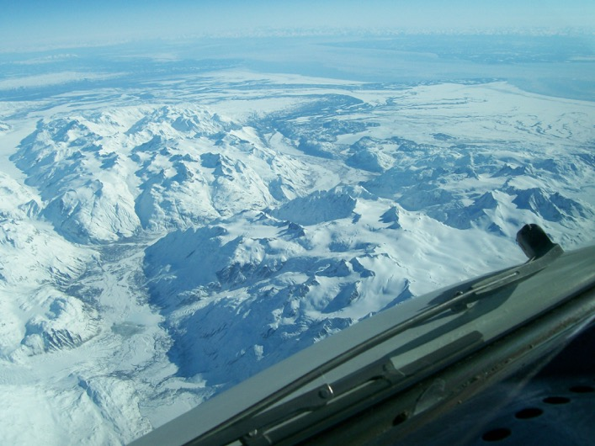
B. Flight Crew Talking Points and Briefing Points:
1. Keeping the big picture- flightcrew should visit air traffic control towers, ground control and approach control positions, as part of normal commercial flightcrew training, to understand controller on other end of radio, what ATC sees in front of them, what are ATC procedures, capabilities, limitations, general level of commercial aviation flightcrew knowledge.
2. Consider formal procedure for flightcrew members to keep track of local traffic in, on and around the airport, for phase of flight, direction of travel.
3. Consider formal procedure for flightcrew to continually brief location, movement of other air, ground traffic, conflicts may arise in space and time.

Slide 47
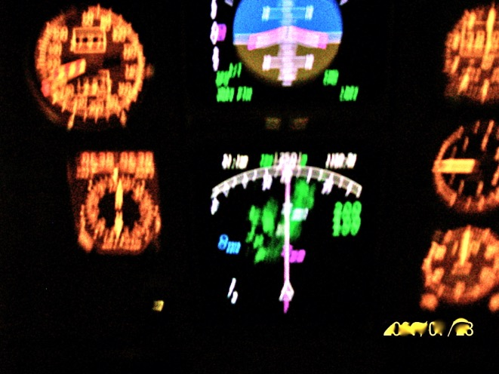
C. Procedures, Checklists, Actions
1. Flight crew: keep track of big picture of Ground, Tower, Approach and Departure, departure and arrival traffic, nearby aerodrome traffic
2. Mental or Verbal Map of known local traffic flow: runway diagram for ground traffic flow, land and hold short points, intersecting runways, published ground traffic conflict trouble spots; SIDS and STARS for arrivals and departures
3. Traffic changes by daylight or night time ops, by VFR, IFR, wind changes.
4. Listening watch on all frequencies when tower is running tower and ground ops at off-hours of major airports or during normal ops, at smaller, less busy airports; keep a track of other traffic moving.

Slide 48
C. Procedures, Checklists, Actions
1. Flight crew: keep track of big picture of Ground, Tower, Approach and Departure, departure and arrival traffic, nearby aerodrome traffic
2. Mental or Verbal Map of known local traffic flow: runway diagram for ground traffic flow, land and hold short points, intersecting runways, published ground traffic conflict trouble spots; SIDS and STARS for arrivals and departures
3. Traffic changes by daylight or night time ops, by VFR, IFR, wind changes.
4. Listening watch on all frequencies when tower is running tower and ground ops at off-hours of major airports or during normal ops, at smaller, less busy airports; keep a track of other traffic moving.

Slide 49
C. Procedures, Checklists, Actions
1. Flight crew: keep track of big picture of Ground, Tower, Approach and Departure, departure and arrival traffic, nearby aerodrome traffic
2. Mental or Verbal Map of known local traffic flow: runway diagram for ground traffic flow, land and hold short points, intersecting runways, published ground traffic conflict trouble spots; SIDS and STARS for arrivals and departures
3. Traffic changes by daylight or night time ops, by VFR, IFR, wind changes.
4. Listening watch on all frequencies when tower is running tower and ground ops at off-hours of major airports or during normal ops, at smaller, less busy airports; keep a track of other traffic moving.

Slide 50
C. Procedures, Checklists, Actions
1. Flight crew: keep track of big picture of Ground, Tower, Approach and Departure, departure and arrival traffic, nearby aerodrome traffic
2. Mental or Verbal Map of known local traffic flow: runway diagram for ground traffic flow, land and hold short points, intersecting runways, published ground traffic conflict trouble spots; SIDS and STARS for arrivals and departures
3. Traffic changes by daylight or night time ops, by VFR, IFR, wind changes.
4. Listening watch on all frequencies when tower is running tower and ground ops at off-hours of major airports or during normal ops, at smaller, less busy airports; keep a track of other traffic moving.

Slide 51
C. Procedures, Checklists, Actions
1. Flight crew: keep track of big picture of Ground, Tower, Approach and Departure, departure and arrival traffic, nearby aerodrome traffic
2. Mental or Verbal Map of known local traffic flow: runway diagram for ground traffic flow, land and hold short points, intersecting runways, published ground traffic conflict trouble spots; SIDS and STARS for arrivals and departures
3. Traffic changes by daylight or night time ops, by VFR, IFR, wind changes.
4. Listening watch on all frequencies when tower is running tower and ground ops at off-hours of major airports or during normal ops, at smaller, less busy airports; keep a track of other traffic moving.

Slide 52
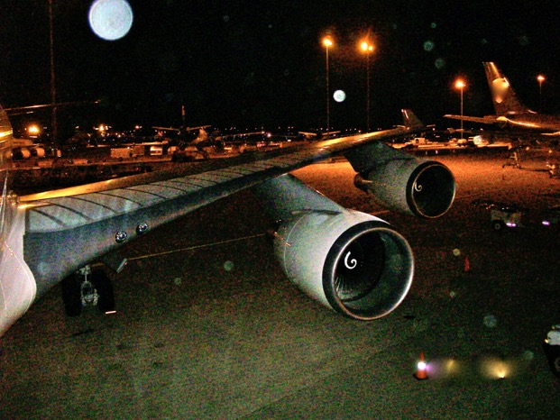
C. Procedures, Checklists, Actions
1. Flight crew: keep track of big picture of Ground, Tower, Approach and Departure, departure and arrival traffic, nearby aerodrome traffic
2. Mental or Verbal Map of known local traffic flow: runway diagram for ground traffic flow, land and hold short points, intersecting runways, published ground traffic conflict trouble spots; SIDS and STARS for arrivals and departures
3. Traffic changes by daylight or night time ops, by VFR, IFR, wind changes.
4. Listening watch on all frequencies when tower is running tower and ground ops at off-hours of major airports or during normal ops, at smaller, less busy airports; keep a track of other traffic moving.

Slide 53
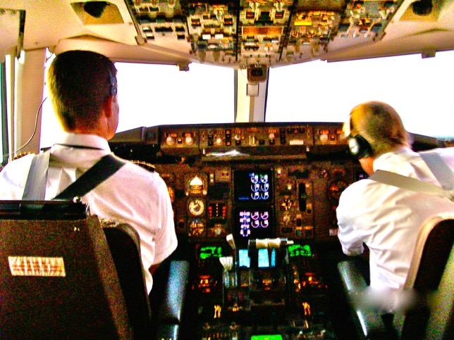
D. Additional Crew and ATC Training Items, Briefing Points:
Understanding everyone’s role in runway collision prevention, radio calls and responsibilities to pick up any errors quickly
1. How does ATC interact with air traffic from their point of view
2. How do flight crew interact with ATC from their point of view
3. How might flight crew of different flights interact with each other
4. How flight crew members of the same flight interact with each other, such as CRM

Slide 54
D. Additional Crew and ATC Training Items, Briefing Points:
Understanding everyone’s role in runway collision prevention, radio calls and responsibilities to pick up any errors quickly
1. How does ATC interact with air traffic from their point of view
2. How do flight crew interact with ATC from their point of view
3. How might flight crew of different flights interact with each other
4. How flight crew members of the same flight interact with each other, such as CRM

Slide 55
D. Additional Crew and ATC Training Items, Briefing Points:
Understanding everyone’s role in runway collision prevention, radio calls and responsibilities to pick up any errors quickly
1. How does ATC interact with air traffic from their point of view
2. How do flight crew interact with ATC from their point of view
3. How might flight crew of different flights interact with each other
4. How flight crew members of the same flight interact with each other, such as CRM

Slide 56
D. Additional Crew and ATC Training Items, Briefing Points:
Understanding everyone’s role in runway collision prevention, radio calls and responsibilities to pick up any errors quickly
1. How does ATC interact with air traffic from their point of view
2. How do flight crew interact with ATC from their point of view
3. How might flight crew of different flights interact with each other
4. How flight crew members of the same flight interact with each other, such as CRM

Slide 57
D. Additional Crew and ATC Training Items, Briefing Points:
Understanding everyone’s role in runway collision prevention, radio calls and responsibilities to pick up any errors quickly
1. How does ATC interact with air traffic from their point of view
2. How do flight crew interact with ATC from their point of view
3. How might flight crew of different flights interact with each other
4. How flight crew members of the same flight interact with each other, such as CRM

Slide 58
D. Additional Crew and ATC Training Items, Briefing Points:
Understanding everyone’s role in runway collision prevention, radio calls and responsibilities to pick up any errors quickly
1. How does ATC interact with air traffic from their point of view
2. How do flight crew interact with ATC from their point of view
3. How might flight crew of different flights interact with each other
4. How flight crew members of the same flight interact with each other, such as CRM

Slide 59
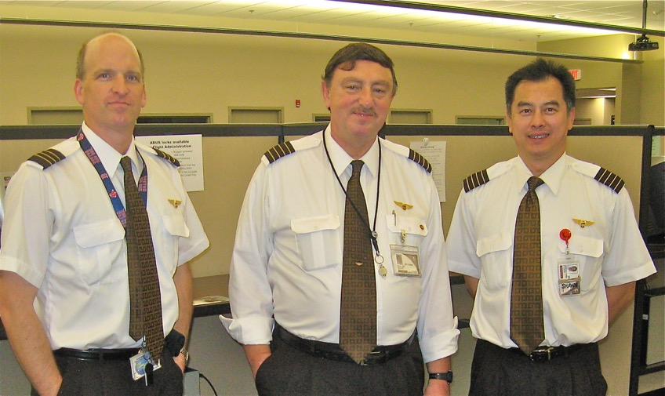
D. Additional Crew and ATC Training Items, Briefing Points:
Understanding everyone’s role in runway collision prevention, radio calls and responsibilities to pick up any errors quickly
1. How does ATC interact with air traffic from their point of view
2. How do flight crew interact with ATC from their point of view
3. How might flight crew of different flights interact with each other
4. How flight crew members of the same flight interact with each other, such as CRM

Slide 60
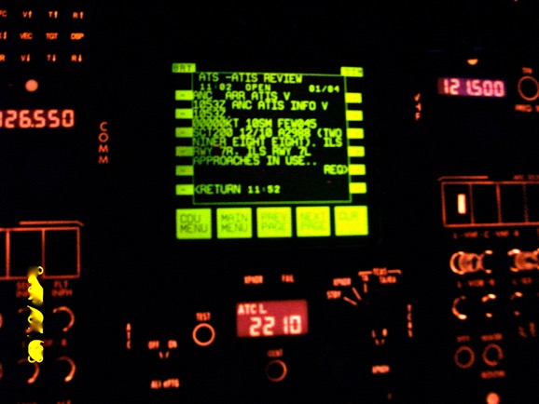
E. Actions taken that day: Why a Runway Collision did not occur
1. Encourage open communications: light crew, additional crewmembers, jump-seaters (ACMs). ACMs often notice something first because they are sitting slightly back and have a different viewpoint.
2. Listen to all comments made by fellow flight crew members, ATC and by other flights.
3. Be situationally aware may mean to switch attention, scan and thought processes back and forth between details and big picture. HF-very hard to keep one’s attention moving back and forth. Plan to keep that process between the details and the big picture active.

Slide 61
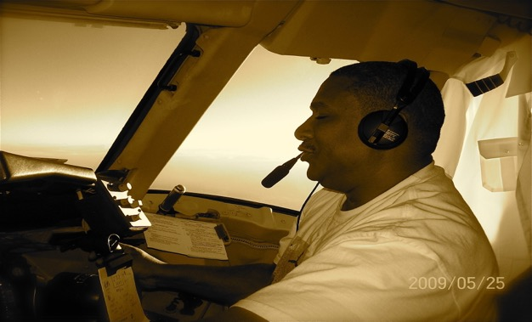
E. Actions taken that day: Why a Runway Collision did not occur
1. Encourage open communications: flight crew, additional crewmembers, jump-seaters (ACMs). ACMs often notice something first because they are sitting slightly back and have a different viewpoint.
2. Listen to all comments made by fellow flight crew members, ATC and by other flights.
3. Be situationally aware may mean to switch attention, scan and thought processes back and forth between details and big picture. HF-very hard to keep one’s attention moving back and forth. Plan to keep that process between the details and the big picture active.

Slide 62
E. Actions taken that day: Why a Runway Collision did not occur
1. Encourage open communications: light crew, additional crewmembers, jump-seaters (ACMs). ACMs often notice something first because they are sitting slightly back and have a different viewpoint.
2. Listen to all comments made by fellow flight crew members, ATC and by other flights.
3. Be situationally aware may mean to switch attention, scan and thought processes back and forth between details and big picture. HF-very hard to keep one’s attention moving back and forth. Plan to keep that process between the details and the big picture active.

Slide 63
E. Actions taken that day: Why a Runway Collision did not occur
1. Encourage open communications: light crew, additional crewmembers, jump-seaters (ACMs). ACMs often notice something first because they are sitting slightly back and have a different viewpoint.
2. Listen to all comments made by fellow flight crew members, ATC and by other flights.
3. Be situationally aware may mean to switch attention, scan and thought processes back and forth between details and big picture. HF-very hard to keep one’s attention moving back and forth. Plan to keep that process between the details and the big picture active.

Slide 64
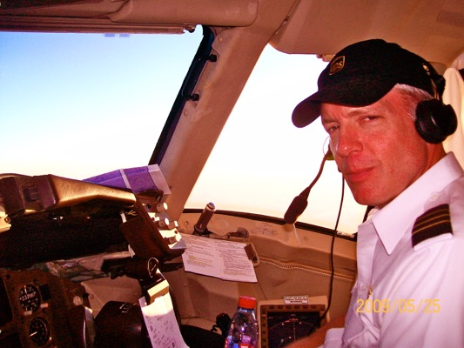
E. Actions taken that day: Why a Runway Collision did not occur
1. Encourage open communications: light crew, additional crewmembers, jump-seaters (ACMs). ACMs often notice something first because they are sitting slightly back and have a different viewpoint.
2. Listen to all comments made by fellow flight crew members, ATC and by other flights.
3. Be situationally aware may mean to switch attention, scan and thought processes back and forth between details and big picture. HF-very hard to keep one’s attention moving back and forth. Plan to keep that process between the details and the big picture active.

Slide 65

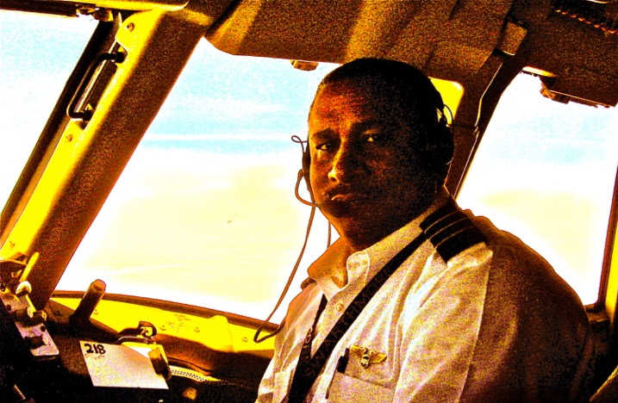
E. Actions taken that day: Why a Runway Collision did not occur
4. Recognize whose role it was to correct the unusual circumstance, give Tower time, space and radio transmission time to make the calls needed without talking over them.
5. Expected Tower call: most likely call in reaction to the circumstance, we were able to prepare ourselves to comply with such with as little fanfare as possible, gave Tower time to handle the problem, kept our actions from making things worse.

Slide 66
E. Actions taken that day: Why a Runway Collision did not occur
4. Recognize whose role it was to correct the unusual circumstance, give Tower time, space and radio transmission time to make the calls needed without talking over them.
5. Expected Tower call: most likely call in reaction to the circumstance, we were able to prepare ourselves to comply with such with as little fanfare as possible, gave Tower time to handle the problem, kept our actions from making things worse.

Slide 67
E. Actions taken that day: Why a Runway Collision did not occur
4. Recognize whose role it was to correct the unusual circumstance, give Tower time, space and radio transmission time to make the calls needed without talking over them.
5. Expected Tower call: most likely call in reaction to the circumstance, we were able to prepare ourselves to comply with such with as little fanfare as possible, gave Tower time to handle the problem, kept our actions from making things worse.

Slide 68
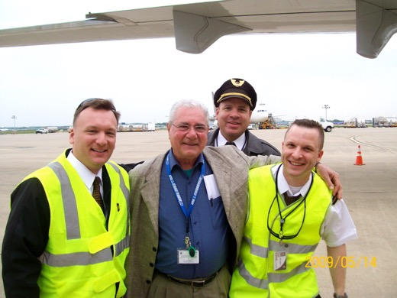
E. Actions taken that day: Why a Runway Collision did not occur
4. Recognize whose role it was to correct the unusual circumstance, give Tower time, space and radio transmission time to make the calls needed without talking over them.
5. Expected Tower call: most likely call in reaction to the circumstance, we were able to prepare ourselves to comply with such with as little fanfare as possible, gave Tower time to handle the problem, kept our actions from making things worse.

Slide 69
F. General Take Away for all flight crew & air traffic controllers
1. At each airline and air traffic facility, make a briefing note to regularly talk about:
-How to react to potential runway collision conflicts and
-Procedures to work with tower to de-conflict
-Procedures to be in synchronization with tower’s steps to resolve the conflict.
2. At each airline and air traffic facility, make a briefing note on
-How to keep the process of maintaining the big picture and scanning the details is essential for the safety of situational awareness.

Slide 70
F. General Take Away for all flight crew & air traffic controllers
1. At each airline and air traffic facility, make a briefing note to regularly talk about:
-How to react to potential runway collision conflicts and
-Procedures to work with tower to de-conflict
-Procedures to be in synchronization with tower’s steps to resolve the conflict.
2. At each airline and air traffic facility, make a briefing note on
-How to keep the process of maintaining the big picture and scanning the details is essential for the safety of situational awareness.

Slide 71
F. General Take Away for all flight crew & air traffic controllers
1. At each airline and air traffic facility, make a briefing note to regularly talk about:
-How to react to potential runway collision conflicts and
-Procedures to work with tower to de-conflict
-Procedures to be in synchronization with tower’s steps to resolve the conflict.
2. At each airline and air traffic facility, make a briefing note on
-How to keep the process of maintaining the big picture and scanning the details is essential for the safety of situational awareness.

Slide 72
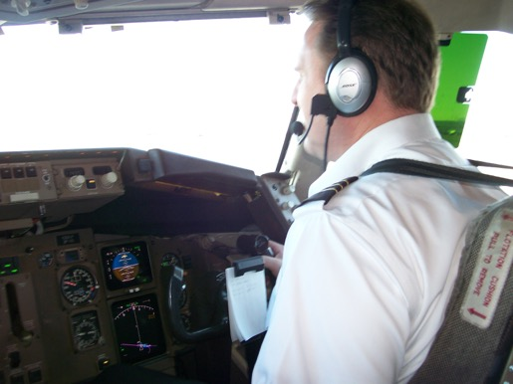
F. General Take Away for all flight crew & air traffic controllers
1. At each airline and air traffic facility, make a briefing note to regularly talk about:
-How to react to potential runway collision conflicts and
-Procedures to work with tower to de-conflict
-Procedures to be in synchronization with tower’s steps to resolve the conflict.
2. At each airline and air traffic facility, make a briefing note on
-How to keep the process of maintaining the big picture and scanning the details is essential for the safety of situational awareness.

Slide 73
Scenario of a Commercial Aviation Runway Collision Prevented:
Runway Collision Prevention Strategy, with Procedures
Captain Paul Miller paulmiller@safetyforecast.com
PREVENTING RUNWAY COLLISIONS
Eurocontrol Safety Forum June 6-7, 2017
Eurocontrol Headquarters, Brussels Belgium EU
Q & A now or later

Slide 74
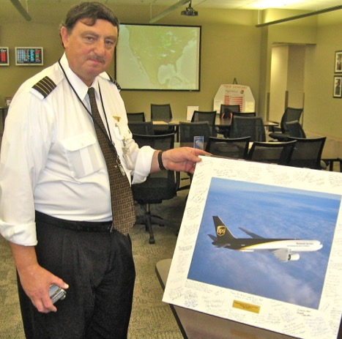
Scenario of a Commercial Aviation Runway Collision Prevented:
Runway Collision Prevention Strategy, with Procedures
Captain Paul Miller paulmiller@safetyforecast.com
PREVENTING RUNWAY COLLISIONS
Eurocontrol Safety Forum June 6-7, 2017
Eurocontrol Headquarters, Brussels Belgium EU

Slide 75
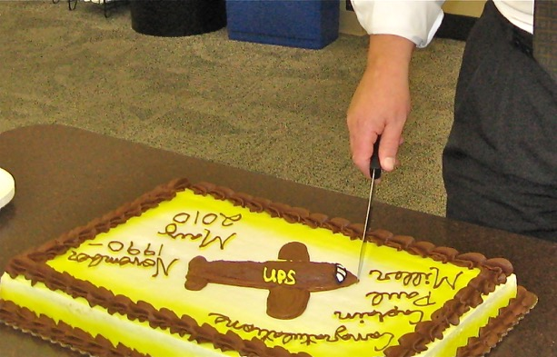
Scenario of a Commercial Aviation Runway Collision Prevented:
Runway Collision Prevention Strategy, with Procedures
Captain Paul Miller paulmiller@safetyforecast.com
PREVENTING RUNWAY COLLISIONS
Eurocontrol Safety Forum June 6-7, 2017
Eurocontrol Headquarters, Brussels Belgium EU

Slide 76
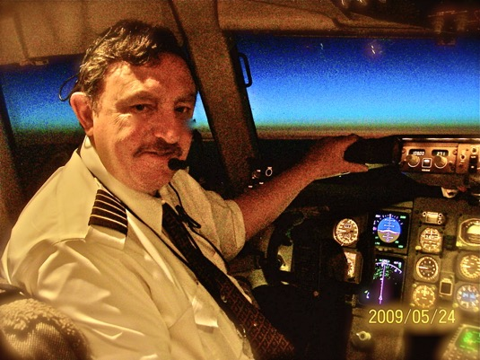
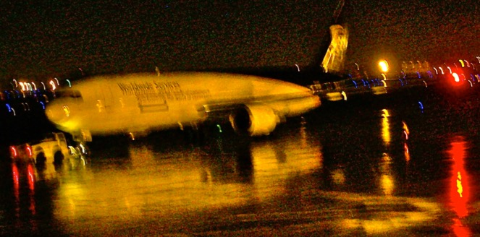
Thank you
paulmiller@safetyforecast.com
Thank you
PREVENTING RUNWAY COLLISIONS
Eurocontrol Safety Forum June 6-7, 2017
Eurocontrol Headquarters, Brussels Belgium EU

