Slide 1
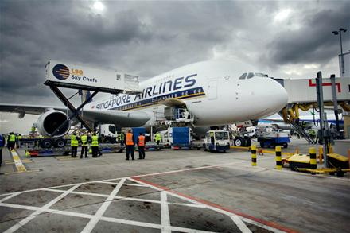
2017 Safety Forum Runway Incursion scenarios
6th June 2017
Notes:
1

Slide 2
ICAO Runway Incursion Definition
“Any occurrence at an aerodrome involving the incorrect presence of an aircraft, vehicle or person on the protected area of a surface designated for the landing and take-off of aircraft”
ANSP’s and Airports safety performance indicators often include counting the number of runway incursions as a measure of risk/failure/success….
But how is this definition used in real life…….

Slide 3
1. Despite numerous attempts by the ATC controller, to issue a landing clearance to Flight 123 on short final, the aircraft did not receive it as it was still on the previous frequency.
Flight 123 landed with no further incident.
Is this landing a runway incursion?

Slide 4
2. Flight 123 landed without landing clearance being issued.
The controller had not issued it due to distraction with an imminent runway direction change.
Is this landing a runway incursion?

Slide 5
3. The Tower controller cleared Flight 123 to land, after visually confirming that an Airport Ops vehicle undertaking a runway inspection had vacated the runway.
ATC had not received the verbal ‘runway vacated’ RT message from the Ops vehicle.
There was therefore the potential for the Airport Ops vehicle, who had been conducting a Runway Inspection at the time, to re-enter the runway without seeking ATC permission.
Is this a runway incursion?

Slide 6
4. Whilst waiting for departure at the holding point from runway XY at Hold AB, Flight 123 reported an engine fire.
The Fire Service attended and declared that the aircraft was fit to taxi back to stand.
In order to do so, Flight 123 was cleared to enter the runway (in order to vacate at the next holding point) followed by a Fire Service vehicle, and 2 Airport Ops vehicles.
Whilst doing so, one of the Ops vehicles asked the ATC controller if the Police vehicle which was now on the runway with them, had been issued with a clearance to do so.
The controller confirmed that no Police vehicles had been cleared to enter the runway.
As Flight 123 and the accompanying vehicles vacated the runway, the Airport Ops vehicle confirmed that the runway was clear of all vehicles and available for use.
Was the Police vehicle a runway incursion?

Slide 7
5. At night, flight 123 at runway holding position Alpha One, was given a conditional line up clearance, which was read back correctly.
The aircraft was then observed to cross the Alpha One lit stop bar, but at the correct time with respect to the conditional traffic clearance.
Is this a runway incursion?

Slide 8
6. An aircraft is cleared to line up for departure on the runway.
The aircraft lines up as instructed.
To the controllers surprise the aircraft is next seen accelerating through 100kt and completes its departure.
Is this a runway incursion?

Slide 9
7. An aircraft waiting at a holding point is cleared to enter the runway for departure after a landing clearance has been issued to another aircraft which is on finals.
The departing aircraft does not move as the pilot realises the situation.
Is this a runway incursion?

Slide 10
8. An aircraft taxying for departure on the parallel taxiway to the runway exceeds his given clearance on the taxiway and enters the ILS Glidepath critical area.
Is this a runway incursion?

Slide 11
9. An aircraft is cleared to land after a departing aircraft has taken off.
The landing aircraft is overflying the threshold when the departing aircraft just gets airborne from the same runway.
Is this a runway incursion?

Slide 12
10. Flight 123 was waiting at the runway holding point to enter the runway for departure.
An aircraft was on finals to land.
ATC gave a clearance to Flight 123 “After the landing, line up runway XY”
The aircraft on finals carried out a go-around due to cabin insecure.
Seeing the go-around, Flight 123 entered the runway and lined up.
Is this a runway incursion?

Slide 13
Summary
There are short descriptions of real events
All are runway safety events and should be investigated, but how many are runway incursions?
In prior presentations to industry experts none of the above scenarios have been unanimously agreed.

